Slide 1

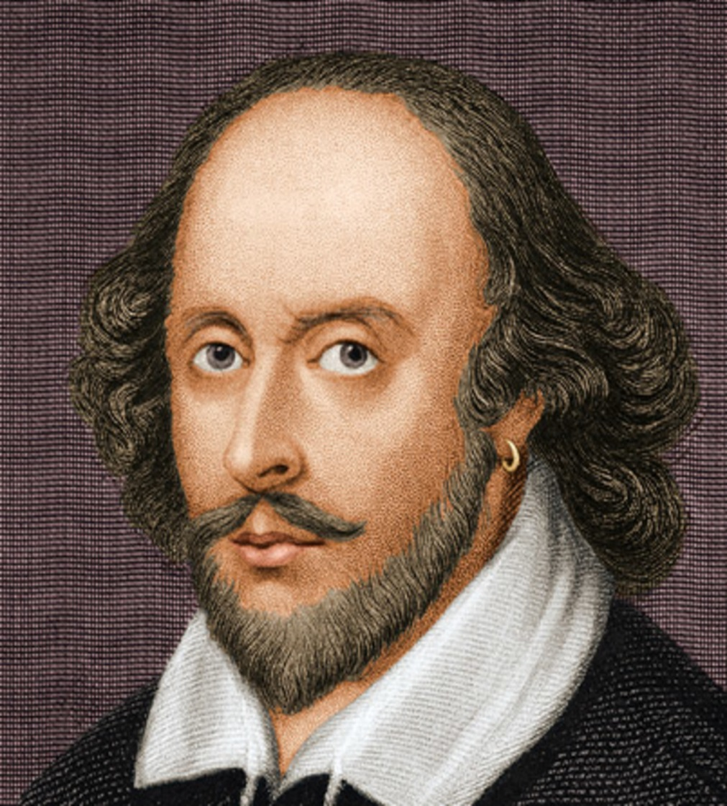

Wel Come
Khandoker Mufakkher Hossain
William Shakespeare

Slide 2
King Lear
By
William Shakespeare

Slide 3
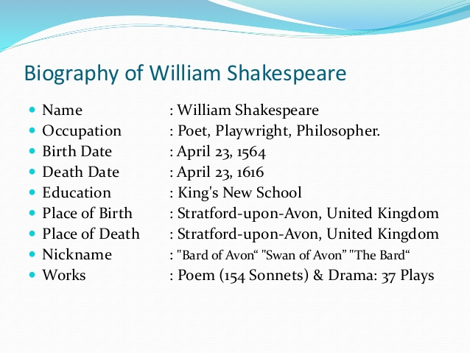

Slide 4
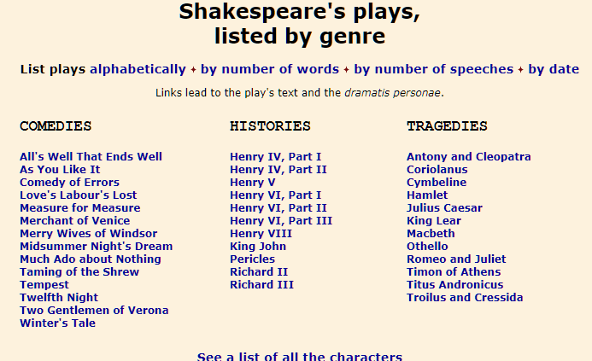

Slide 5
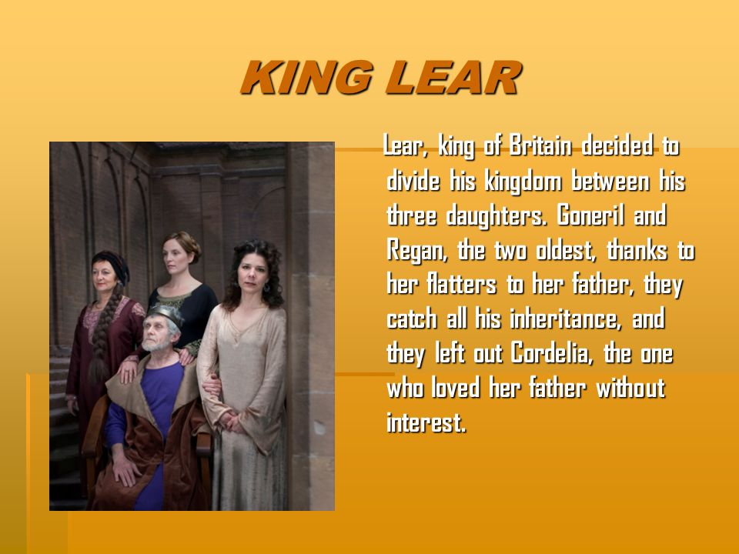

Slide 6
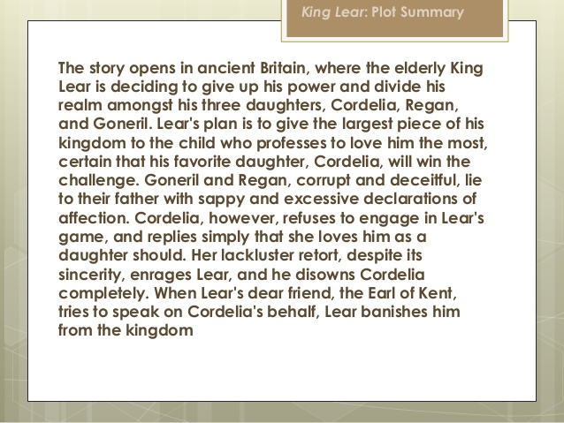

Slide 7
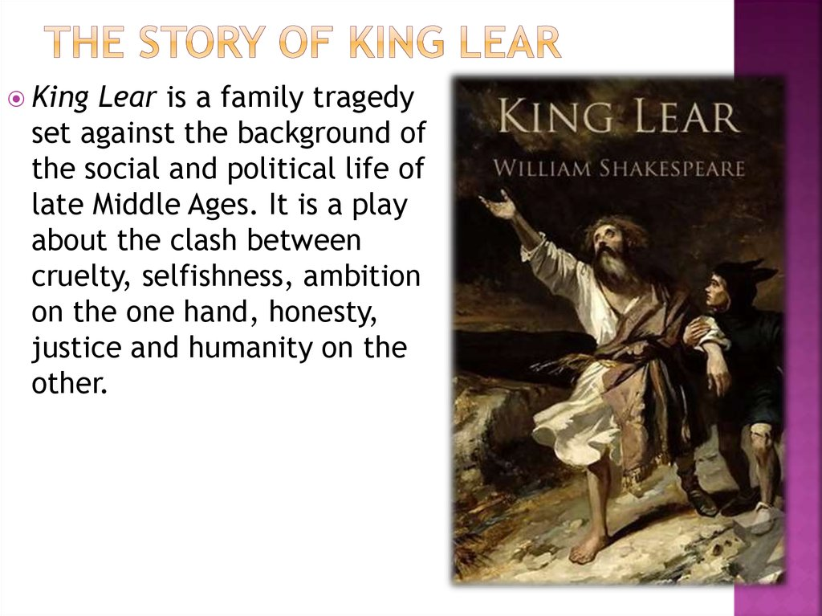

Slide 8
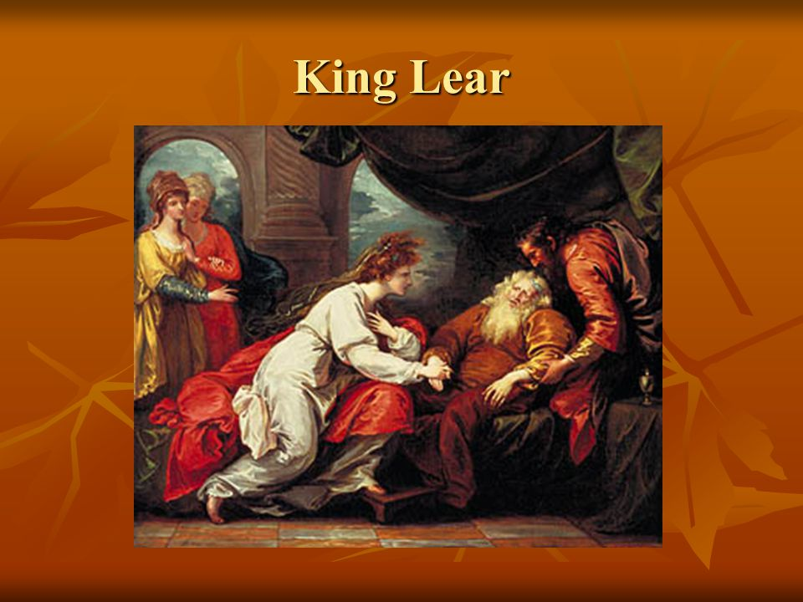

Slide 9
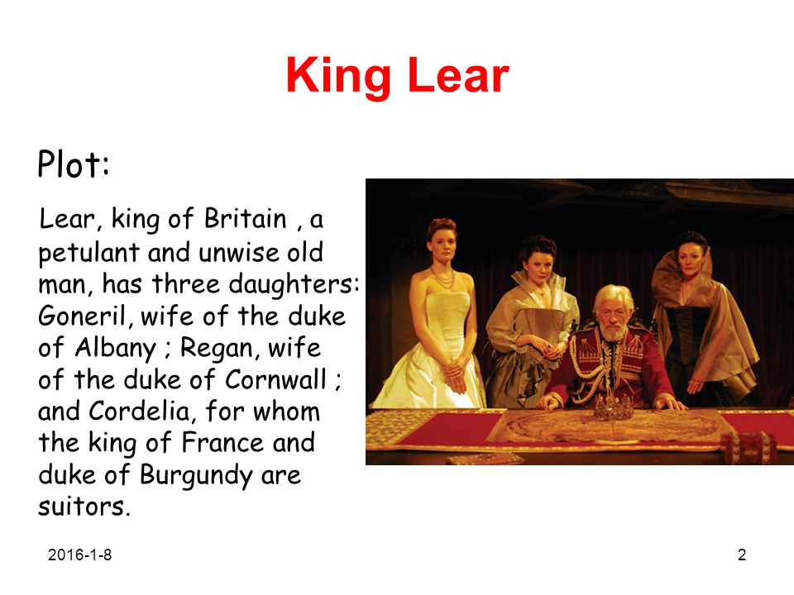

Slide 10
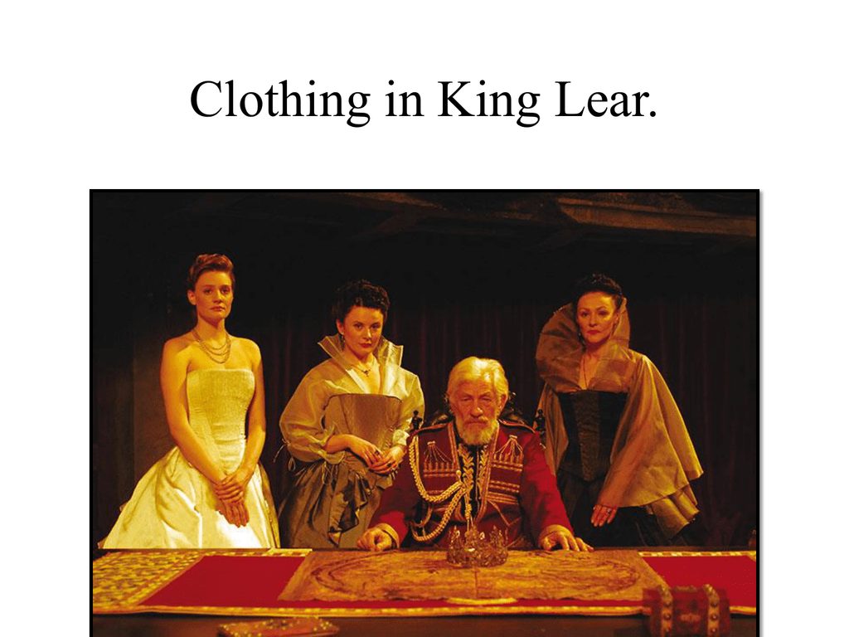

Slide 11
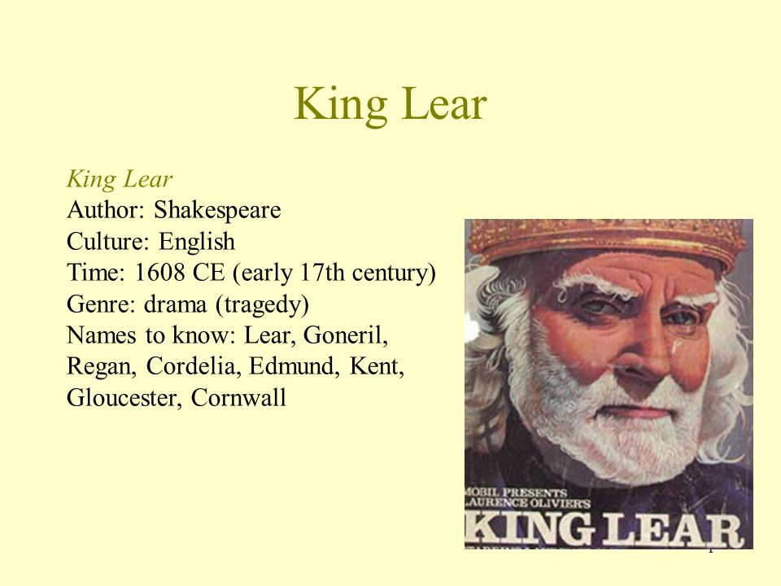
Summary

Slide 12
Elderly King Lear decides to divide his kingdom between his three daughters: Goneril, Regan, and Cordelia.
He promises the largest portion of the kingdom to the daughter who best expresses her affection for him.
Goneril and Regan both deliver wildly embellished speeches. Cordelia, Lear's favorite, speaks the simple truth and is banished for it.

Slide 13
William Shakespeare’s As You Like It is a comedy written around 1599. This play follows Rosalind and her cousin, Celia, as they flee the Court of Duke Frederick into the countryside. In the Forest of Arden, the two women disguise themselves as men and meet other travelers, including the men they love, Orlando and Oliver. The pastoral landscape and strange circumstances of their flight examine the problems inherent to Shakespeare’s England and the peculiar “performance” of human life.

Slide 14
Act I
The play opens with two brothers: Orlando, the younger, and Oliver, the elder. Their father has just died and Oliver refuses to share the inheritance. Instead, Oliver convinces Orlando to participate in a wrestling match that is so dangerous it is meant to kill him. However, against all odds, Orlando wins the wrestling match. Duke Senior’s daughter, Rosalind, falls in love with Orlando when he wins the fight.

Slide 15
Act –I
>> Rosalind gives Orlando a necklace as a sign of her affection. Unfortunately, Rosalind’s father, Duke Senior, has been deposed by his younger brother, Duke Frederick. Though the two young lovers long to be together, Duke Frederick banishes Rosalind. Rosalind and her cousin, Celia, flee to the Forest of Arden with Touchstone, the court fool. Rosalind disguises herself as a young man named Ganymede in order to protect herself and Celia on the road.

Slide 16
Act II
Act II begins in the Forest of Arden. Here, Duke Senior has created a type of mock court. He and his courtiers reminisce about their courtly life while in exile.
Meanwhile, back in the court, Duke Frederick is disturbed to find his daughter, Celia, missing. Rather than believe she would willingly run away, he blames Orlando. But Orlando is no longer at home because he has discovered his brother’s murderous plot. He and his servant, Adam, flee into the forest to escape Oliver.

Slide 17
Act II>> When they arrive in the forest, Touchstone, Rosalind disguised as Ganymede, and Celia disguised as Aliena, meet two country folk in the woods. They ask Corin, an old shepherd, to help them find a cottage in which to live. As an interlude between this merry scene and the scene to come, Jaques mocks Amiens’s pastoral song and establishes himself as the critical clown of the story.

Slide 18
Orlando and Adam, having had no luck finding a place to stay, are close to starvation. Orlando leaves Adam under a tree to go off in search of help. Luckily for both of them, Orlando finds Duke Senior’s court in the woods. Though Orlando initially demands food, Duke Senior benevolently invites Orlando and Adam into his court.
Act III- Back in the city, a furious Duke Frederick seizes all of Oliver’s lands until he can bring Orlando back to the court.

Slide 19
Act III >> Orlando, now settling into his life in the woods, begins to hang poems on trees praising Rosalind’s beauty. He has been infatuated with Rosalind since meeting her at the wrestling match. Orlando’s love poetry is atrocious. Rosalind reads some of it and decides that she cannot accept such a terrible wooer as a lover.

Slide 20
Act III >> Dressed as Ganymede, she offers her help to Orlando. She teaches him how to woo women by asking him to pretend she is Rosalind and court her.
While the highborn characters are learning how to fall in love, the lowborn characters go through a series of comedic love affairs. Touchstone falls in love with a goat herder named Audrey.

Slide 21
Act III >> Though he arranges for a priest to marry them in the woods, Touchstone convinces him that they should wait until they can be married in a real church. Ganymede, Corin, and Aliena watch Silvius, a shepherd, try to court Phoebe, who wants nothing to do with him. When Ganymede intervenes to help Silvius in his pursuit, Phoebe falls in love with Ganymede.

Slide 22
Act IV: As Ganymede, Rosalind follows through on her promise to teach Orlando how to woo her by pretending to be Rosalind. First, she chides him for being late to their meeting. She then asks him what he would do if she were the real Rosalind. Orlando reveals himself to be an impetuous lover when he says, “I would kiss before I spoke.”

Slide 23
Act IV-> Much like his sentimental, poorly structured love poetry, his wooing is uninformed and immature. On the surface, Ganymede sets out to right his errors; behind the disguise, Rosalind teaches the object of her affection how to properly court her.

Slide 24
Act IV > -After going through the beginning of a wedding ceremony in which Celia, as Aliena, pretends to be the priest, Ganymede makes Orlando promise that he will prove his love for Rosalind by arriving on time to their next meeting.
Though Rosalind feigns indifference and control in Orlando’s presence, as soon as he leaves, she too affects the sentiments of a love-struck poet.

Slide 25
Act IV-> Celia mocks her cousin by telling her that her love is not “fathomless” but rather “bottomless”: the more she pours in, the more pours out the bottom. While the two women are waiting for Orlando to return, Silvius enters and gives Rosalind a letter from Phoebe stating that she wants to marry Ganymede. Rosalind derides the letter and mocks Silvius for loving such a woman.

Slide 26
Act IV-> Then she sends him away. Oliver, Orlando’s brother, enters in a state of distress. He presents Rosalind with a bloody napkin and explains why Orlando is late for his lesson with Ganymede. Orlando happened upon a sleeping Oliver in the woods at the same time as a lion. Orlando battled the lion to save his brother. Rosalind, as Ganymede, faints and Oliver questions Ganymede’s masculinity. Rosalind attempts to convince him that the reaction was an act, though Oliver does not believe her.

Slide 27
Act V
Touchstone and William fight over Aubrey’s love. Touchstone prevails because of his power with words. Oliver and Celia have fallen in love and plan to be married. Orlando expresses his jealousy and bitterness to Ganymede. He is annoyed that his brother has found the woman he loves while Orlando cannot find Rosalind. Ganymede convinces Orlando that he can summon Rosalind with magic.

Slide 28
Act V-> Ganymede says that Rosalind will be at Oliver’s wedding and ready to hear Orlando’s proposal to her. Ganymede also convinces Phoebe to make a drastic promise: If at the wedding Phoebe refuses to marry Ganymede, Phoebe must marry Silvius.
After a pastoral song interlude, the story continues in Duke Senior’s court. Ganymede reminds Phoebe, Orlando, and Silvius of their promises. Touchstone entertains the court while Aliena and Ganymede leave to change back into their natural identities.

Slide 29
Act V-> When they reenter the court, they are escorted by Hymen, the Hellenistic god of marriage. Duke Senior graciously welcomes his daughter and niece. Realizing her true identity, Oliver pledges to marry Celia. Phoebe rejects Ganymede now that she knows that the “young man” was Rosalind in disguise the entire time. Having rejected Ganymede, Phoebe accepts Silvius, in accordance with the promise she made. Rosalind and Orlando confess their love for each other.

Slide 30
Act V- Hymen then speaks to each of the couples and restores the natural order. He tells them that Duke Frederick has stepped down from the throne and returned power to the rightful Duke Senior. After Senior returns to his lands, Oliver names Orlando his heir. All is set right.

Slide 32
The End

