Slide 1
WELCOME

Slide 2
Introduction
Abul kalam rubel Assistant Teacher (commerce) Shaheed alauddin High School
Mirzapur, Pakundia, Kishoreganj
Class: Six Time: 40 Minutes
Contact # 01712276872

Slide 3
CLASS-SEVEN
Section-A
Number of Students: 50
Time: 50 Minutes
Subject: English Second Paper

Slide 4
TITLE OF THE LESSON
NOUN AND
ITS CLASSIFICATION

Slide 5
Learning Outcomes
1. Students will learn about the classification of Nouns.
2. They will know the uses of Nouns.

Slide 6
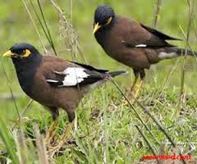
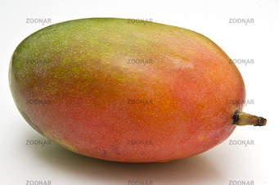
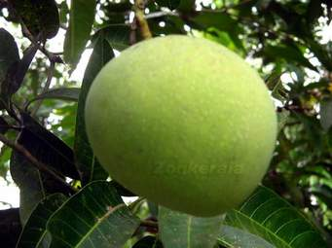
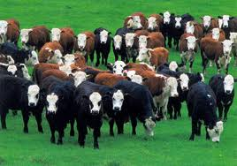
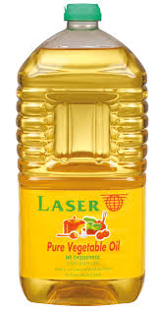
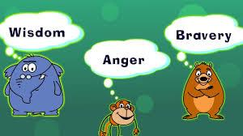
What can you see in the pictures?
Shalik
Bird
A herd of cows
Oil
Name of quality, action, state

Slide 7
Look at the diagram?
Noun
Common
Collective
Material
Abstract
Proper

Slide 8
EXAMPLES OF DIFFERENT KINDS OF NOUNS
PROPER NOUN
Fuad, Sakhipur, Tangail, Quran, Bible, Padma, Sunday, January, etc.
COMMON NOUN
Man, boy, girl, woman, book, pen, table, flower, newspaper, etc.
COLLECTIVE NOUN
Class, team, army, party, a group of boys, a bunch of flowers, etc.
MATERIAL NOUN
Water, oil, sugar, rice, milk, honey, sand, cloth, flour etc.
ABSTRACT NOUN
Honesty, kindness, illness, illiteracy, poverty, love, friendship etc.

Slide 9
DIFFERENCE BETWEEN PROPER NOUN & COMMON NOUN
PROPER NOUN | COMMON NOUN
Karim | Boy
Rina | Girl
Friday | Day
July | Month
Bangladesh | Country
Padma | River
Fazli | Mango

Slide 10
DIFFERENCE BETWEEN COMMON NOUN & COLLECTIVE NOUN
COMMON NOUN | COLLECTIVE NOUN
Boy | A group of boys
Cow | A herd of cows
Flower | A bunch of flowers
Robber | A gang of robbers
Fish | A shoal of fishes
Girl | A group of girls

Slide 11
MATERIAL NOUN USED AS COMMON NOUN
PROPER NOUN USED AS COMMON
PROPER NOUN
Karim is a good boy.
Shelly is an English poet.
COMMON NOUN
There are three Karims in our class.
Nazrul is the Shelly of Bangladesh.
MATERIAL NOUN
1. Water has no colour.
2. Rice is our main food.
COMMON NOUN
1. The water od this pond is impure.
2. The rice of Barisal is fine.
ABSTRACT NOUN USED AS COMMON NOUN
Honesty is the best policy.
Kindness is a noble virtue.
The honesty of this man is praise worthy.
The kindness of Mohsin is known to all.

Slide 12
GROUP WORK
Match the following parts of sentences from column A to column B.
Column A
Column B
(a) Proper Noun is the name
(b) Common Noun is the name of
(c) Collective Noun is the name of
(d) Material Noun is the name
(e) Abstract Noun is the name
(i) of quality, action, state
(ii) of a particular person, place, thing
(iii) of substance that can’t be counted
(iv) a group or collection
(v) a class

Slide 13
EVALUATION
What is Noun?
What is the difference between Proper and Common Noun?

Slide 14
HOME WORK
Fill in the blanks with appropriate Nouns
One who teaches the students is a-------.
------is the best policy.
Our cricket------is strong.
-----is an International Language.
We write on---------.
-----has no colour.
Kamal is a good-------.
One who delivers letters is a-------.
The ----is a faithful animal.
------is our main food.

Slide 15
THANK YOU

