Slide 1
WELCOME

Slide 2
Teacher ‘s Identity
CHANDAN BISWAS
ASSISTANT TEACHER
ANDHA HIGH SCHOOL
E-mail: chandanb13@gmail.com

Slide 3
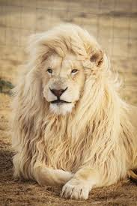
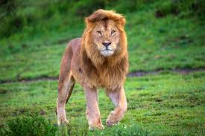
Look at the picture
The Lion

Slide 4
Class Identity
English-1st Paper
Class-Six
Lesson-15
The lion’s mane

Slide 5
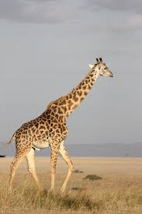
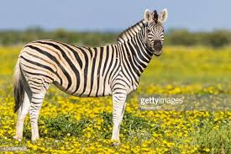
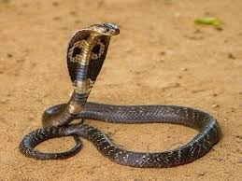
Look at the picture
The animals of jungle

Slide 6
Learning outcomes
After completing the lesson students will be able to-
*Read and understand the texts.
*To know about the animals.
*Answer the questions.
* Write short paragraph.

Slide 7
Learn the meanings of these words :
reflection
mane
Roared
paw
smooth
jungle
crown
– প্রতিফলন
কেশর
- গর্জন করা
- থাবা
- মসৃণ
- বন
- মুকুট

Slide 8
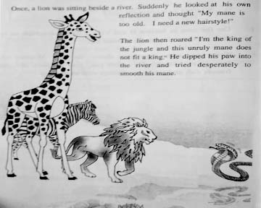
Read the following Passage

Slide 9
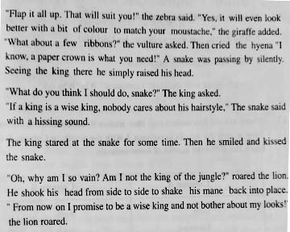
Read the following Passage

Slide 10
Individual work
Match the words in Column A with the meanings given in column B .
Column A | Column B
Mane | A line of hair that some people have on their upper lip
Roar | Move quickly
Unruly | Lift or move upwards
Flap | A sound like a long ‘s’
Moustache | The long hair on the neck of a horse or a lion
Raise | To make a very loud , deep sound
Hissing sound | Difficult to control or manage

Slide 11
Home work
Answer the following question .
Why did the lion want to change his hairstyle ?
What was the giraffe’s suggestion ?
Do you agree with the snake’s comment ? Why / Why not ?

Slide 12
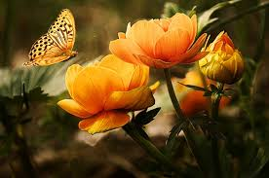
Thank you
everybody

