Slide 1
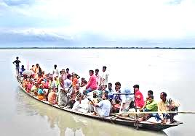
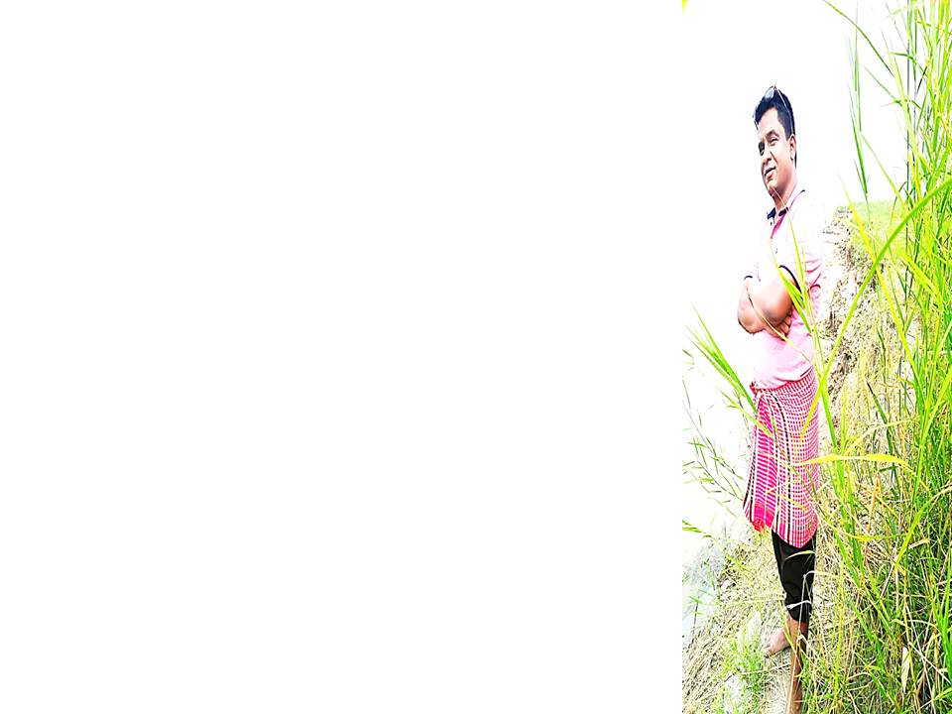
Welcome

Slide 2
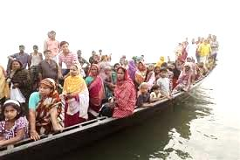
Introduction
Mohammad Azharul Islam
Assistant Teacher
Hugra Habib Kader High School,Tangail
ENGLISH FOR TODAY
CLASS : Nine & Ten
UNIT - 4
Lesson : 1

Slide 3
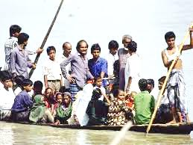
What about the picture?
Discuss with your partner then answer the following questions.
Where can you fine this kind of boat ?
Why does the boatman carry passengers across a river ?
Why do people use country boats ?

Slide 4
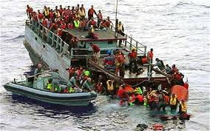
Let’ watch the picture
Discuss in pair. What were the causes of this accident? And say how we can avoid it?

Slide 5
So today we’ll discuss about
The ferry boat.

Slide 6
Learning outcomes
After completing this lesson, students will be able to-
ask and tell about problems.
seek and give suggestions.
listen for specific information.
narrate something in writing.

Slide 7
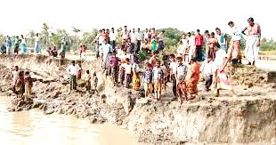
Let’s discuss about-------

Slide 8
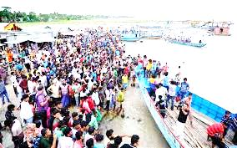
Let’s discuss about-------

Slide 9
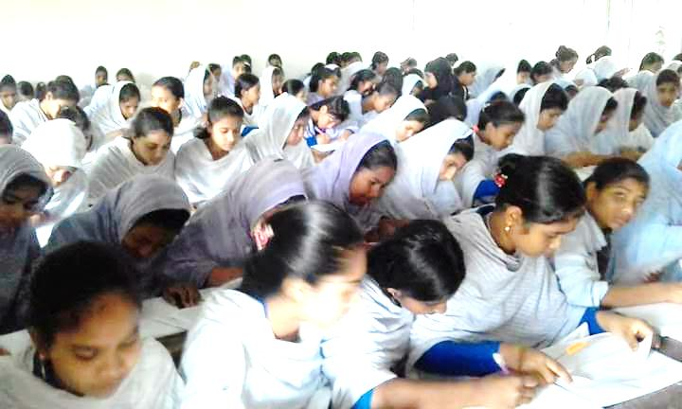
Individual Work
Read the text silently then answer the multiple choices questions that has given in the text.

Slide 10
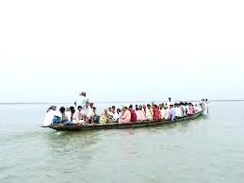
Cross the river
They are crossing the river by boat.

Slide 11
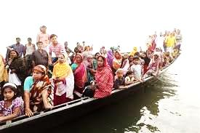
Cross the river
They are crossing the river by boat.

Slide 12
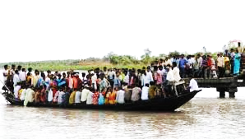
Individual/Pair works.
Look at the pictures and guess why do many people have little or no patience in situations as in the ferry boat?

Slide 13
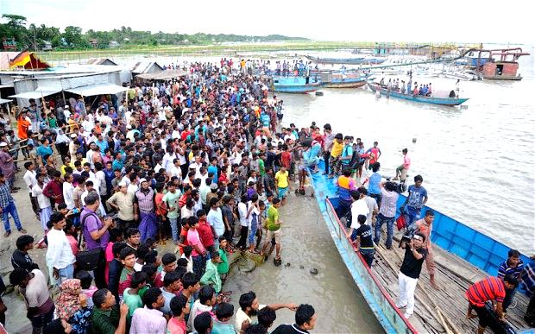
Population problems?
Look at the above pictures and guess if we have too many people are bank of the river then what will happen?

Slide 14
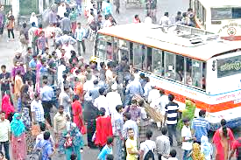
Look at the above pictures and guess if we have too many people in a town, bus and train then what will happen?

Slide 15
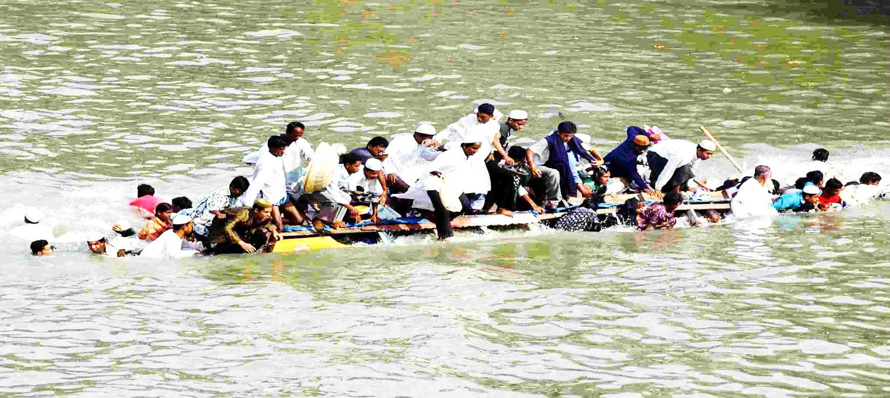
Home Work
Write a paragraph with in ten sentences about The ferry accident.

Slide 16
Thank You
So Much

