Slide 2
Welcome to My Class

Slide 3
Let me introduce myself
Abdul Latif
Lecturer in English
Alauddin Siddique College
Kalihati, Tangail

Slide 4
Look at the following sentences
The lazy boys will never shine in life.
We visited many beautiful places in the last vacation.
The girl with white dress looks nice.
The ship of the ancient mariner stood still like a painted ship upon a painted ocean.
The job was nicely done by the trainee.

Slide 5
Declaration of the Lesson
Uses of Pre-modifiers

Slide 6
Adjective as pre-modifier
When an adjective is used before the modified word it is called adjective pre-modifier.
1. A village doctor is a familiar figure in the rural areas of Bangladesh.
2. Rabindranath Tagore is a great poet of Bengali literature.
3. Shakespeare is the greatest dramatist of the world.
4. An old man with steel rimmed spectacles was sitting there.

Slide 7
Determiners as pre-modifier
Articles:
1. Sabbir is an ideal student
2. I saw some boys in the field. The boys were playing football
Demonstratives(this, that, these, those etc.) :
1. In those days people enjoyed the freedom of speech.
2. This book is mine.

Slide 8
Determiners as pre-modifier
Possessives (my , his , her, your etc.):
1. Yesterday I met my uncle
2. That handsome young man is her husband
Quantifiers(few, little, much, many etc.):
1. There is a little water in the judge
2. Girls waste most time in chatting

Slide 9
Determiners as pre-modifier
Numbers (one, two, three etc.) :
1. The boy bought three books from the fair.
2. The landlord had four sons.
Ordinals (first, second third etc.) :
1. He is the second boy in the class.
2. Nelson Mandela was the first black president of South Africa.

Slide 10
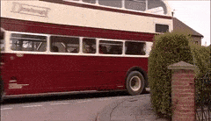
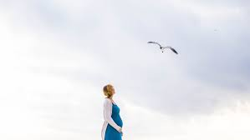
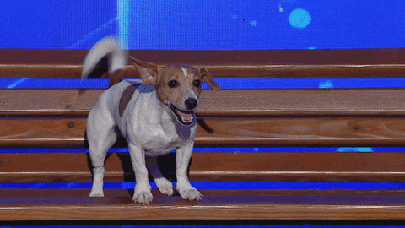
Present participle as pre-modifier
Present Participle = (verb + ing)
1. The man got into the running bus.
2. The woman in blue and white is looking at a flying bird.
3. A barking dog seldom bites.
4. Bring me the floating flower.

Slide 11
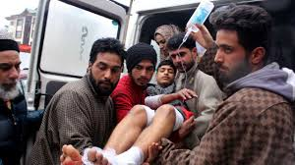
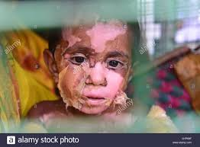
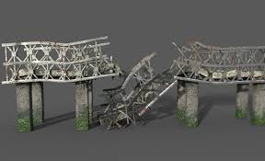
Past participle as pre-modifier
1. The injured students were sent to hospital.
2. A burnt child dreads the fire.
3. The destroyed bridge should be repaired.

Slide 12
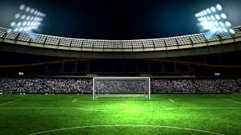
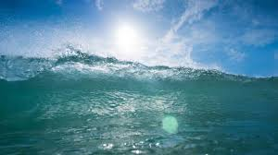
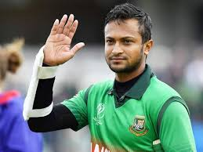
Noun as pre-modifier
1. We went to the football stadium yesterday.
2. The sea level is rising high day by day.
3. Saki Al Hasan is a famous cricket player.

Slide 13
Nominal compound as pre-modifier
1. She is a record breaking typist.
2. Mark the wheat-producing countries in the map.
3. Try to use this labor-saving method.
4. Green house effect is a man-made problem.

Slide 14
Intensifier as pre-modifier
(Very, at all, absolutely, completely, highly, extremely, too, quite etc.)
1. Raza is very weak in English.
2. I am extremely sorry.
3. The building was completely destroyed .
4. You are absolutely right.

Slide 15
Evaluation
Use pre-modifier as directed.
1. Television has become -------------(Pre-modify the noun) source of entertainment.
2. He is an ---------- ( use intensifier) brilliant boy.
3. A balanced diet is a good mixture of ------------ ( use an adjective) foods.
4. I want --------( use an article) book took from me.
5. There is a ------------- (use a quantifier) water in the pond.
6. A village doctor is a ------------ (use pre-modifier) person in rural areas.
7. Most of the people of ---------- (use a possessive) country are unaware of pollution.

Slide 16
Home Work
Write Ten Sentences and Underline the Pre-modifiers Used in Those Sentences

Slide 17
Good Bye

