Slide 2
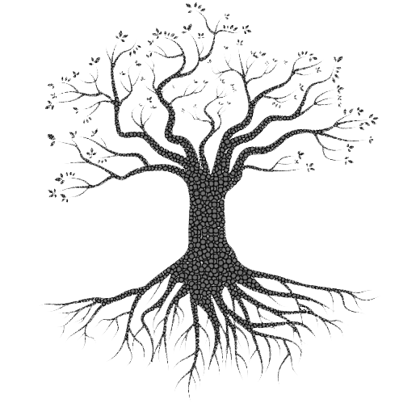
Let us see some pictures.

Slide 4
Let us watch the video.
Please click here to go to internet for watching Video.
Discuss with your partner what they are and how they are related to the topic of your text.

Slide 5
My Roots
So, our topic of the Class is -----
Unit : XII
[ROOTS]
Lesson : 1

Slide 6
Learning outcomes
After the students have studied the lesson, they will be able to --- ---
participate in conversations and debates.
exchange personal information.
narrate incidents and events in a logical sequence.
present own ideas, give and ask for information.

Slide 7
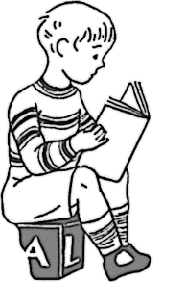

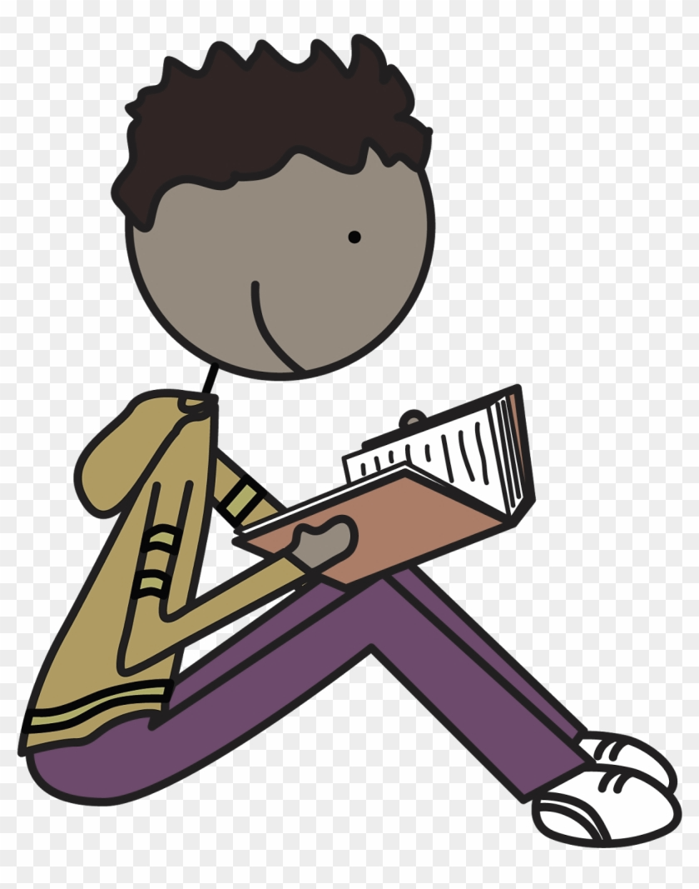

Slide 8

New Word
Caption
Words that are printed undermeath a picture
Syn.: description, explanation

Slide 9

New Word
Festival
A day or period of celebration
Syn.: celebration

Slide 10
A: Look at the pictures and the caption below. How do you feel looking at the photo? Why do you think people take such risks to go home to celebrate Eid?

Slide 11

B: Open at page no. 152 from the text and read it to answer the questions that follow.
1. Why do most of the people living outside home desire during the Eid vacation?
2. What happens to transport during Eid vacations?
3. What are the roots of human beings?
4. How do human beings become rootless?
5. What makes people rush for their homes in spite of serious hazards?
TEXT

Slide 12
B: Read the following text.
Eid is the main religious festival of the Muslims in Bangladesh. Eid means happiness. Eveyone wants to share this happiness with their near and dear ones. So most of the people, who are living outside their home for different reasons have a strong desire to get back home during the Eid vacations. As a result, there is a mad rush in the buses, trains, or launches for the home-bound people. This often causes transport accidents that take away many lives. However, it cannot stop people’s desire to meet their family, in-laws, or friends. What makes people rush for their homes in spite of serious hazards? This is the pull of the roots. Do human beings have roots like the trees? The answer is ‘yes’

Slide 13
but unlike the roots of the trees they are invisible, they lie in our minds. It’s these roots that make a bond between us and family members, in-laws, friends, neighbours or even between us and the land where we were born and grew up. In that sense our families, land of birth, relatives, our culture, traditions, or surroundings are our roots. And wherever we stay, we have a continuous pull of our roots. It’s our roots that develop our identity making us what we are. When we lose that bond, we become rootless. Human beings who do not have any root or contexts, are non entity. In other words, they do not have their own identity. Such persons are devoid of values, humanity, and social responsibilities. They don’t know where they are from, and/or where they are heading towards. This often makes them feel empty and lost.
BACK

