Slide 1
Welcome

Slide 2
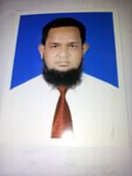
Introduction : Teacher
MD.ABDUR ROUF
Lecturer(English) KHALNA ISLAIA FAZIL MADRASHAH PATNITOLA,NAOGAON. MOB:01767650169

Slide 3
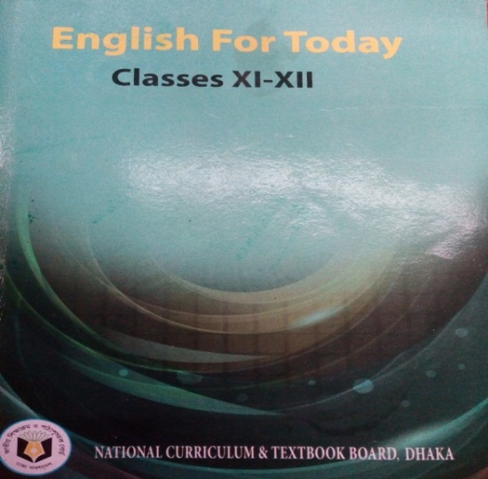
Introduction of the lesson
English For Today
Class: xi-Xii
Unit: five ,Lesson:4

Slide 4
The picture of a miserable woman

Slide 5
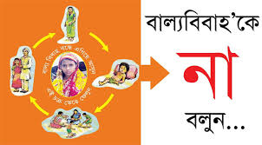

Slide 6
Announcement of the lesson
The story of shilpi

Slide 7
Learning Outcomes
By the end of lesson the student will be able to……….
reading, writing, speaking and listening skill
Describe word meaning with synonym and antonym
Ask and answer questions
Tell about the miserable story of ‘shilpi’

Slide 8
Shilpi was only 15 years old when she married Rashid in 2008. Marrying off daughters at an early age is a standard practice for many families living in rural Bangladesh. After her wedding, Shilpi joined a local empowerment group that provides adolescent girls with the tools needed to gradually change cultural practices, particularly those pertaining to early marriage and pregnancy. The group's activities include discussions on how to most effectively change behaviour related to reproductive health as well as one-on-one counseling. It also offers peer-to-peer support and life skills training that help adolescents say no to early marriage

Slide 9
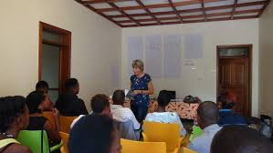
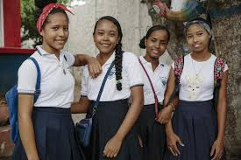
The empowerment group is one of more than 10,000 groups supported by some local Non Government Organizations (NGOs) working all over Bangladesh. These NGOs work through Canada ‘s Adolescent Reproductive Health Project which also aims to increase access to quality health services for adolescents. During one of the group sessions, Shilpi came to understand the potentially harmful effects of early marriage and pregnancy. While maternal mortality in Bangladesh has declined by nearly 40 percent since 2001, the rate remains high with 194 maternal deaths per 100,000, live births in 2010-dropping from 322 in 2001 with a projected decrease to 143 by 2015. Girls who get pregnant are at risk of serious health complications. These include dangerous 60 English For Today hemorrhage and fistula, a painful internal injury caused by obstructed childbirth that commonly leads to serious maternal morbidities and social exclusion.

Slide 10
When Shilpi heard about those risks, she invited her husband, Rashid, to discuss pregnancy with a counsellor. After hearing about the risks, Rashid agreed to delay having children for five years despite pressures from his parents and neighbours to produce an offspring. Together, the couple met with a female health care provider, who informed them about the various family planning options available. Shilpi’s mother-in-law and neighbours continued to pressurize the newlyweds. Deeply rooted cultural practices and traditions caused a rift between Shilpi and Rashid and their extended family, some of whose members insulted and criticized the couple. Unable to convince their close relatives of the risks, Shilpi and Rashid returned to the counsellor. They took the help of a parent peer who has been trained to speak to other parents about adolescent issues. Shilpi’s mother-in-law and neighbours eventually came to understand the harmful effects of early pregnancy on mother and child. Today, the village no longer pressurizes the couple; their parents and neighbours now support them and speak out against early marriage and pregnancy.

Slide 11
Word—Meaning
Discussion-------conversation
Supported--------------proved
Relative----------comparative
Reproductive------reproduce
Empowerment-give power to
Increase-----------------growth
Potentially----------possibility
Serious--------------important
Counselor -------------adviser
Exclusion------------omission

Slide 12
Life history of Shilpi
Shilpi is a miserable girl.
She was married in 15 years old with Rashid in 2008.
After her wedding, Shilpi joined a local empowerment group.
The group's activities include discussions on how to most effectively change behaviour related to reproductive health as well as one-on-one counselling. It also offers peer-to-peer support and life skills training that help adolescents say no to early marriage.
Shilpi came to understand the potentially harmful effects of early marriage and pregnancy.
Shilpi heard about those risks, she invited her husband, Rashid, to discuss pregnancy with a counsellor.
Shilpi’s mother-in-law and neighbours eventually came to understand the harmful effects of early pregnancy on mother and child .

Slide 13
Group Work
MCQ------
1.Shilpi was married –Roshid/Rashid/Rashidul/Raihan.
2.The word ‘supported’ means—neglected/confused/proved/connected.
3.The eleboration of the word ‘NGO’—Non Government Organization/ Non Government Organiz/ Non Govern Organization.
4.How many groups of the empowerment—20,000/10,000/40,000/30,000.
5. These NGOs work through –-Canada’s /America/France/ Japan.

Slide 14
Evaluation
1.Who is Shilpi?
Ans: Shilpi is a miserable girl.
2.When did Shilpi marrige?
Ans: Shilpi marrided at the age of 15.
3. Whom did Shilpi was married?
Ans: Shilpi was married with Rashid.
4.Where did Shilpi join?
Ans: Shilpi joined a local empowerment group.
5.What is a standard practice for many families living in rural Bangladesh? Ans: Marrying off daughters at an early age is a standard practice for many families living in rural Bangladesh.
6.What does the empowerment group offer?
Ans: the empowerment group offers peer-to-peer support and life skills training that help adolescents say no to early marriage.
7.What will happen if the girls get married at an early age?
Ans: Girls who get pregnant are at risk of serious health complications .

Slide 15
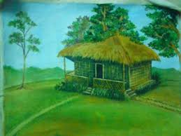
Home Work
Write a summary above the passage not more than 70 words.

Slide 16
Thank you all

