Slide 1
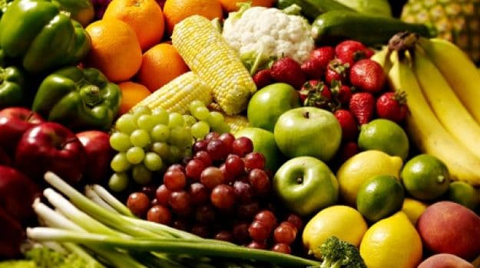
Welcome

Slide 2
Identity
MD.ABDUR ROUF
LECTURER IN ENGLISH
Khalna Islamia Fazil Madrasah Patnitala,Naogaon.Mobile No:01767650169
ENGLISH FIRST PAPER
CLASS- XII
UNIT-05, LESSON-01
Date : 24/08/2019

Slide 3
Let’s Watch the video
https://www.youtube.com/watch?v=8FbwKHEPIvM
What is video about?
So, What are we going to study or discuss ?

Slide 4
Food Adulteration Reaches to New Height
Supported By Matador Stationary

Slide 5
Learning Outcomes
To increase vocabulary
To define adulteration
To find banned pesticides
. To identify different adulterated food items
. To express about excessive use of preservatives

Slide 6
Word meaning
Adulteration- pollution, intoxication
Arsenic - a poison which kill slowly but surely
Formalin –one kind of preservative used in Laboratory
DDT - one kind of banned pesticides, scientific name- para, para Di cloro,Di floro Tri clro Ethene
Pesticides – poisonous chemical used to kill insects

Slide 7
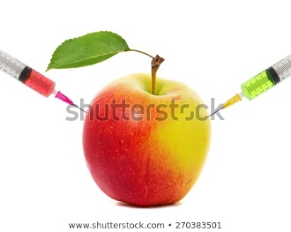
What are they injecting?
What types of food we are eating
Adulteration: Mixing poisonous chemicals with fruits

Slide 8
Let’s see another picture
Process of different types of adulteration

Slide 9
Let’s see some poisonous chemicals at a glance
FOOD
D.D.T
Chlorden
formalin
Arsenic
Chromiam
Haptachlor
Michrobials
Led

Slide 10
Pair Work 7 mints.
Write five sentences about excessive use of preservatives

Slide 11
Use of chemicals with vegetables

Slide 12
Adulteration
Let’s See the picture again

Slide 13
Let’s know
Some important findings:
About 50% vegetables and 35% fruits of the capital markets are contaminated with banned pesticides such as DDT, Aldrin, Heptachlor chlorden etc.
Formalin is used with fish and fruits to look them fresh
Poor manufacturing process is also responsible for adulteration.
Disobedience to set rules is responsible for adulteration.

Slide 14
Group Works:
Group -1:a. Identify some adulterated foods
b. Who adulterate foods?
Group -2: a. Why people use pesticides?

Slide 15
Individual work:
Name some banned pesticides.

Slide 16
Evaluation
How is fruits contaminated?
Is our food safe which we have everyday?
Why people use preservatives with foods?
How to prevent food adulteration?

Slide 17
Thanks for nice co-operation

