Slide 1
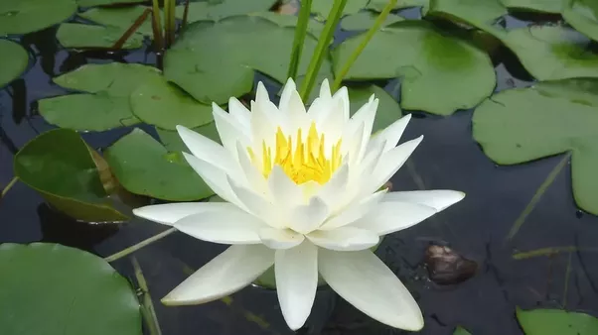
Welcome

Slide 2
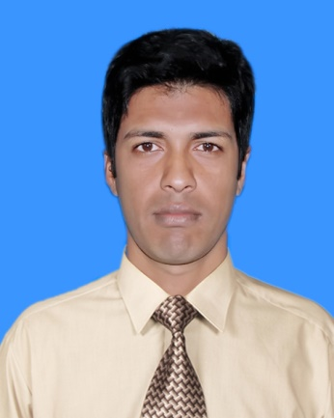
Introduction
Md. Magzumi
Assistant Teacher
Kutubpur Hat GPS
Shibchar, Madaripur.
Mob: 01720647519 Emailtmagzumi1985@gmail.com

Slide 3
Class : Two
Subject : English
Time : 45 minute

Slide 4
Learning Outcome
1.1.1 : become familiar with English sounds by listening to common English word.
1.2.1 : recognize and read the Alphabet both small and Capital. (Non cursive)

Slide 5
Let’s we sing a song.
We shall overcome
We shall overcome
We shall overcome someday
Oh deep in my heart, I do believe,
………………………………..

Slide 6
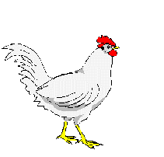
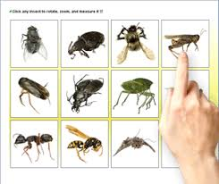
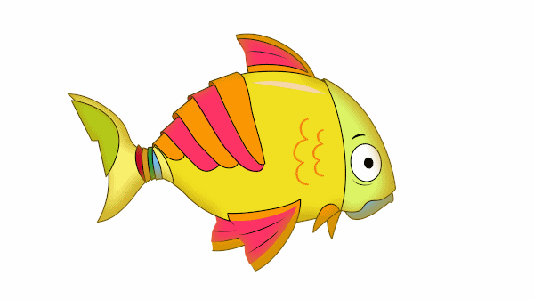
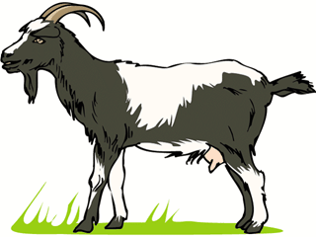
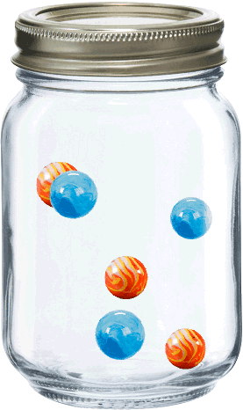
What can you see in this pictures?
Fish
Goat
Hen
Insects
Jar

Slide 7
Today’s Lesson
Alphabet: Ff-Jj
Unit: 8,9,10,11,12
Page: 17,19,21,23,25

Slide 8
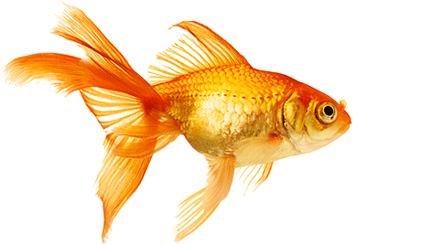
Look listen and say-
Ff
fish

Slide 9
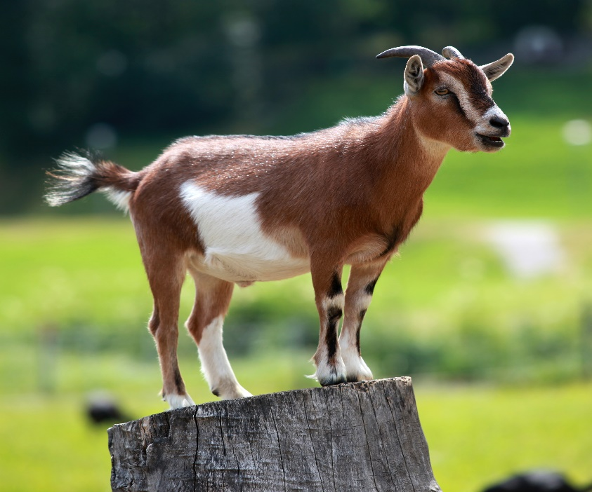
Look listen and say-
Gg
Goat

Slide 10
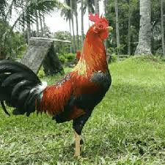
Look listen and say-
Hh
Hen

Slide 11
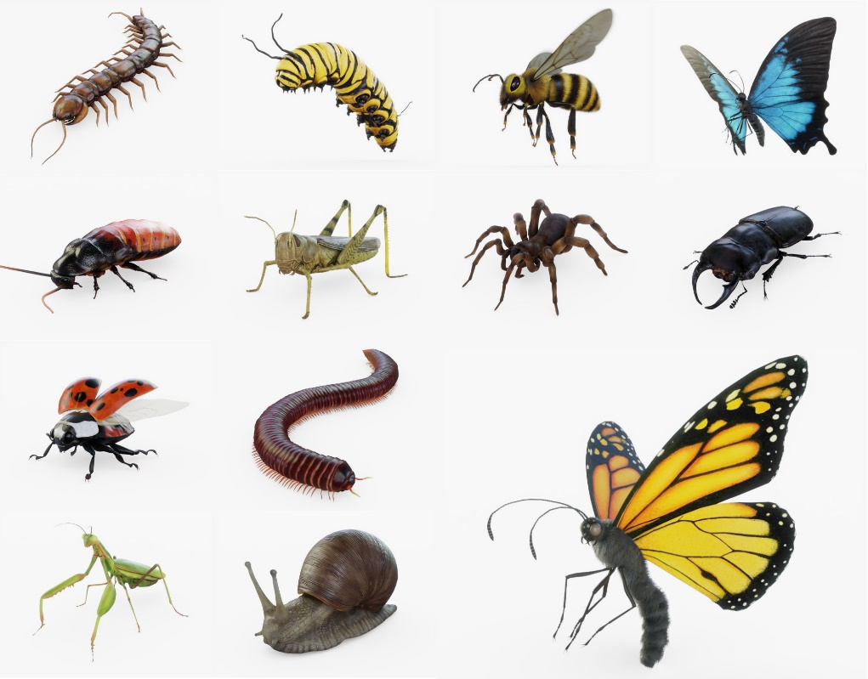
Look listen and say-
Ii
Insects

Slide 12
Look listen and say-
Jj
Jar

Slide 13
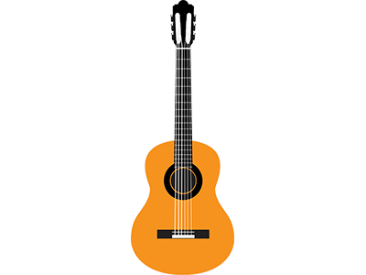
Individual work
F=
flag
G=
Guitar

Slide 14
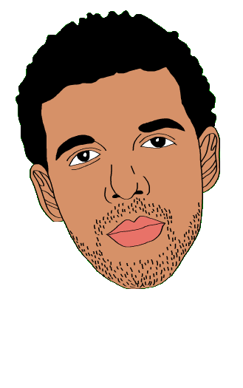
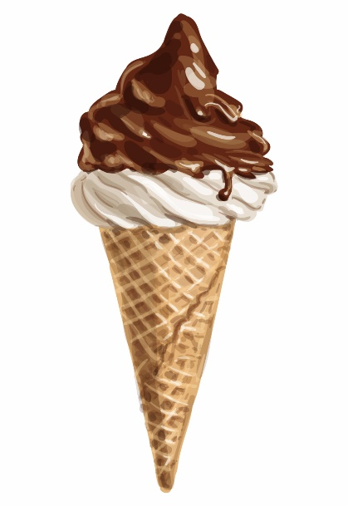
Individual work
H=
Head
Ice cream
I=

Slide 15
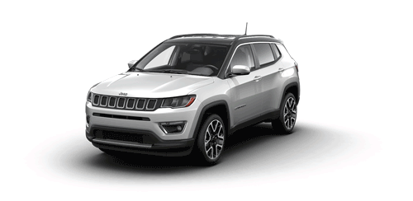
J=
Jeep

Slide 16
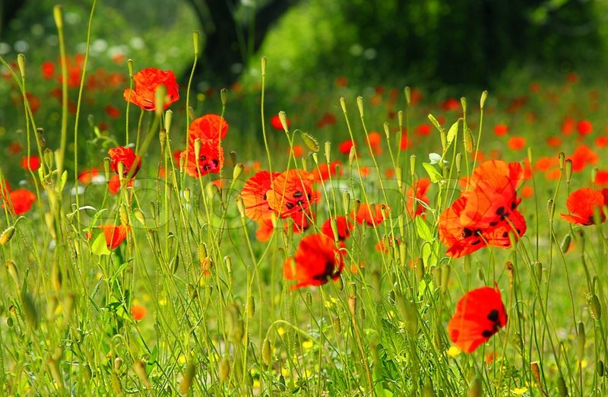
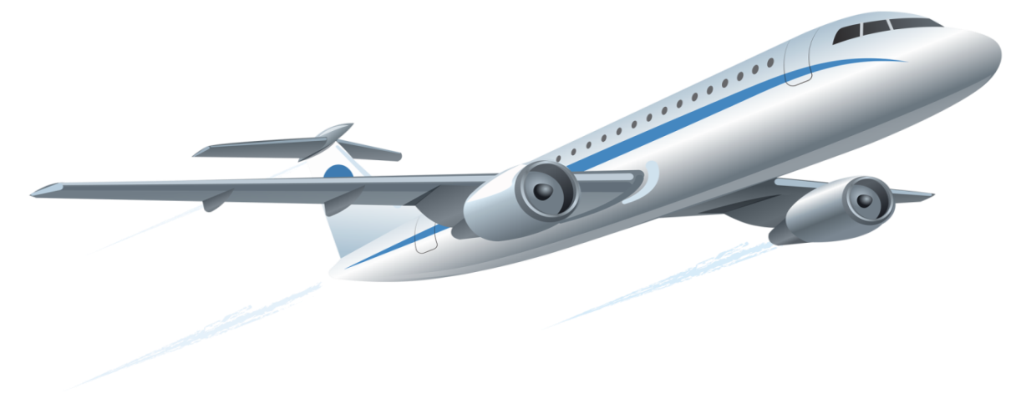
Bye bye

