Slide 1
Welcome to Every body

Slide 2
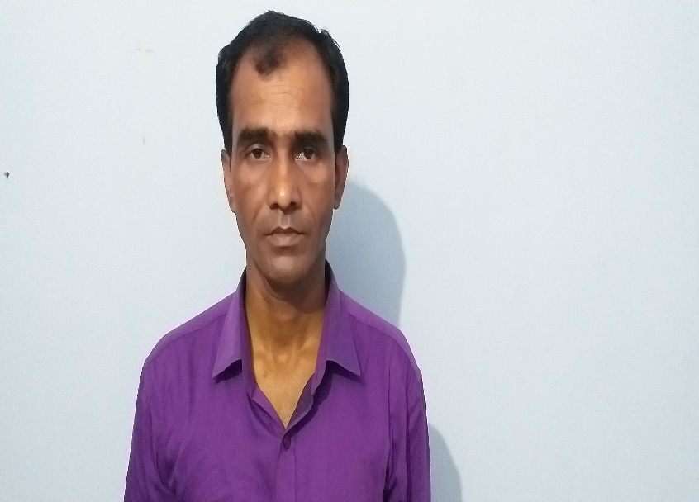
IDENTY OF TEACHER
Md.Rashidul Islam
Head teacher
Nalukabari Govt. primary school

Slide 3
Learning Outcomes:
Students will be able to
1.3.1 Recognize which words in a sentence are stressed.
1.1.1 Say words, phrases and sentences with proper sounds and stress.
1.5.1 Read words, phrases and sentences in the text with proper pronunciation, stress and intonation

Slide 4
Today’s Lesson
Occupations

Slide 5
Lets we watch the video

Slide 6
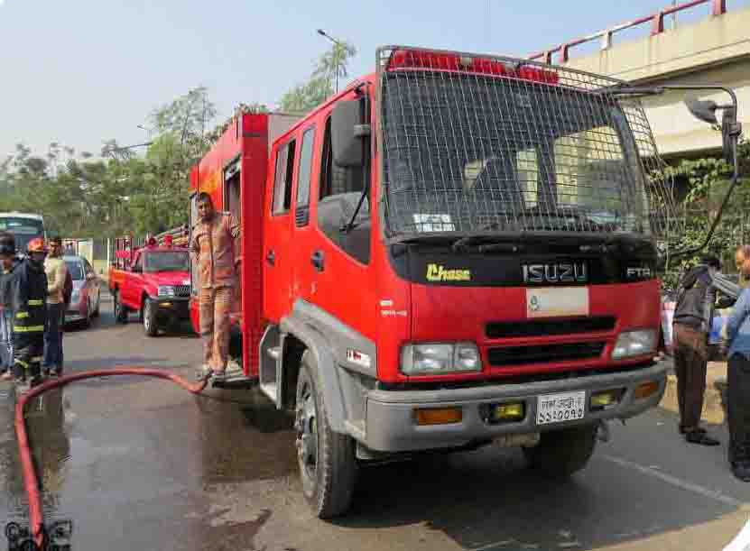
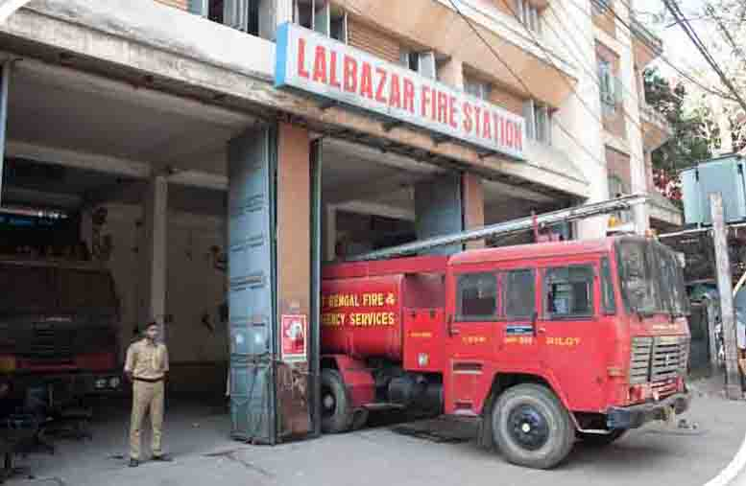
Lets we watch the pictures

Slide 7
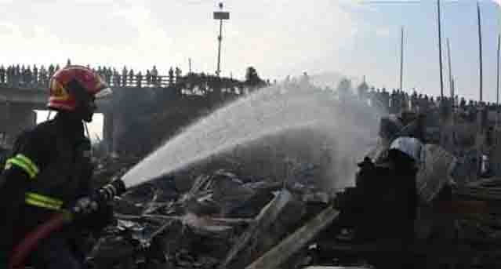
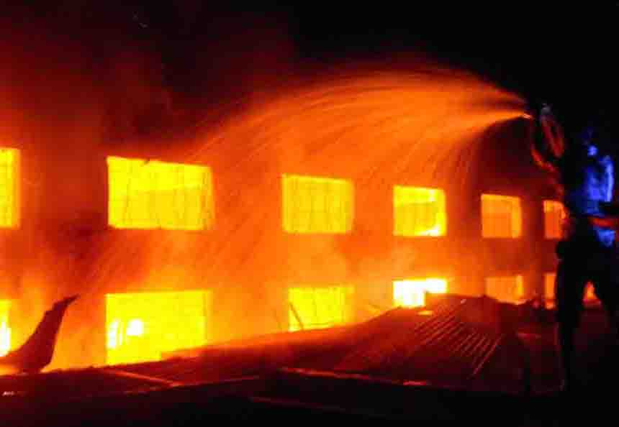

Slide 8
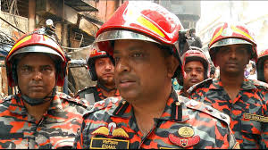
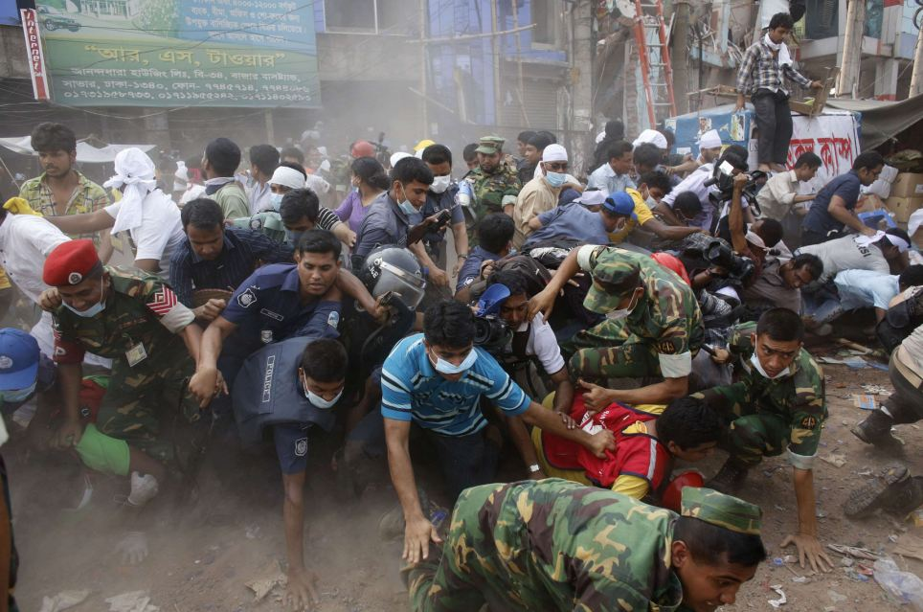
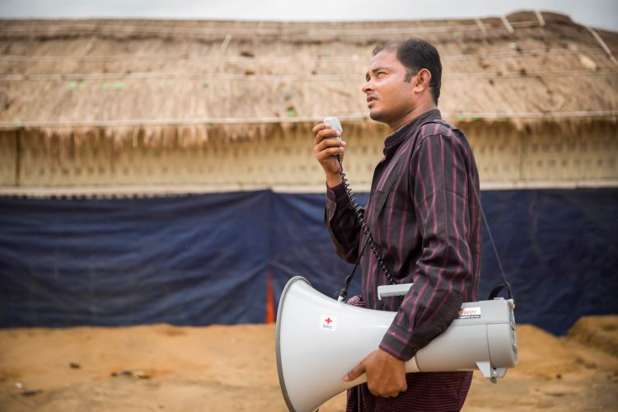
New words
Firefighter
Panic
Volunteer

Slide 9
Word | Word meaning | Make sentence
Panic
Upset
He was panic
Firefighter
One who put out fire
Raju is a firefighter
Volunteer
Help selflessly
is a volunteerRaju

Slide 10
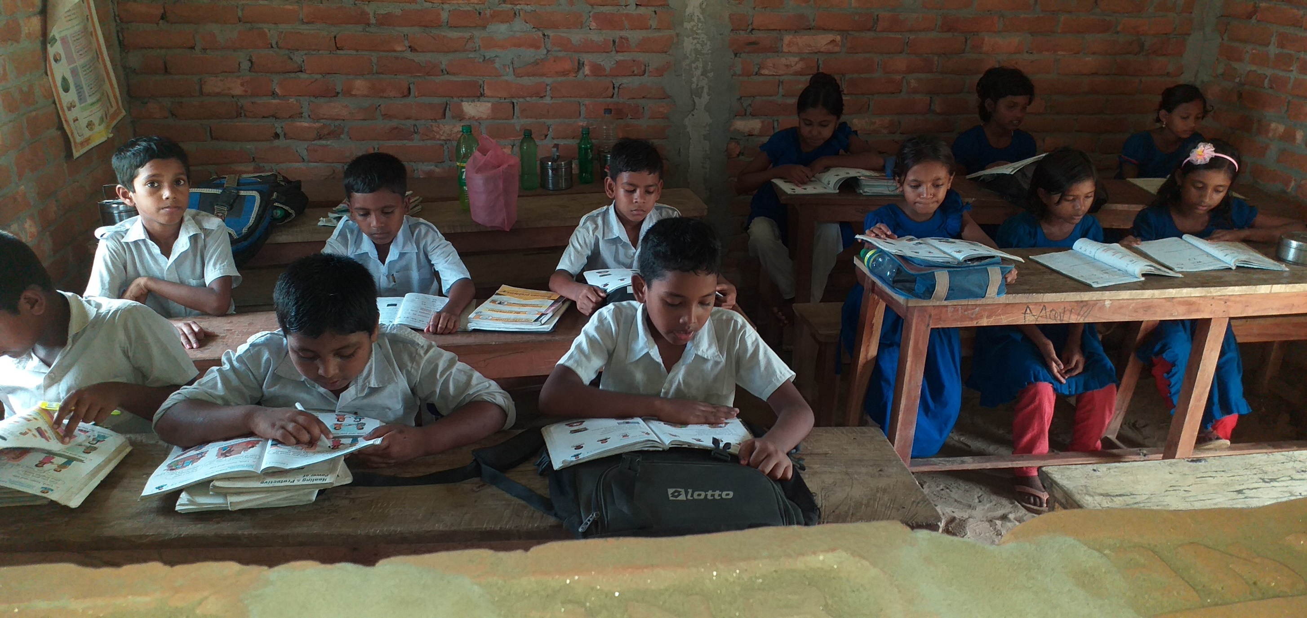
The students will read with Teacher

Slide 11
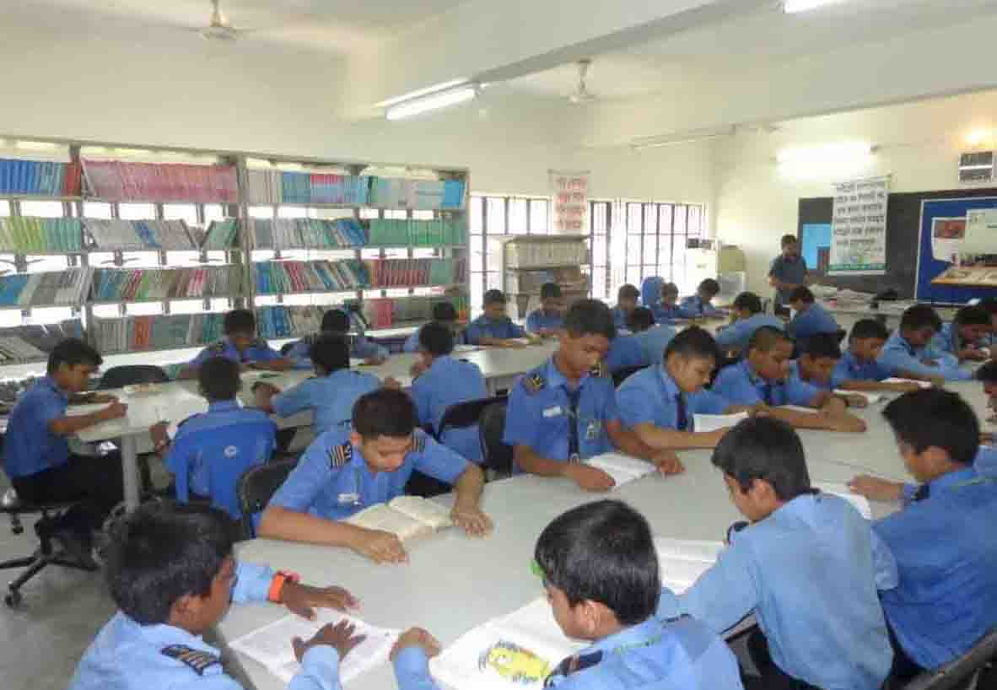
Group Reading

Slide 12
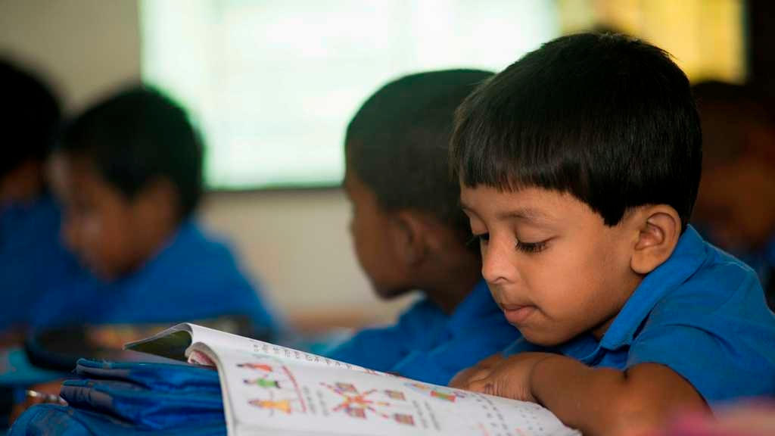
The student indevidules reading

Slide 13
Written test
Answer to the questions
Question
Answer
1.What does Raju do?
Raju is a firefighter.
2. Who help the students to leave the building?
Teacher help the students to leave building.
3. What does Raju likes?
Raju likes teaching very much.

Slide 14
Evaluation as oral
Word meaning
Came
Free
Join
Safe
Talk
Long
Visit
Leave
Job

Slide 15
Homework
Write the five sentence about A firefighter

Slide 16
Thanks to all….

