Slide 1
Welcome to my class
dear students.

Slide 2
Introduction
Mazada Akter
Lecturer (English)
Barabor alim Madrasha
Class IX-x
Subject : English 1st paper

Slide 3
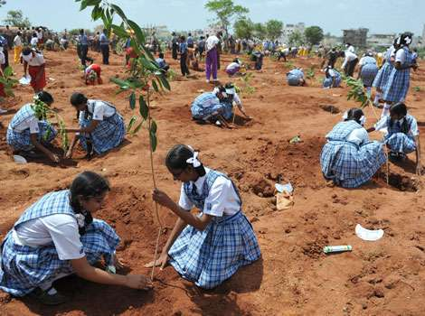
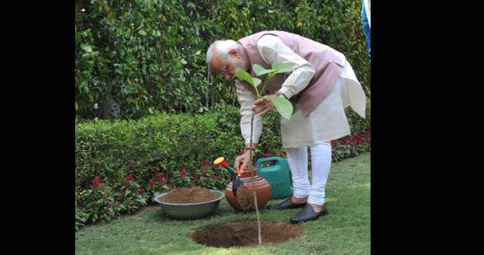
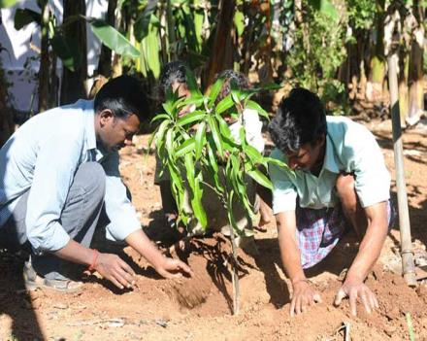
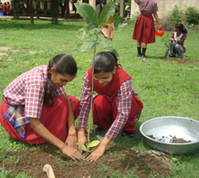
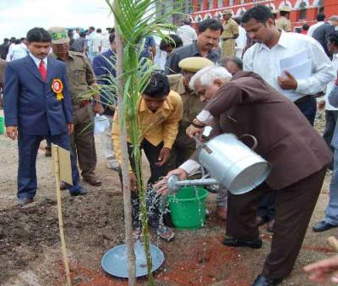
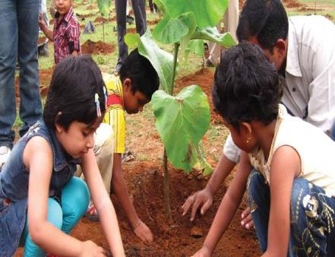
Tree plantation

Slide 4
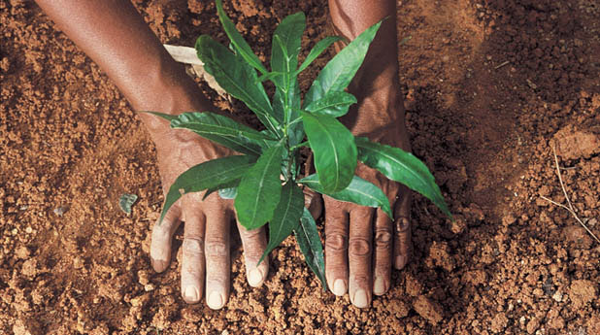

Slide 5
Learning outcomes.
After studied this lesson, students will be able to—
tell what tree plantation is
describe the importance of tree plantation
tell about the effect of deforestation
write a paragraph
After studied this lesson, students will be able to—
tell what tree plantation is
describe the importance of tree plantation
tell about the effect of deforestation
write a paragraph

Slide 6
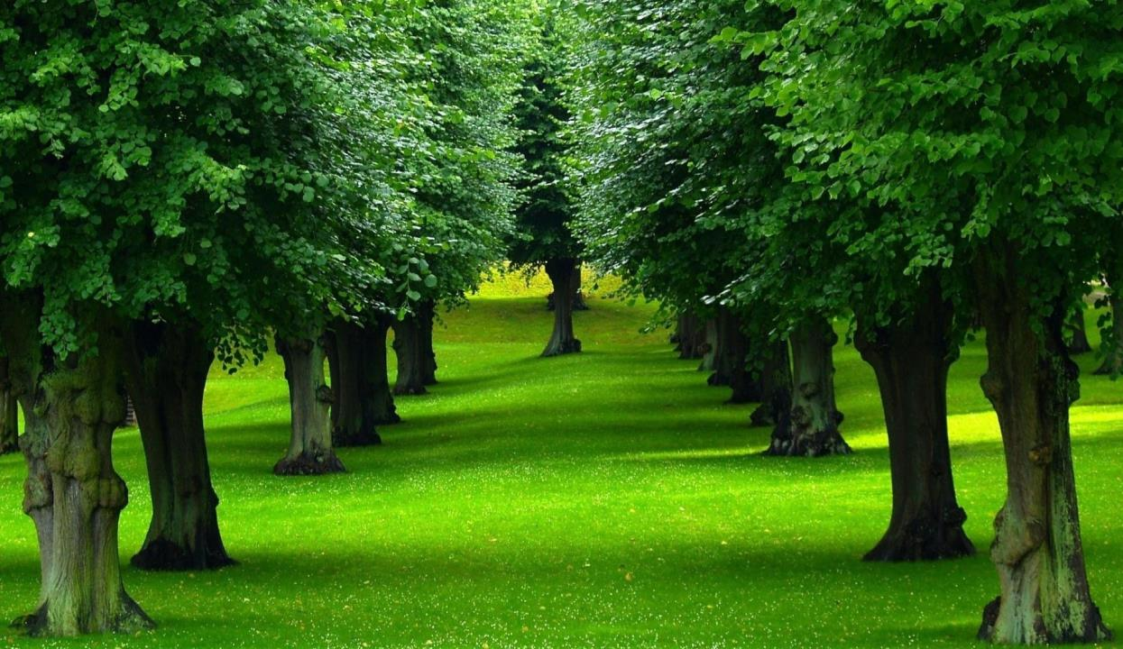
Trees are the most important element
of nature and environment.

Slide 7
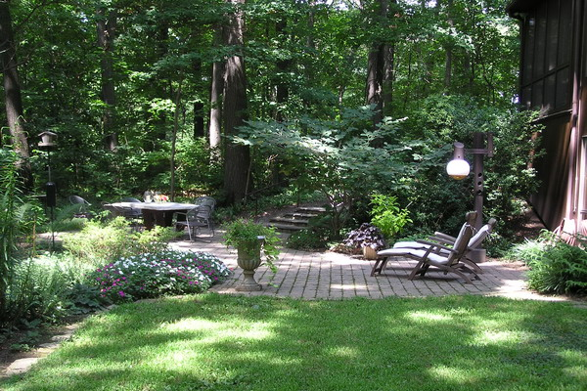
We cannot think a healthy environment without tree

Slide 8
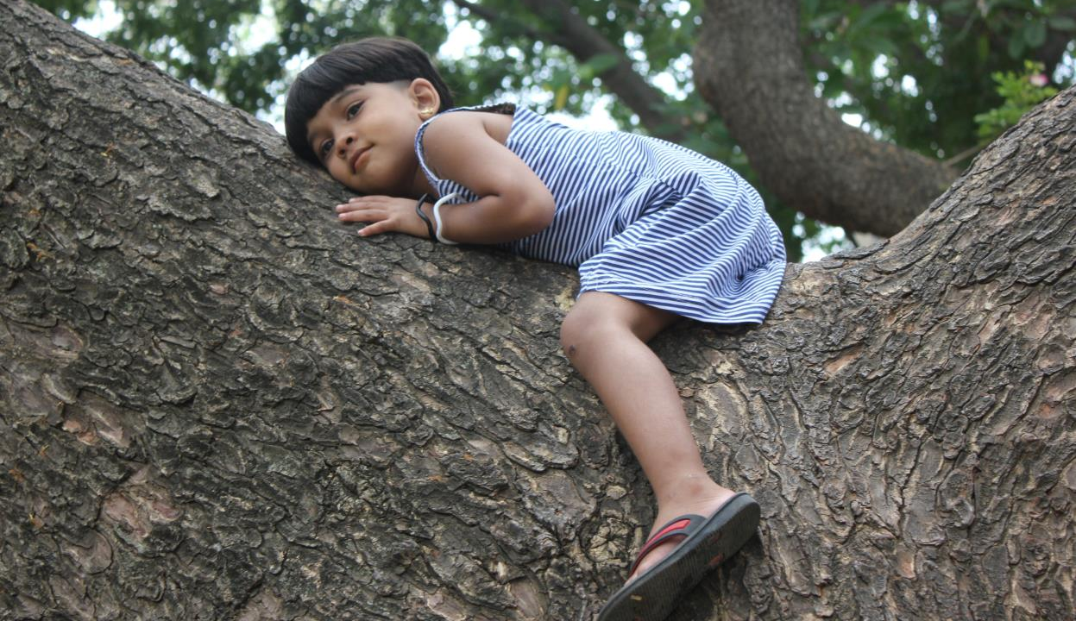
Tree is our most intimate friend.

Slide 9
Why should we plant trees?
We should plant tree for our existence as we cannot live without oxygen

Slide 10
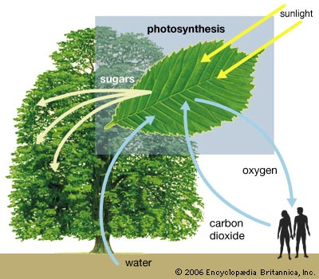
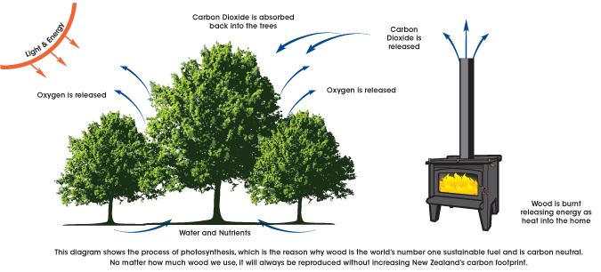
Trees are the factory of receiving carbon dioxide and releasing oxygen. We live by receiving oxygen from the tree.

Slide 11
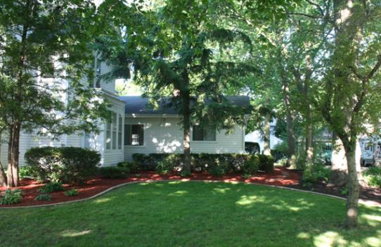
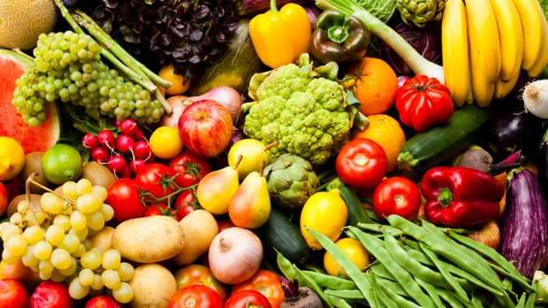
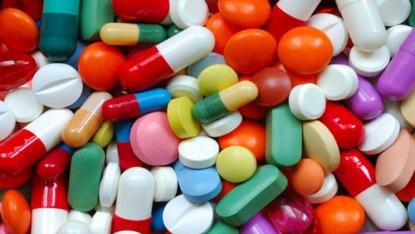
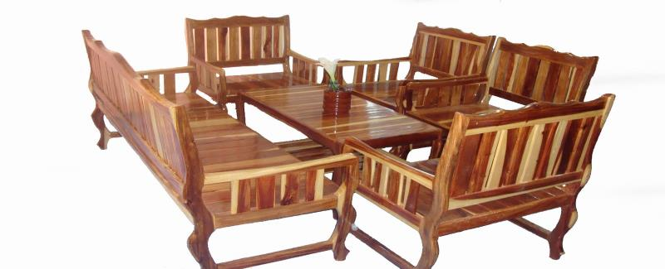
It provides us with shed, food, medicine and furniture.

Slide 12
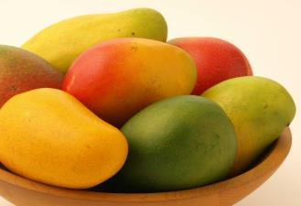
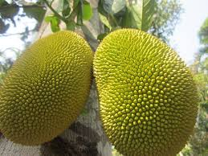
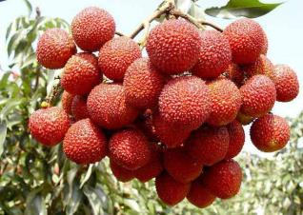
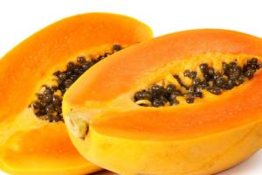
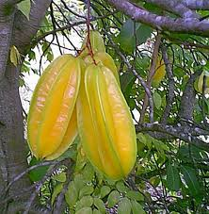
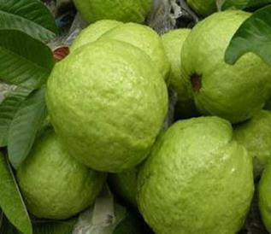
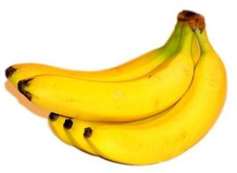
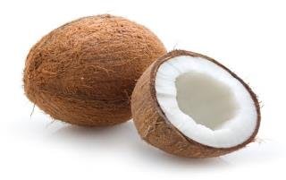
Tree meets out fruits thirst.

Slide 13
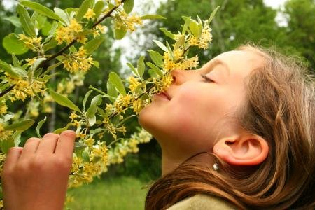
We feel delight with the beauty of flowers and sweet smell.

Slide 14
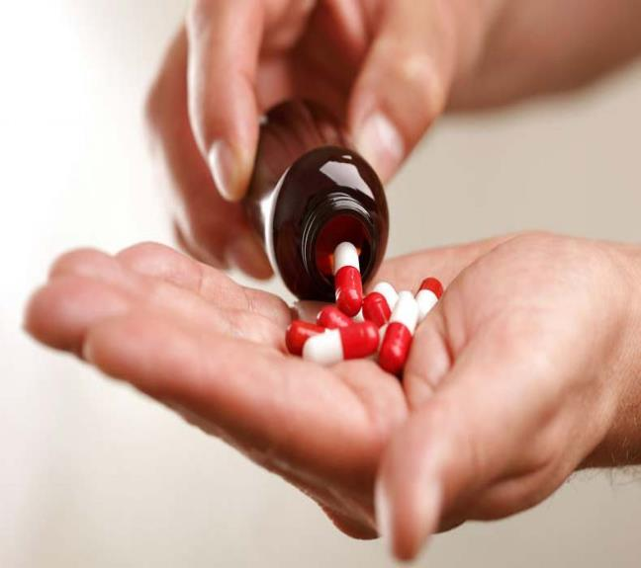
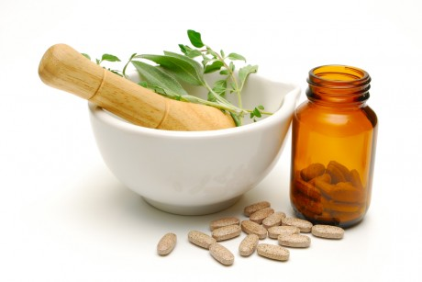
Medicine is made from trees.

Slide 15
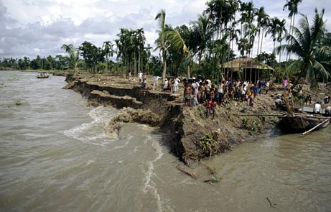
Moreover, it protects river erosions.

Slide 16
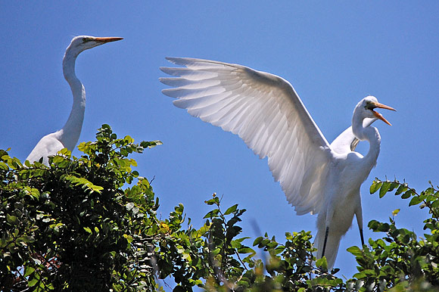
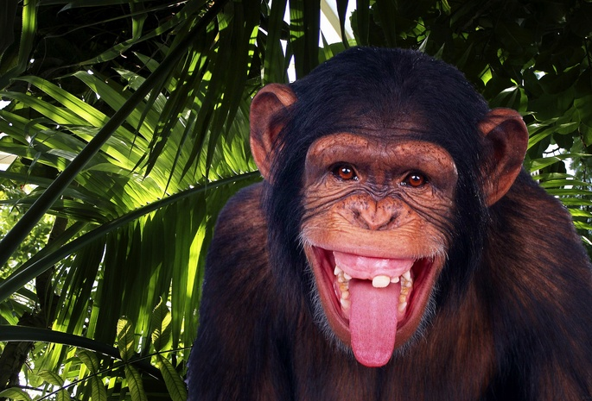
It gives shelter to the birds and beasts.

Slide 17
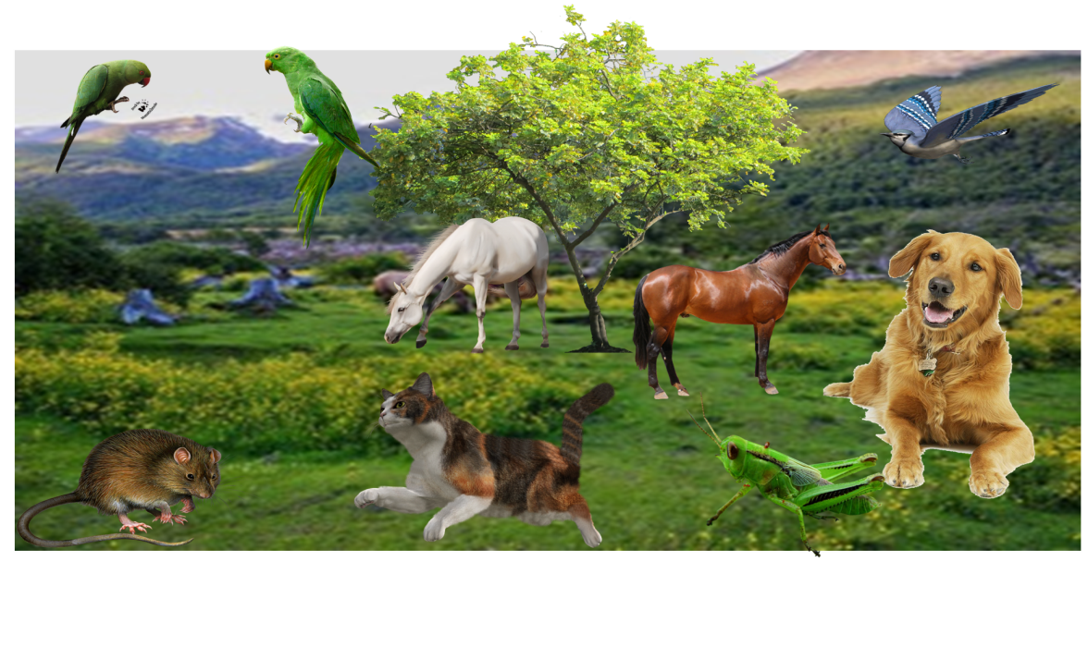
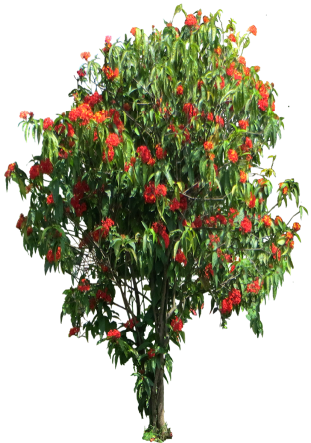
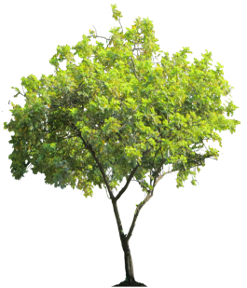
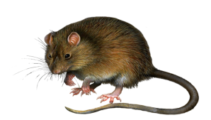
It ensures the ecological balance of our environment.

Slide 18
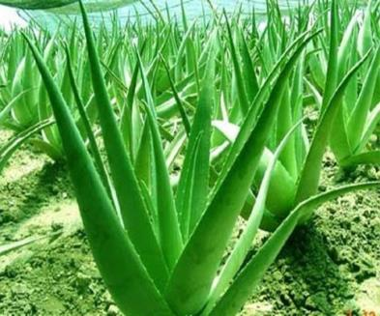
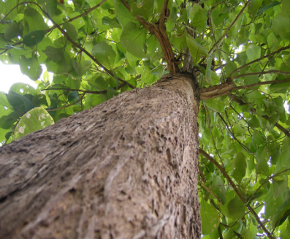
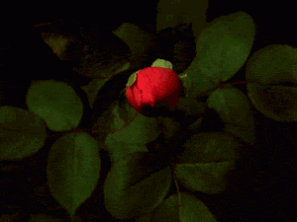
What kinds of tree should we plant?
We should plant all kinds of tree like medicinal tree, flower tree, tree of furniture and shelter.

Slide 19
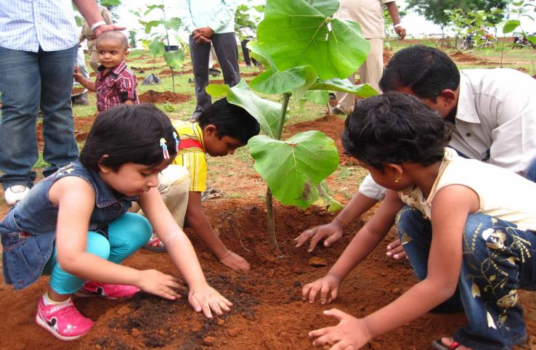
What is the best time to plant tree?
The first week of July is the best time of planting tree because it is the tree planation week.

Slide 20
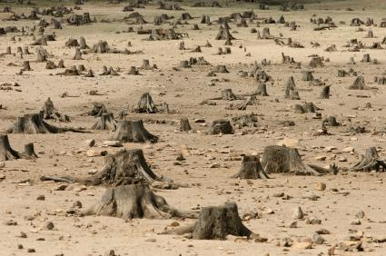
What happens if we do not plant tree?
If we do not plant tree, the country will be turned into desert for deforestation and all living beings will loss their existence.

Slide 21
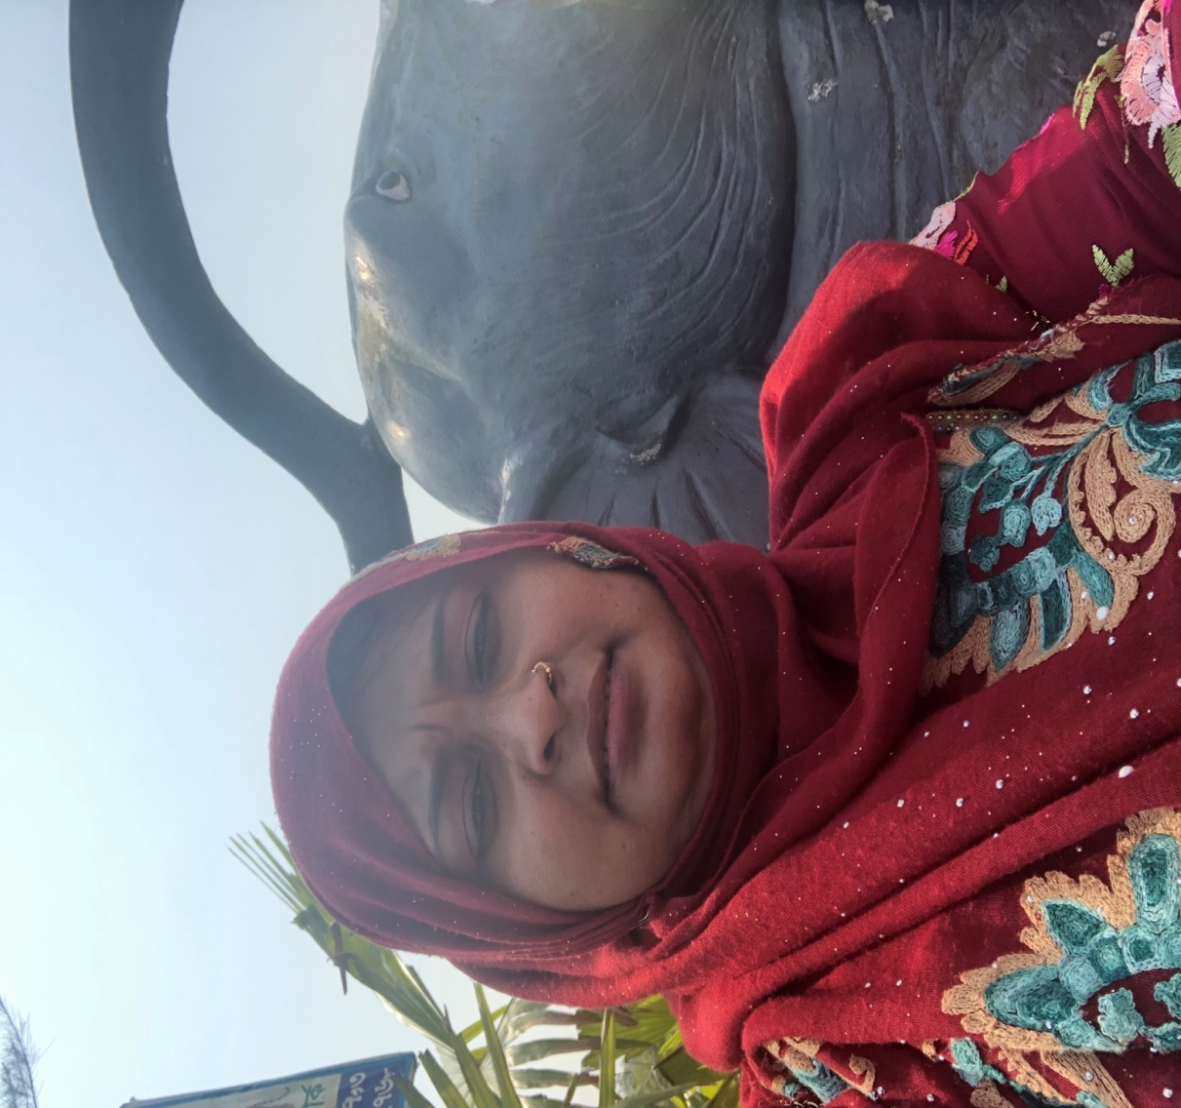
So the importance of tree plantation is easily realized.

Slide 22
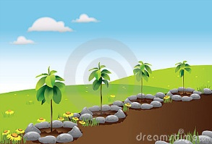
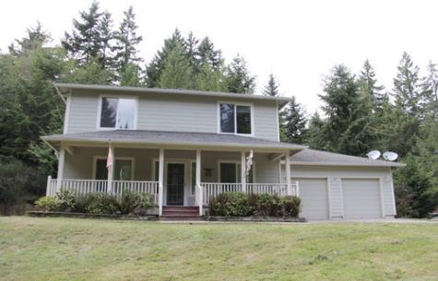
What should be our duty now?
That’s why we should plant trees more and more in any blank space like open and unused place, by the side of the house, roads, high ways, by the side of schools, colleges and offices to ensure a happy ,healthy and fresh environment.

Slide 23
Suppose, you and some of your friends live in a residential area near a river. There is not enough tree in that locality and for that the area is in the victim of river erosion. The heat of the sun is un bearable. Moreover, you cannot enjoy the natural scenery and chirping of birds. Now write a paragraph in a group how to make your area green and make it a suitable environment.
Group Work

Slide 24
Home Work
Write a paragraph on
“ The importance of Tree Plantation”
with the information you learnt from your class.

Slide 25
Trees are the most important element of nature and environment. We cannot think a healthy environment without tree. It is our most intimate friend. So tree plantation is most essential for us. Tree plantation means growing trees. We should plant tree for our existence as we cannot live without oxygen. We live by receiving oxygen from the tree and releasing carbon dioxide. Trees are the factory of receiving carbon dioxide and releasing oxygen. It provides us with shed, food, medicine and furniture. We fill our thirst of taste with interesting fruits all the round. We feel delight with the beauty of flowers and sweet smell. It keeps us physically fit providing medicine and herbs. Moreover, it protects river erosions. It gives shelter to the birds and beasts. It ensures the ecological balance of environment. We should plant all kinds of tree like medicinal tree, flower tree, tree of furniture and shelter. The first week of July is the best time of planting tree because it is the tree plantation week. If we do not plant tree, our country will be turned into desert for deforestation and all living beings will loss their existence. So the importance of tree plantation is easily realized. That’s why we should plant trees more and more in any blank space like open and unused place, by the side of the house, roads, high ways, by the side of schools, colleges and offices to ensure a happy ,healthy and fresh environment.

Slide 26
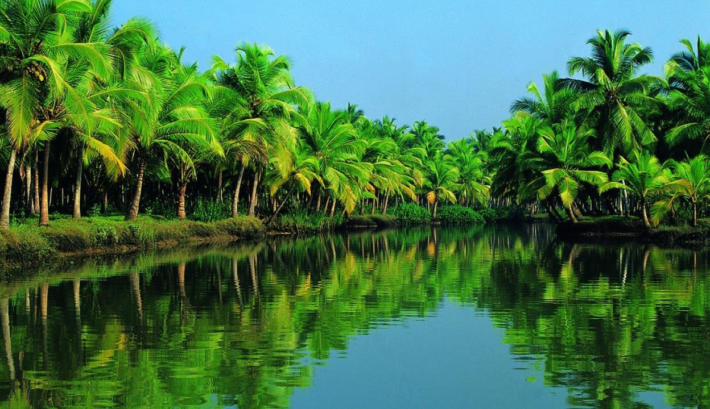
Aallah Hafez
Ending slide.

