Slide 1
Good morning my dear students.

Slide 2


Teachers information
Mazada Akter
Lecturer (English)
Barabor alim Madrasha
Class IX-X
Subject : English 1st paper

Slide 3
Lesson plan
Class : Nine \ Ten
Subject : English 1st Paper
Section : Unit 05, lesson 02
Time : 50 minutes.

Slide 4

So our Today’s Lesson
is
ENVIRONMENTAL POLLUTION

Slide 5

FROM THIS LESSON WE WILL BE ABLE TO ---
Learn new vocabulary
Causes of Environmental Pollution
Kinds of Environmental Pollution
Rules of using Modal Auxiliary Verbs.

Slide 6
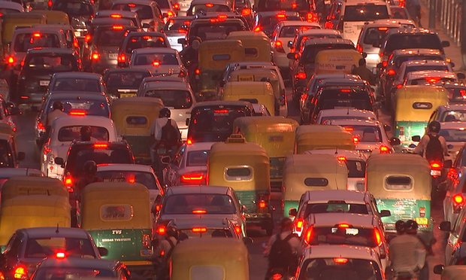
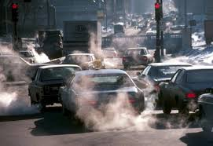
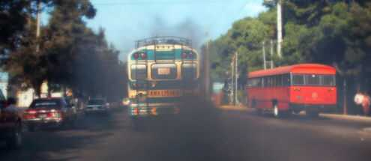
Sound is polluted by vichles’s horn
Air is polluted by smoke from vichles.

Slide 7

Pair Work
How water is polluted?
Water is polluted ………..
By throwing industrial waste materials in the ponds, canals, river etc.
By throwing chemical in the field.
If we bath our animals into the pond, canals, river etc

Slide 8
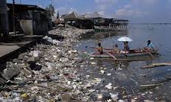
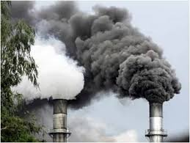
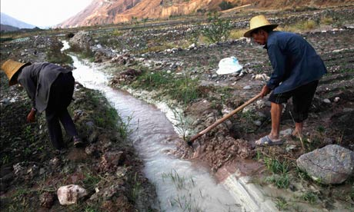
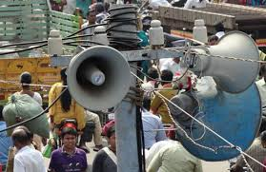
Kinds of Environmental Pollution
Water Pollution
Air Pollution
Soil Pollution
Sound Pollution

Slide 9
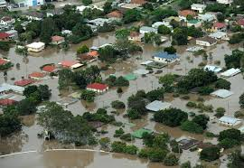
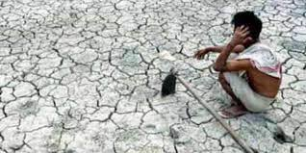
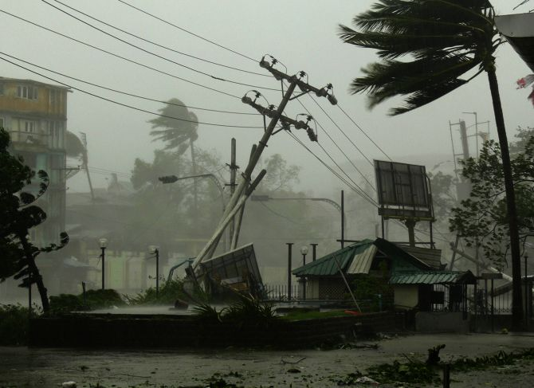
Flood
Draught
Cyclone

Slide 10
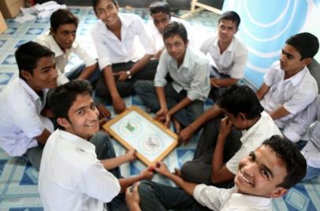
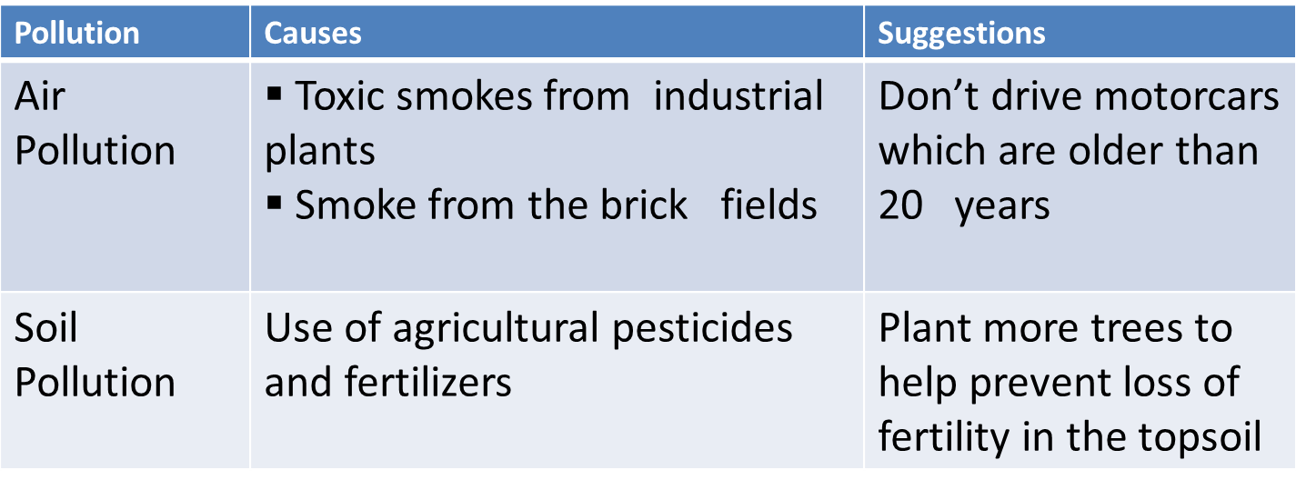
Group Work

Slide 11
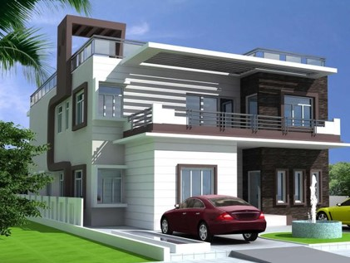
Home Work
Write five sentences about the subject
Polluting the land
means
polluting the water

Slide 12
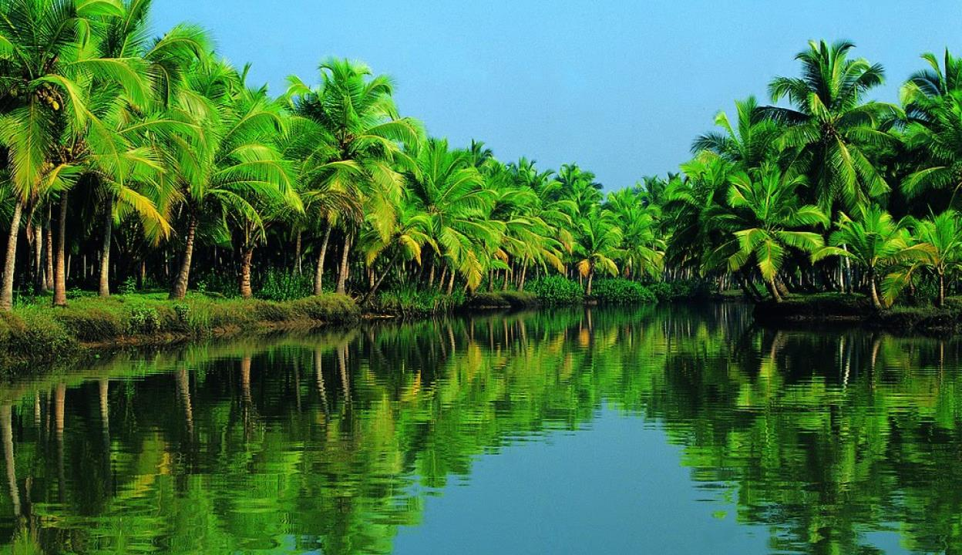
Thanks

