Slide 1
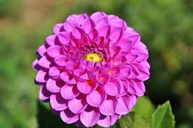
Good morning
Welcome to my English for today class

Slide 2
IDENTITY
Mazada akther
Lecture in English
Barabor Alim Madrasha
Phone:01798003534
mazadasalim@gmail.com
class:xi

Slide 3
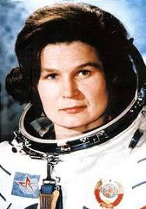
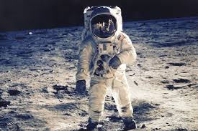
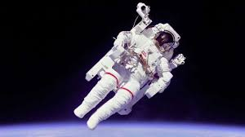
Lets see some picture and try to guess
Astronauts

Slide 4
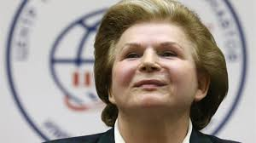
Our todays lesson is
Valentina tereshkova
Lesson 3 page 50

Slide 5
Learning outcome's
At the end of the class the students will be able to
Tell the meanings of some word
Tell about the early space mission
Tell about valentine Tereshkova

Slide 6
Read the text silently
Time 5 minutes
Valentina Tereshkova (born on 6 March 1937)
Valentina Tereshkova was born in the village Maslennikovo, Tutayevsky District, in Central Russia. TereshkovaÕs father was a tractor driver and her mother worked in a textile plant. Tereshkova began school in1945 at the age of eight, but left school in 1953 and continued her education through distance learning. She became interested in parachuting from a young age, and trained in skydiving at the local Aero club, making her first jump at age 22 on 21 May 1959. At that time she was employed as a textile worker in a local factory. It was her expertise in skydiving that led to her selection as a cosmonaut.
After the flight of Yuri Gagarin (the first human being to travel to outer space in 1961), the Soviet Union decided to send a woman in space. On 16 February 1962, ÔÔproletariaÕÕ Valentina Tereshkova was selected for this project from among more than four hundred applicants. Tereshkova had to undergo a series of training that included weightless flights, isolation tests, centrifuge tests, rocket theory, spacecraft engineering, 120 parachute jumps and pilot training in MiG-15UTI jet fighters.

Slide 7
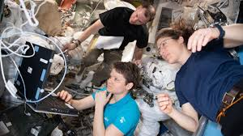
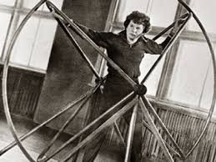
astronaut
A person who is trained to travel in spacecraft
weightless
Feeling light in the space

Slide 8
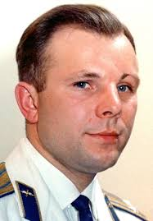
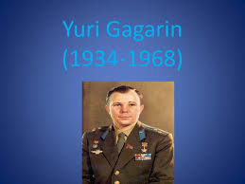
Do you know the person ?
The first human being to travel to outer space in 1961

Slide 9
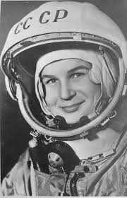
Let us know about valentina Tereshkova
Valentina became interested in parachuting from a young age, and trained in skydiving at the local Aero club, making her first jump at age 22 on 21 May 1959. It was her expertise in skydiving that led to her selection as a cosmonaut.
Valentina Tereshkova was born in the village Maslennikovo, Tutayevsky District, in central Russia.

Slide 10
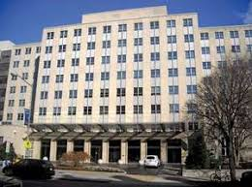
Valentine Tereshkova's Education
V .T began school in 1945 at though of eight ,but left school in 1953 and contained her education though distance learning

Slide 11
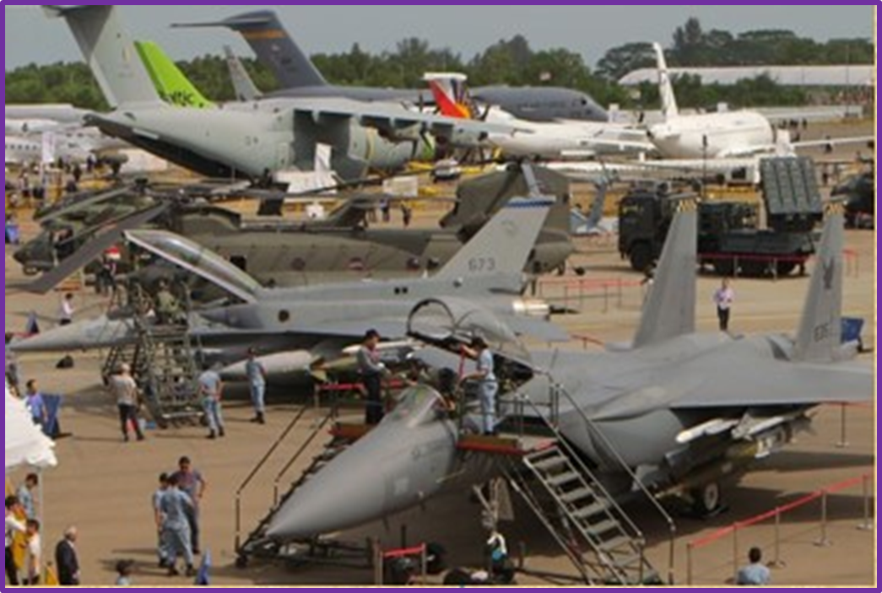
Valentina became interested in parachuting from a young age, and trained in skydiving at the local Aero club, making her first jump at age 22 on 21 May 1959. It was her expertise in skydiving that led to her selection as a cosmonaut.

Slide 12
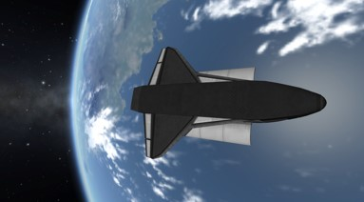
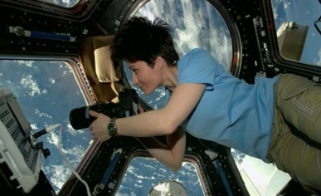
Tereshkova orbited more flight time than the combined times of all American astronauts who had flown before that date and maintained a flight log and took photographs of the horizon which were later used to identify aerosol layers within the atmosphere.

Slide 13
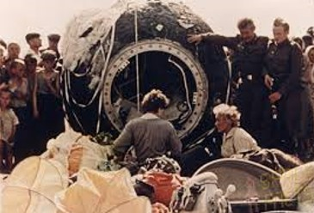
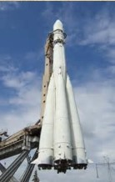
Since the successful of the spacecraft vestok -5 on june 1963 Tereshkova began to preparing for her own fight .After finishing all preparations she was sealed inside vestok -6 and launched

Slide 14
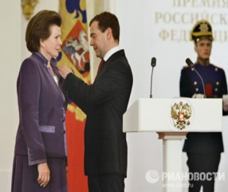
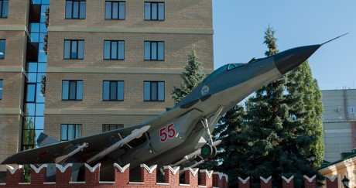
In 1977 Tereshkova earned a doctorate in Engineering from Zhukov sky Air Force Academy, Russia.

Slide 15
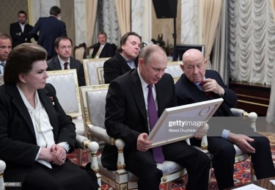
Valentina Tereshkova
Afterwards Tereshkova turned to politics. During the Soviet regime she became one of the presidium members of the Supreme Soviet. Now this living legend is a member in the lower house of the Russian legislature.

Slide 16
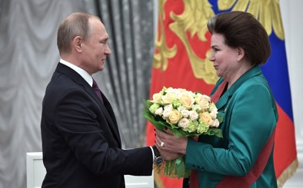
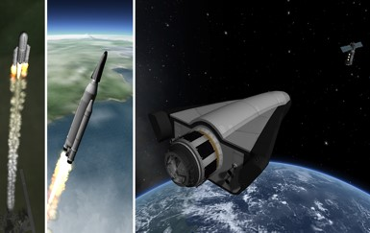
On her 70th birthday when she was invited by the Russian Prime Minister Vladimir Putin, she expressed her desire to fly to Mars, even if for a one-way-trip.

Slide 17
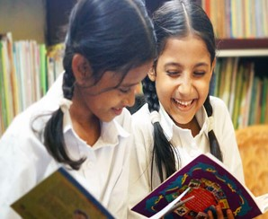
Pair work
Make a flow chart finding out the historical importance of the mentioned years in the text. First one has been done
6 March, 1937, birth of Valentine Tereshkova
1
2
3

Slide 18
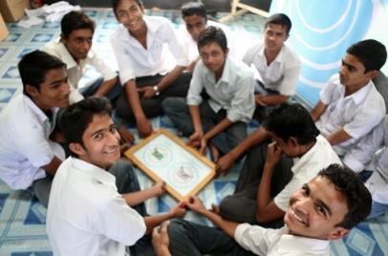
Group Work
Group: One
Where was Valentine Tereshkova born ?
Group: Two
What was the educational qualification of Tereshkova?
Group: Three
Who was the first human being to travel to outer space?

Slide 19
Evaluation
Who was the first human being to travel to outer space?
1. When did Tereshkova begin school
2. When did Tereshkova make her first jump
3. What did she express on her 70th birthday

Slide 20
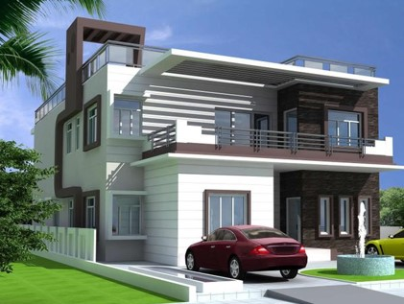
Home Work
Write a summery on the passage “Valentina Tereshkova”

Slide 21
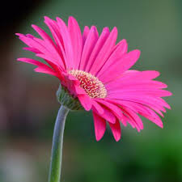
Thanks

