Slide 1
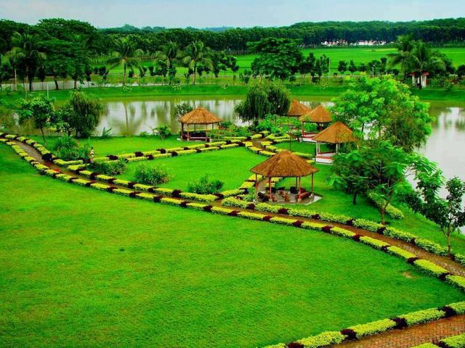
Welcome

Slide 2

INTRODUCTION
‡gvt gqbvj †nv‡mb
mnKvix wkÿK(AvBwmwU)
BwjqUMÄ iv. we. D”P we`¨vjq|
`vD`Kvw›`, Kzwgjøv|
CLASS: SIX
SUBJECT: ENGLISH SECOND PAPER
UNIT: ONE
LESSON: THIRTEEN
TOPIC: PRESENT CONTINUOS TENSE

Slide 3
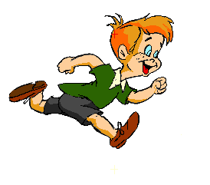

What is the boy doing?
The boy is running.
What is the bird doing?
The bird is flying.

Slide 4
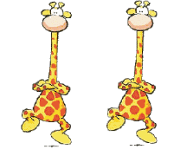
What are the giraffes doing?
The giraffes are dancing.

Slide 5

Today’s Topic
Present Continuous Tense
The present continuous tense is used for something happening now. The action is not finished.

Slide 6
LEARNING OUTCOMES OF THE LESSON
By the end of the lesson the students will be able to
give questions’ answer using present continuous tense.
identify present continuous tense.
make sentences with present continuous tense .

Slide 7
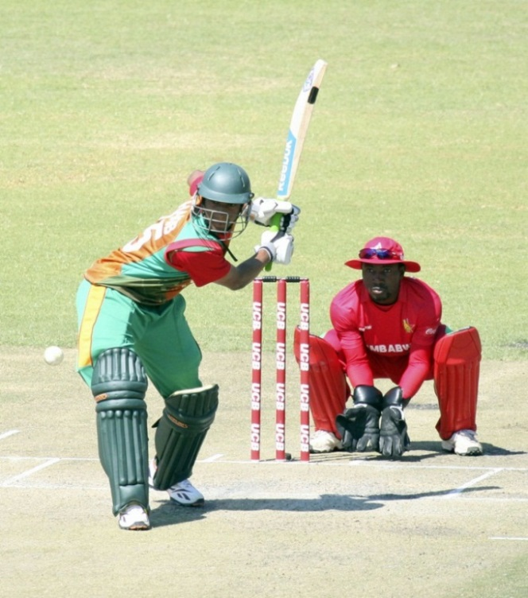
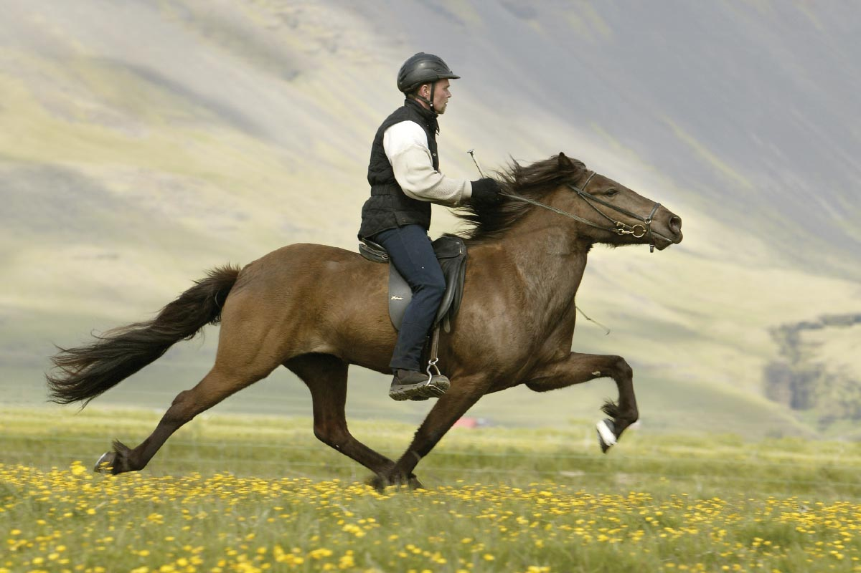
Answer the questions and notice the red colored words
What are they doing?
They are playing cricket.
Is the man riding a bicycle?
No, the man is not riding a bicycle?
What is the man doing?
The man is riding a horse.

Slide 8
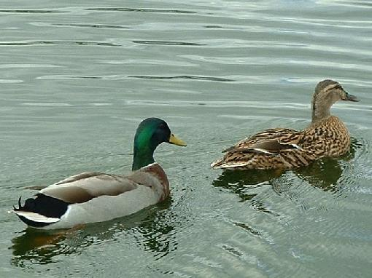
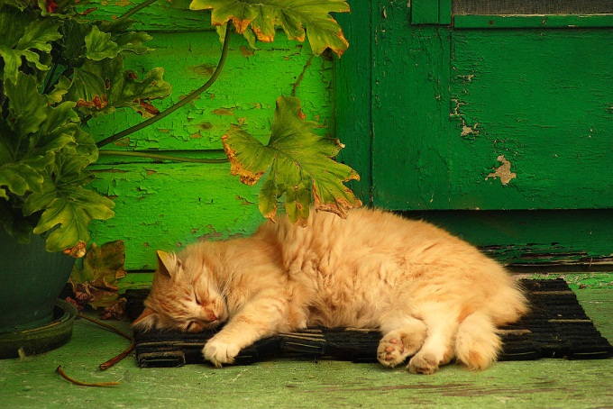
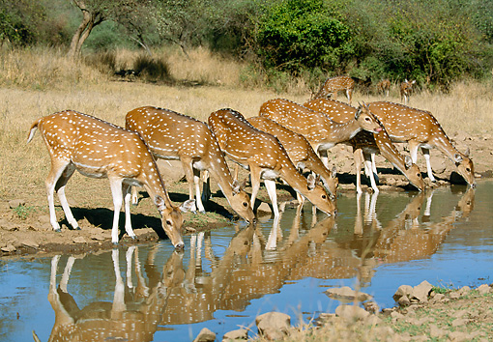
What are two ducks doing in the water?
Two ducks are swimming in the water.
What is the cat doing?
The cat is sleeping .
What are deer doing?
Deer are drinking water.

Slide 9
Structure Of present Continuous Tense
Affirm-ative | Subject | am/is/are | verb | ing | Others
I am doing my homework.
Negati-ve | Subject | am not/is not/are not | verb | ing | others
I am not doing my homework.
Interro-gative | Am/Is/Are | Subject | verb | ing | Others + ?
Am I doing my homework?

Slide 10
Where are these used?
am
I
is
He, She, 3rd person singular number, It, That
We, You, They, 3rd person plural number
are

Slide 11
Make sentences from the jumble words. (pair works)
are
I
taking my bath.
am
Mangoes
looking green.

Slide 12

Read all the sentences first and find out which sentences are present continuous tense say tick for them if not say cross for them. (Pair work)
1. They go to school everyday.
x
2. Shila is making a cup of tea.
_/
3. Arpon played badminton yesterday.
x
4. It is not raining now.
_/

Slide 13
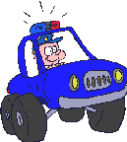


Look at the pictures and write what they are doing in each picture. Write them in 3 structures of present continuous tense(affirmative, negative and interrogative) for each picture. (Pair work)
1
2
3

Slide 14
Answer
A police is driving a car.
A police is not driving a car.
Is a police driving a car?
A man is digging soil.
A man is not digging soil.
Is a man digging soil?
The chickens are eating.
The chickens are not eating.
Are the chickens eating?

Slide 15

Homework
At your home look around and write what the people are doing. Write 10 sentences with present continuous tense.

Slide 16

THANK YOU ALL

