Slide 1
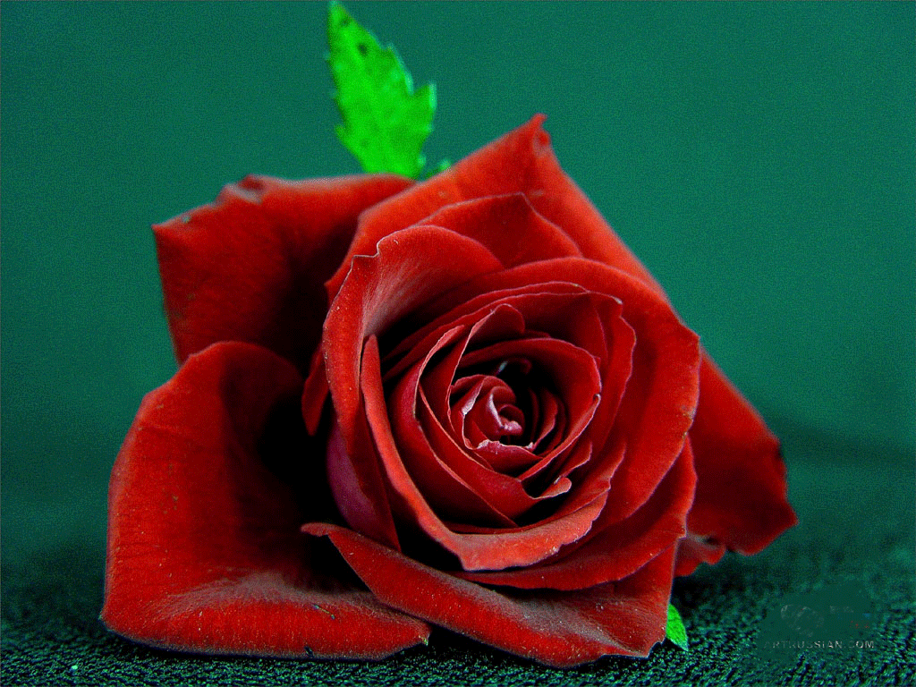
W E L C O M E TO ENGLISH CLASS

Slide 2
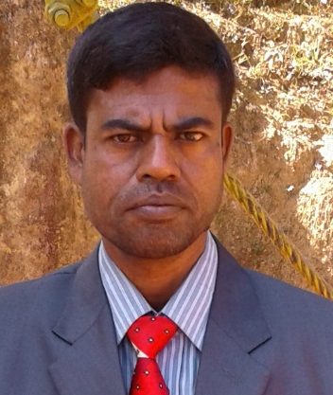
TEACHER’S IDENTITY
MD. ABDUR RAZZAK
ASSISTANT TEACHER (ENGLISH)
SATRUJITPUR NURUL ISLAM DAKHIL MADRASAH
CONTACT NUMBER : 01721588402
e-mail :abdurrazzakmtrt@gmail.com

Slide 3
PRONOUN part-1 class 8
Time: 45 minutes
Learning outcomes
By the end of the lesion the Ss will able to
# say what pronoun is.
# define four kinds of pronouns.
# use pronouns in their real life.

Slide 4
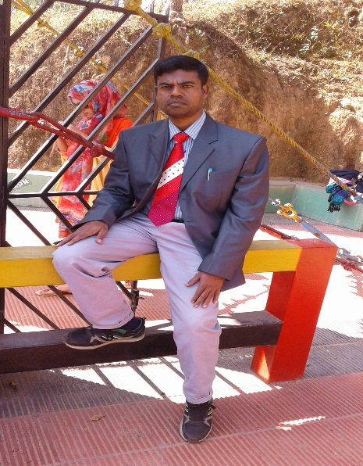
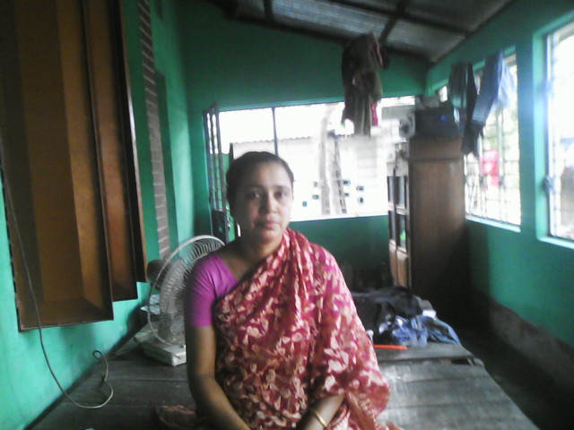
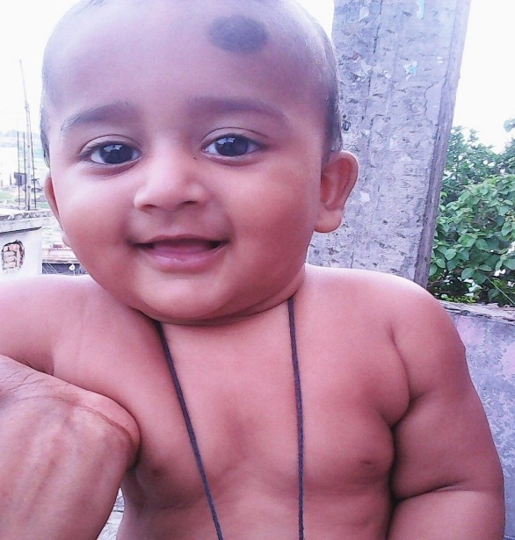
Man
He
Woman
She
Baby
It
They
Pronoun

Slide 5
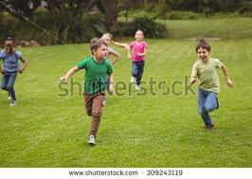
they
Personal pronoun
Personal pronoun
Rita/she
Ria/she
John/he
Suman/he
nominative
I,we,
He,she,they,Karim,one,it.
objective
Me,us
Him,her,them,Karim,one,it.
possessive
My,mine,our,ours.
His,her,their,Karim’s ones,its.
You,thee
You,thou
Your,yours,thy,thine.

Slide 6

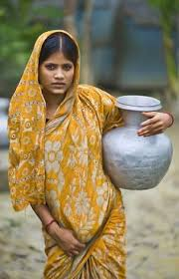
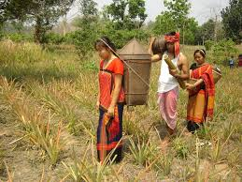
THEN; himself, herself and Themselves are:
Reflexive pronoun
This is Mr. Jaman. He himself is a teacher.
herself
Shima is his wife. She ………….is carrying water.
Themselves
They are chakma. They …………… do their all activities.
Similarly myself, yourself, ourselves, oneself, itself etc. are the example of reflexive pronoun.

Slide 7
Work individually
Fill in the gaps with personal/reflexive pronoun.
…….am a teacher.
………….students like me very much.
…………..do everything as I direct …………… .
They help ……….in my classroom activities.
so I feel proud of ………… activities.
They ………………..do their work attentively.
I ………….monitor them cordially.
I
MY
They
Them
me
their
themselves
myself

Slide 8
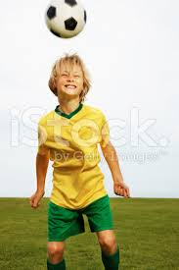

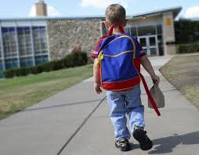

that
where
which
The boy who is playing is a student of class six.
The island…….. looks beautiful is Andamans.
The school ………
the boy reads in is famous.
The book …………..
Mom gave me
Was a dictionary.
Relative pronoun
Similarly what, how, when, whose, whom etc. are the example of relative pronoun.

Slide 9
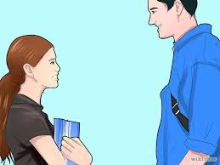
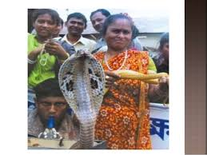

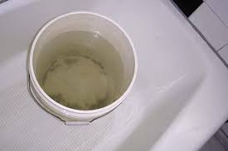
Who are that person ?
which book do you want?
What is your name?
How much water in the bucket?
Interrogative pronoun
Similarly ,where, whom, whose, when etc. are the example of Interrogative pronoun.

Slide 10
Work in pair.
Insert pronoun in the blank.
The pen ……….. I lost was black.
The man ………came is my brother.
The place ………..I live is lovely.
The time …………he will come is uncertain.
…………is this woman.?
……….pen do you want?
………..are you going?
………...are you doing?
Which/that
who
where
when
Who
Which
Where
What

Slide 11
HOME WORK
# Rewrite the following paragraphs using appropriate pronouns.
James and Mary were siblings. One day James and Mary returned from school. James and Mary were very hungry and went straight into the kitchen. James and Mary wanted to eat something. In the kitchen James and Mary saw a cat. The cat was drinking the milk mother had kept for James and Mary. James ran out screaming. James was scared. James was always afraid of cats. Mary was a brave girl. Mary was not afraid of anything. Mary shooed the cat away. The cat ran out. James saw the cat running away. James came back into the kitchen. James praised Mary for Mary’s courage. Mary thanked James.

Slide 12

THANKS ALL

