Slide 1
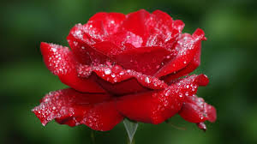
Welcome to English class

Slide 2
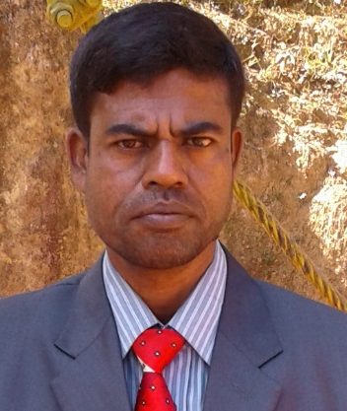
TEACHER’S IDENTITY
MD. ABDUR RAZZAK
ASSISTANT TEACHER (ENGLISH)
SATRUJITPUR NURUL ISLAM DAKHIL MADRASAH
CONTACT NUMBER : 01721588402
e-mail :abdurrazzakmtrt@gmail.com

Slide 3
Article for class 8
Time: 45 minutes
Learning outcomes
By the end of the lesion the Ss will able to
# say what article is.
# define How many kinds of articles are there.
# use articles differently.

Slide 4


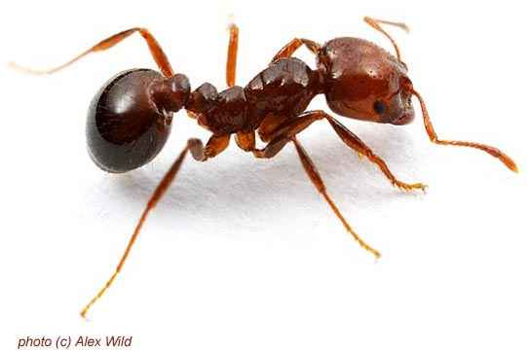
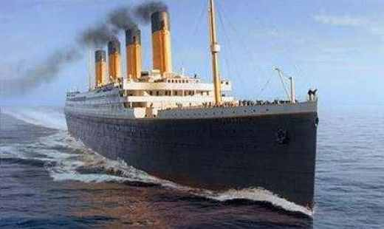
a
The man reads ………..book. what>?
An
………ant is ……..insect. What?
an
The
the
………Titanic is ……..largest ship. What?
SO what do we mean by a, an and the ?
They are Article

Slide 5
OUR TODAY’S LESSON IS
ARTICLE

Slide 6
article
A, an and the is called………………… . what?
Kinds of article
Indefinite article
definite article
Indefinite article
A, and an is called ……………….. .What?
definite article
The is called ……………………. . what?

Slide 7
Use of indefinite article a and an
consonant based word (word begins with consonant)
vowel based word (word begins with vowel)
an
Egg
Ant
Umbrella
Ink pot
Orange
elephant
a
Boy
Girl
Book
Pen
Bag
box
an
a
an
a
an
a
an
a
an
a

Slide 8
An - before vowel sound word
A - before consonant sound word
An
An
An
Honest man
Hour
Honourable person
A
A
A
Hotel
Hospital
Home sick

Slide 9
A before “U” sound word (not an)
For example:
But an before vowel sound word
A
A
A
A
A
Europian lady
Ewe
Unique game
Unit
Union
For example
An
An
An
Untidy girl
Ugly bird
Unsafe tube-well

Slide 10
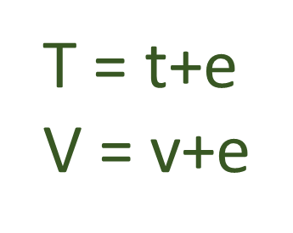
An – before vowel sound letter
A - before consonant sound letter
A
A
A
A
A
A
A
A
B = b+e
C = c+e
D = d+e
G = g+e
J = j+a
K =k+a
P = p+e
Q = q+u
An
An
An
An
An
An
An
An
F = a+f
H = a+h
L =a+l
M =a+m
N =a+n
R = a+r
S = a+s
X = a+x
A
A

Slide 11
For example:
A
A
A
A
A
A
B. A
C. A
T. O
T. P. O
G. M
D. C
An
An
An
An
An
M. A.
F. R. C. S
S. D. O
L. L. B
H. M

Slide 12
A BEFORE “ONE”
For example:
A
A
A
ONE TAKA NOTE
ONE EYED MAN
ONE LEGGED CHAIR

Slide 13
Use of definite article “The”
Rule-1
The before particular person or object.
For example:
The boy is playing. (a particular boy not any boy)
The chair looks nice.(a particular chair not any chair)
The man is my brother.(a particular man not any man)
The pen writes well. (a particular pen not any pen)

Slide 14
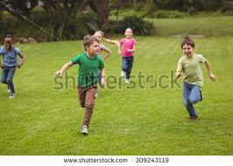

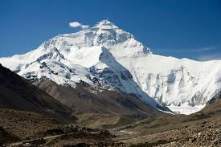
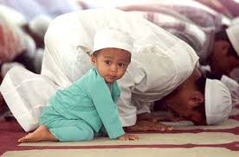
Rule-2: The before plural number not A or An
For example:
The boys are plying.
The Andamans island is in India.
Nepal is called the Himalayas’ daughter.
The Muslims are praying

Slide 15




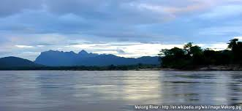

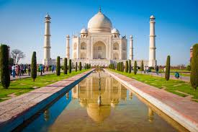
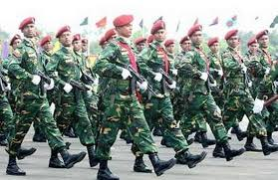

Rule-3 : The before only one thing in the world.
For example:
The Gita
The earth
The Agnibina
The moon
The Jamuna
The Tajmahal
The Everest
The Quran
The army

Slide 16
Similarly:
The Bay of Bengle
The north
The south
The west
The east
The pacific
The noorjahan road
The Shat Gombuj mosjid
The national park

Slide 17
Rule- 4: The before superlative degree
The best boy
The cleverest girl
The most beautiful sight
The happiest man
The largest station

Slide 18

an
) Mr. Gani is ---honest man.
b) He is --- Headmaster of the school.
c) You are -- -happy man.
d) ---- the tigers of Sundarban are healthy.
e) I saw ---one eyed man in the street.
the
a
The
a

Slide 19
HOME WORK
# Fill in each gap with suitable article.
Rajshahi is (a)____ old city. It stands on (b)_____ Padma. In (c)_____ village called Bausa in Rajshahi there is (d)_____ man who is recognized as (e)_____ book lover. He is Polan Sarker. Polan Sarker is (f)_______ old man. He buys books with (g)______his own money. He lends villagers books. (h)______ villagers become delighted with books they borrow from Sarker. They have found that reading is a good habit.

Slide 20

Thanks

