Slide 1
Welcome
WELCOME

Slide 2
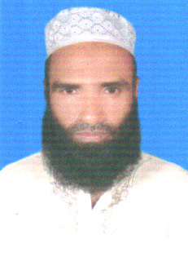
Md Abdul Malek
Assistant Teacher(Computer)
Sukhari Bazar Islamia Dakhil Madrasah.
Atpara, Netrakona.
01719719806
E-mail:mdmalek163@gmail.com

Slide 3
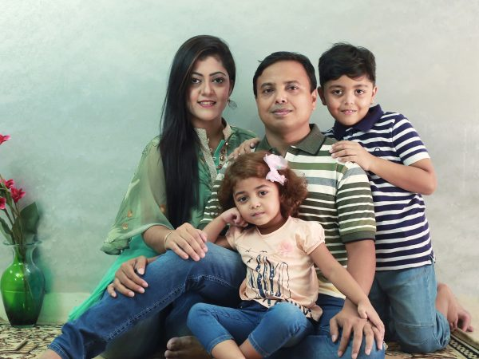

Slide 4
Class:Five
Unit:3
Lesson:1-2
Todays lesson
:Saikats family

Slide 5
Learning outcomes: --------------------------
By the end of the lesson the students will be able to- Listening:4.2.1Understand and enjoy simple stories. Speaking:3.1.1ask and answer Wh questions Reading:1.5.1read words phases and sentences in the text with proper prounciation, stress and intonation Writing:10.2.1write short and simple composition on familiar objects such as people place and events

Slide 6
Saikats family

Slide 7
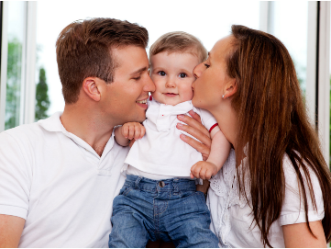
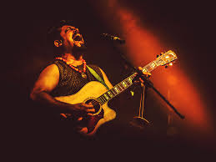
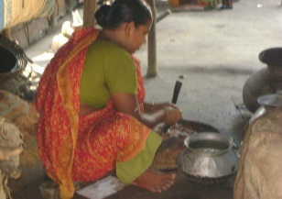
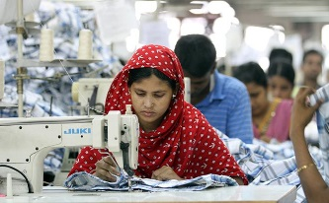
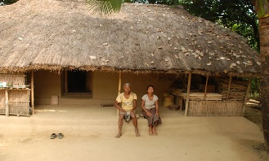
New words
parents
parents
music
music
housewife
housewife
sewing
sewing
neighbours
neighbours

Slide 8
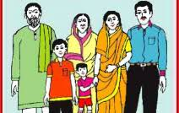
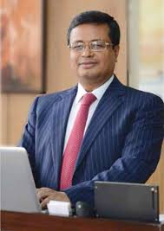
Saikat lives with his parents in a flat in Bogra.
His father Mr.Rashidul Islam is a banker.

Slide 9
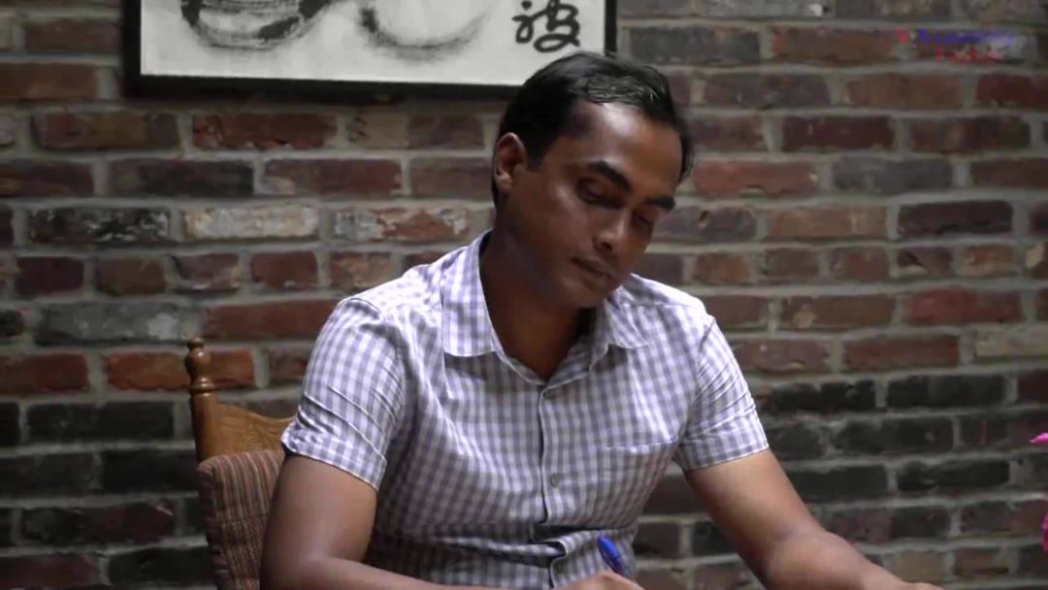
But in his free time Mr. Islam writes stories and listens music.
Sakat’s mother is Mrs. Monwara Islam.She is a housewife.In her free time she enjoys sewing.She makes dresses.She often gets orders from her friends and neighbours.

Slide 10
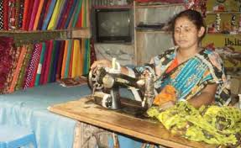
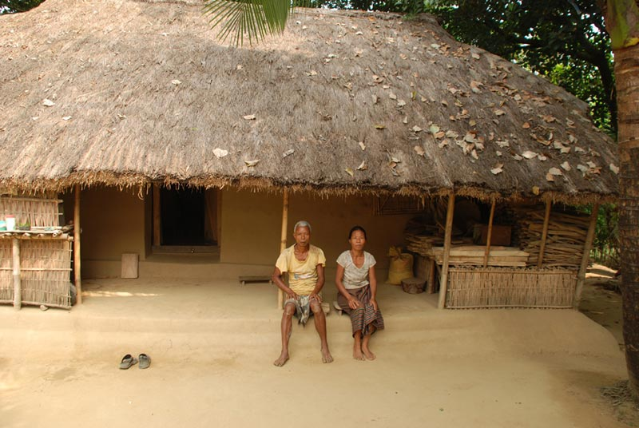
Banker
In his free time she enjoy sewing.
She often gets orders from her friends and neighbours.

Slide 11
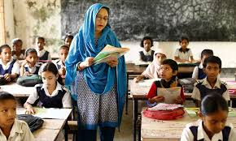
Teacher’s Model Reading

Slide 12
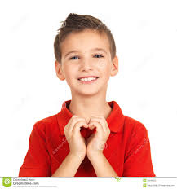
Group work: ---------------- picture of boy Group name :Saikat

Slide 13
Groupk work
Rearrange
Group-A
Group-B
renptsa
oragb
Ans:parents
Ans:Bogra
simuc
eref
Ans:music
Ans:free

Slide 14
Individual work --------------------- open your book page-10 and silent read the text book

Slide 15
Evaluation: -------------- Answer the following question: 1.What is your Saikats father name? 2.Who lives in a flat in Bogra ? 3.What does Saikat do in his free time ? Fill in the blanks : 1.she is a ----------- 2.He is a -----……………….student. 3.-----…………………….makes dresses.
housewife
good
She

Slide 16
write five sentences about your own family
Home work

Slide 17
Thanks to all

