Slide 1



Slide 2
MD. KOWSER ALI
ASISSTANT TEACHER
DURLOVPUR GOVT. PRIMARY SCHOOL
HORINAKUNDU, JHENIDAH.
kowser.gps@gmail.com
Sub: English
Class: Two
Lesson : Where is it?
Parts of the lesson: (Activity-A)
Page No-47

Slide 3

Safety environment by greetings song.
Hello! Hello! How are you?
I’m well, I’m good.
I’m great, I’m wonderful.
Hello! Hello! How are you?
I’m fine! I’m great today.

Slide 4
Checking homework and justify the previous lesson.

Slide 5
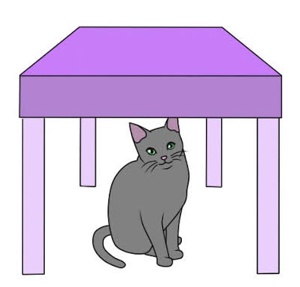
Where is the cat?
Now try to say-
What can be the topic of our today’s lesson?

Slide 6

Our today’s lesson is--
Activity-A

Slide 7
LEARNING OUTCOMES
By end of the lesson students will be able to-------
Listening: 1.1.1 become familiar with English sounds by listening to common
English words.
Speaking: 1.1.1 repeat after the teacher simple words and phrases with proper
sounds and stress.
1.1.2 say simple words and phrases with proper sounds and stress.
Reading: 1.4.1 read words and phrases with the help visual clues and simple
sentences. (about 30 new words)

Slide 8
Look, listen and say.
Where is the pen? (Teacher will show up in reality)

Slide 9
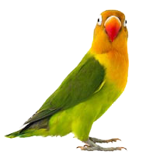
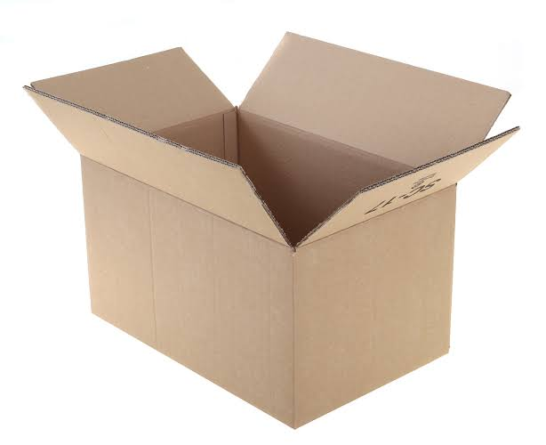
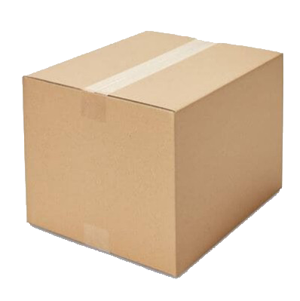
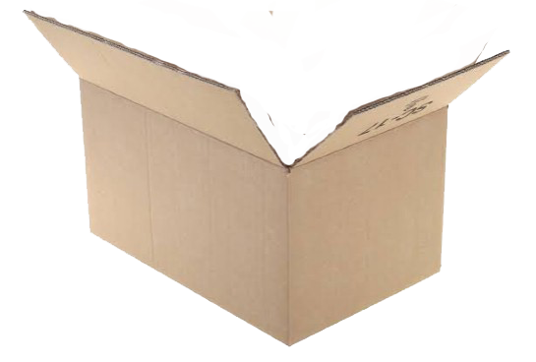
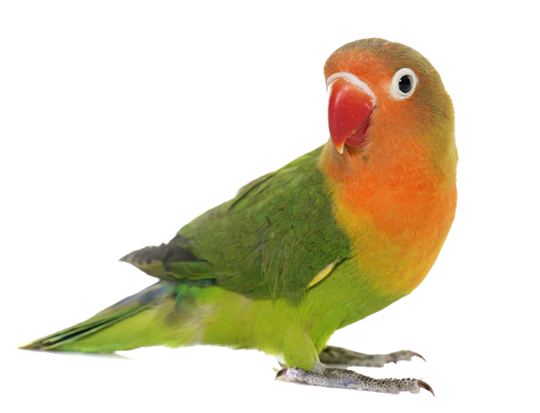
Look, listen and say.
Where is the bird?

Slide 10
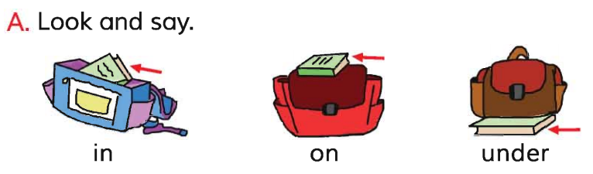
Open your English book at page-47 and see the Activity-A.
Where is the--------?
Repeat after me.
Reading- SGW

Slide 11
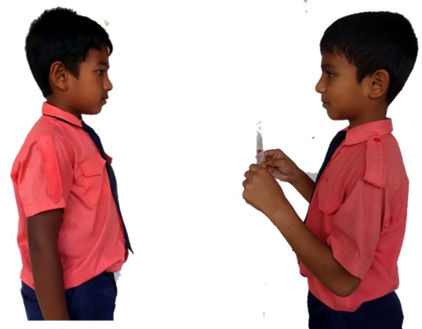
Pair work.
Where is the --------?/Show up in reality.
One more.

Slide 12
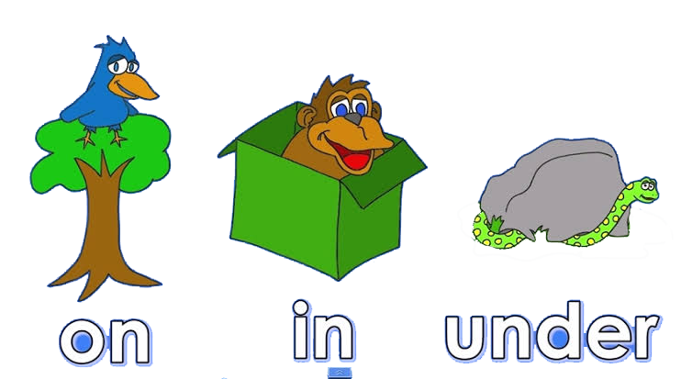
Look and say.
in
on
under
See again.

Slide 13
Read and say.
in
under
on
under
on
in
in
under
on
Identifying weak students and taking to cure.

Slide 14
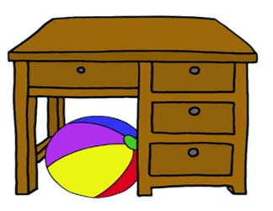
One day one word
Where is the ball?
under
নিচে
Spell out the word - SGW

Slide 15
Find out the letters that are made by the word--------.
u
h
n
d
c
z
e
k
r
n
Find out the correct word-------.
undar
under
ander
ender

Slide 16
Say the missing letter.
unde-
und-r
un-er
u-der
Write the word to your notebook.
তারিখঃ ০০/০০/০০
under
আন্ডার
নিচে

Slide 17
Homework
Page 37 will be well read and written.

Slide 18

That’s all for today. Goodbye. See you tomorrow.

