Slide 1
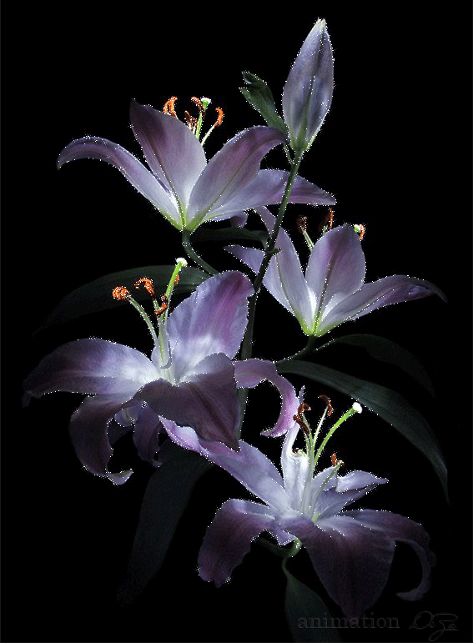
Welcome to our Today’s Class

Slide 2
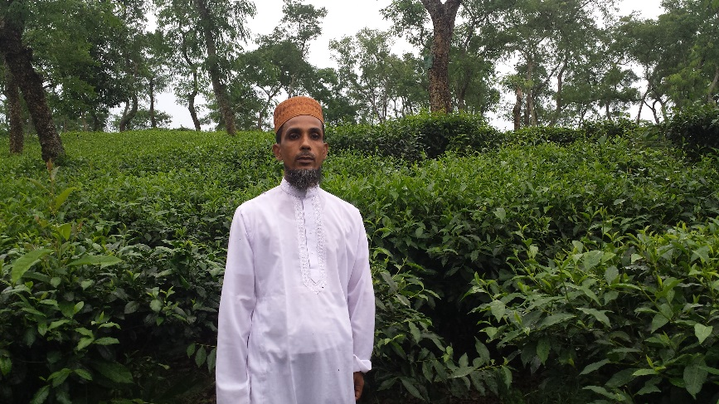
Introduction
Mohammod Helal Uddin
Assistant Teacher (English)
Wahid Siddek High School,
Gurarai,Sadar,Mulvibazar.
E-mail; helal.bd.mb@gmail.com
Mobile; 01720630018
Class- Nine & Ten
Unit : seven
Lesson : 06

Slide 3
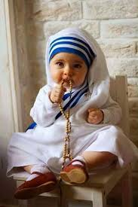
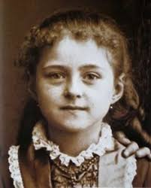
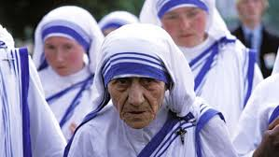
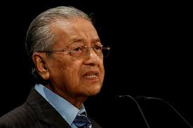
Look at the pictures then say about them
Child
Child
Young
Baby
Young
Baby
Old
Muhatir Mohammod
Nenson Mendela

Slide 4
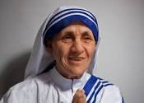
Announcing the Class
Today Our Class is……..
Love for humanity (Mother Teresa)

Slide 5
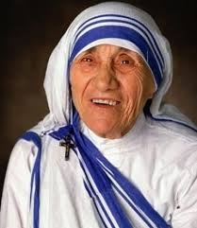
Some information of Mother Teresa
Traveled to Calcutta in
1931
Born in
1910
Achieved noble in
1979
Died in
1997

Slide 6
Learning Out comes
End of the lesson, the students will be able to……
Read and understand texts through silent reading
Ask and answer questions
Write a dialogue about Mother Teresa

Slide 7
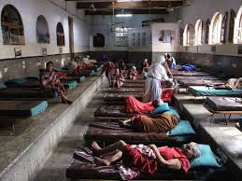
Group Work
Look at the pictures then answer the questions
What does Nirmal Hriday stand for ?
02. Why do you think the home is named Nirmal Hriday?
03 .Why did Mother Teresa want the dying people to feel that they too deserve care and love ?

Slide 8
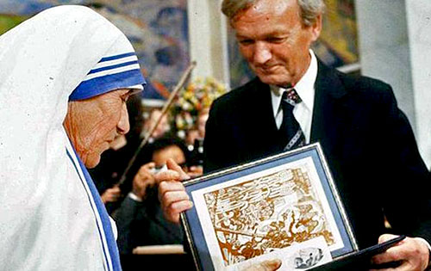
Achievement
Mother Teresa achieved Nehru Prize of Promotion of International Peace and Understanding in 1972.

Slide 9
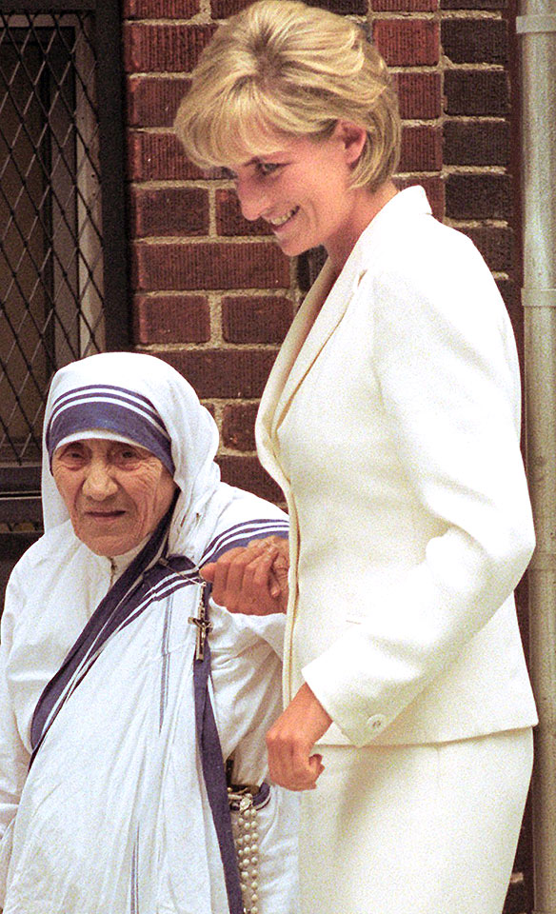
Do you know them?
Princess
Diana
Mother Teresa
Notes:
To advance to Mother Teresa.

Slide 10
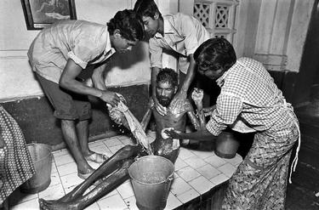
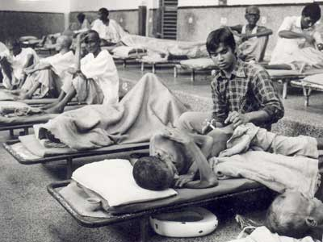
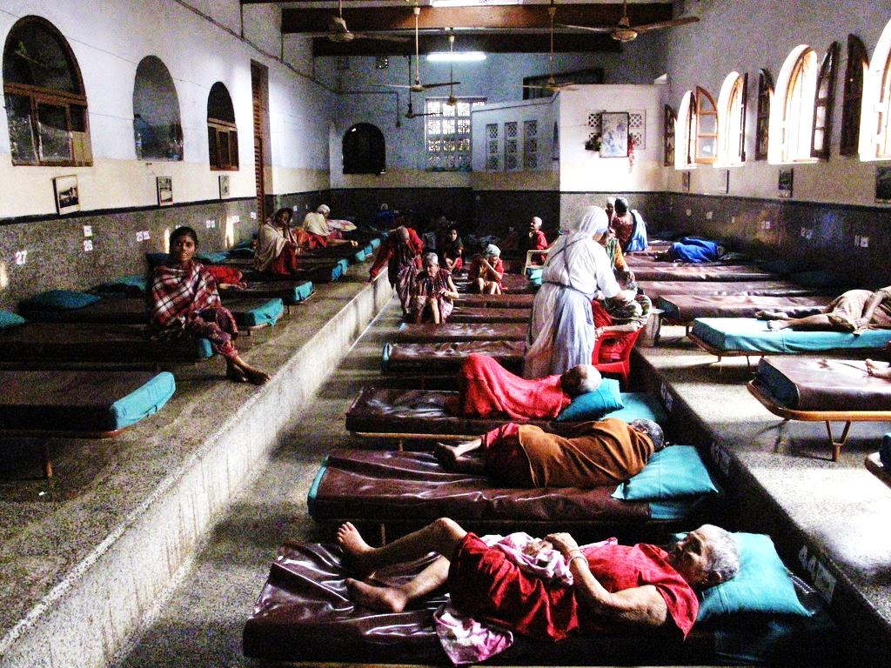
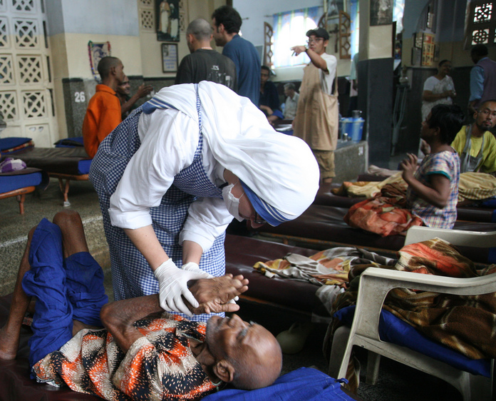
She and her fellow nuns gathered the dying people off the streets of Kolkata and brought them to this home. They were lovingly looked after and cared them.

Slide 11
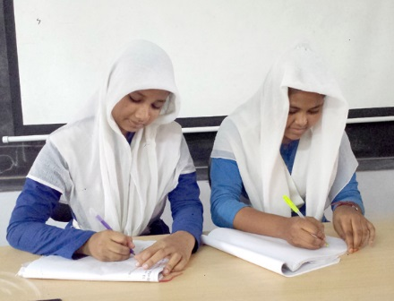
Pair Work
Read the passage then answer the following questions page no-103
What did Mother Teresa initially do before beginning to work for humanity ?
What did Mother Teresa and her group do ?

Slide 12
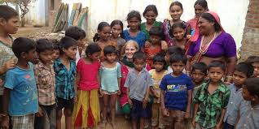
Evaluation
01. Who founded ‘ Nirmal Hriday’ ?
02.Where she opened a home for the orphans ?

Slide 13
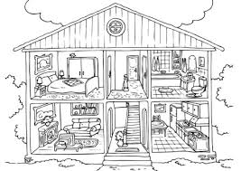
Home Work
Write a dialogue about Mother Teresa

Slide 14
Thank You

