Slide 1
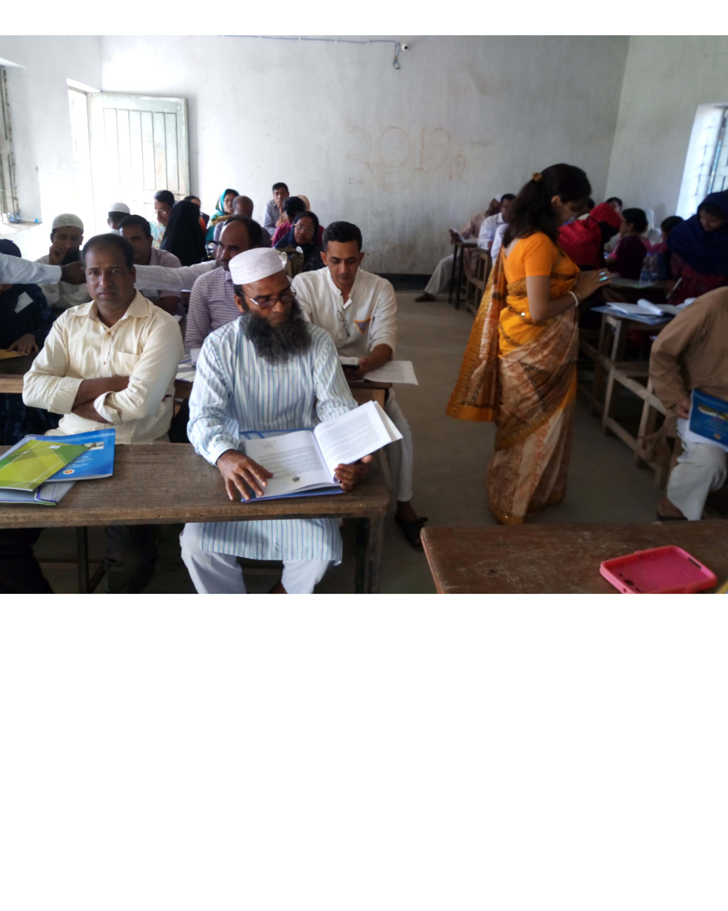
welcome

Slide 2
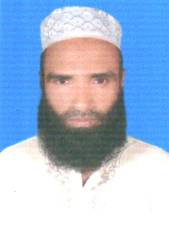
Md Abdul Malek
Assistant Teacher(Computer)
Sukhari Bazar Islamia Dakhil Madrasah.
Atpara, Netrakona.
01719719806
E-mail:mdmalek163@gmail.com

Slide 3
Subject: English For Today
Class : vi
Lesson : 21
Date : 17-05-19

Slide 4
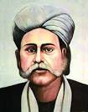
Look at the picture
Who is in the picture ?

Slide 5
Lesson
So, the lesson for today is : Hason Raja
(The mystic bard of Bangladesh)

Slide 6
Learning Outcomes:
#
After completing this lesson ss will be able to :
# increase vocabulary
# ask and answer questions.
# write summary.

Slide 7
Read the following sentences.
Hason Raja was a well-known mystic bard of Bangladesh.
He tried to search the through meditation.
He wrote many songs and poems to express his deep thought.
He is a mystic poet too.
Individual work
Famous=
Search=
Meditation=
Express=
Mystic=
MM

Slide 8
Individual Work
Write synonyms of the following words
Mystic=
Famous=
Search=
Express=
Meditation=

Slide 9
Solution
Mystic = a person who practices mysticism.
Famous = well-known.
Search = examine to find out something.
Express = denote.
Meditate = think deeply.

Slide 10
Read the text silently

Slide 11
Pair Work
(a ) Who was Hason Raja ?
(b)When was he born ?
(c) When was “Hason Udash” published ?

Slide 12
Solution
(a) Hason Raja was a mystic bard of Bangladesh.
(b) He was born in 1856.
(c) “Hason Udash was published in 1906.

Slide 13
Read the passage again carefully .

Slide 14
Group work
Write the summary of the passage.

Slide 15
Write a dialogue between you and your friend on “ A well-known mystic bard of Bangladesh”.

Slide 16
Thanks to all

