Slide 1
Welcome

Slide 2
Introduction
Teachers Info
Abul kucher
Assistant Teacher, ICT
Bishowanathpur Salameia
Hossaina Dhakil Madrasha
Class Info
Class : Eight
Subject: English 1st Paper
Unit: One
Lesson: ?
Time: 50 minutes

Slide 3
Let’s see a vedio
Http://youtube.com/watch?v=Uosm-cF1URM
Have you used this thing before?
What is it called?
Notes:
Elicitation

Slide 4
Lesson Title
Nakshi Kantha
Notes:
Title of the lesson: Nakshi Kantha

Slide 5
After this lesson, student will be able to :
be familiar with Nakshi Kantha.
improve our vocabulary .
Understand text by silent reading.
write a paragraph about Nakshi Kantha
Notes:
Title of the lesson: Nakshi Kantha

Slide 6
Read the passage silently

Slide 7
Silent Reading
Nakshi kantha is a kind of embroidered quilt. The name was taken from the Bengali word, ‘naksha’ which means artistic pattern. It is a kind of traditional craft and is said to be indigenous to Bangladesh and West Bengal in India. The art has been practiced in rural Bengal for centuries. The name ‘Nakshi kantha’ became popular after the poet Jasimuddin’s poem ‘Nakshi kanthar Math’was published in 1929.
Notes:
Title of the lesson: Nakshi Kantha

Slide 8
Silent Reading
Traditional kanthas are made for family use. Old or new cloth and thread are used to make these quilts. Mymensingh, Jamalpur, Rajshahi, Faridpur, Bogra and Jessore are most famous for this craft. Now it is produced commercially. You can find them in many expensive handicraft shops in cities. The quilts are now in great demand because of the colourful patterns and designs embroidered on them.
Notes:
Title of the lesson: Nakshi Kantha

Slide 9
Let’s see the key words of the passage

Slide 10
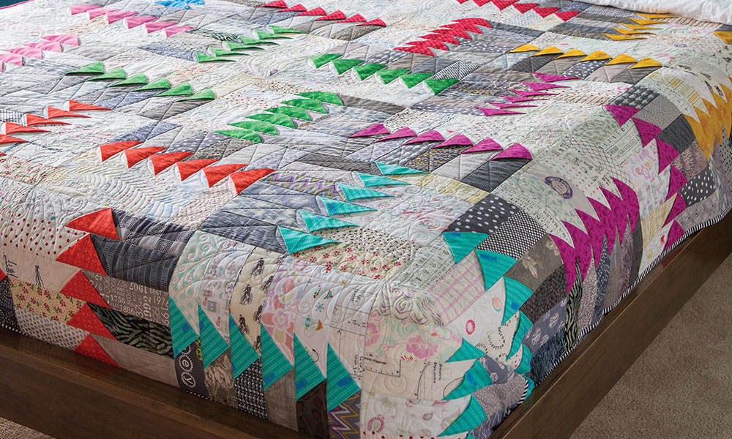
Key Words
Quit
a knitted or fabric bedspread with decorative stitching.
Notes:
Title of the lesson: Nakshi Kantha

Slide 11
Key Words
Artistic
having or revealing natural creative skill.
Notes:
Title of the lesson: Nakshi Kantha

Slide 12
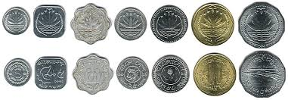
Key Words
Commercially
in a way that is concerned with buying, selling, and making a profit.
Notes:
Title of the lesson: Nakshi Kantha

Slide 13
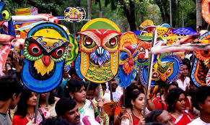
Key Words
Traditional
existing in or as part of a tradition; long-established.
Notes:
Title of the lesson: Nakshi Kantha

Slide 14
Individual Work
Complete the following sentences with the clues given.
Bengali
rural
quilt
Patterns
years
expensive
naksha
1 Naksha means artistic ----------------
2 The name was taken from a --------------- word ------------
3 The art has been practiced in -------------- Bengal for --------
4 Nakshi kanthas are now sold in ------------- shop.
5 Nakshi Kanthas are a kind of -------
Notes:
Title of the lesson: Nakshi Kantha

Slide 15
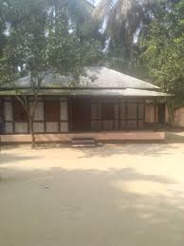
Home Work
Write a paragraph about
“How to make a Nakshi Kantha”.
Notes:
Title of the lesson: Nakshi Kantha

Slide 16
Thank you
Notes:
Title of the lesson: Nakshi Kantha

