Slide 1
Welcome

Slide 2
Introduction
Md. Senamul Islam
Assistant Teacher
Malson GPS
Adamdighi
Bogura
SUJEET:ENGLISH
CLASS: ONE
UNIT:23
LESSON: 1-3
PAGE:46
TOPIC: THE ROOM

Slide 3
Learing out come
1.1.1 Listening:To become farmiliar with English sounds by listening to common English words.
1.1.2 Speaking: To repeat after the teacher and say simple words phrascs and sing the Alphabet song

Slide 4
Look at the picture and think about it ?

Slide 5
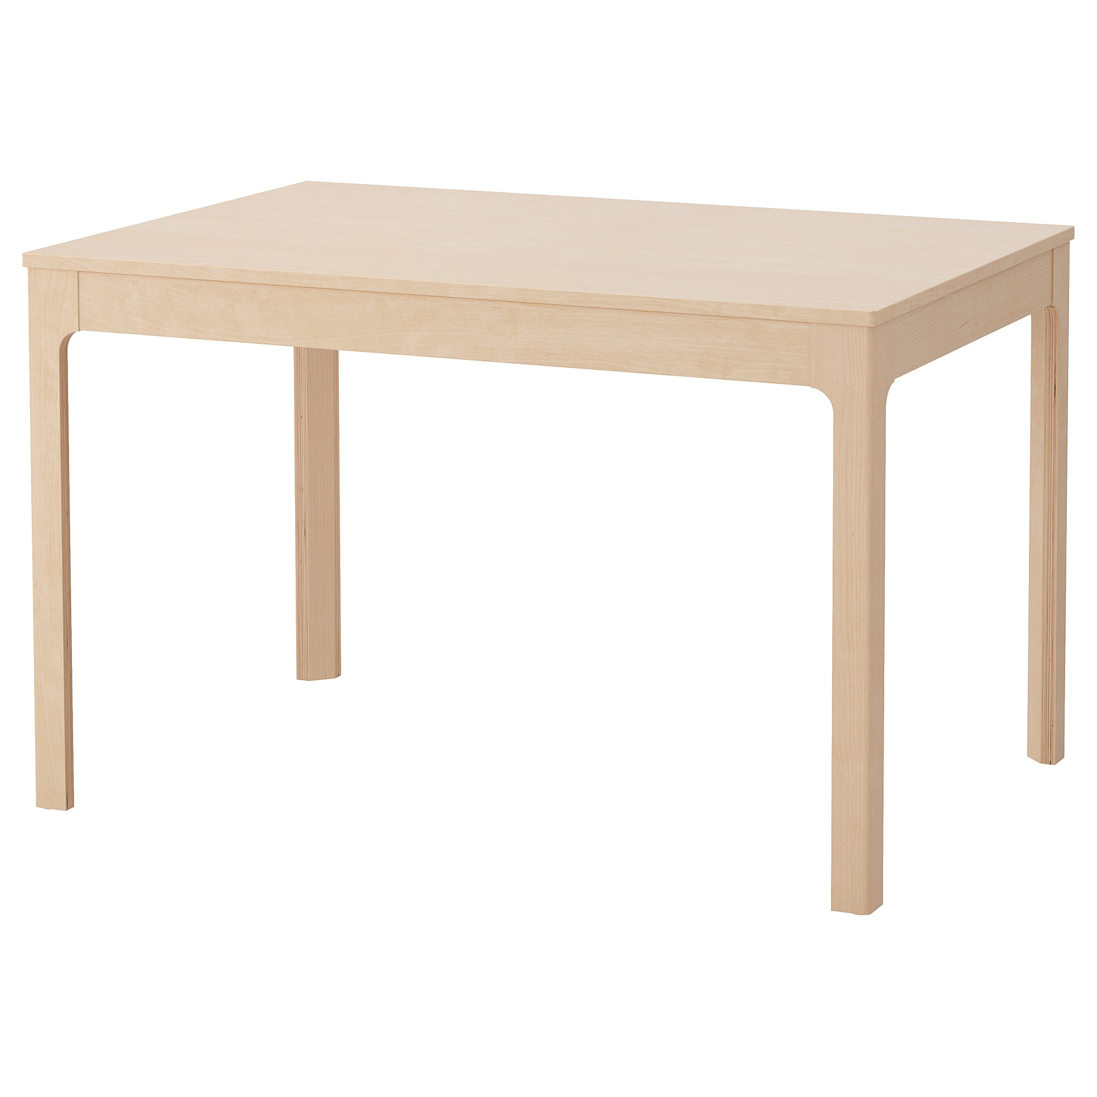
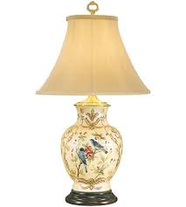
coat
cot
cap
Table
Lamp
Tv

Slide 6
Practice

Slide 7
What’s this?
cap
What’s this?
table
What’s this?
televtion

Slide 8
Cot
Cap
Table
Coat

Slide 9
Task

Slide 10
