Slide 1



Slide 2
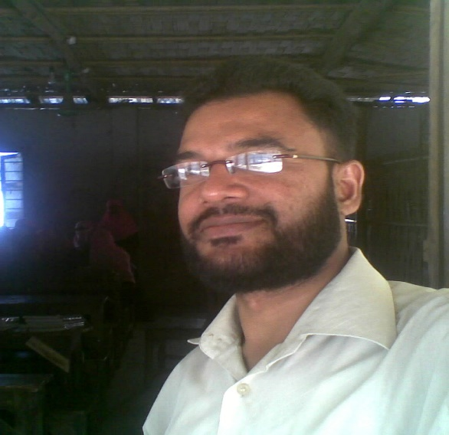
Introduction
Md.Abu Noman
Assis:Teacher
B.N.D. Madrasah
Chakaria Purasava,Cox’sbazar.
Mobile: 01818-541454
E-mail:masternoman24434@gmail.com

Slide 3
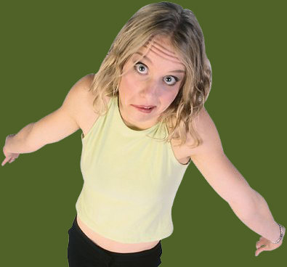
Standard Punctuation
Do I need a comma?
Or do I need a semicolon?

Slide 4
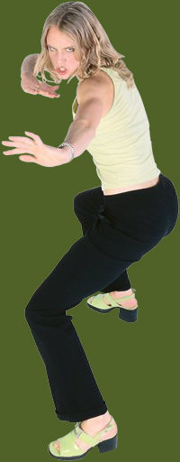
This presentation covers standard punctuation: end marks, commas, semicolons, and apostrophes.

Slide 5
Punctuation items on an objective test might look like these . . .

Slide 6

Sample Item 1
  As we got out of the car we could smell the
  delicious chicken and rice that Grandma was
  cooking for dinner.
  car, we
  chicken, and
  rice, that
  No change is necessary.
  As we got out of the car we could smell the
  A
  delicious chicken and rice that Grandma was
  B C
  cooking for dinner.
  car, we
  chicken, and
  rice, that
  No change is necessary.
  As we got out of the car, we could smell the
  A
  delicious chicken and rice that Grandma was
  B C
  cooking for dinner.
  car, we
  chicken, and
  rice, that
  No change is necessary.
Do you need a comma after car, chicken, or rice?
Exactly! You need to connect the introductory clause.

Slide 7
Sample Item 2
  Since Grandma wasnt looking, Julie filled the dogs bowls with leftovers from the meal.
  Since Grandma wasn’t looking, Julie filled the dogs’ bowls with leftover’s from the meal.
  Since Grandma wasn’t looking, Julie filled the dogs’ bowls with leftovers from the meal.
  Since Grandma wasnt looking, Julie filled the dogs bowls with leftovers from the meal.
  Since Grandma wasn’t looking, Julie filled the dogs’ bowls with leftover’s from the meal.
  Since Grandma wasn’t looking, Julie filled the dogs’ bowls with leftovers from the meal.
An item might have 3 or 4 versions of a sentence, and you will have to choose the letter where all punctuation is correct.
Notice that the apostrophes are all correct in version C.

Slide 8
End Marks
Use the period [ . ] to end statements.
  Jasmine ate a chocolate-broccoli muffin.
Use the question mark [ ? ] when asking a question.
Did Jasmine eat a chocolate-broccoli muffin?
Use — not overuse — the exclamation mark [ ! ] to signify excitement or emphasis.
Oh, no! Jasmine ate a chocolate-broccoli muffin!

Slide 9
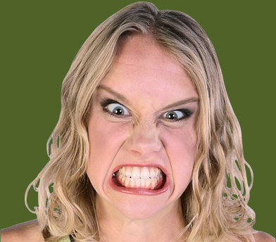
Do I have broccoli stuck in my teeth? I have an appointment at the dentist’s!

Slide 10
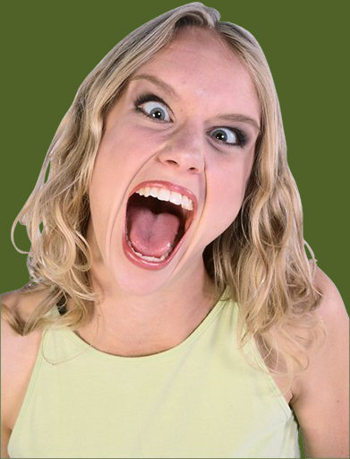
One exclamation mark per essay is a good average.
But I really love! I mean love! the exclamation mark! ! ! I want to use it all the time! ! ! It’s me! ! !
X

Slide 11
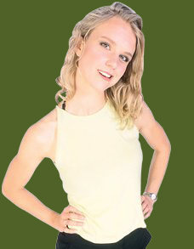
Commas, Part 1
Use commas to connect introductory, interrupting, and some concluding material.
Interrupting material will include a comma before and a comma after.
Without a doubt, Jasmine will pass the comma test.
Jasmine will, without a doubt, pass the comma test.
Jasmine will pass the comma test, without a doubt.
You should know commas as well as I do!

Slide 12
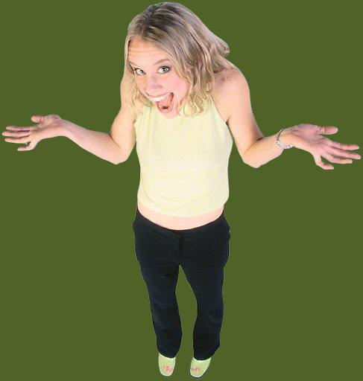
Commas, Part 2
Use a comma with a coordinating conjunction to connect two sentences.
Coordinating conjunctions = and, but, for, or, nor, yet, and so.
Jasmine will pass the comma test. Slacker Sam will not.
Jasmine will pass the comma test, but Slacker Sam will not.
You have to study if you want to do well!

Slide 13
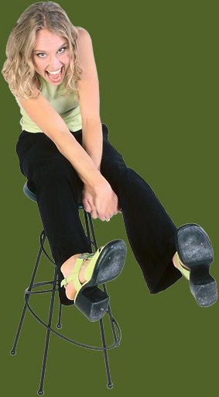
Commas, Part 3
Use and alone to connect two items.
Use commas and an and to connect three or more items.
Jasmine will buy a bag of potato chips and a hotdog.
Jasmine will buy a bag of potato chips, a hotdog, and a soda
Hard work deserves a reward!

Slide 14
Semicolon
Use the semicolon [ ; ] to connect two main clauses.
Do not use the semicolon to introduce a list. The comma with a transition like such as or including, or the colon [ : ] does that job.
Jasmine worries about her grade in statistics. Math is not her best subject.
Jasmine worries about her grade in statistics; math is not her best subject.
Jasmine prefers classes that require her to write: Intro to Humanities, Abnormal Psychology, and US Government.
But I excel at punctuation!

Slide 15
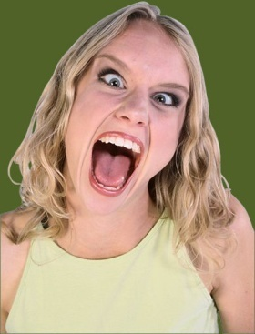
Apostrophe
Use the apostrophe [ ’ ] with an s to show possession: Jasmine’s pen, the cat’s eyes, the professor’s’frowns
Or use the apostrophe to indicate the letters/spaces removed in a contraction: she’ d, can’ t, should’ ve
We cant cheat from Jasmines punctuation quiz because shes absent today!
We can’t cheat from Jasmine’s punctuation quiz because she’s absent today!
Ha! Dentist appointment!

Slide 16
Quick Test, Part 1
Directions: In the items that follow, choose the option that corrects an error in the underlined portion(s). If no error exists, choose “No change is necessary.”
Show me what you know.

Slide 17
Item 1
  Although Raymond will eat a grasshopper, he
  refuses all green vegetables; such as peas,
  spinach, and even cucumbers.
  Although, Raymond
  grasshopper he
  vegetables, such
  No change is necessary.
  Although Raymond will eat a grasshopper, he
  A B
  refuses all green vegetables; such as peas,
  C
  spinach, and even cucumbers.
  Although, Raymond
  grasshopper he
  vegetables, such
  No change is necessary.
  Although Raymond will eat a grasshopper, he
  A B
  refuses all green vegetables, such as peas,
  C
  spinach, and even cucumbers.
  Although, Raymond
  grasshopper he
  vegetables, such
  No change is necessary.

Slide 18
Item 2
  Before his calculus exam Scott rubbed his lucky
  rabbit’s foot and found his favorite pencil.
  exam, Scott
  rubbed, his
  foot, and
  No change is necessary.
  Before his calculus exam Scott rubbed his lucky
  A B
  rabbit’s foot and found his favorite pencil.
  C
  exam, Scott
  rubbed, his
  foot, and
  No change is necessary.
  Before his calculus exam, Scott rubbed his lucky
  A B
  rabbit’s foot and found his favorite pencil.
  C
  exam, Scott
  rubbed, his
  foot, and
  No change is necessary.

Slide 19
Item 3
  Francine has five chair’s but six guests coming
  for Thanksgiving dinner; she hopes that old Uncle
  Ross remembers to bring an extra.
  chairs
  guest’s
  remember’s
  No change is necessary.
  Francine has five chair’s but six guests coming
  A B
  for Thanksgiving dinner; she hopes that old Uncle
  Ross remembers to bring an extra.
  C
  chairs
  guest’s
  remember’s
  No change is necessary.
  Francine has five chairs but six guests coming
  A B
  for Thanksgiving dinner; she hopes that old Uncle
  Ross remembers to bring an extra.
  C
  chairs
  guest’s
  remember’s
  No change is necessary.

Slide 20
Item 4
  Roseanne washed the piles of dirty dishes; while
  Maria vacuumed the filthy rug; they tried to
  complete a month’s worth of housekeeping in a
  single hour.
  dishes while
  tried, to
  months
  No change is necessary.
  Roseanne washed the piles of dirty dishes; while
  A
  Maria vacuumed the filthy rug; they tried to
  B
  complete a month’s worth of housekeeping in a
  C
  single hour.
  dishes while
  tried, to
  months
  No change is necessary.
  Roseanne washed the piles of dirty dishes while
  A
  Maria vacuumed the filthy rug; they tried to
  B
  complete a month’s worth of housekeeping in a
  C
  single hour.
  dishes while
  tried, to
  months
  No change is necessary.

Slide 21
Item 5
  Audrey can’t leave work early, and Peggy wont
  help with the cupcakes, so I guess I’ll have to do
  all the baking myself.
  cant
  won’t
  Ill
  No change is necessary.
  Audrey can’t leave work early, and Peggy wont
  A B
  help with the cupcakes, so I guess I’ll have to do
  C
  all the baking myself.
  cant
  won’t
  Ill
  No change is necessary.
  Audrey can’t leave work early, and Peggy won’t
  A B
  help with the cupcakes, so I guess I’ll have to do
  C
  all the baking myself.
  cant
  won’t
  Ill
  No change is necessary.

Slide 22
Item 6
  During our picnic, we were tormented by
  insects: ants swarming into the potato
  salad, bees buzzing by our ears, and a katydid
  jumping into Henry’s open mouth.
  picnic we
  insects; ants
  salad bees
  No change is necessary.
  During our picnic, we were tormented by
  A
  insects: ants swarming into the potato
  B
  salad, bees buzzing by our ears, and a katydid
  C
  jumping into Henry’s open mouth.
  picnic we
  insects; ants
  salad bees
  No change is necessary.
  During our picnic, we were tormented by
  A
  insects: ants swarming into the potato
  B
  salad, bees buzzing by our ears, and a katydid
  C
  jumping into Henry’s open mouth.
  picnic we
  insects; ants
  salad bees
  No change is necessary.

Slide 23
Quick Test, Part 2
Directions: In the items that follow, choose the sentence that is correctly punctuated.
Try a different type of item.

Slide 24
Item 7
  Roger spent three hours writing Christinas paper.
  Roger spent three hour’s writing Christina’s paper.
  Roger spent three hours writing Christina’s paper.
  Roger spent three hours writing Christinas paper.
  Roger spent three hour’s writing Christina’s paper.
  Roger spent three hours writing Christina’s paper.

Slide 25
Item 8
  When the crickets and the frogs sing Luis cannot get a good nights sleep.
  When the crickets and the frogs sing, Luis cannot get a good night’s sleep.
  When the cricket’s and the frog’s sing, Luis cannot get a good nights sleep.
  When the crickets and the frogs sing Luis cannot get a good nights sleep.
  When the crickets and the frogs sing, Luis cannot get a good night’s sleep.
  When the cricket’s and the frog’s sing, Luis cannot get a good nights sleep.

Slide 26
Item 9
  Before you start painting the walls, you’ll need a drop cloth and a ladder.
  Before you start painting the walls you’ll
  need a drop cloth, and a ladder.
  Before you start painting the walls, youll need a drop cloth, and a ladder.
  Before you start painting the walls, you’ll need a drop cloth and a ladder.
  Before you start painting the walls you’ll
  need a drop cloth, and a ladder.
  Before you start painting the walls, youll need a drop cloth, and a ladder.

Slide 27
Item 10
  Darlene laughed at Jebs haircut; it looked,
  as if goat’s had grazed on his head.
  Darlene laughed at Jeb’s haircut; it looked
  as if goats had grazed on his head.
  Darlene laughed at Jeb’s haircut, it looked
  as if goats had grazed on his’s head.
  Darlene laughed at Jebs haircut; it looked,
  as if goat’s had grazed on his head.
  Darlene laughed at Jeb’s haircut; it looked
  as if goats had grazed on his head.
  Darlene laughed at Jeb’s haircut, it looked
  as if goats had grazed on his’s head.

Slide 28

The End.

