Slide 1
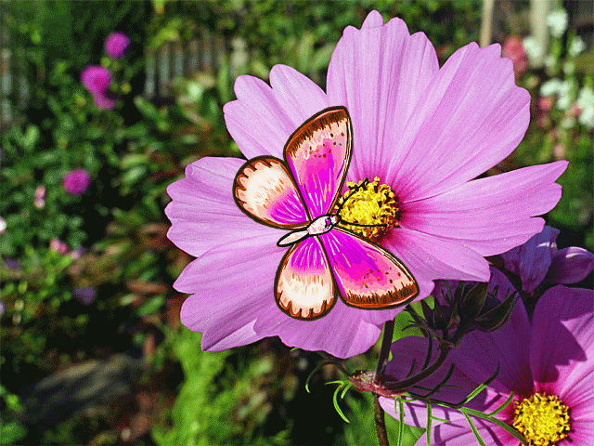
Welcome

Slide 2
Teachers identity
Hemia Afrin
Assistant teacher
Digholia (s)Govt. primary school.
Cell phone : 01729541294
E-mail: hemiaafrin15061999@ gmail.com

Slide 3
Lessons identity
Class: Two Subject: English
Unit: 24 Lesson: A
Time: 45 minutes Date: 2/11/19

Slide 4
Learning outcomes
Listening:
1.1.1To become familar with english sounds by listening to common english words.
Speaking:
1.1.1.Repat after the simple words and phrases with proper sounds and stress..
1.1.2.Say simple words and phrases with proper sounds and stress.
Reading:
1.4.1 read words and phrases with the help of visual clues and simple sentences.

Slide 5
One day One word
Forest- বন

Slide 6
Todays Lessons
Animals and where they live.

Slide 7
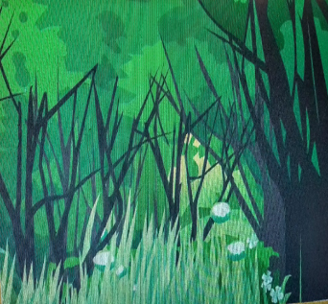
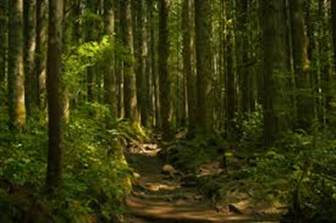
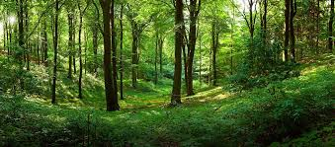
Look and Listen
Forest

Slide 8
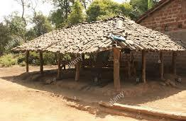
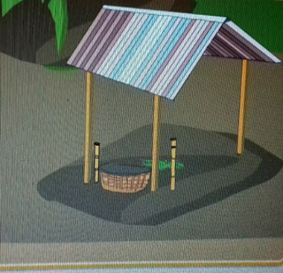
Shed

Slide 9
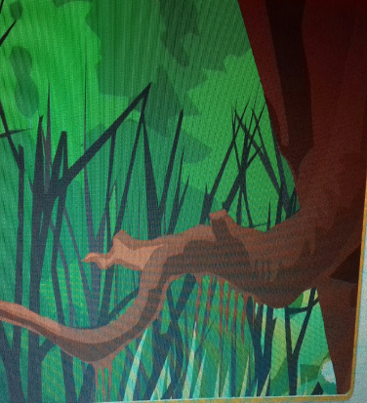
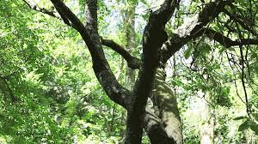
tree

Slide 10
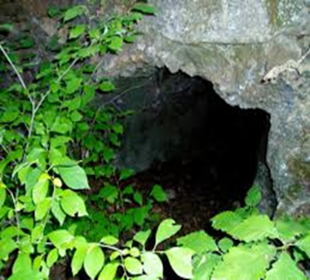
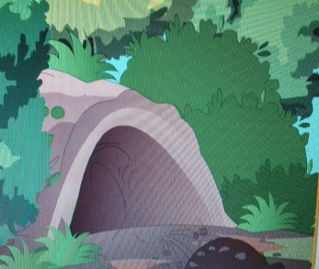
Den

Slide 11
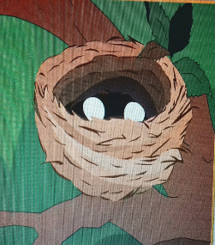
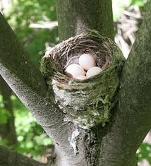
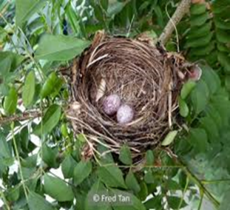
nest

Slide 12
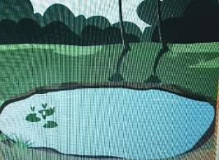
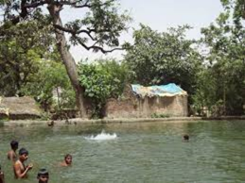
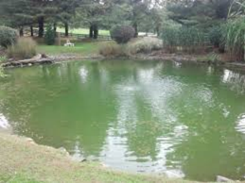
pond

Slide 13
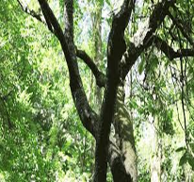
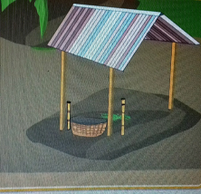
tree
shed
den

Slide 14
Thanks

