Slide 1

WELCOME

Slide 2
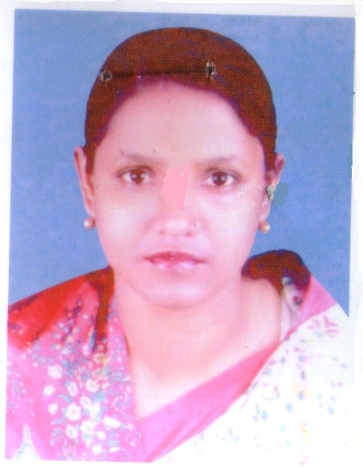

Presented by:
Aliza Begum HeadTeacher
Pallimangal Govt. Primary School.
Dakshin Surma, Sylhet.

Slide 3

Learning Outcomes: Students will be able to
Listening:
4.2.1 understand and enjoy simple stories.
Speaking:
1.1.2 Say words,phrases and sentences with proper sounds and stress.
Reading:
1.7.1 read paragraphs, dialogues, stories,letters and other texts.

Slide 4
Lets see a video

Slide 5

Todays Lesson
The Farmer had three sons

Slide 6

A farmer had three sons.His sons were not in a good term with each other. They often quarrelled among themselves . So, the old farmer was unhappy with them. The old farmer wanted to teach them a good lesson.So, he hit upon a plan. He called all his sons and asked them to bring some sticks. Acording to their fathers order ,the sons collected some sticks and brought to him .The farmer advised the sons to tie the sticks in bundle. The sons did it acordingly. Then the farmer asked each of his sons to break the bundle. Every of them tried to break the bundle of sticks but failed. This time the old farmer asked them to untie the bundle . The sons did it at once. Then he gave a stick to each of his sons. He again asked them to break the sticks. The sons could break their stick easily. Then the farmer talled his sons that if they remained united like the bundle of sticks , nobody could harm them. He also warned them if they quarrelled again and separate they would break down like the single stick .He taught his sons the importance unity. The sons realized and promised to remain united.

Slide 7

Three sons quarrelled_______themselves .
The farmer wanted to _______his sons a good lessons.
c) Everyone of them tried to the break______.
d) Nobody could _____the bundle. e)The sons promise to _____ united.
Teach | break | among | Be,bundle
good | unhappy | easily | they

Slide 8
Write True or False:
a)The sons of the farmer was in a good term with each other.
b)The old farmer was happy with them .
c)The sons collected some sticks and tide in bundle.
d)Nobody could break the bundle of sticks.
e)The old farmer thought his sons the importance of unity. f) Unity is strength.

Slide 9

EVALUATION
Answer the following question:
a)How was the sons relation among themselves?
b)Who was unhappy?
c)Why was the old farmer unhappy?
d) Who did not pay heed to his word?
e) What did the old farmer want to teach?

Slide 10

Home work
Supose you are Sami,rami is your sister. Now write a letter to your sister advising her to keep good term to each other.

Slide 11

Thank you

