Slide 1
Md. Eunuse Ali
Assistant Teacher (English)
Charan High School.
Kalihati, Tangail.
E-mail: eunusali223@gmail.com
Contanct : 01767476436
Class-Nine & Ten
Time-50 Mins

Slide 2
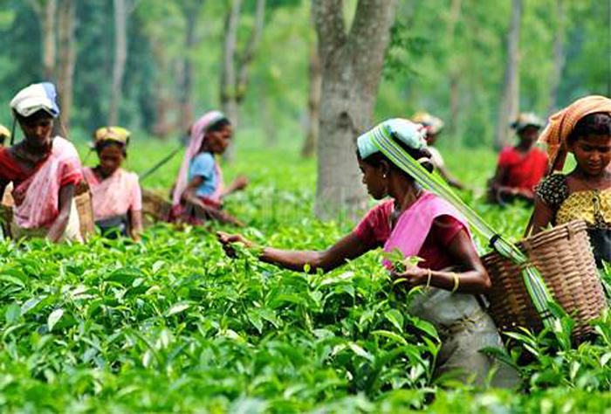
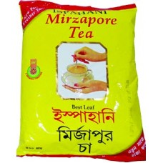
Can you see anything?

Slide 3
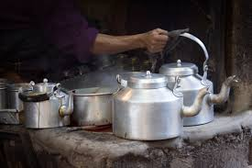

Slide 4
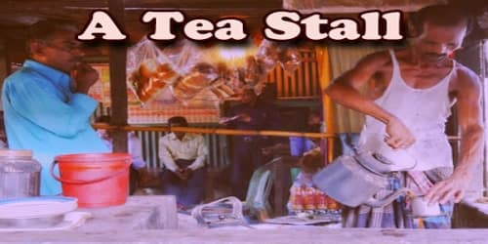

Slide 5
Our Today’s Lesson is-
A paragraph on
“A Tea Stall”

Slide 6
Learning Outcomes
The end of the lesson, students will be able to ---
Ask and answer the questions.
Answer the multiple choice questions.
Fill in the gap with suitable words.
Write a paragraph on “Tea-stall.”

Slide 7
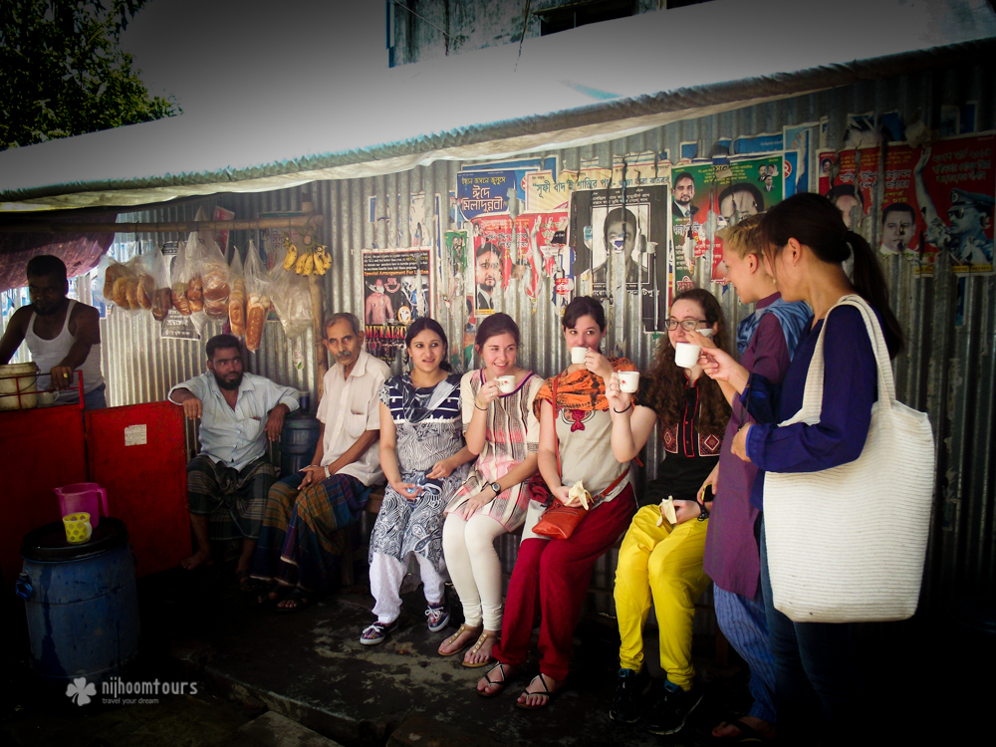
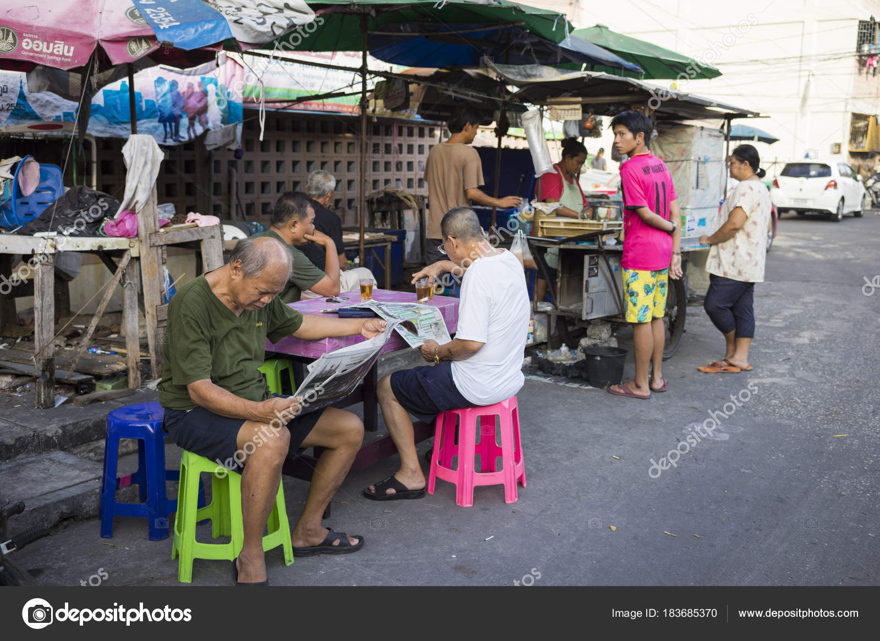
Different types of people in a tea stall.
Tea is a popular drink all over the world. So, a tea stall is a common place to all classes of people.

Slide 8
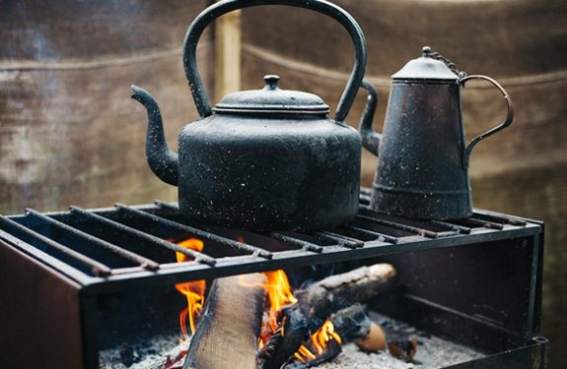
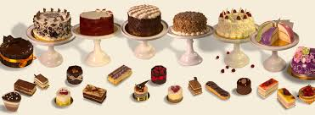
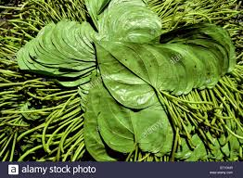
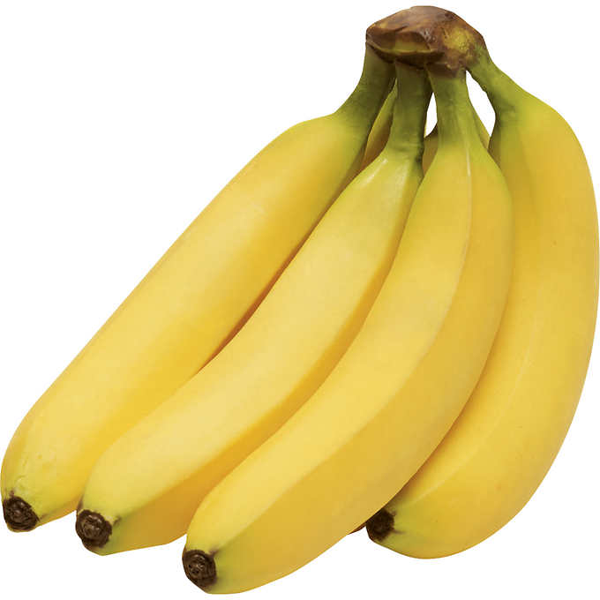
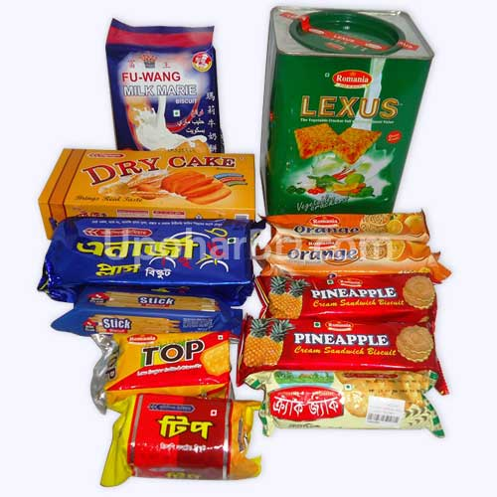
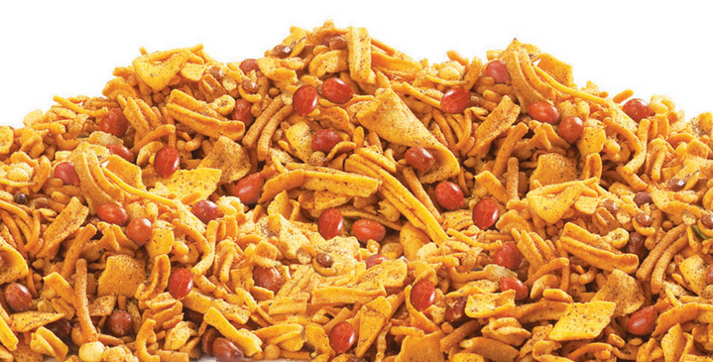
In a tea stall, hot drink, --- , ---, ---, ---, and --- are available here.
Hot drink or prepared tea
cakes
Betel leaf
Banana
Chanachur
Biscuits

Slide 9
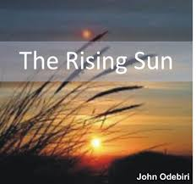
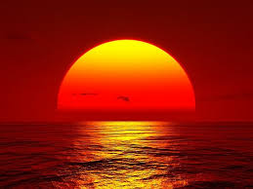
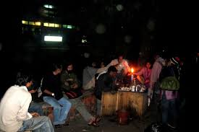
It opens early in the morning and closes late at night.
Night

Slide 10
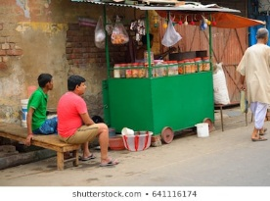
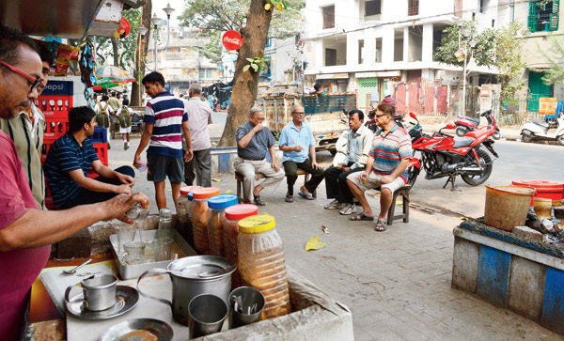
It is not well-furnished. Sometimes there is only a chair, a table and some benches.

Slide 11
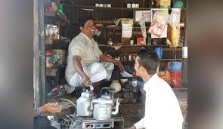
A tea stall has two parts. In front parts, there is the kitchen.

Slide 12
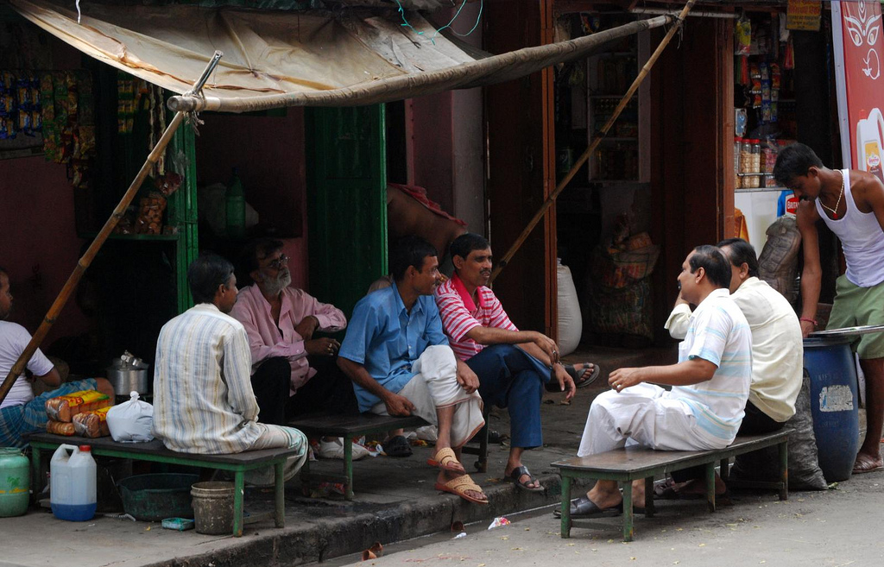
Different kinds of people gather here to refresh themselves.

Slide 13
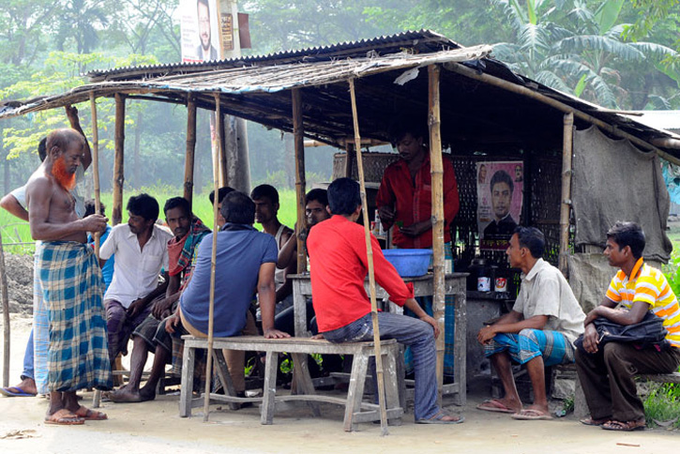
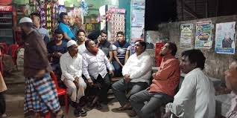
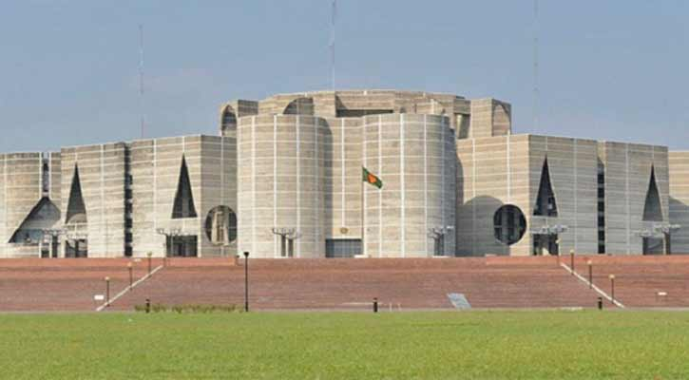
With a cup of tea, they discuss different topics. Sometimes they also discuss on politics & gossiping too. So a tea stall is called Mini-Sangsad.

Slide 14
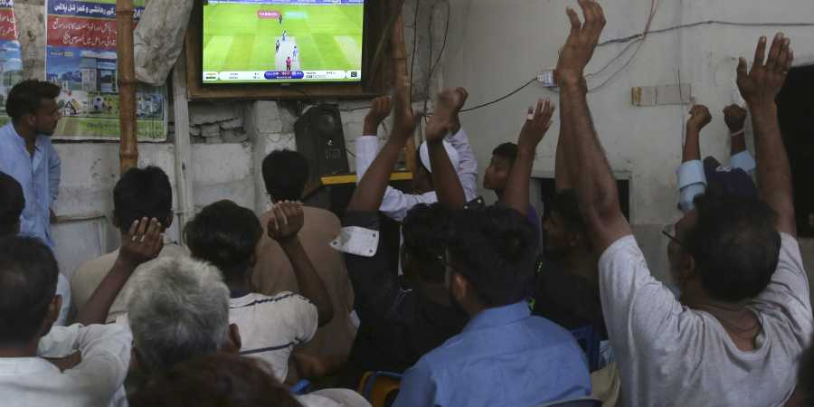
Some people watch Television, some read daily newspaper. It’s a noisy, busy & meeting place too.

Slide 15
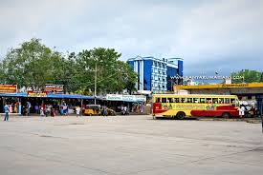
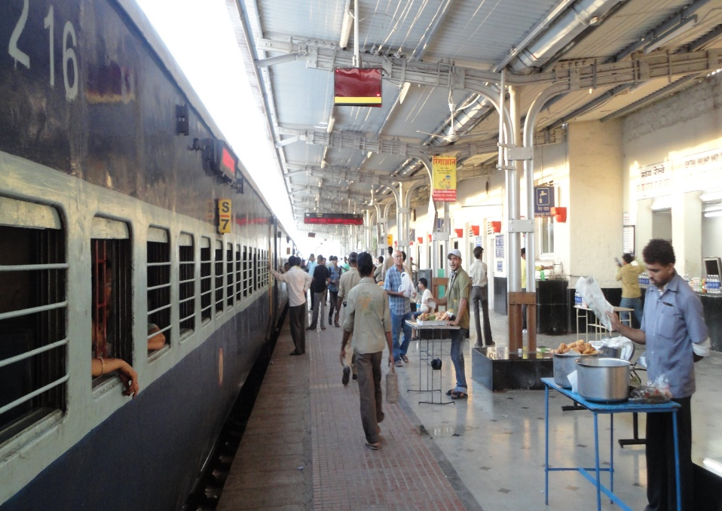
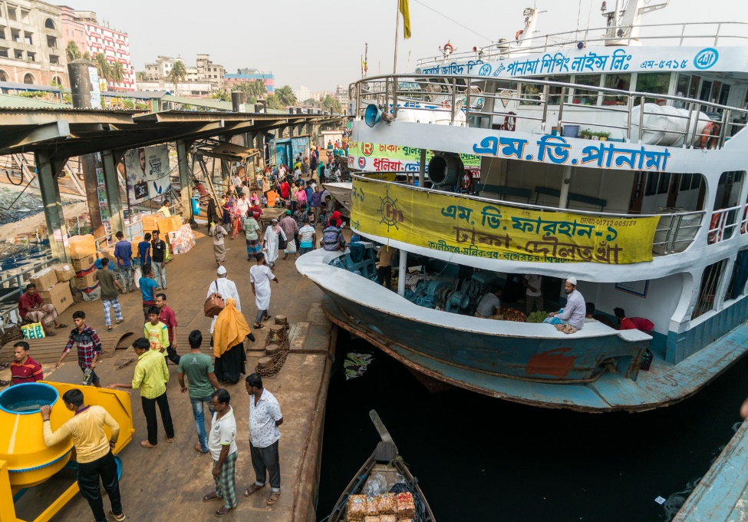
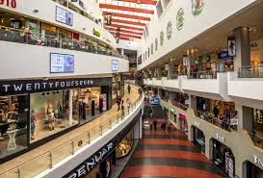
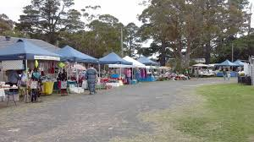
Generally, a tea-stall is found at the turn of road, --- , ---, ---and ---.
Railway Station
Launch ghat
Bus Station
Village Market

Slide 16
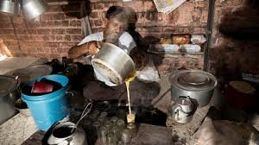
The owner of the tea stall is also a self-reliant person. Really its utility can not be ignored.

Slide 17
Fill in the gap with suitable word. (Individual work)
Almost all classes of people come here and (a)
_________ while tacking tea. They discuss different
affairs especially government and (b)___________.
There is sometimes a (c)________ in a tea cup.
However a tea stall remains (d)_______ with all kinds
of people from morning to (e) ________.

Slide 18
Choose the best answer from the alternative ( in pair )
1. Which thing is always on the oven? (a) Pan (b) Jar (c) Kettle (d) Pot
2. How is the water on the oven ?
(a) Normal (b) boiled (c) Cold (d) Icy
3. Which things are kept near the kettle? (a) Glasses (b) Bottles (c) Mug (d) Cups
4. For why the water bowl is kept ? (a) washing cups (b) Drinking water (c) Boiling water (d) washing water
5. A glass of water is sold ---------- . (a) Tk.4 (b) Tk.5 (c) Tk.1 (d) Tk.2

Slide 19
Evaluation
What is a tea stall ?
When does it open and close ?
Where is it situated ?
How is a tea stall furnished ?
What do people do there ?

Slide 20
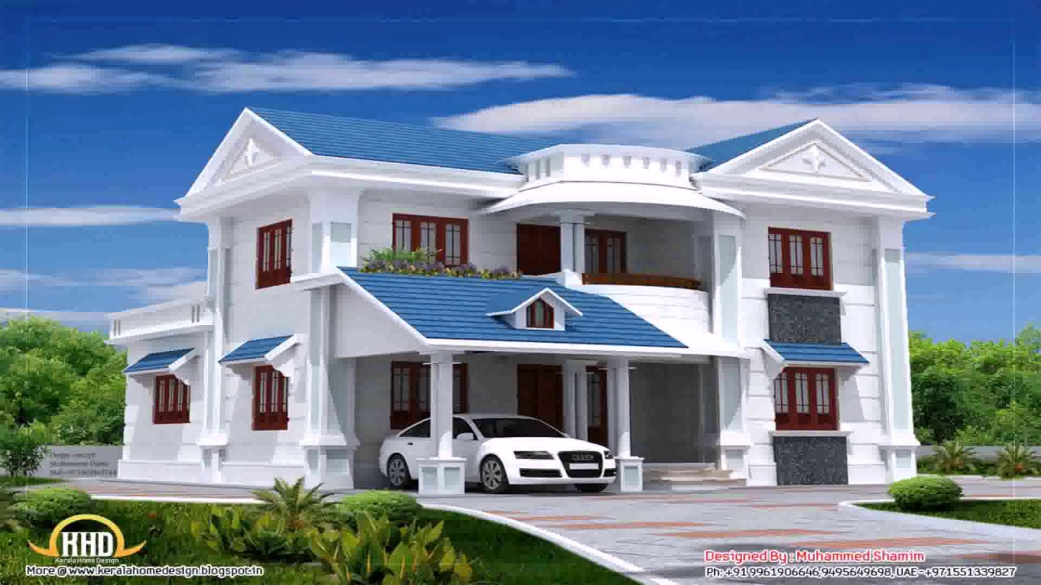
Homework
Write a paragraph about “ A Tea Stall.”

