Slide 1
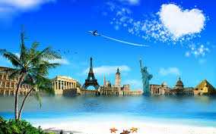
Good Morning Students

Slide 2
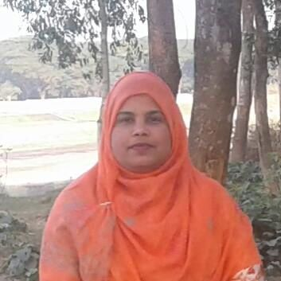
Taslima Akter
Assistant Teacher (ICT)
Edward Institution,Mymensingh
Class – Six
English For Today
Unit- 22
lima809603@gmail.com

Slide 3
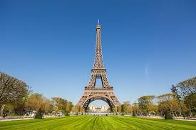
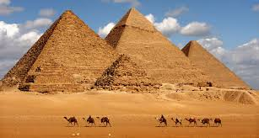
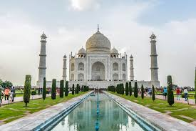
Look at the pictures . What are they called?
Eiffel Tower
Pyramids

Slide 4
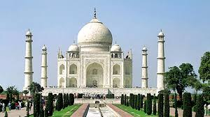
Taj Mahal

Slide 5
Learning outcomes
By the end of the lesson students will be able to..
read and understand texts.
follow instructions,commands,requests accordingly.
answer the questions .

Slide 6
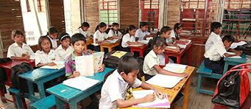
Reading text.

Slide 7
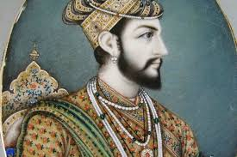
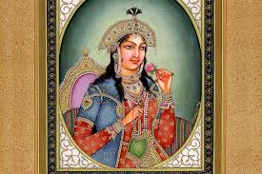
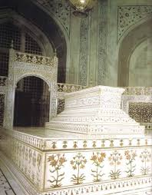
Shah Jahan
Mumtaz
It is the place where Mumtaj is sleeping for ever.
Mumtaz’s Tomb

Slide 8
Make questions using the cues given below
Class Work
1. What is ………………………………….?
2.Where is …………………………………?
3.How………………………………………..?
4.Who ……………………………………….?
5.When………………………………………?
6.How many ………………………………?
7.Why ………………………………………..?

Slide 9
Evaluation
Complete the following table with the information given in the passage.
Shah Jahan | built
Taj Mahal | is
Its area | is
Mumtaj | died
To complete the Taj | It took

Slide 10
Home Work
Write a short paragraph about a wonder that innovation you surprise the most.

Slide 11
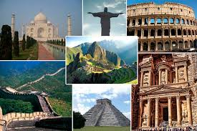
Thank you all

