Slide 1
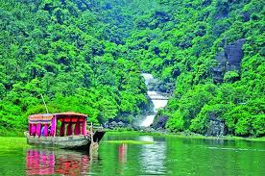
Good Morning Students

Slide 2
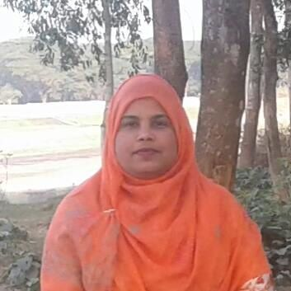
TASLIMA AKTER
ASSISTANT TEACHER (ICT)
EDWARD INSTITUTION,MYMENSINGH
CLASS – SIX
ENGLISH 1ST PAPER
LESSON - 13
lima809603@gmail.com

Slide 3
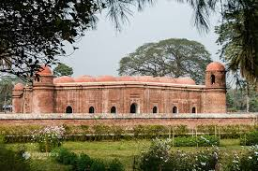
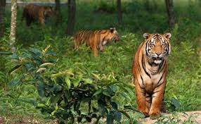
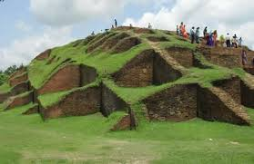
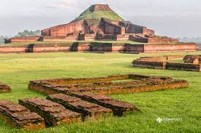
What can we the pictures ?
Shat Gambuj mosque
Sundarban
Maynamoti
Somapura Mahavihara

Slide 4
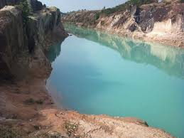
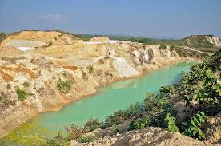
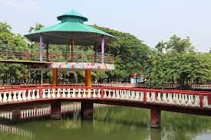
This places are less known to us but beautiful.

Slide 5
Today’s lesson - - -
An unseen beauty of Bangladesh.

Slide 6
Learning Outcomes—
After completing the lesson students will be able to--
read and summarize the texts.
Ask and answer the questions.
Write a short paragraphs.

Slide 7
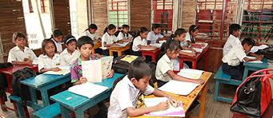
Read the text ---

Slide 8
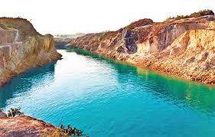
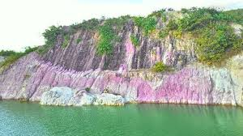
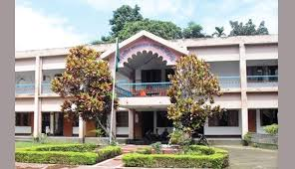
Someshwari River
Ceramic mountain
Birushiri Tribal cultural Academy

Slide 9
Group work
Write the main attractions of Birishiri

Slide 10
Evaluation
1.Where is shusong Durgapur located?
Ans- Netrokona District.
2.How far is it from Dhaka?
Ans- 170km north from Dhaka.
3.How many ethnic groups live in here?
Ans- There are 4 ethnic groups.
4.Where is Birishiri Tribal cultural Academy located?
Ans-It is located at Durgapur .

Slide 11
Home Work
Write a paragraph on a beautiful place that you know.

Slide 12
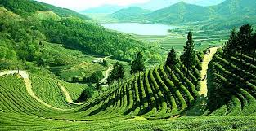
Thank you very much

