Slide 1
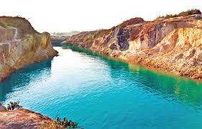
Good Morning students

Slide 2
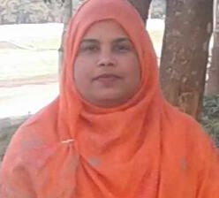
Taslima Akter
Assistant Teacher (ICT)
Edward Institution, Mymensingh
Class – Seven
Subject- English 2nd paper
Lesson- Article
lima809603@gmail.com

Slide 3
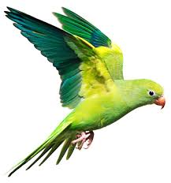
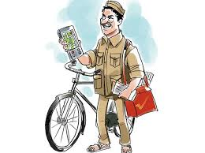
This is a bird.
He is a postman

Slide 4

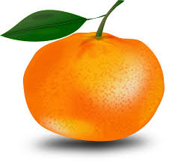
This is an umbrella.
It is an orange.

Slide 5
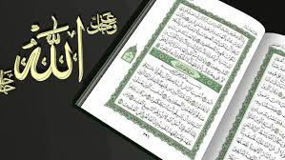
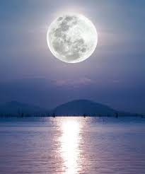
We should recite the Holy Quran daily.
The Moon gives us at night.

Slide 6
Can you guess what are the underlines about?
Article

Slide 7
Learning Outcomes
By the end of the lesson We will be able to-
define article.
use article a and an properly.

Slide 8
The
We are called
Article
A
An

Slide 9
What are the divisions of ..
Article
Definite
Indefinite
The
A, An
Definite article is used to particularize a noun
Indefinite article is used to generalize a noun.

Slide 10
If you find a consonant as the first letter of the word , that means (b, c, d, f, g, h, j, k, l, m, n, p, q, r, s, t, v, w, x, y & z)
You have to write ‘a’ before the word.
If you find a vowel as the first letter of the word , that means (a, e, i, o, u)
You have to write ‘an’ before the word.

Slide 11
Some common used articles
Consonant sound –before “A”
Vowel sound-before- “An”
A ball
A dog
A cat
A tiger
A net
A book
A flag
A lion
A horse
A chair
An ass
An egg
An eye
An arm
An orange
An inkpot
An ox
An umbrella
An owl
An elephant

Slide 12
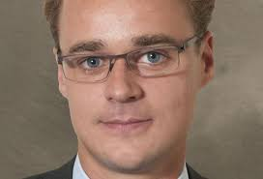
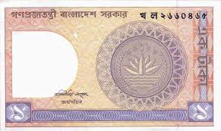
He is a European
ইউ
I have a one taka note.
ওয়া
A is used before the sound –ইউ, ওয়া

Slide 13
Follow some examples
a one-eyed deer
a union
a university
a useful book
a unique scene

Slide 14
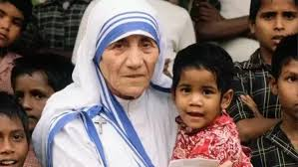

She is an honest women .
অ
Dr. Karim is an M.B.B.S.
এ
‘An’ is used before the sound of- অ , আ , এ

Slide 15
Follow some examples
an hour ( ‘h’ silent)
an honest ( ‘h’ silent)
an M.A.
an M.P.
an L.L.B.
an M.L.A.
an S.D.O.
an H.S. School

Slide 16
Evaluation
Fill in the blanks with appropriate article-
Tial is ______ brilliant boy.
You showed ______ excellent performance.
Tarif is ______ university student.
It takes ______ hour to go there.
5.I have mobile phone.

Slide 17
Home Work
Fill in the blanks with a/an.
Tarif is _____ meritorious student. He studies in ____ renowned school. There is _____ expert headmaster in the school. He is ____ honest man. The school has achieved ____ unique position in regard of result.

Slide 18

Thank you all

