Slide 1

Welcome

Slide 2
Md. Ariful Islam
Asst: Teacher
Panti Secondary School
Phone: 01850195396

Slide 3
Class: vii
Sub: English 1st paper
Date : 08/10/ 2019
Time : 50 minutes

Slide 4
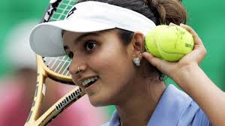
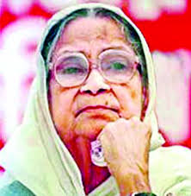
See the pictures and discuss with your friend .5 minutes
Why are they pioneer?

Slide 5
To-day’s our lesson is
Unit – Five
Lesson- 1 ( Begum Rokeya 1)

Slide 6
By the end of this lesson students will be able to
Talk about the pictures.
Ask and answer question.
Discuss about the people.
Write a paragraph.

Slide 7
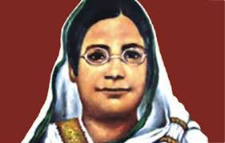
7 minutes
1. Who is the woman?
2. What do you know about her?

Slide 8
Vocabulary 8 minutes
Famous- adj
(Renawal) -Sakib al Hasan is a famous cricketer.
Writer –noun
( a person who writes poem /stories etc called writer.) Nazrul Islam is a great writer.
Upper – adj –
(Higher) Upper class Muslims go to Saudi Arab.
Cause- noun –
(reason) There are many causes of his failure.

Slide 9
Raed the passage and find out the answer of the following questions.
10 miniutes
Where did Begum Rokeya live?
Ans: Begum rokeya lived in Rangpur.
2. What was the name of her father?
Ans Her father’s name is Jahiruddin Muhammad Abu Haider Saber.
3. What did she fight for?
Ans: She fight for the rights of women.
4. What was her husband?
Ans : Her husband was the Deputy Megistrate .

Slide 10
Read the passage in a again and answer the following questions
1. Begum Rokeya was born in- 8 minutes
a) 1888
b) 1882
a) 1888
d) 1889
b) 1880
2.She learnt Bangla and -------------- from her elder brother
a) Urdu
b) Arabic
c) Hindi
d) English
3 Her husband was Deputy Magistrate of
a) Vagolpur
b) Modhupur
a) Nodia
a) Rangpur
4. Begum Rokeya had great love for her ----
a) Money
b) Power
c) Home
d) Mother tongue

Slide 11
Home Work
Write a paragraph about Begum Rokeya

Slide 12

Thanks a lot for your hard work

