Slide 1

Welcome

Slide 2
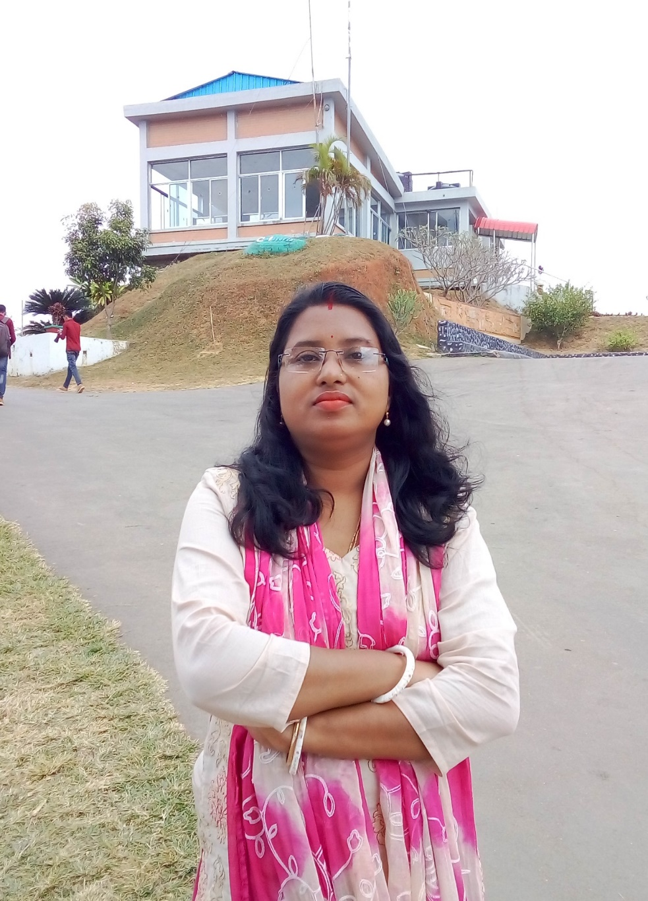
Teachers name
Shikha Rani Biswas
Assistant teacher
Ramdi GOVT Primary School
Kuliarchar, Kishoregonj.

Slide 3
Introduction of the lesson
Lesson-4-6 Parts of the lesson: Alphabet (M)
Unit: 16
Look , listen and say. Trace in the air.

Slide 4
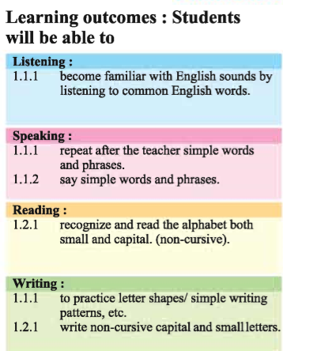

Slide 5
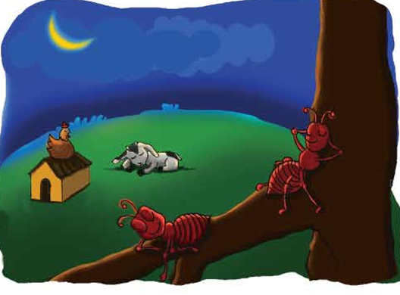

Slide 6
Video

Slide 7
Good morning student

Slide 8
How are you?

Slide 9
Fine, thank you.

Slide 10
Moon
What is this ?

Slide 11


Slide 12
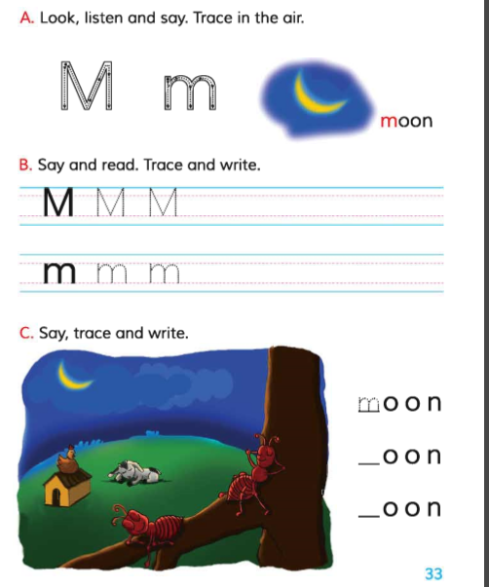

Slide 13


Slide 14
M

Slide 15
m

Slide 16
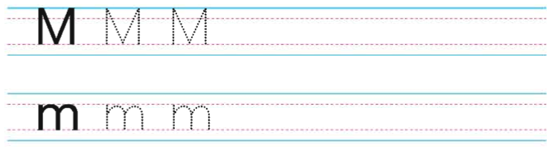

Slide 17
Groupe worke
1 . M
2. m

Slide 18
Home worke
M m

Slide 19
No more today

Slide 20

Goodbye

