Slide 1
Welcome to my class

Slide 2
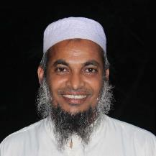
Introduction of the teacher
Dewan Rezaul Hassan
(Assistant Teacher)
Baropakhia Rothindrapara Government Primary School
Delduar, Tangail.
E-mail:drezaulhassan@gmail.com

Slide 3
Introduction of the lesson:
Class: five
Unit:06 Lesson: 01
Lesson title: Eat healthy
Today’s lesson: “A, B, & C”.
Page # 22

Slide 4
Learning outcomes:
Student will be able to----
Listening:
3.3.1. Understand question about objects around them.
3.4.1. Understands statements made by the teacher and students.
Speaking:
1.1.1. Say words phrases and sentence with proper sounds and stress.
6.2.1. Talk about people, objects, events etc.
8.1.1. take part in conversation on appropriate topics.
Reading-
1.5.1. Read words and sentence in the text with proper pronunciation, stress
intonation.

Slide 5
Let’s sing
‘Good morning song`.

Slide 6
Dear students,
answer the following questions:
1. What do you usually have for breakfast/ lunch?
2. What food you like most?
3. Do you like fruits? Vegetables?
4. Do you like ice-cream? Or milk? And why?

Slide 7
Today’s lesson is
“Eat healthy”
Unit:06 Lesson: 01
Lesson title: Eat healthy
Today’s lesson: “A, B, & C”.
Page # 22

Slide 8
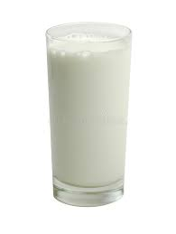
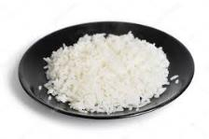
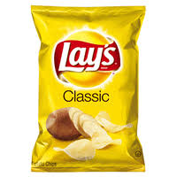
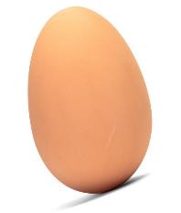
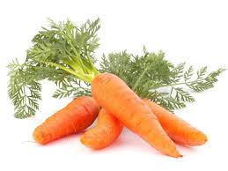
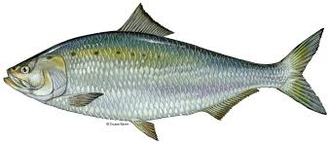
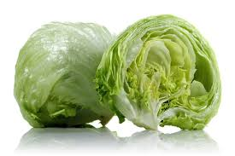
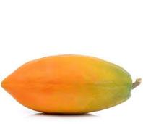
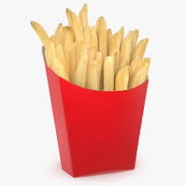
Let’s see the pictures &
Think alone & discuss in pair.
What are these?

Slide 9
milk
rice
egg
fish
lettuce
chips
papaya
carrots
fries
orange
chocolate
Ice-creme

Slide 10
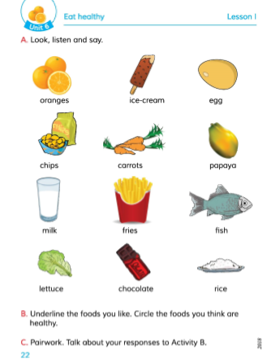
Now, dear students,
take your EFT book and
open at page 22.
I’ll read & all off you will follow me.

Slide 11
Mime game:
One student come to here for mime action.
(One after another)

Slide 12
Ask in groups:
1.Which food are good for health?
Underline the word.
2. Which food are not good for
health? Circle, them.

Slide 13
One student come here.
Then I ask to follow me & practice in pairs & in groups:
“I like orange. What do you like?”
After, you’ll do it in pairs. then in group.

Slide 14
Task
1.Write down five foods which are good for
health.
2.Write down five foods which are not good
for health.

Slide 15
Thanks for watching.

