Slide 2
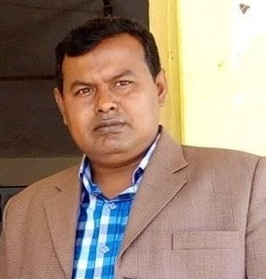
Teacher’s Identity
Md. Ali Hosen
Assistant teacher
Madhobpara Govt. Primary School
Kaligonj, Lalmonirhat.

Slide 3
Lesson Identity
Class: Five
Subject: English
Lesson: Cyclone Aila
Lesson unit: Babul………in the sky.

Slide 4
Learning outcomes
Students will be able to……..
3.4.1- understand statements made by the teacher and students.
1.1.2- say sentences with proper intonation.
1.7.1- read paragraphs,dialoges stories,letters and other texts.
9.1.1-write short and simple paragraphs.

Slide 5
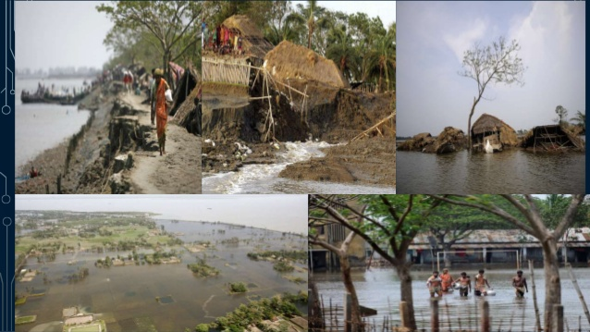
Look at the picture and think
What do you see the picture?

Slide 6
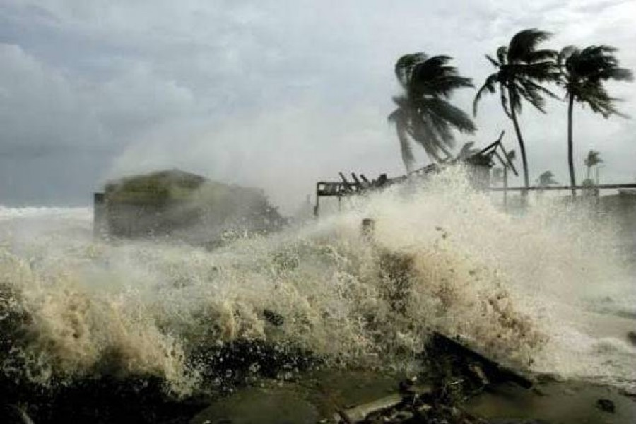
Cyclone Aila

Slide 7
Open your text book at page 95

Slide 8
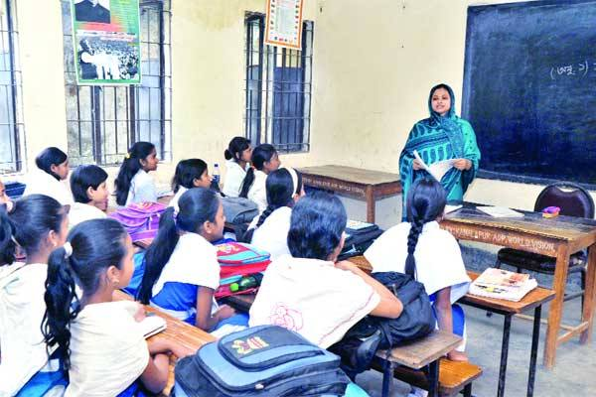
Teacher’s read the text loudly and students listen.

Slide 9
Lets see some
New words
Grocery shop
A shop selling foodstuff and other household necessities.
Island
A small land surrounded by water.
Roof
A protective covering of the top of a house.
Dark
Having no or very little light.

Slide 10
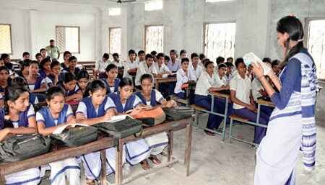
Teacher and student’s read the text loudly

Slide 11
Lets make 4 groups and fill in the gaps each group
Who fast make clap
Dublar char is an----------.
Babul’s family had-----------members.
The sky was------------on that evening.

Slide 12
Pair work
Write True or False
Babul’s family lives on an island.
Nipa was seven years old.
Babul’s parents checked the emergency kit.

Slide 13
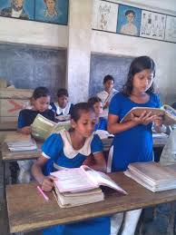
Student’s read silently

Slide 14
Answer the question
1. Where does Babul and his family live?
2. What was Babul’s father?
3. Why was everyone afraid?

Slide 15
Home task
Write five sentence about Cyclone Aila.

