Slide 1
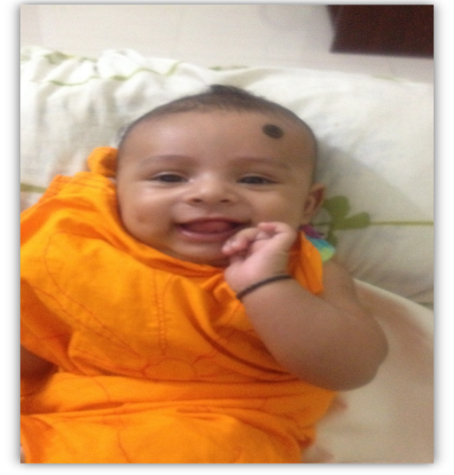


Slide 2
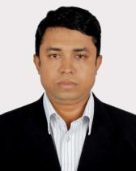
Presented by
Muhammad Mahbubul Alam
Assistant Teacher
Sharaipara Hazi Abdul Ali Government Primary School
Pahartali, Chittagong.

Slide 3
এবার আমরা সবাই একটা ভিডিও দেখব।
https://www.youtube.com/watch?v=YJyNoFkud6g

Slide 4

ENGLISH FOR TODAY
Class: Three
Unit: 34
Time: 35 Minutes

Slide 5
LEARNING OUTCOME
Students will be able to say some new words with meaning.
Students will be able to read the text with proper pronunciation .
Student will be answer the short question from the text.
Students will be able to write about their family by own try.

Slide 6
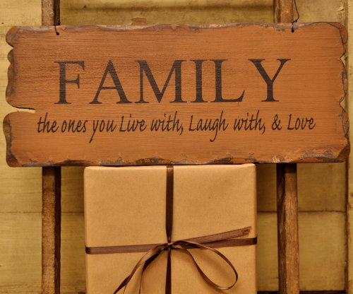
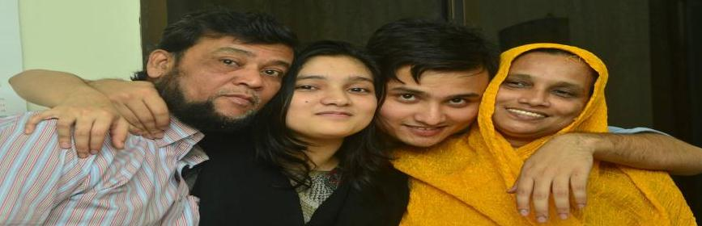

Slide 7

Family
Mother
Brother
Sister
Grandmother
Father
Grandfather

Slide 8











Slide 9
New word with meaning

Slide 10

Banker –
who work in the bank or Money-lender

Slide 11
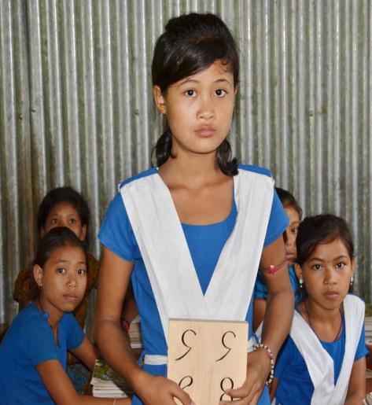
Student –
Learner

Slide 12
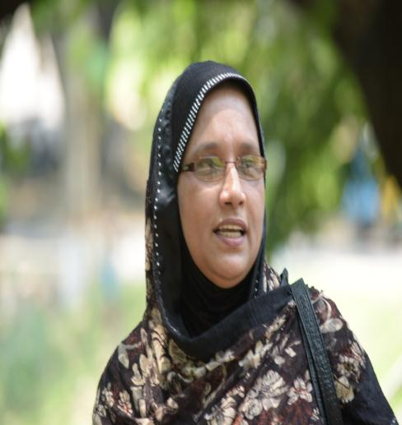
Teacher –
A person who teaches in a educational institution.

Slide 13
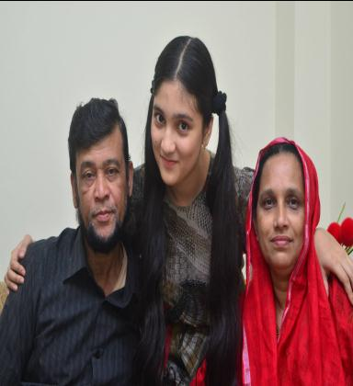
Family-
A group of people related by law.blood or custom.

Slide 14
New words with meaning
Banker – who work in the bank or Money-lender
Student – Learner
Teacher- A person who teaches in a educational institution.
Family- A group of people related by law. blood or custom.

Slide 15
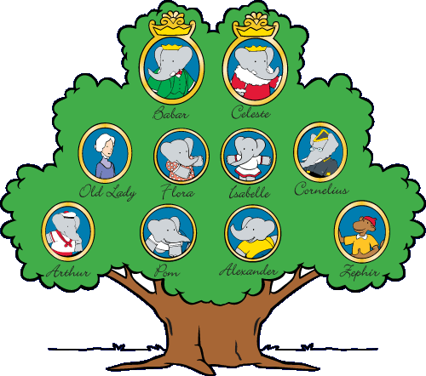
TODAY’S LESSON
My FAMILY

Slide 16
Lets introducing with Tisha’s family

Slide 17
Tisha’s family
Consist on four members
Parents
FATHER
MOTHER
Tisha and Her brother

Slide 18

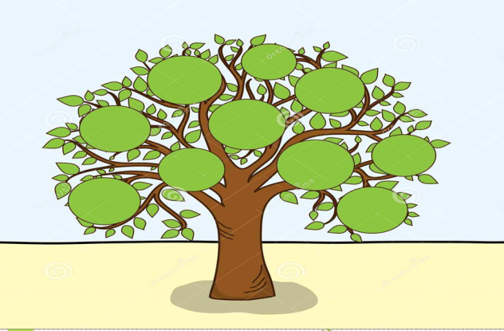
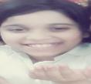
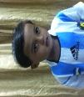
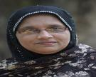

Tisha’s family
Tisha
Mother
Brother
Father

Slide 19
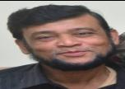


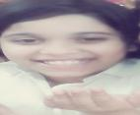
Identity of Tish’s Family
Tisha’s Father.
He is a banker.
Tisha’s Mother.
She is a teacher .
Tisha is a student of class Three.
Tisha’s Brother.
He is two years old.

Slide 20
Introduce with text book
Unit 34
Page no.68
Read the text-
I’m Tisha……..years old.
Repeat after me.

Slide 21
Group work
Group: 1
Group: 2
Write the meaning of the following words:
Banker-
Student-
Teacher-
  Answer the following question:
What does Tisha’s mother do?
What does Tisha’s father do?
How old is Tisha’s brother?

Slide 22
ANSWER
Answer for the Group 1
Money-lander
Learner
Home maker
Answer for the Group 2
Tisha’s mother is a house wife.
Tisha’s father is a banker.
Tisha’s brother is two years old.

Slide 23
EVALUATION

Slide 24
Matching the following words
.Mother
Father
.Tisha
Brother
Two years old
.Student
.Banker
Teacher

Slide 25
Write down a short paragraph about your family.
Homework

Slide 26

Thank you Everyone
Good bye

