Slide 1
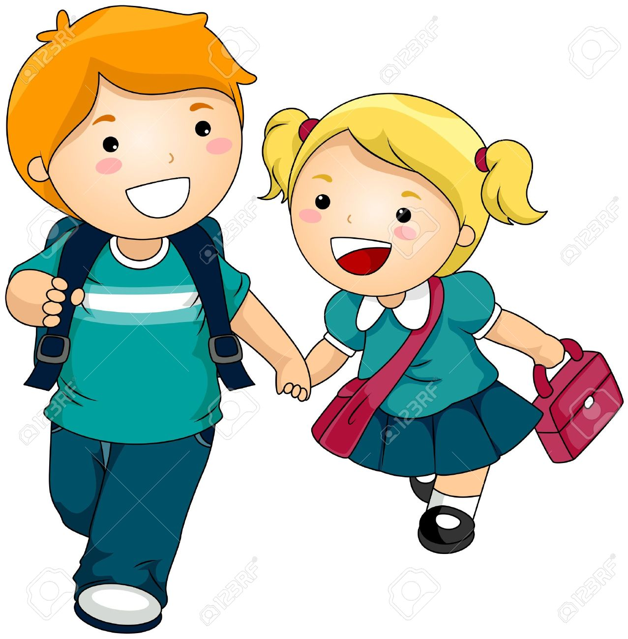
1
2
WELCOME
3
IDENTITY
4
GREETING
5
WATCH VIDEO
6
D..BE..LESSON
WELCOME
TODAY’S LESON

Slide 2
1
2
MOHAMMAD JAKIR HOSSAIN
ASSISTANT TEACHER
BADERA GOVT.PRIMARY SCHOOL
TARAIL,KISHOREGANJ.
MOBAIL:01719341643
EMAIL:jakir5959@gmail.com
WELCOME
3
IDENTITY
4
GREETING
5
WATCH VIDEO
6
D..BE..LESSON
SUBJECT:ENGLISH FOR TODAY
UNIT:42, LESSON: 1-2
(STORY: THE LION AND THE MOUSE)
One day………….was angry.
TIME: 45 MINUTES.
DATE: 12.10.2019
TODAY’S LESON

Slide 3
1
2
WELCOME
3
IDENTITY
4
Teacher
Student,s
GREETING
Good morning, students.
Good morning, teacher
5
WATCH VIDEO
6
How are you today?
Fine. and you?
D..BE..LESSON
Fine, thank you.
You are welcome sir.
TODAY’S LESON

Slide 4
1
2
WELCOME
3
IDENTITY
Dear students, Let us go to watch a video.
4
GREETING
5
https://youtu.be/iPybpc-xuG0
WATCH VIDEO
6
D..BE..LESSON
Discuss about the video with the students.
TODAY’S LESON

Slide 5
1
2
Dear student’s
WELCOME
3
1.Do you know what is the meaning of the ‘Lion’?
IDENTITY
4
2.What does the lion eat?
GREETING
3.Is it big?
5
WATCH VIDEO
6
1.Do you know what is the meaning of the ‘Mouse’?
D..BE..LESSON
2.What does the mouse eat?
TODAY’S LESON
3.Is it small?

Slide 6
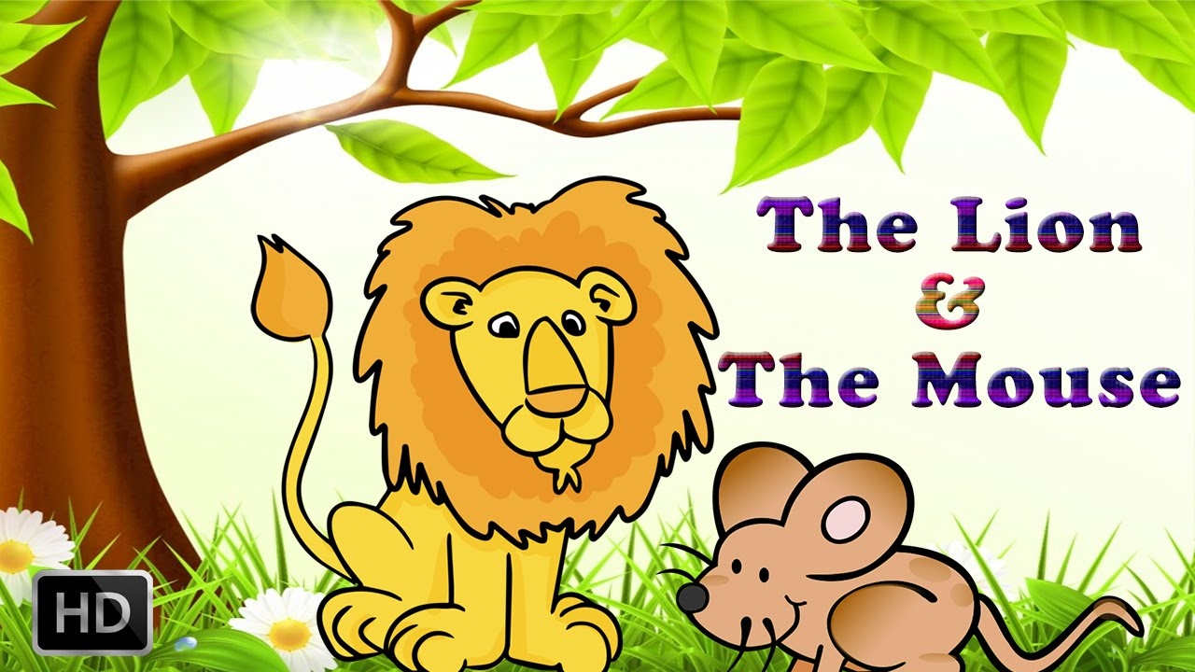
1
Dear student’s,Today we are going to start a new lesson.
2
WELCOME
The name of the new lesson is…
3
IDENTITY
4
GREETING
5
WATCH VIDEO
6
D..BE..LESSON
‘The Lion and the Mouse’
TODAY’S LESON
Page no:84

Slide 7
7
8
By the end of the lesson students will be able to…
LEARNING OUT..
9
Listening:
1.1.1 Recognize sound differences in the context of words.
1.2.1 Recognize which syllable in a word is stressed.
1.3.1 Recognize which words in a sentence are stressed.
4.3.1 enjoy and understand simple stories.
Speaking:
1.1.1 repeat after the teacher and say words, phrases and sentenceswith proper sounds stress and intonation.
6.2.1 talk about people, objects, events,etc.
Reading:
1.4.1 to read words, phrases and sentences in the text.
1.5.1 read words, phrases and sentences in the text with proper pronunciation,
stress and intonation.
W.C.WORK
10
NEW WORD’S
11
WARD’S DETAIL
12
WARD’S DETAIL
WARD’S DETAIL

Slide 8
7
8
Dear Students,
Open your book at page no.84.
Look at the picture’s in activity-A.
Think alone & share opinion each other.
LEARNING OUT..
9
W.C.WORK
10
NEW WORD’S
11
WARD’S DETAIL
12
Students,
What are you looking in the picture’s?
WARD’S DETAIL
WARD’S DETAIL

Slide 9
7
Dear students, Look at board.
Here are some new word’s of the lesson.
8
LEARNING OUT..
9
W.C.WORK
10
Sharp, Forest, Roar,
Afraid, Trap, Strong,
NEW WORD’S
11
WARD’S DETAIL
12
WARD’S DETAIL
WARD’S DETAIL
Students, Do you know what is the meaning of the word’s.

Slide 10
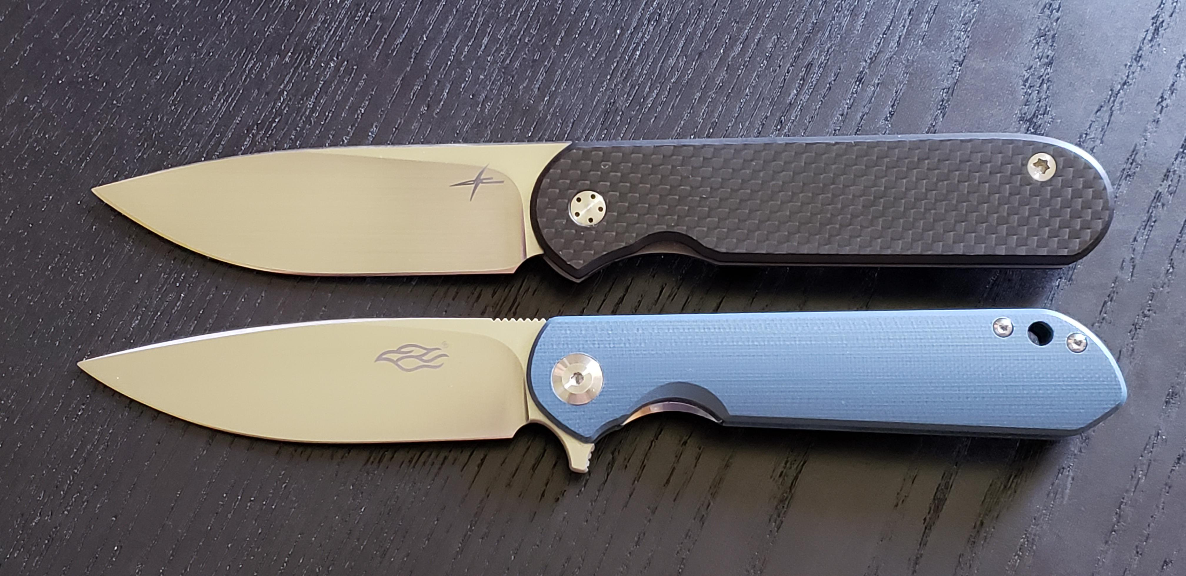
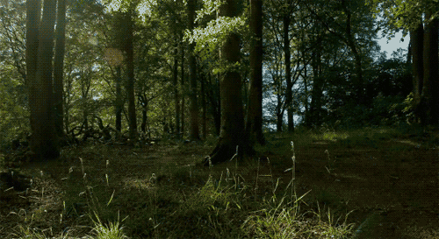
7
01
02
Sharp
Forest
8
LEARNING OUT..
9
W.C.WORK
10
Keen
ধারালো
Jungle
বন,অরণ্য
NEW WORD’S
11
WARD’S DETAIL
12
WARD’S DETAIL
WARD’S DETAIL

Slide 11
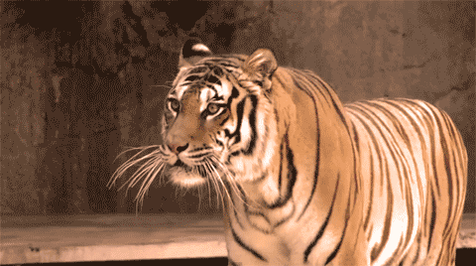
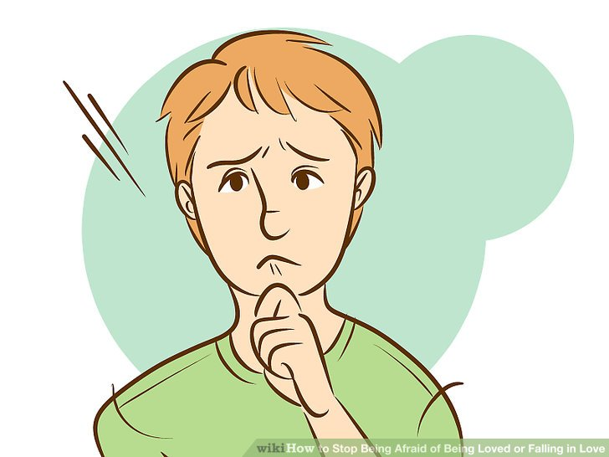
03
04
7
Roar
Afraid
8
LEARNING OUT..
9
W.C.WORK
10
Shout
গর্জন
Funky
ভীত
NEW WORD’S
11
WARD’S DETAIL
12
WARD’S DETAIL
WARD’S DETAIL

Slide 12
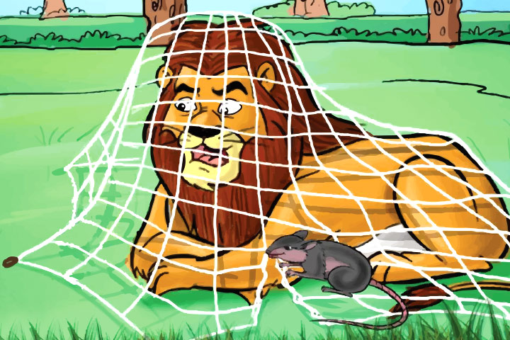
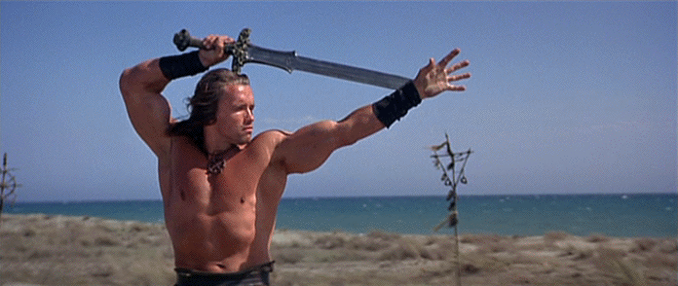
05
06
7
Trap
Strong
8
LEARNING OUT..
9
W.C.WORK
10
Snare
ফাঁদ
Potential
শক্তিশালী
NEW WORD’S
11
WARD’S DETAIL
12
WARD’S DETAIL
WARD’S DETAIL

Slide 13
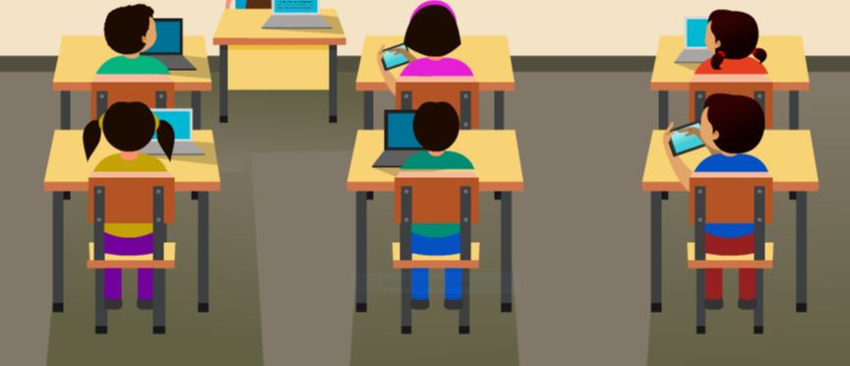
13
Student’s we are going to listen a story
14
One day, a lion was sleeping in the forest. The lion was big and strong. All the animals feared the lion, apart from one mouse.
The mouse was playing near the lion. She ran onto the lion’s nose and he woke up. He was angry.
Dear student’s ,
Listen to the text attentively.
TEACHER’S READ
15
R... QUESTION’S
16
T.M.READING
17
T.M.READING
18
T.M.READING
PAIR WORK

Slide 14
13
14
Student’s read the question’s silently & think what will be answer.
TEACHER’S READ
15
R... QUESTION’S
16
1. What was the lion doing?
2. Who did not fear the mouse?
3. Why was the lion angry?
T.M.READING
17
T.M.READING
18
T.M.READING
PAIR WORK

Slide 15
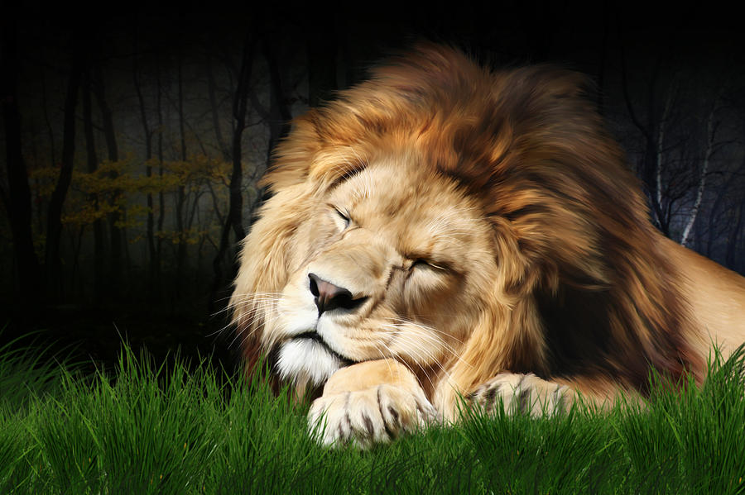
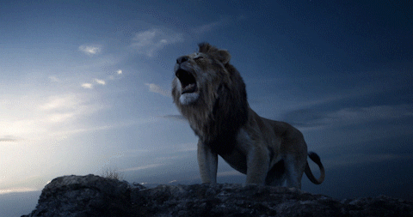
13
Dear student’s read the text with me
14
TEACHER’S READ
15
R... QUESTION’S
16
T.M.READING
17
T.M.READING
18
T.M.READING
PAIR WORK
One day, a lion was sleeping in the forest. The lion was big and strong.

Slide 16
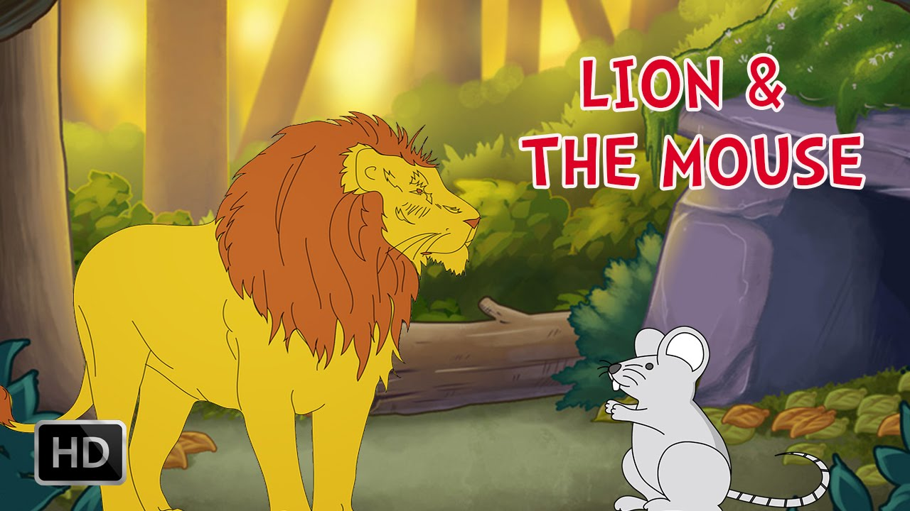
13
Dear student’s read the text with me
14
TEACHER’S READ
15
R... QUESTION’S
16
T.M.READING
17
T.M.READING
18
T.M.READING
PAIR WORK
All the animals feared the lion, apart from one mouse.

Slide 17
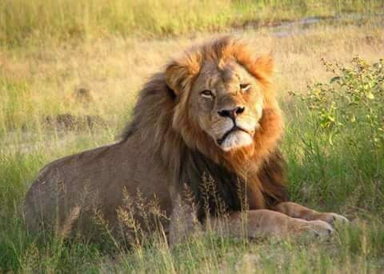
13
Dear student’s read the text with me
14
TEACHER’S READ
15
R... QUESTION’S
16
T.M.READING
17
T.M.READING
18
T.M.READING
PAIR WORK
The mouse was playing near the lion. She ran onto the lion’s nose and he woke up. He was angry.

Slide 18
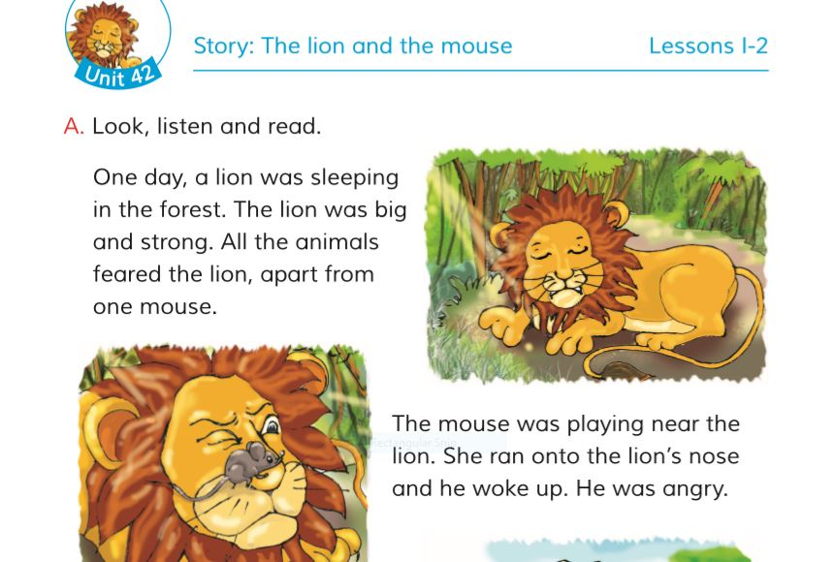
13
Dear Students, make pair and read the text with pair.
14
TEACHER’S READ
15
R... QUESTION’S
16
T.M.READING
17
T.M.READING
18
T.M.READING
PAIR WORK

Slide 19
19
20
GROUP WORK
21
Dear Students, make group and read the text by the help of the group.
EVALUTION
22
HOME WORK
One day, a lion was sleeping in the forest. The lion was big and strong. All the animals feared the lion, apart from one mouse.
The mouse was playing near the lion. She ran onto the lion’s nose and he woke up. He was angry.
BYE BYE

Slide 20
19
20
GROUP WORK
21
EVALUTION
Dear Students, come on the stage any 2 or 3 student and read the text one by one loudly.
22
HOME WORK
BYE BYE
Page no:84, Activity-A

Slide 21
19
20
GROUP WORK
21
EVALUTION
22
DEAR STUDENT’S
HOME WORK
You will write 5 sentences about a lion.
BYE BYE

Slide 22
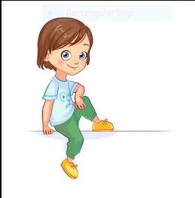
19
20
GROUP WORK
21
EVALUTION
Welldone!
THE END
22
HOME WORK
BYE BYE

