Slide 1

Welcome
Md. Nurul Huda
B. A (Hons.); M. A (English); B. Ed (1st class); M. Ed (1st class)
Asst. Teacher (English)
Pearapur High School, Gaibandha
E-mail: nhuda.simple@gmail.com

Slide 2

English 1st Paper.
Class-Nine
Time-50 Minutes.

Slide 3
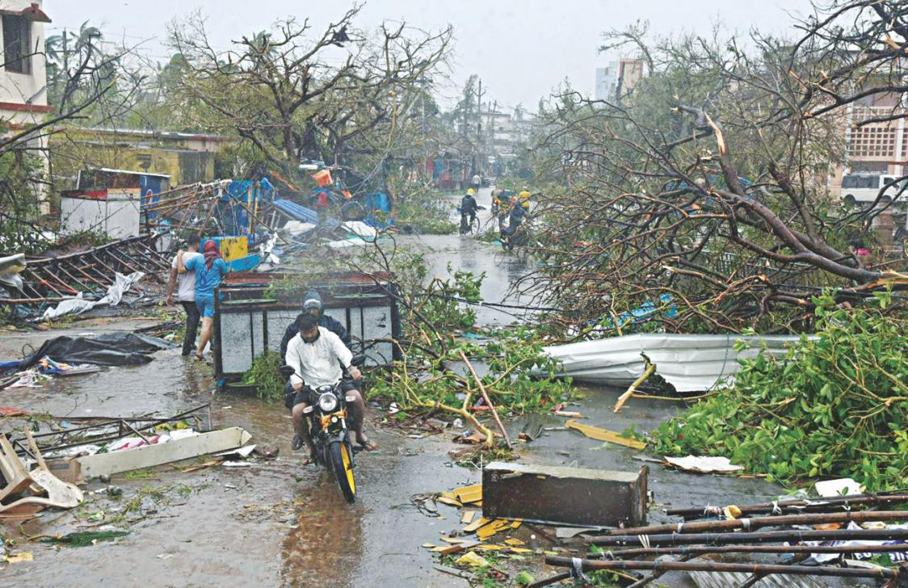
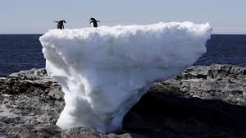

Slide 4
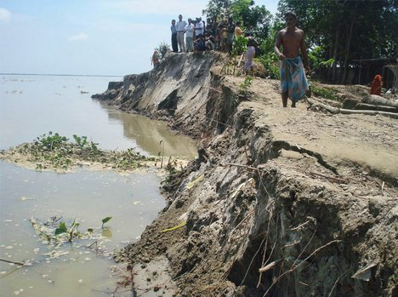
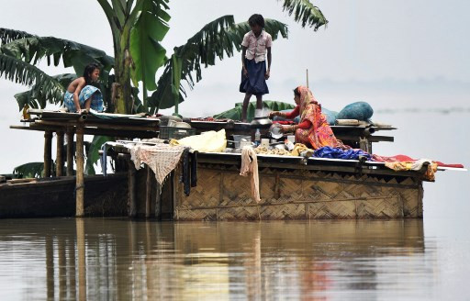
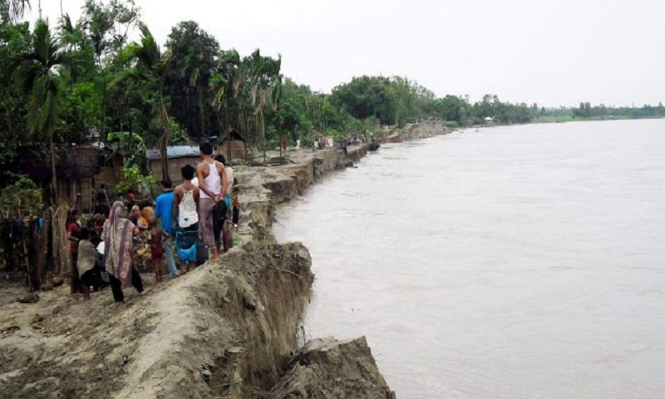
What do you see in these pictures?

Slide 5

The Greed of the Roaring Rivers
So, the title of the lesson is
Unit- 5
Lesson-1
Page- 50

Slide 6


Learning outcomes
After completing the lesson SS will be able to –
Section-A: Comprehend and summarize the text
Section-B: Choose the meaning
Section-C: Ask and answer the questions
Section-D: Fill up the gaps

Slide 7


Slide 8
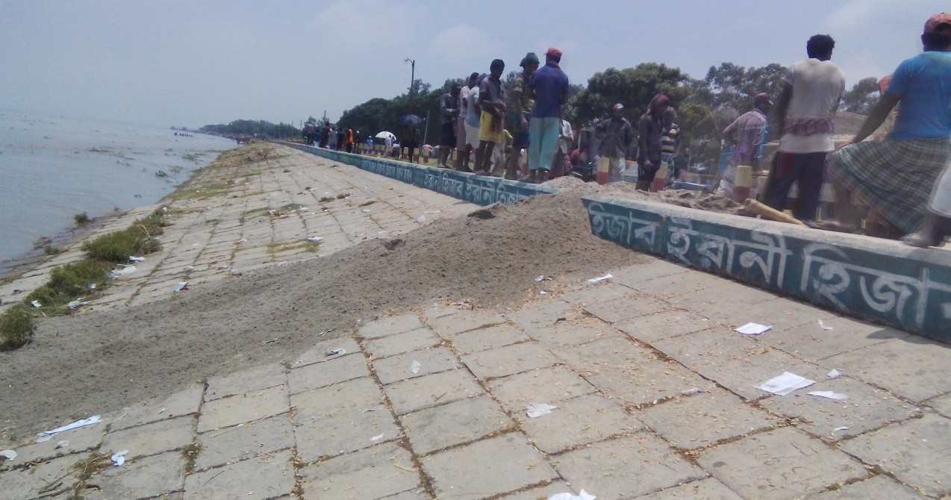

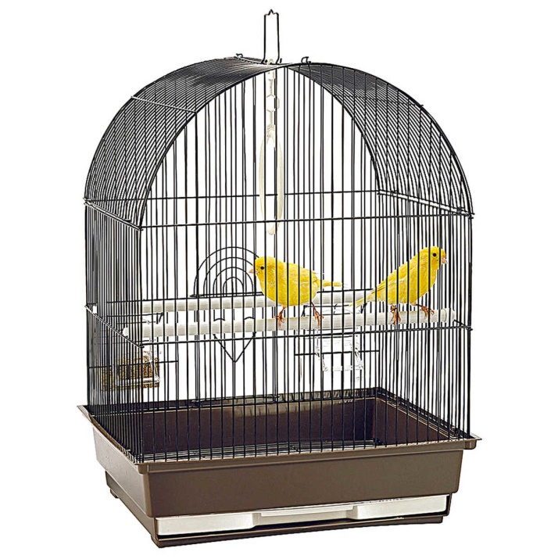

Embankment
Dam, barrier
Cage
Aviary, bound, limitation

Slide 9
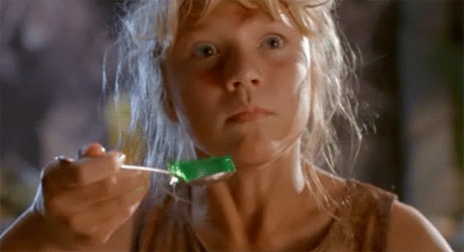
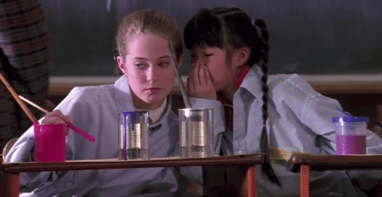
Tremble
Shaking of anything
Whispering
Secret talking

Slide 10
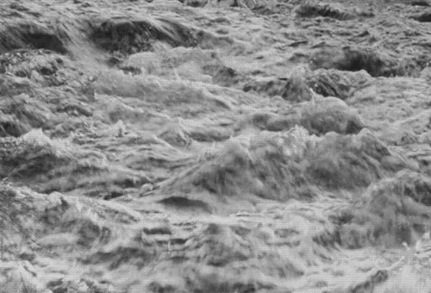
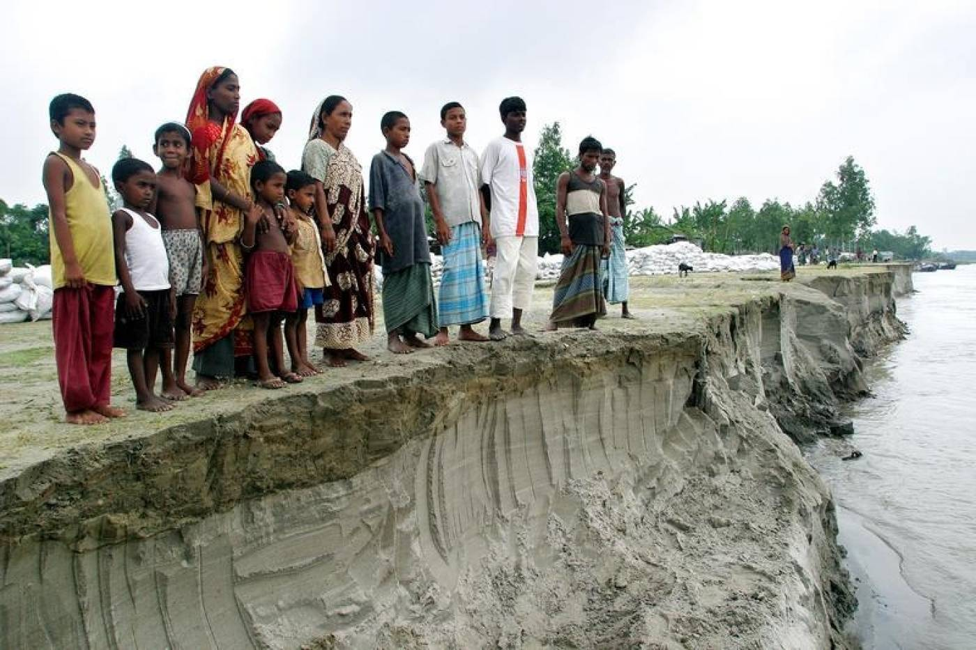


Turmoil
unrest
Erosion
decay

Slide 11
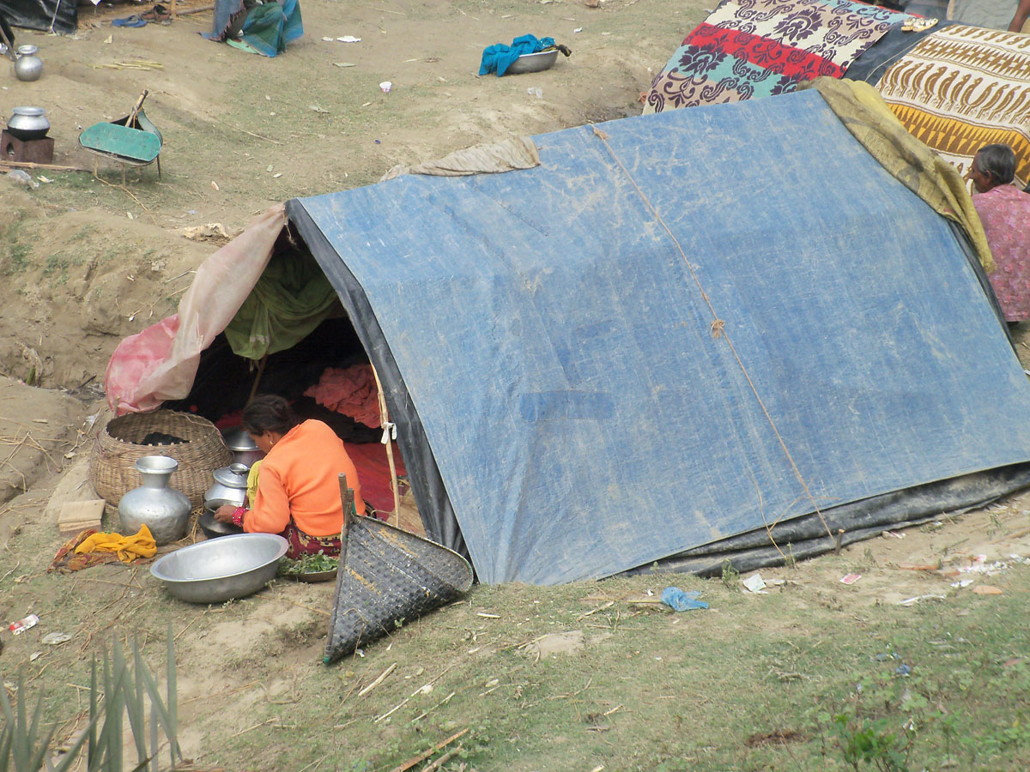
Meherjan lives in a slum on the Sirajgonj Town Protection Embankment. Her polythene roofed shelter looks like a cage. She is nearly 45 but looks more than her age. In front of her shelter, she is trying to make a fire to cook the day’s only meal. Her weak hands tremble as she adds some fallen leaves and straw to the fire. The whispering wind from the river Jamuna makes the fire unsteady. The dancing of the flames reminds Meherjan of the turmoil in her life.
Notes:
Teacher/ Facilitator can follow the passage from Text book to complete it.

Slide 12
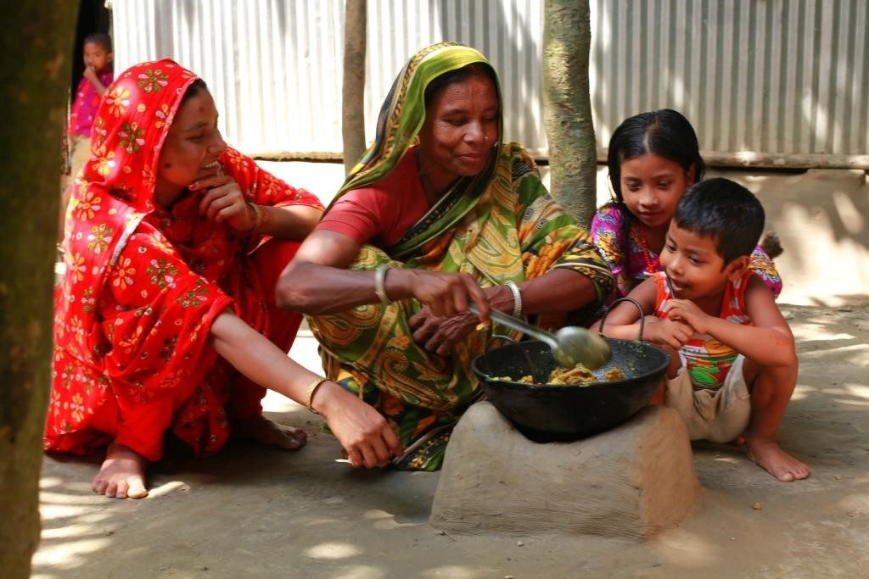
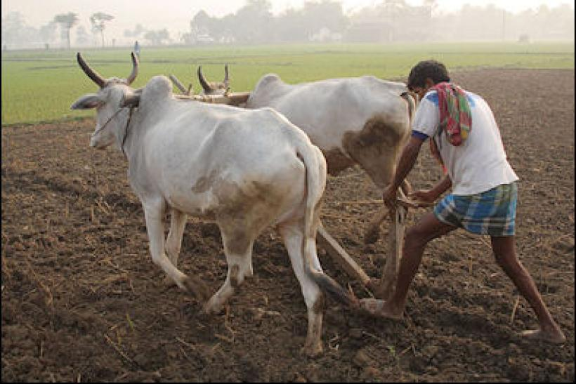
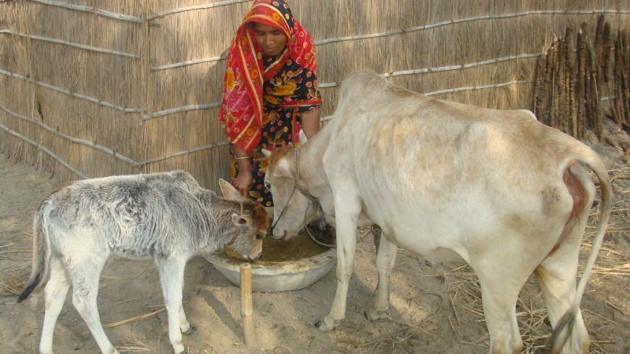
Not long ago Meherjan had everything- a family, cultivable land and cattle.
Notes:
Teacher/ Facilitator can follow the passage from Text book to complete it.

Slide 13
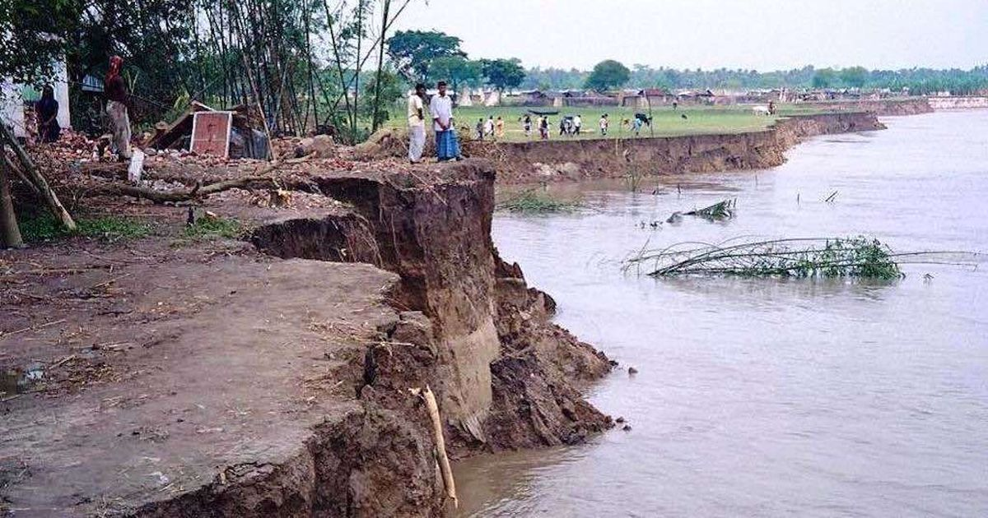
The erosion of the Jamuna consumed all her landed property gradually.
Notes:
Teacher/ Facilitator can follow the passage from Text book to complete it.

Slide 14
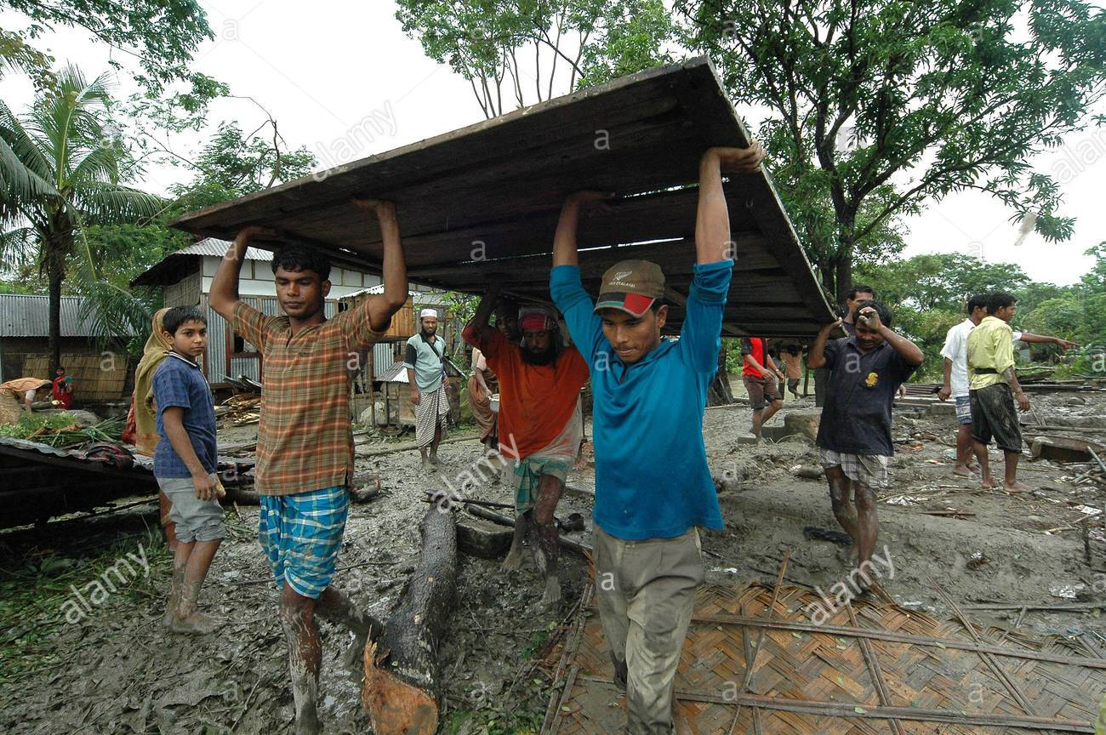
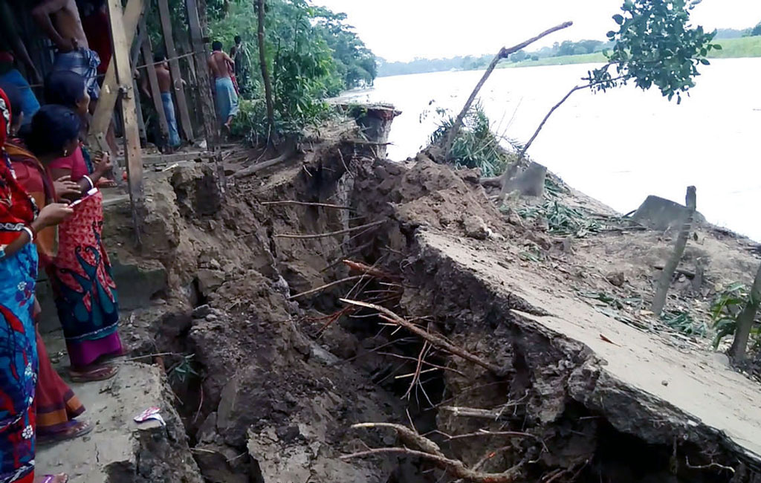
There are thousand others waiting to share the same fate with Meherjan. Bangladesh is a land of rivers that affect its people. Erosion is a harsh reality for the people living along the river banks.
Notes:
Teacher/ Facilitator can follow the passage from Text book to complete it.

Slide 15
Individual Work
Answer the following questions
1. In paragraph 3 ‘roaring rivers’ mean
(i) rivers having many rowing boats in them
(ii) rivers that flow strongly making wild sounds
(iii) rivers that make people cry out
(iv) rivers that have noisy fishes
2. What do you mean by ‘turmoil’?
(i) rest (ii) unrest (iii) decay (iv) dirt

Slide 16
Group Work
Answer the following questions
a) What does Meherjan use to make fire for cooking her meals?
b) What property did Meherjan lose due to river erosion?
c) What do you know about Meherjan’s family?
d) In which season does river erosion most likely occur?

Slide 17

Write a short paragraph on “River Erosion”

Slide 18


