Slide 1

WELCOME

Slide 2
INTREDUCE
Rana Hamid
ASSISTANT TEACHER
MOHESPUR GOVT.PRIMARY SCHOOL
KALAI, JOYPURHAT.
.
CLASS:TWO
SUBJECT:ENGLISH
LESSON:22
LESSON TOPIC:SIZES

Slide 3
LEARNINGOUTCOMES
STUDENT WILL BE ABLE TO
1.1.1 Become familiar English sounds by listening to common English words.
Speaking:
Repeat after the teacher simple words and phrases with proper sounds and stress.
1.1.2 Say simple words and phrases with proper sounds and stress.
Reading:
1.3.1 Recognize and read the names of objects having the same initial and final sounds.
1.4.1 Read words and phrases with the help of visual clues(about 30 new words) and simple sentences.

Slide 4
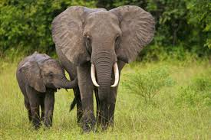

Slide 5
SIZES

Slide 6

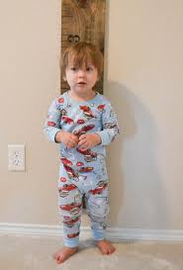
tall
short

Slide 7
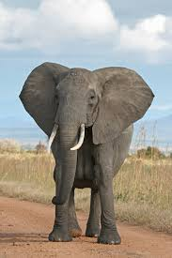
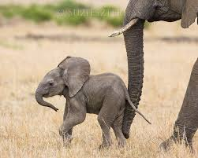
s
big
small

Slide 8
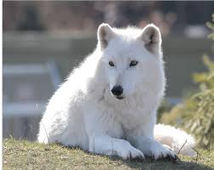

Thin
fat

Slide 9
a tall boy

Slide 10
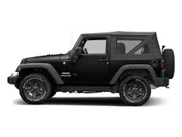
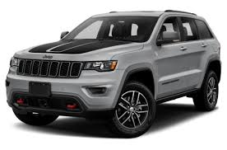
a big jeep

Slide 11
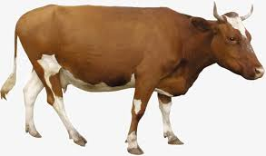
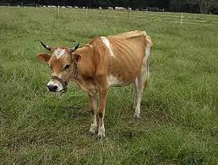
a fat cow

Slide 12
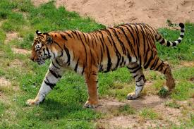
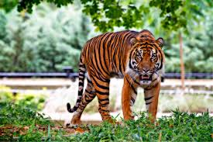
Assesment
fat
thin

Slide 13
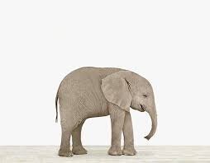
big
Small

Slide 14

Thank you

