Slide 1


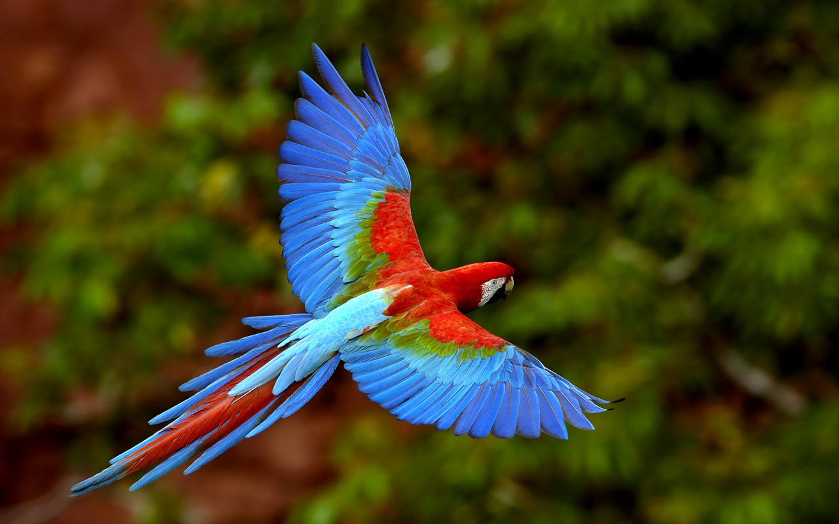
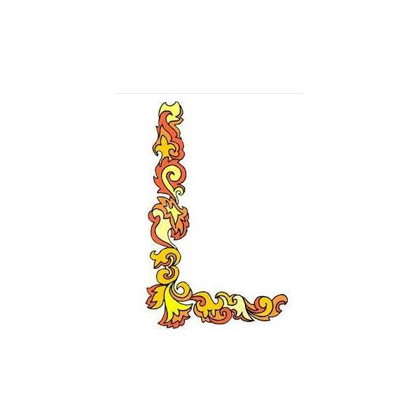
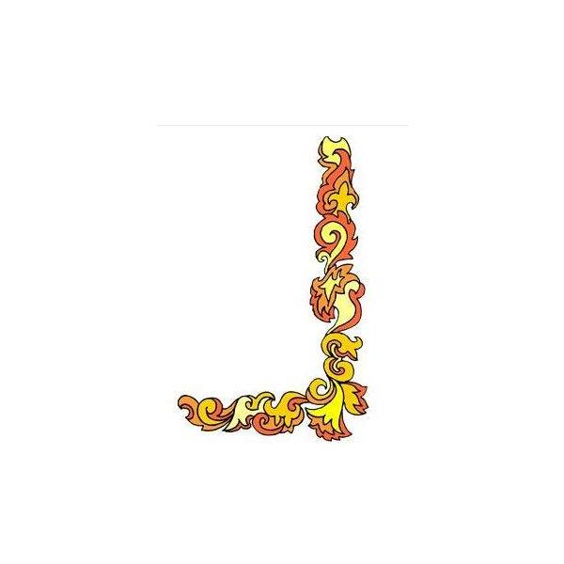
Welcome

Slide 2
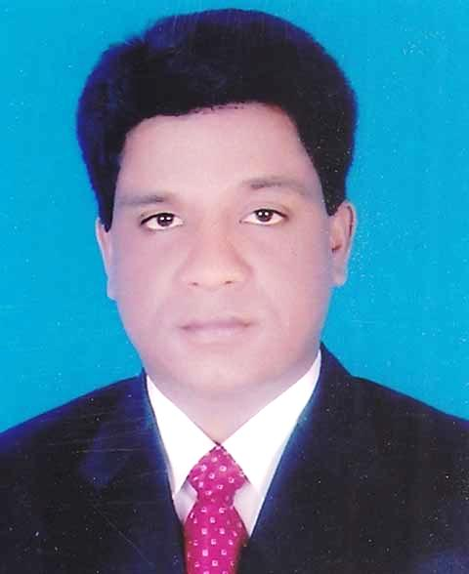
INTRODUCTION
SUBJECT: English 1st Paper
CLASS: Six
Lesson -12
Prepared by
Mohammad Azharul Islam
Assistant Teacher (English)
Hugra Habib Kader High School
Tangail Sadar Tangail.
Mobile : 01718308

Slide 3
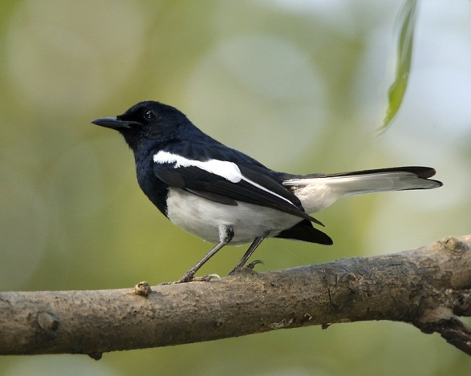
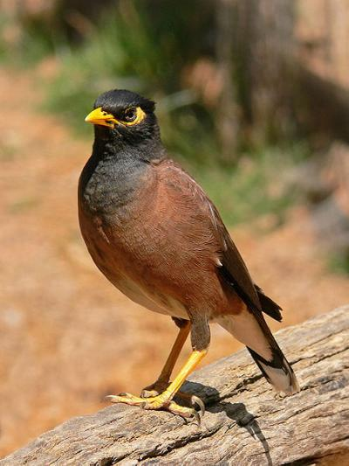
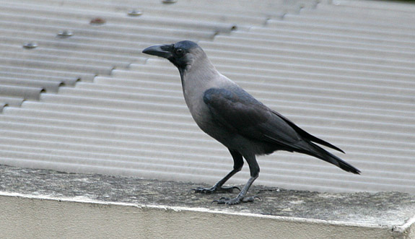
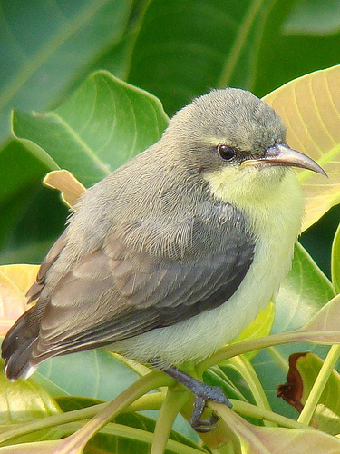
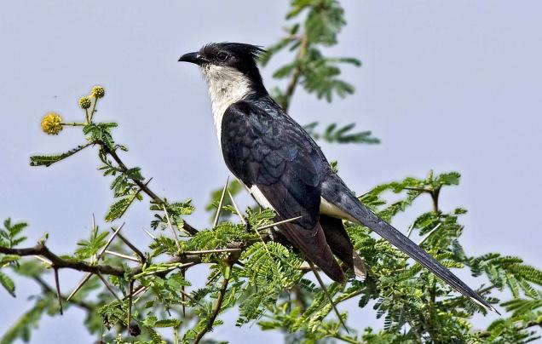
Magpie Robin
Shalikh/Myna
Crow
Tuntuni/Tailorbird
Cuckoo (Kokil)

Slide 4
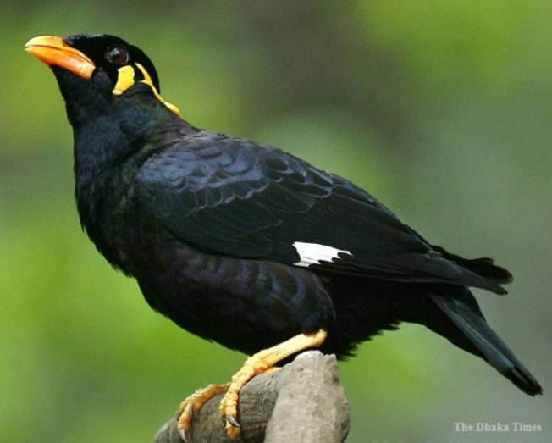
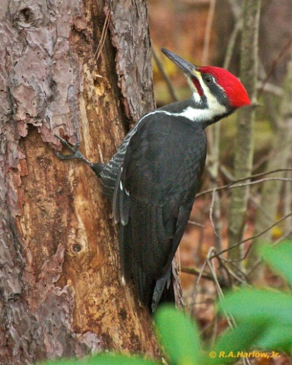
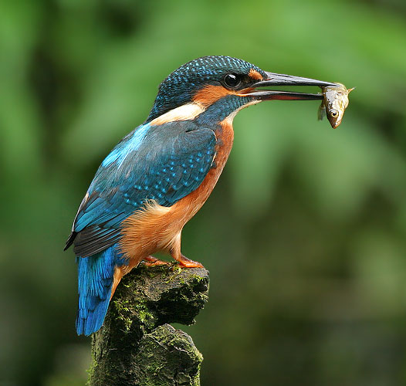
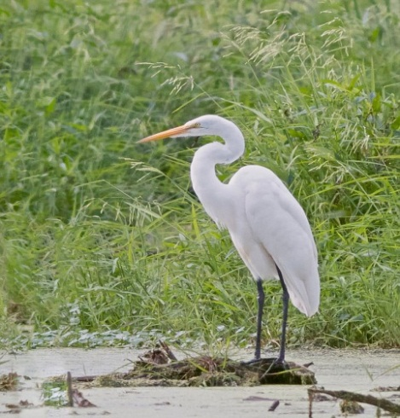
6
7
Moyna
Woodpecker
8
9
Kingfisher
Heron

Slide 5
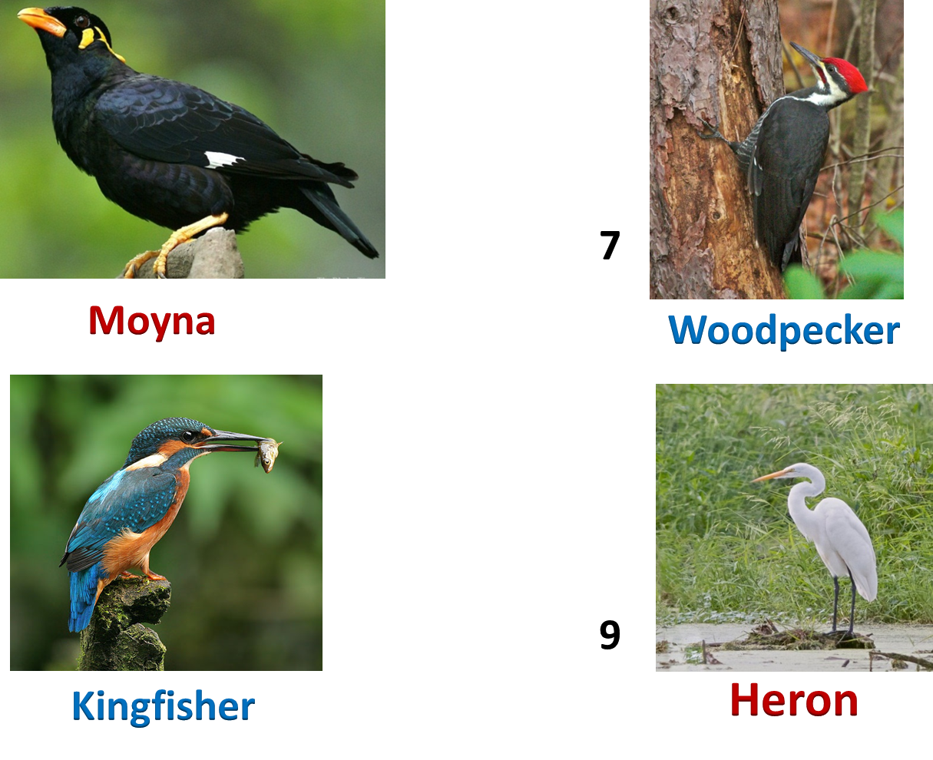

Slide 6
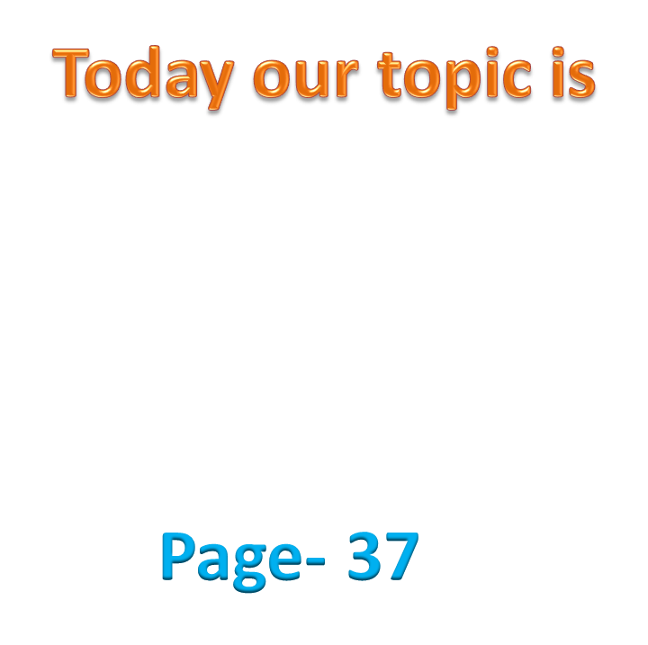
Birds of Bangladesh

Slide 7
Learning outcomes
By the end of the lesson the students will be able to
Talk about the video and pictures.
Read and understand text.
Write answers to questions.
Write a short paragraph.

Slide 8
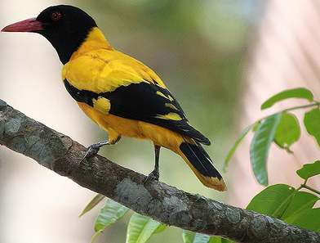
Can you tell the name of this bird?
Blackheaded Oriole
(Benebau)

Slide 9
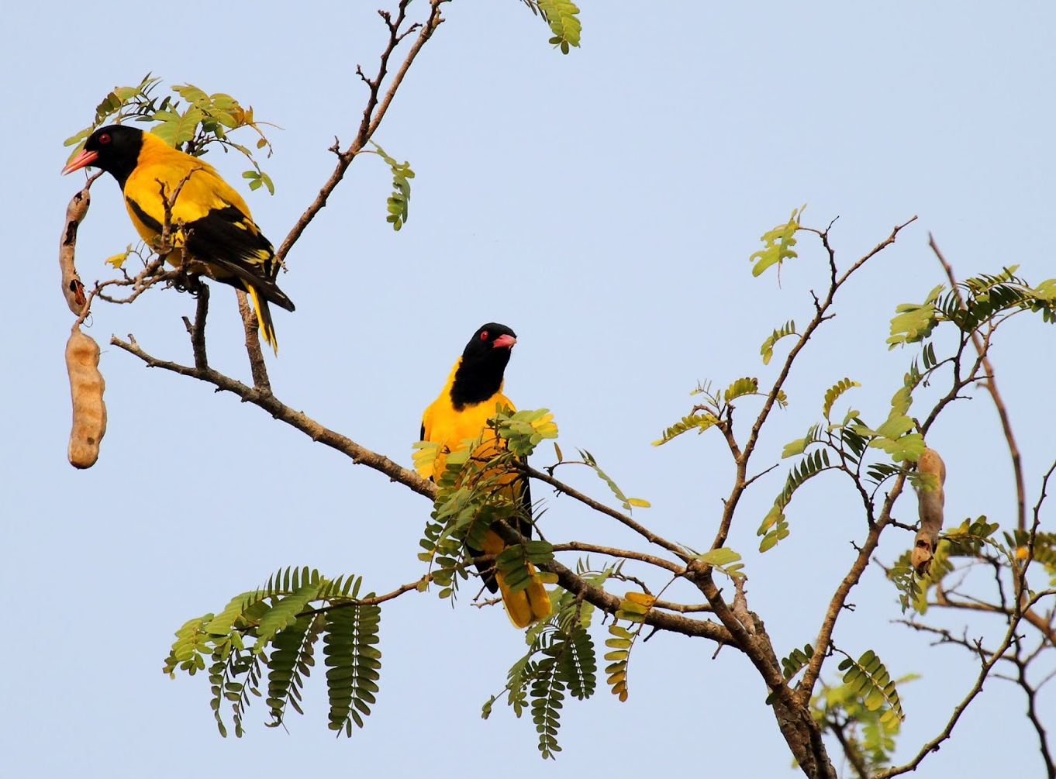
Describe the picture

Slide 10
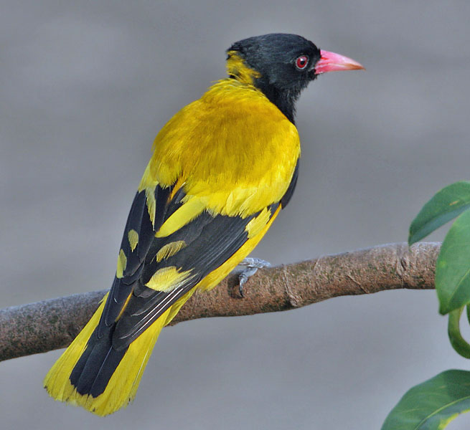
What is the colour of its body? Yellow
What is the colour of its beak? Red
What is the colour of its throat, tail and some part of its wings? Black
Can you guess what is the length of this bird? 25cm

Slide 11
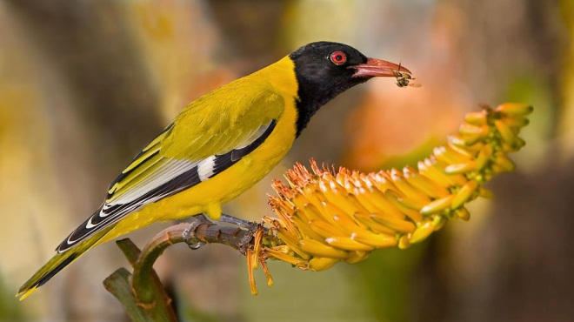
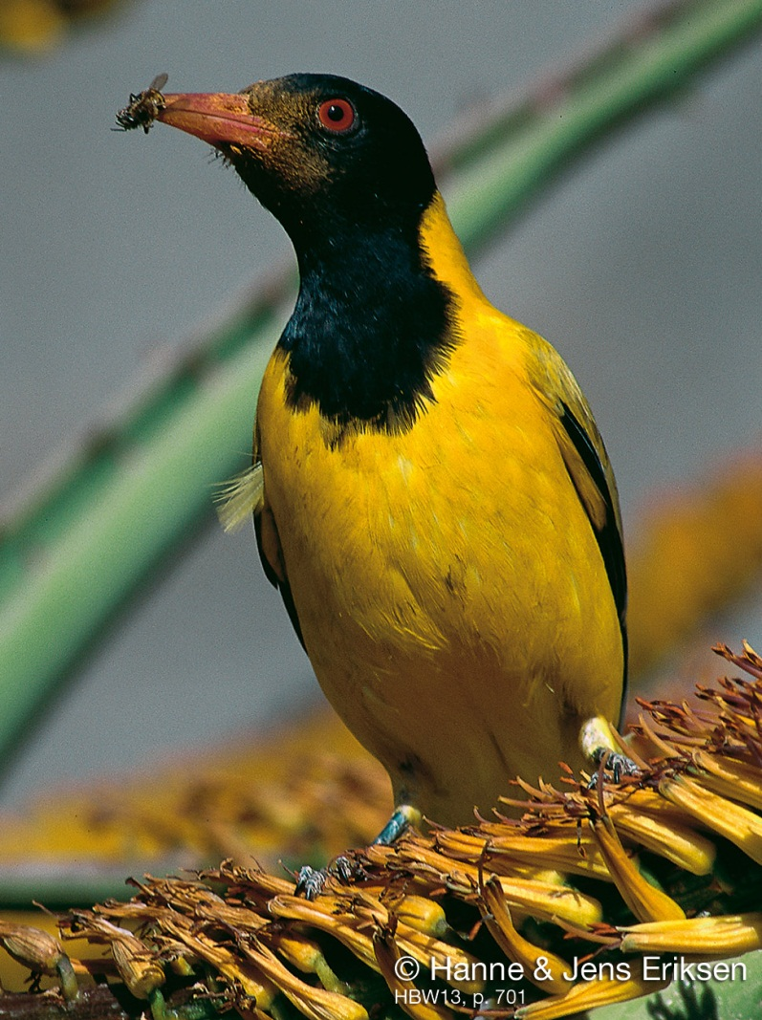
Guess what does this bird eat?
All kinds of insects and worm

Slide 12
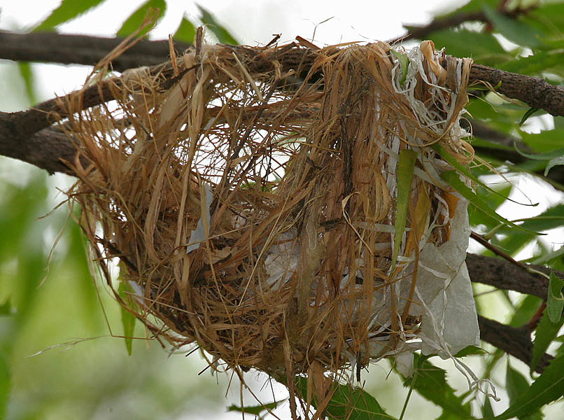
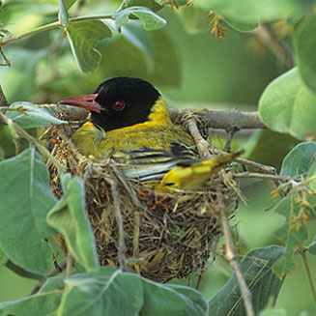
Can you guess by which the nest is made of ?
Dry grass and barks of trees.

Slide 13
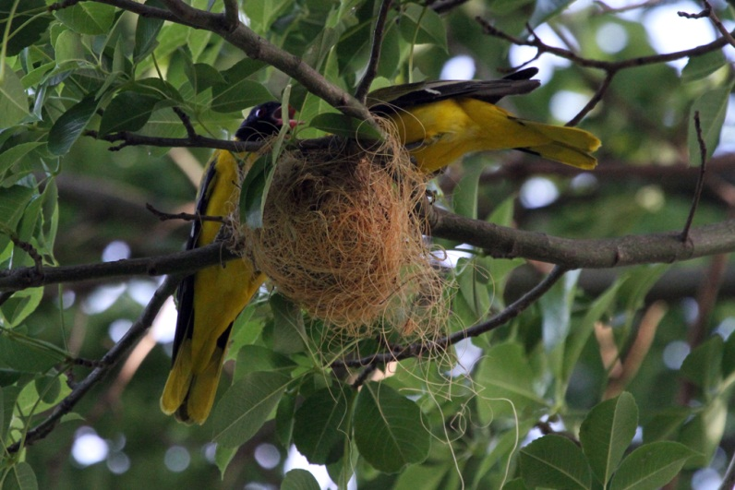
Both the male and female birds build their nest.

Slide 14
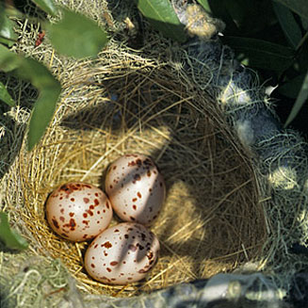
The black headed Oriole lays two or three eggs at a time.

Slide 15
Read the passage about ‘Benebau’ from the text book and write the answer of the following questions.
1. What are we proud of?
Ans: We are proud of our soil, forest, fruits and birds.
2. In which countries is Blackheaded Oriole seen?
Ans: It is seen in Bangladesh, India, Srilanka, Mayanmar and some countries .
3. How is its call?
Ans: Its call is sweet and pleasant.

Slide 16
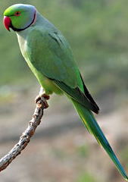
Look at the bird ‘Tia’ and write a paragraph on it using the clues given.
yellow and round eyes
strong, curved red beak
whole body green
tall, slim tail
feet red
makes nest in Shimul tree
found all over Bangladesh
42 cm length
Eats grass, nuts, chilli and fruits

Slide 17





Please don’t cut trees.
Let us live happily and peacefully.

Slide 18
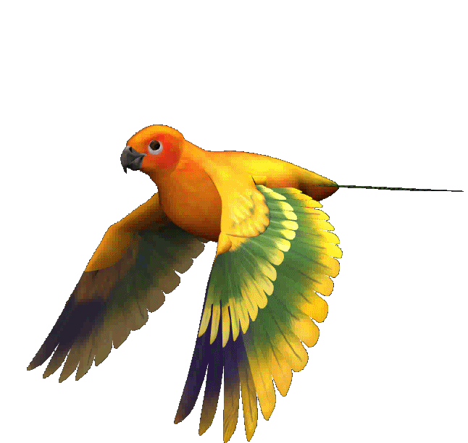
THANKS ALL

