Slide 1

Welcome

Slide 2

Introducing:
Md.Saiful Islam
Assistant teacher (English)
Bagbari Chowbaria High School
Tangail Sadar,Tangail
ID-NO: 371

Slide 3
Class-9
Sub: English-1st paper
Unit-2
Lesson-3
Time: 50 minutes
Date: 28/04/2019

Slide 4
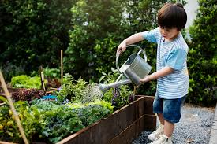
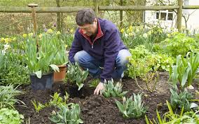
What is the picture about?
Gardening

Slide 5
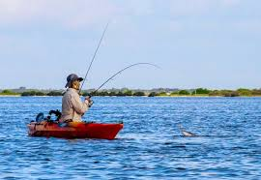
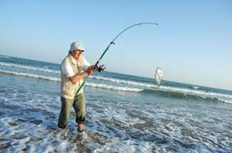
What is the picture about ?
Fishing

Slide 6
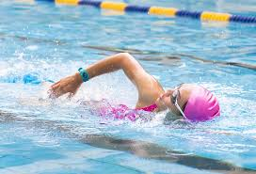
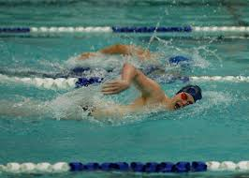
What are they doing?
Swimming

Slide 7
Lesson declaration :
Pastimes

Slide 8
Learning out comes:
After finishing the lesson learners will be able to-
1. Say what is pastime
2. Match the sentences
3. Say true or false
Choose the best answer from the alternative
say the meaning of the words
Make a dialogue about pastime

Slide 9
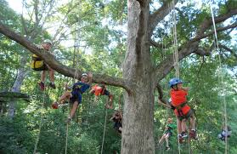
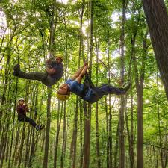
What is the picture about
Climbing trees

Slide 10
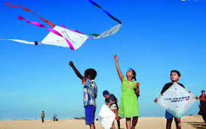
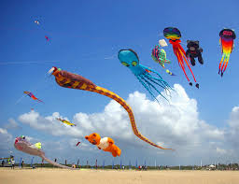
Is it pastime?
Yes

Slide 11


What is the picture about?
Reading books

Slide 12
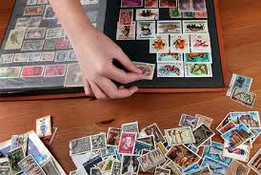
What is the picture about?
Stamp collecting

Slide 13
Individual work
What is pastime?
One`s favourite occupation or leisure

Slide 14
Peer work
Make a dialogue between you and your friend about pastime

Slide 15
Group work:
Write the meaning of the following words: pastime, decline, rapid, unfortunately, significance.
Pastime- leisure
Unfortunately- unluckily
Significance-importance
Decline- decay
Rapid- quick

Slide 16

Evaluation:

Slide 17
Say whether the following sentences are true or false. If false give the right answer.
Pastime is changing.
RSPB is an organization.
The computer users in 2000 were 40%.
(d) In 1990, 41% teenagers liked TV watching .
(e)The decreasing urbanization has reduced the number of open fields.
True
True
False. 18%
True
False. The increasing urbanization has reduced the number of open fields

Slide 18


Slide 19
Home work
Write a paragraph about
Your pastime

Slide 20
Allah hafez
Notes:
Just one click.

