Slide 1
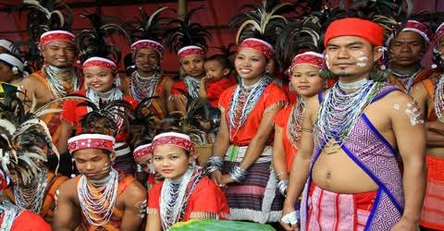
Welcome

Slide 2
IDENTITY
SIFAYAT ULLAH
Assistant Teacher (English)
Class: Eight
Subidpur O.S.Dakhil Madrasha,
Subidpur,Faridgonj, Chandpur.
Subject: English
Time: 45 minute

Slide 3
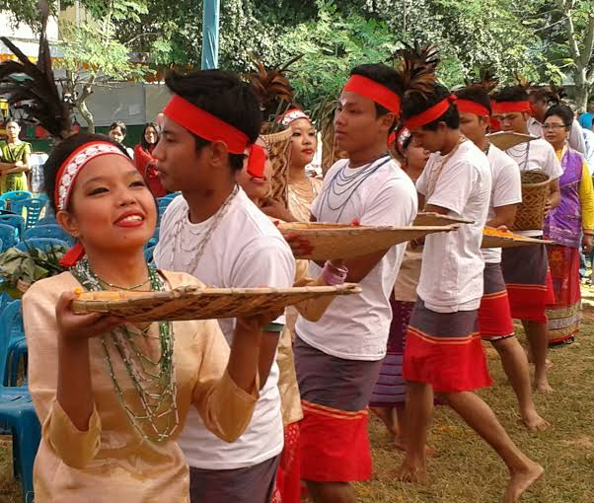
Our ethnic friends

Slide 4
Learning outcome
After finishing the lesson students will be able to-
answer to the questions about the text
Write some new word meanings
Write a short composition on ethnic people

Slide 5
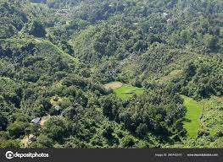
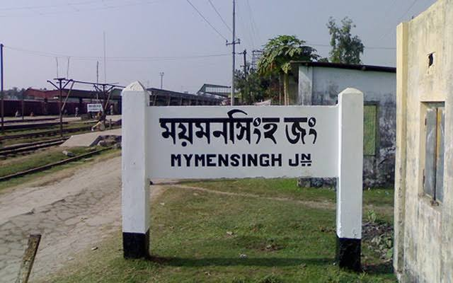
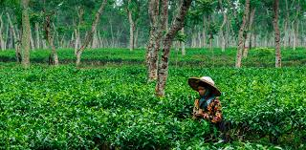
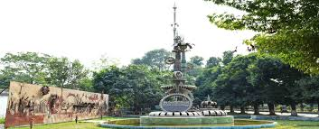
Chittagong Hill Tracts
Mymensingh
Living place of the ethnic people
Sylhet
Rajshahi

Slide 6
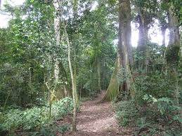
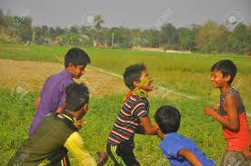
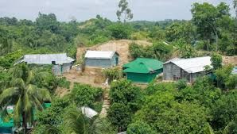
Sort of living place of the ethnic people
Forest Areas
Rural Areas
Hills

Slide 7
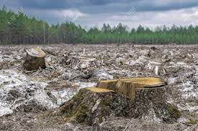
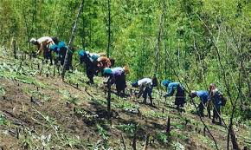
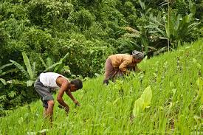
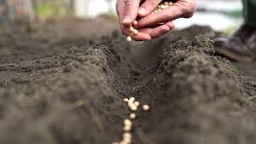
Clearing a piece of land in the forest
Preparing the land
Main Job: Farming
Sowing seeds in the land
Jhum Cultivation

Slide 8
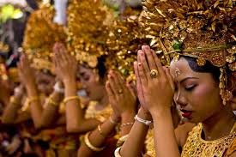
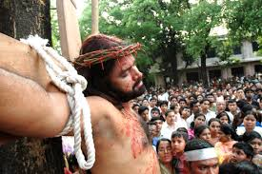
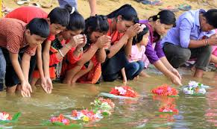
Hindus
Christians
Religion
Buddhists

Slide 9
Ethnic groups by regions

Slide 10
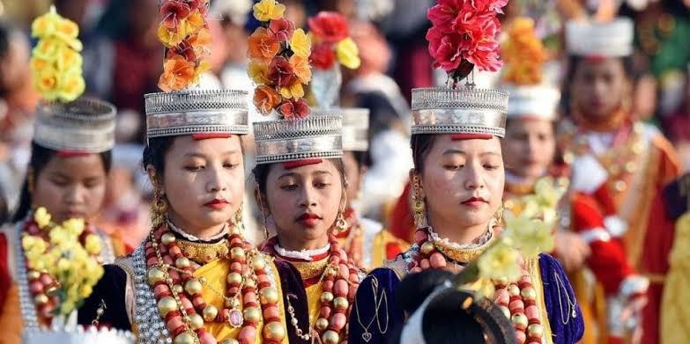
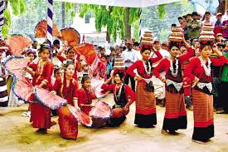
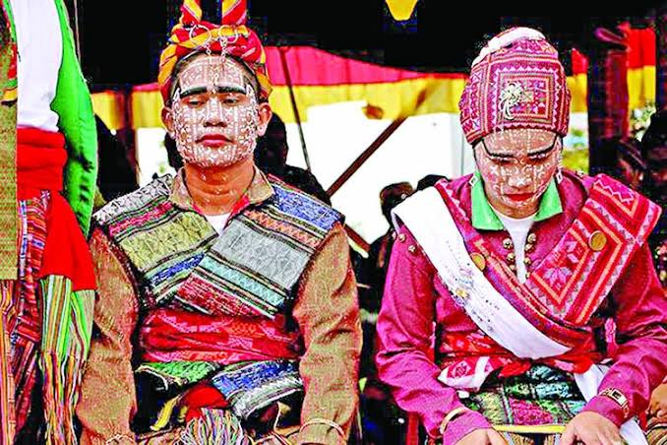
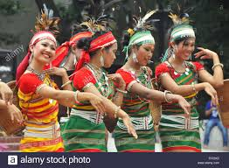
Chakmas
Marmans
Hill Tracts
Moorangs
Tipperas

Slide 11
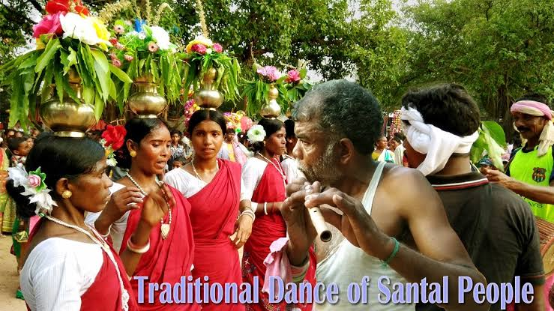
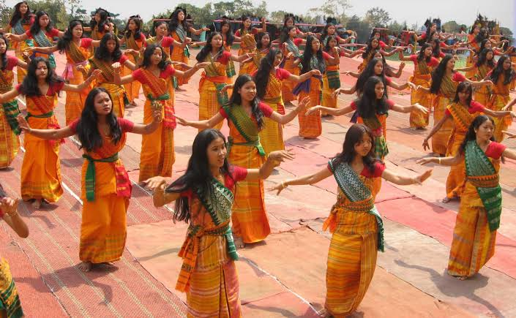
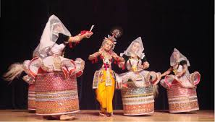
Rajshahi
Santals
Sylhet
Khasias
Monipuries

Slide 12
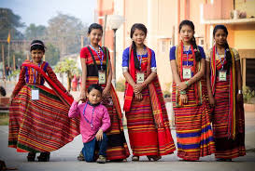
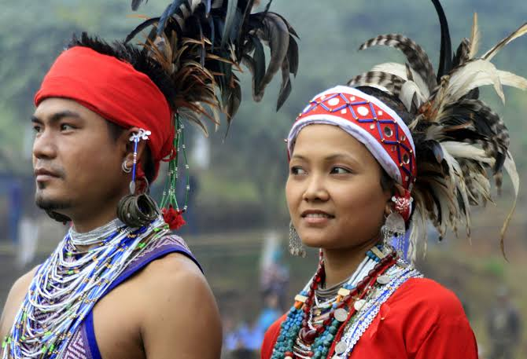
Mymensingh
Hajangs
Garos

Slide 13
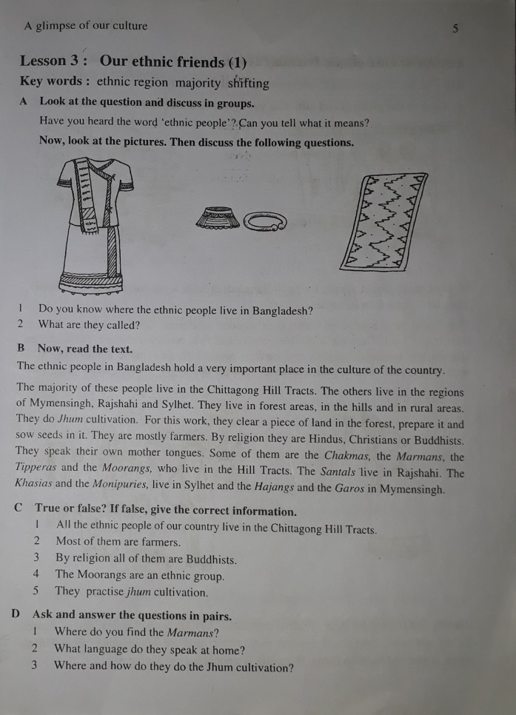
Open your text book at page-5 and read silently
Time: 10 minutes

Slide 14
Individual Work
Learning new words and their meanings
By using board

Slide 15
Group work
Answer the questions in groups.
Which ethnic groups live in Chittagong Hill Tracts?
What are the religions of ethnic people?
Where and how do they do the Jhum cultivation?
Time: 10 minutes

Slide 16
Evaluation
Where do you find the Marmans?
What language do they speak at home?
What is the main job of ethnic people

Slide 17
Home Work
Write a short composition on ethnic people.

Slide 18
THANK YOU FOR YOUR ATTENTION

