Slide 1

All are welcome

Slide 2

Introduce of the teacher
Name: Md.Mohin Uddin
Assistant teacher
Lalargown Gov.Primary School
Bishwamberpur,Sunamgong.
Mobile -01915-216561
Gmail mohinuddin22333@gmail.com
Md.Mohin Uddin

Slide 3
Introduction of the lesson
Class:Five
Unit:6
Lesson: 3-4
Lesson Title: Food Pyramids
Today’s Lesson: Healthy Food
Total Time: 35 minutes

Slide 4
Learning out comes
1.1.1-Say to the food pyramid.
1.1.2-Say to the healthy food.
1.1.3-Say to the unhealthy food.
1.1.4- Say to the new word the the text.

Slide 5
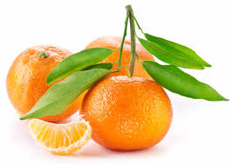
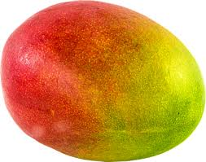
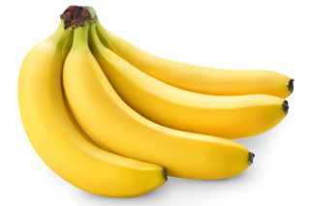
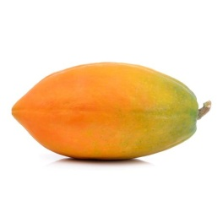
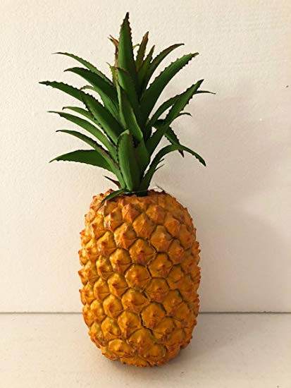
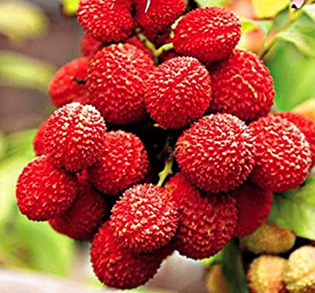
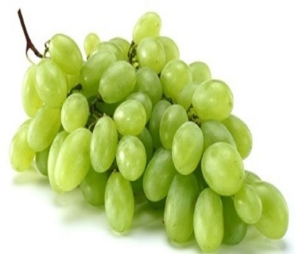
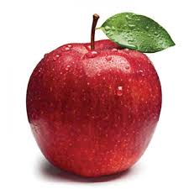
Let’s go the some picture
Fruits

Slide 6
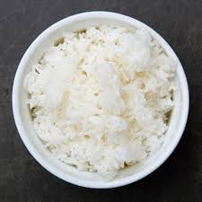
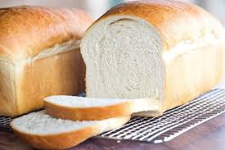
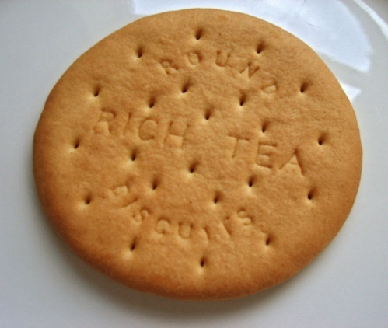
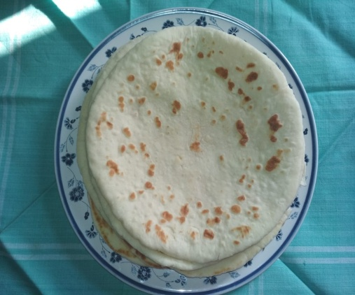
Grains food

Slide 7
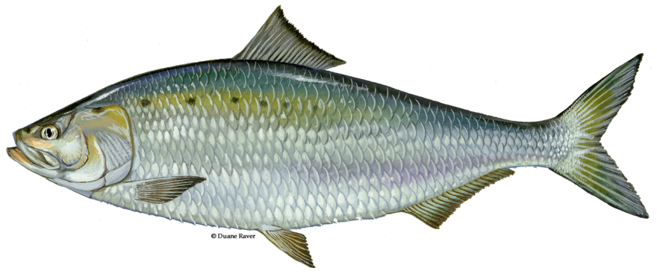
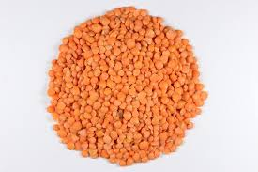
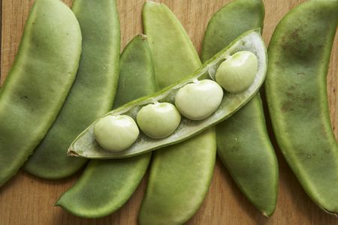
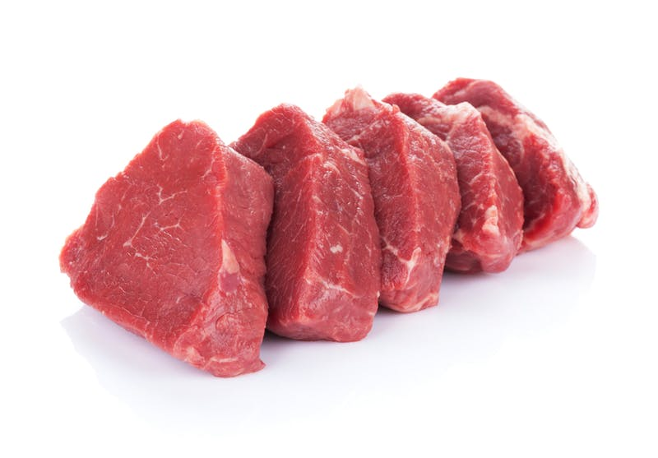
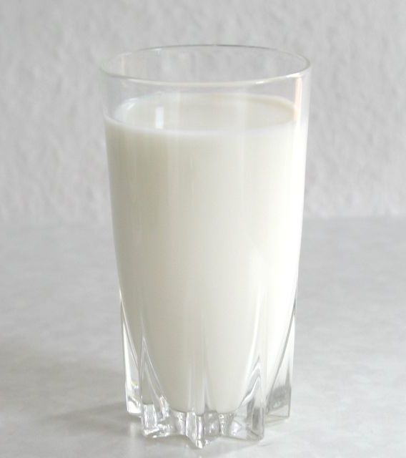
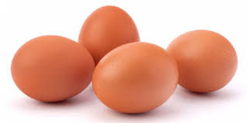
Protein foods

Slide 8
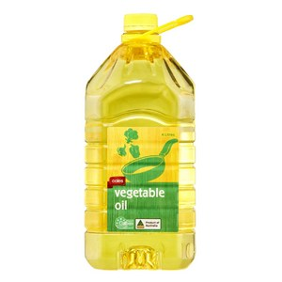
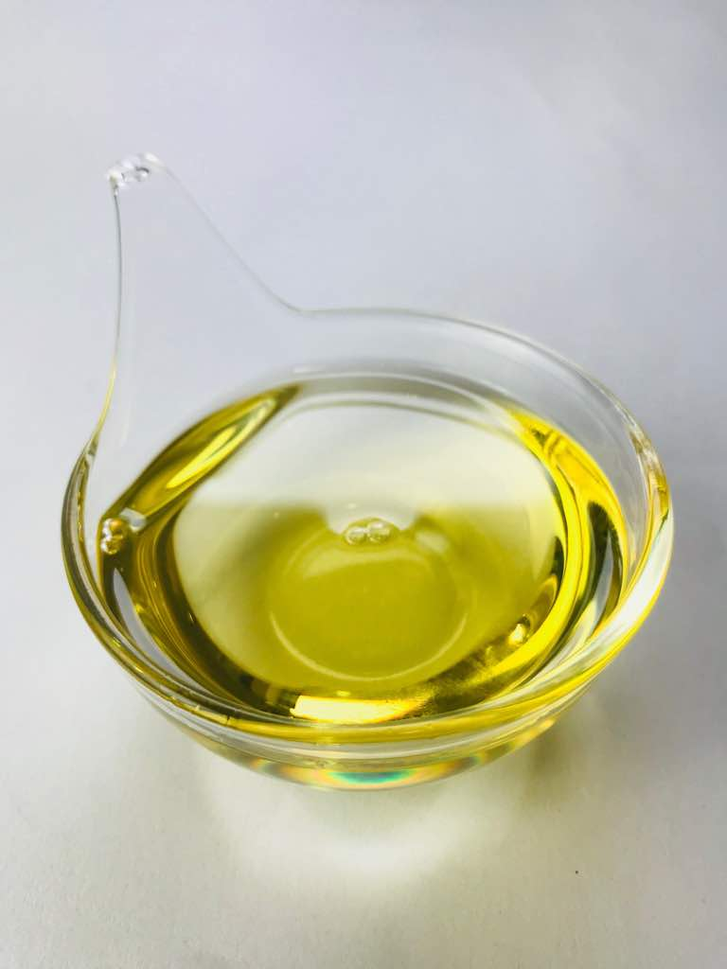
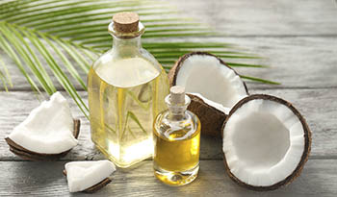
Oil

Slide 9


Presentation of the class
Everybody take an English book and open at page 24

Slide 10
Eat healthy lesson: 4-5
What food is good food? Sometimes the food we like to eat isn’t the healthiest food for us .The Food Pyramid helps us to understand the different food groups ,and it tells us how much of each food group we should eat.
Look at the picture of the Food Pyramid .We eat more of the foods at the bottom of the pyramid. What foods do you see at the bottom ? These are things made from grain, for example ,rice, ruti and bread. Potatoes are not grains, but they are similar. Grains give us energy.
Fruit and vegetables are in the next level of the pyramid .These are also very important for us. They have vitamins. They help our eyes and our health.

Slide 11
On the next level, there are fish, meat, dairy products, beans and lentils. Meat, fish and chicken have protein. Beans and lentils do, too!
Dairy products are things like milk and eggs. They help our teeth and bones. Protein and dairy make us strong.
Fat and oil are at the top of the Food Pyramid. These make food delicious, but our body does not need very much of them.
Page-24

Slide 12
Sometimes we can’t get food from all the different food groups. But when we have choices about food, we need to make good choices.
Page-24

Slide 13
Evaluation
Group Work
What is the Food Pyramid?
A list of foods name but they stay here different level
Write the name of some healthy food and unhealthy food?
Healthy foods:- Papaya, Carrots, Milk, Oranges, lettuce etc.
Unhealthy foods:- Ice-cream, Chips, fries ,chocolate etc.

Slide 14
Pair Works
Write the word meaning.
Healthiest, Important, protein, Dairy
Hame task

Slide 15
Write a short composition about
“Food Pyramid”

Slide 16
Thanks for all

