Slide 1
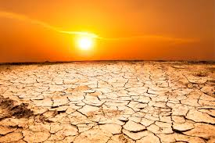
welcome

Slide 2
Introduction of the teacher
Name:Mohin Uddin
Assistant teacher

Slide 3

Introduction of the lesson
Class : 1
Sub: English for today
Unit: 2
Lesson: 4
Lesson tittle: Alphabet
Todays lesson :A (read and say)
Class time:35 miniute

Slide 4
Learning outcomes
Knows to the Alphabet ( A )
Look at the picture with the alphabet (A)
Say to the letter and picture.

Slide 5
Lets play a game
1
1
2
2
2
4

Slide 6
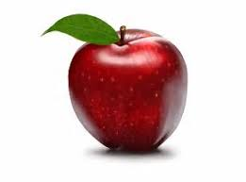
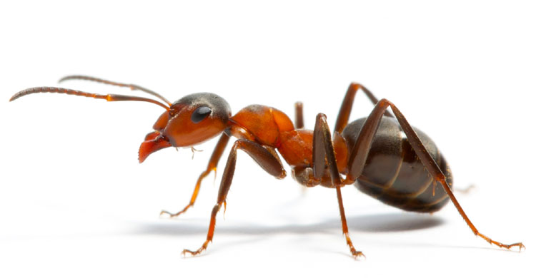
Find out the letter in these picture
Apple
Ant

Slide 7
A
a

Slide 8
Apple
Axe

Slide 9

Read the letter from your task book
Text book
Text book

Slide 10
Now try to answer the question
What is the name of this fruit?
Ans: Apple
What is the name of the animals?
Ans: Ant

Slide 11
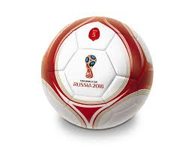
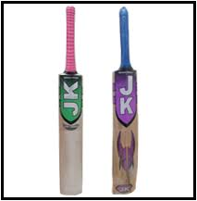
Home task
You write a capital letter “B” form your task in your paper.
B
B

Slide 12

ddd

