Slide 1
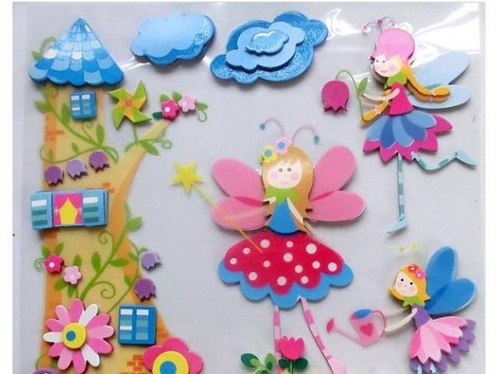
welcome

Slide 2
Presented by
Md.Mohin Uddin
Assistant Teacher
Lalargown Govt.Primary School
Bishwamberpur,Sunamgonj.

Slide 3
Class : Four
Subject : English

Slide 4
Students will be able to….
Read words, Phrases and sentences in the text with proper pronunciation.
Ask and answer WH questions
Make sentences
Write short composition about the text.

Slide 5
Lets we see some pictures

Slide 6
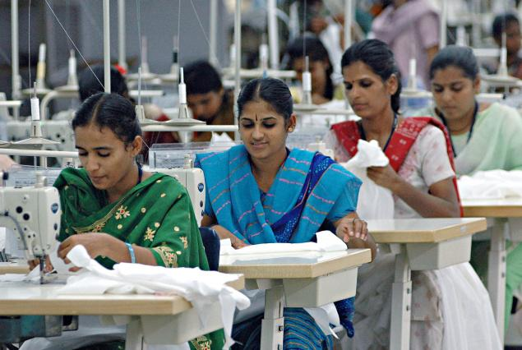
What can we see in the picture?

Slide 7
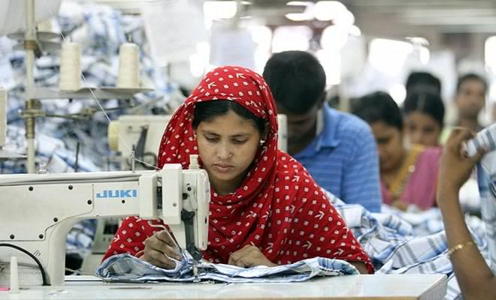

Slide 8
Many People works in garments factory

Slide 9
Garments Workers Life
I am Reshma……More money.

Slide 10
New Words
Worker
Rickshaw puller
Factory

Slide 11
Teacher reading aloud
Students listening Carefully

Slide 12
Group Work
WH Questions
What does Reshma do?
Who is Babul?
Who helps Reshma’s family?

Slide 13
Pair Works
In free time Reshma like to go to ……….
Reshmas father died by an………
Reshma lives in a small house at ………

Slide 14
Home work
write a short composition about garments workers.

Slide 15
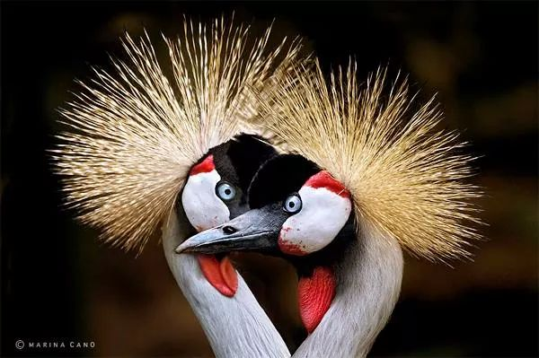
Thanks Everyone

