Slide 1


Slide 2
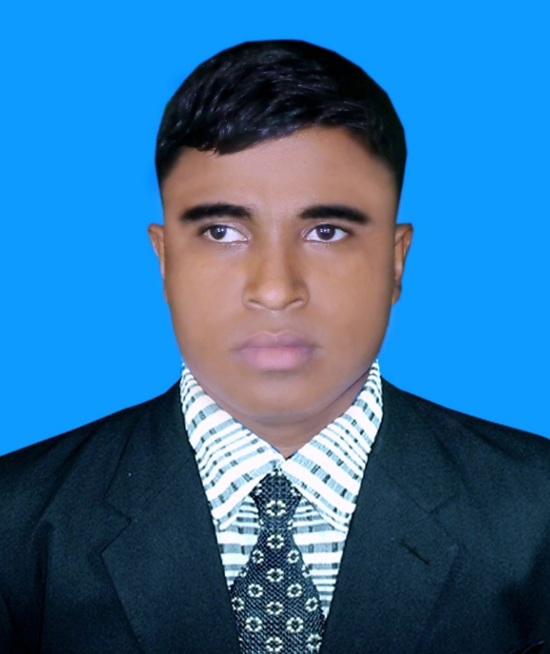
Identity
A.Sukur Ali Khan
Assistant Teacher [English]
Naldha Secondary School
Naldha.Fakirhat.Bagerhat
Mobile No:01303-022986
Email:sukur360720@gmail.com
Class & Subject
English 2nd paper
Adjetive
Class IX & X
Notes:
Lesson declaration.

Slide 3
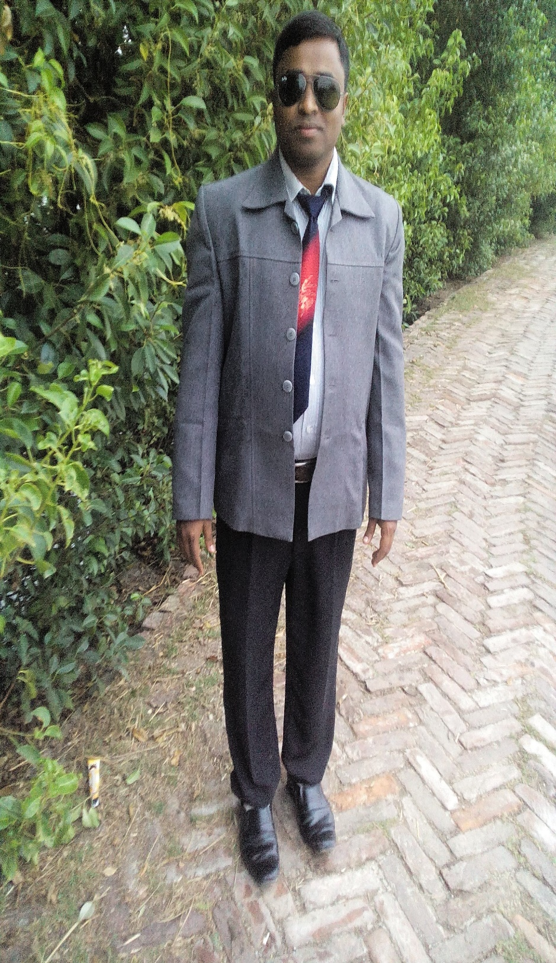
No other boy in the class is as good as Rohim.
Rohim is better than any other boy in the class.
Rohim is the best boy in the class.
What do the lines refer ?
degree

Slide 4
Today’s topic
degree

Slide 5
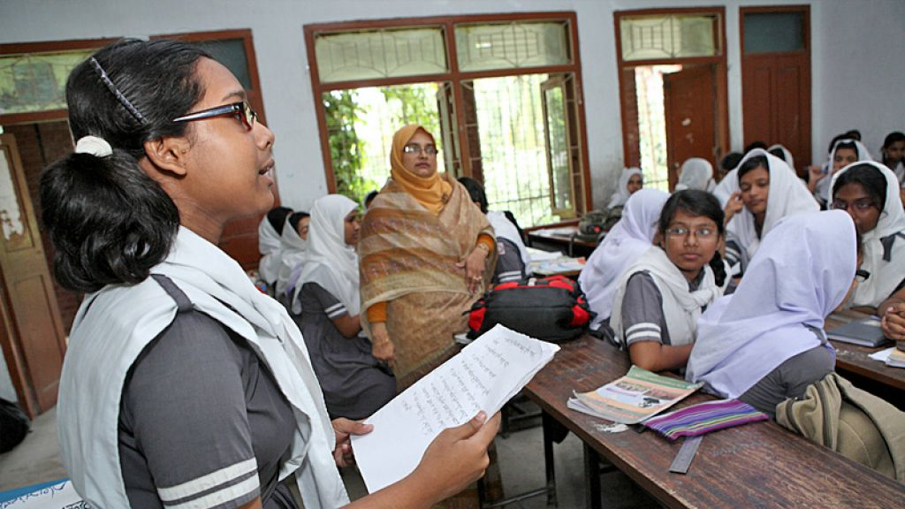
Learning Outcomes
At the end of the lesson the students will be able to
identify positive, comparative & superlative form.
change the positive into comparative & superlative.

Slide 6
Degree means
The comparison of adjective

Slide 7
Classification of degree is three
Positive
Good
Tall
Beautiful
Comparative
Better
Taller
More beautiful
Superlative
Best
Tallest
Most beautiful

Slide 8
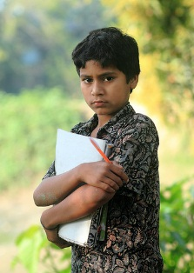
The positive sentence to comparative & superlative.1
Posi: No other boy in the class is as good as Rohim.
Com: Rohim is better than any other boy in the class.
Sup: Rohim is the best boy in the class.
Change the positive into comparative & superlative.
.
No other girl in the village is as tall as Runa.
No other animal in the jungle is as ferocious as tiger.

Slide 9
Change the positive into comparative & superlative.
.
No other girl in the village is as tall as Runa.
No other animal in the jungle is as ferocious as tiger.
Solution
.
Posi: No other girl in the village is as tall as Runa.
Com: Runa is taller than any other girl in the village.
Sup: Runa is the tallest girl in the village.
Posi: No other animal in the jungle is as ferocious as tiger.
Com: Tiger is more ferocious than any other animal in the jungle.
Sup: Tiger is the most ferocious animal in the jungle.

Slide 10
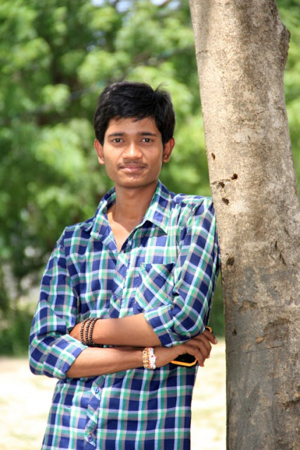
The positive sentence to comparative & superlative.2
Posi: No other boys in the class are as good as Rohim.
Com: Rohim is better than all other boys in the class.
Sup: Rohim is the best of all boys in the class.
Change the positive into comparative & superlative.
.
No other girls in the village are as tall as Runa.
No other persons in our school are as honorable as Kasem sir.

Slide 11
Change the positive into comparative & superlative.
.
No other girls in the village are as tall as Runa.
No other animals in the jungle are as ferocious as tiger.
Solution
.
Posi: No other girls in the village are as tall as Runa.
Com: Runa is taller than all other girls in the village.
Sup: Runa is the tallest of all girls in the village.
Posi: No other animals in the jungle are as ferocious as tiger.
Com: Tiger is more ferocious than any other animals in the jungle.
Sup: Tiger is the most ferocious of all animals in the jungle.

Slide 12
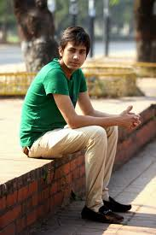
The positive sentence to comparative & superlative. 3
Posi: Very few boys in the class are as good as Rohim.
Com: Rohim is better than most other boys in the class.
Sup: Rohim is one of the best boys in the class.
Change the positive into comparative & superlative.
.
Very few girls in the village are as tall as Runa.
Very few persons in our school are as honorable as Kasem sir.

Slide 13
Change the positive into comparative & superlative.
.
Very few girls in the village are as tall as Runa.
Very few animals in the jungle are as ferocious as tiger.
Solution
.
Posi: Very few girls in the village are as tall as Runa.
Com: Runa is taller than most other girls in the village.
Sup: Runa is one of the tallest girls in the village.
Posi: very few animals in the jungle are as ferocious as tiger.
Com: Tiger is more ferocious than most other animals in the jungle.
Sup: Tiger is one of the most ferocious animals in the jungle.

Slide 14
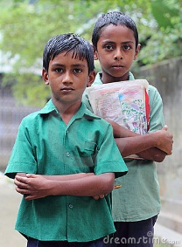
Here we can see that Rohim is tall & Korim is short.
Korim
Rohim
The comparative sentence to positive sentence
_
+
Com: Rohim is taller than Korim.
Posi: Korim is not as tall as Rohim.
Change the comparative sentences into positive
Rana is better than Shimul.
Runa is more beautiful than Bithi.

Slide 15
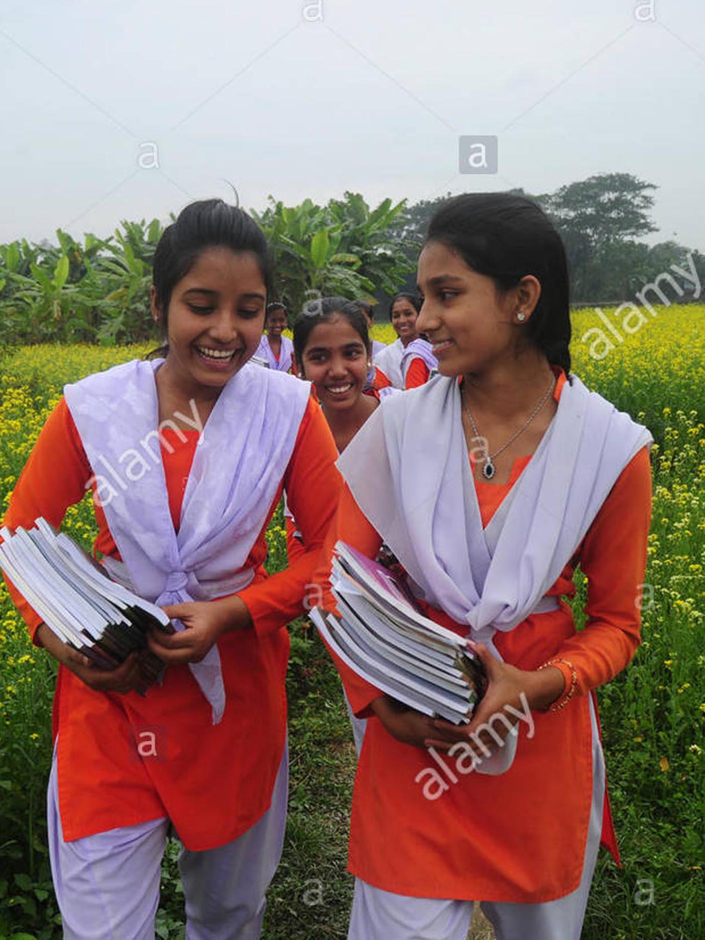
Here we can see that both Sima & Mimi are same.
Mimi
The comparative sentence to positive sentence
Sima
+
+
Com: Sima is not taller than Mimi.
Sup: Mimi is as tall as Sima.
Change the comparative sentences into positive
Rohim is not better than Korim.
Runa is not more beautiful than Bithi.

Slide 16
Here we can see that Korim is short & Rohim is tall.
The comparative sentence to positive sentence
Korim
Rohim
_
Com: Korim is less tall than Rohim.
Posi: Korim is not as tall as Rohim.
Change the comparative sentences into positive
Rana is less good than Minhaj.
Runa is less beautiful than Bithi.

Slide 17
Here we can see that both Sima & Mimi are same.
Sima
Mimi
The comparative sentence to positive sentence
+
+
Com: Sima is not less tall than Mimi.
Sup: Mimi is as tall as Sima.
Change the comparative sentences into positive
Rohim is not less good than Korim.
Runa is not less beautiful than Bithi.

Slide 18
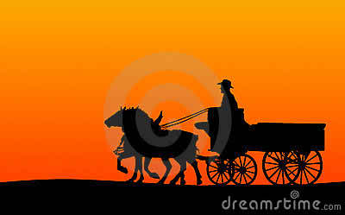
HOME WORK
HOME WORK
HOME WORK
It is the most important story in this book. (sup into posi & com)
He is the shortest of all students in our school. (sup into posi & com)
She is one of the most beautiful girl in the class.(sup into posi & com)
Shikha is taller than Beauty. (com into posi)
Ratul is not taller than Mintu. (com into posi)
It is less tall than that. (com into posi)
She is not less tall than he. (com into posi)

Slide 19

THANK YOU ALL

