Slide 1

WELCOME

Slide 2

Teacher’s Details
S. M. Rabbe
Assistant Teacher
Joynagar GPS, Manikganj Sadar.
Cell: 01729488488
Email: smrabbe.bd@gmail.com

Slide 3
Subject: English
Class: Two Duration: 40 min
Lesson Declaration:
Unit: 1
Lesson: Alphabet. (A) Look, Lesson and Say

Slide 4
Learning Outcomes:
1) Become familiar with English sounds by listening to common English words.
2) Say simple words and phrases with proper sounds and stress.
3) Recognize and read the names of objects having the same initial and final sounds.

Slide 5

Warm Up: Alphabet song abcd

Slide 6
PRESENTATION

Slide 7
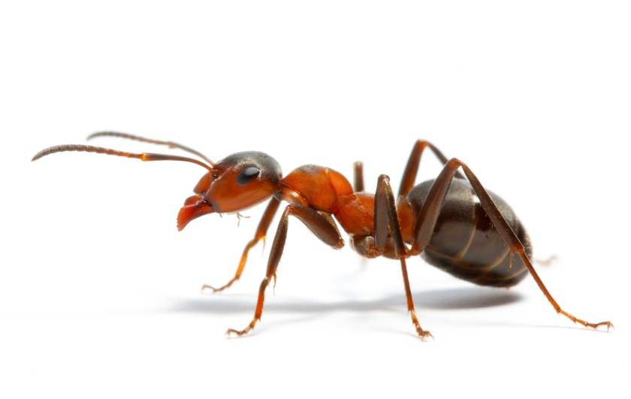
What do you see in the picture?
Ant
A

Slide 8

What do you see in the picture?
Bat
B

Slide 9

What do you see in the picture?
Cup
C

Slide 10

What do you see in the picture?
Doll
D

Slide 11

What do you see in the picture?
Egg
E

Slide 12
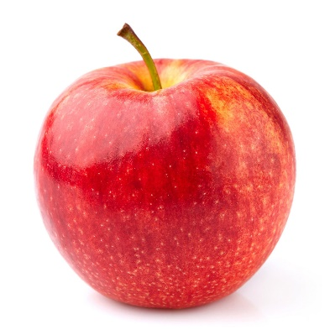

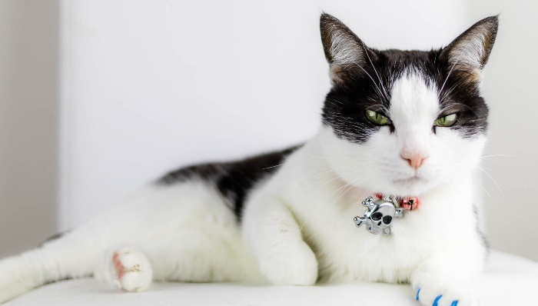
Pair work
Students will ask each other what’s in the picture and answer the question.

Slide 13
Evaluation
I will ask the students to mean and spell of these words.

Slide 14

Thanks to all
Good bye.

