Slide 1
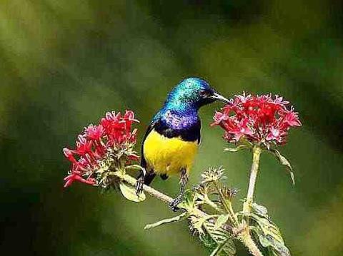



WELCOME

Slide 2
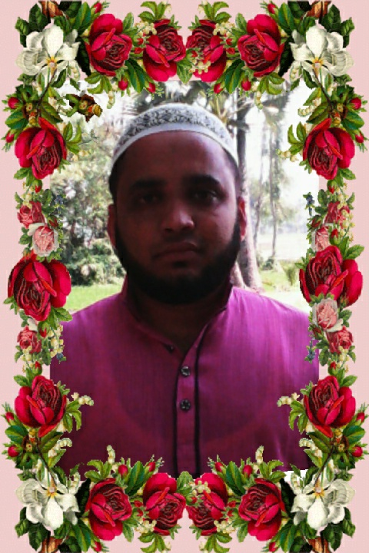

C lass : 6
Sub: English 1st paper
Md.Ataul Islam
Assistant Teacher
Tilakpur adrrsh girl High School
Emil-ataulislamict@gmail.co

Slide 3
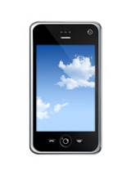


What is this ?
What is this ?
What is this ?
mobile
telephone
TV
What can we get sitting in the room with these technology ?

Slide 4
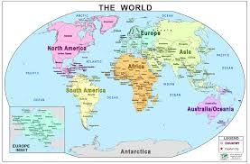
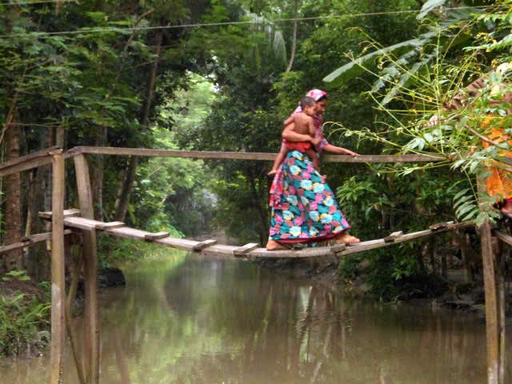

village
world

Slide 5
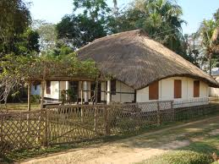
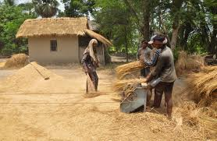
WE LIVE IN A GLOBAL VILLAGE

Slide 6
LEARNING OUTCOMES
Ss will be able to discuss about picture.
Ss will be able to describe letter.
Ss will be able to answer the question.
Ss will be able to match the words.

Slide 7
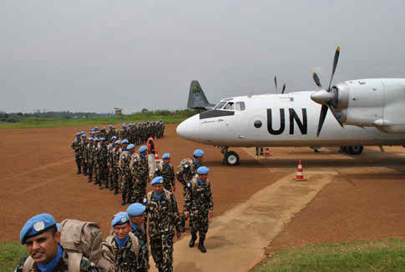
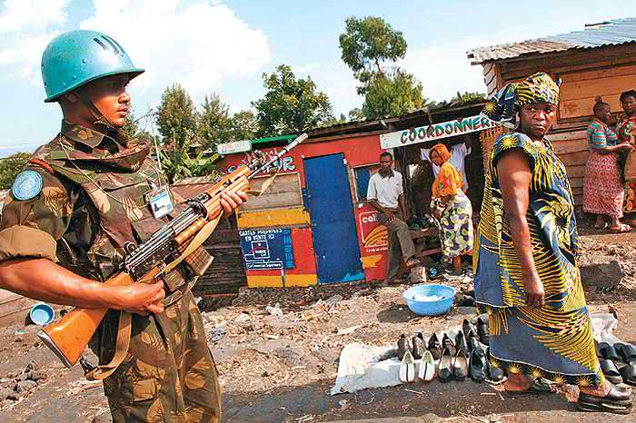
Look at the picture and discuss with your partner .
PAIR WORK
Congo in a UN Peaceking Mission

Slide 8
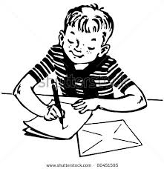
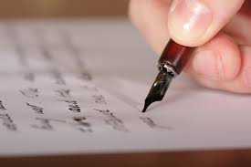
Uncle of Sohan works in the army of Congo UN Peaceking Mission of Africa . Now he is writing a letter about Peaceking Mission Africa .

Slide 9
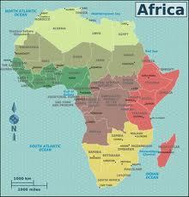
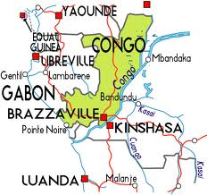
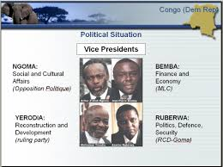
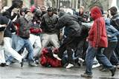
Describe of letter
Political group
violence

Slide 10
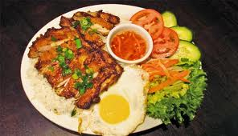


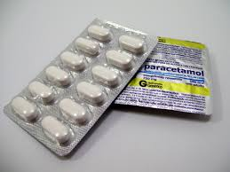
UN Peaceking Mission distribute food,pure water,medicine for helpless people.
Sometimes we build houses and maintain security.
WATER
HOUSE
FOOD
MEDICINE
SECURITY

Slide 11
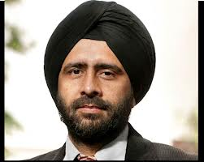
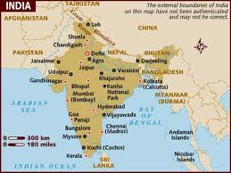

Last week I met an interesting young man. His name is Gurmit Singh.He came to work for a voluntary organisation .His main job is to look after a community school .
Gurmit Singh
India
School

Slide 12
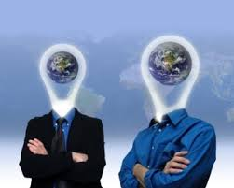
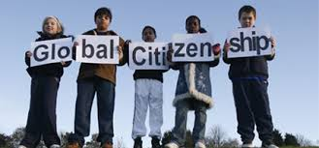
Sohan’s uncle ,Zul belong to a group of ten workers .They all come to different countries. He is a niece fellow and a good friend of ours. We called him”Mr Global Citizen”
Friendship

Slide 13
Match the words in column A with their meaning in column B
A
B
Challenging
Maintain
Graduation
Clash
global
Keep up
International
Difficult
University degree
fight

Slide 14

GROUP
WORK
1.Where is Congo ?
2.Who call Gurmit Singh ‘ Mr Glabal Citizen’?
3.What do you mean by ‘global citizen’?

Slide 15
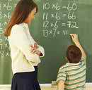

EVALUATION
1.Who writes letter?
2.Where does Sohan’s uncle work ?
3.What does he work there ?
4.Who is Gurmit Singh?
5.What happen in Congo ‘s political group?

Slide 16

HOMEWORK
Write a paragraph about ‘Globalization’.

Slide 17
THANK YOU .

