Slide 1
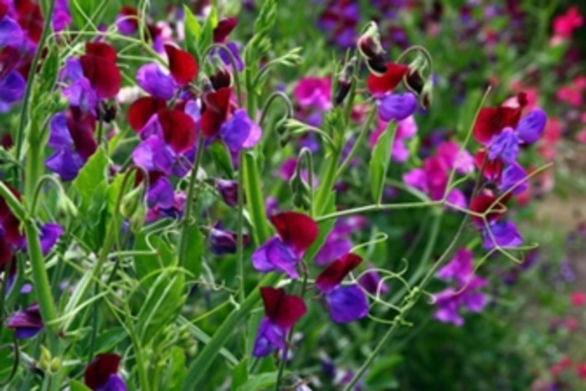
WELCOME
WELCOME

Slide 2
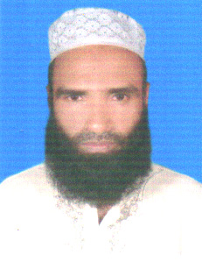
Md. Abdul Malek
Computer Teacher
Sukhari Bazar Islamia Dakhil Madrasah
Atpara, Netrakona
E-mail: mdmalek163@gmail.com
01719719806
Enlish 1st paper
Dakhil class:Six Lesson:12

Slide 3

Map Of Bangladesh

Slide 4
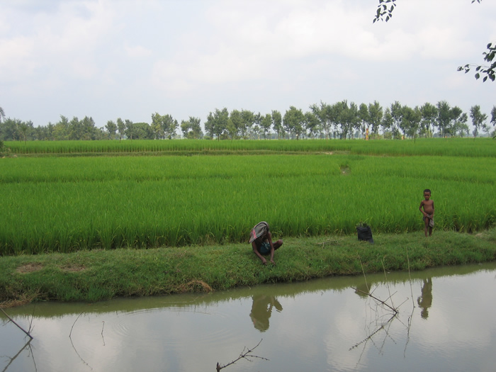
Natural scenery of Bangladesh

Slide 5
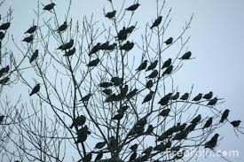
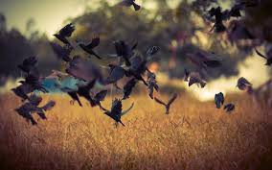
Flocks of bird

Slide 6
BIRDS OF BANGLADESH

Slide 7
Learning Outcomes:
Ss will be learn words meaning.
Ss will be able to identify Benebua bird .
Ss will be write paragraph about Tia .
Ss will be able to answer the question .

Slide 8
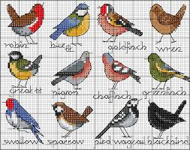
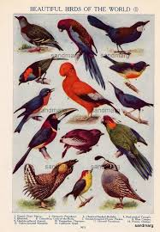
Chart of birds

Slide 9
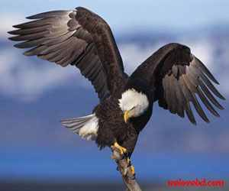
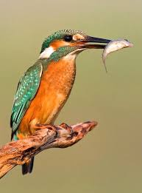
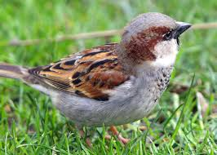
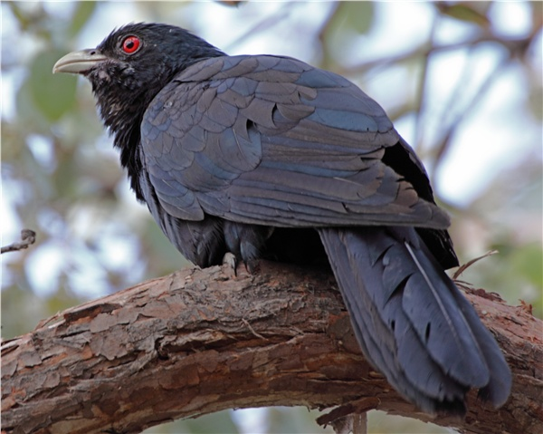
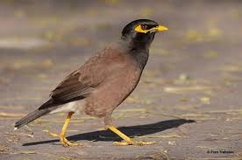
sparrow
kingfisher
eagle
shalik
cuckoo

Slide 10
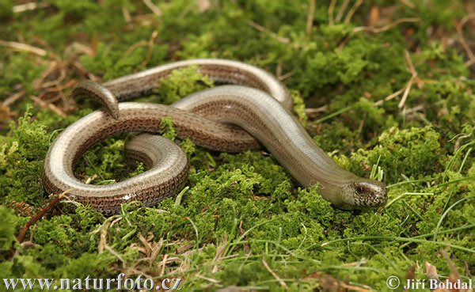
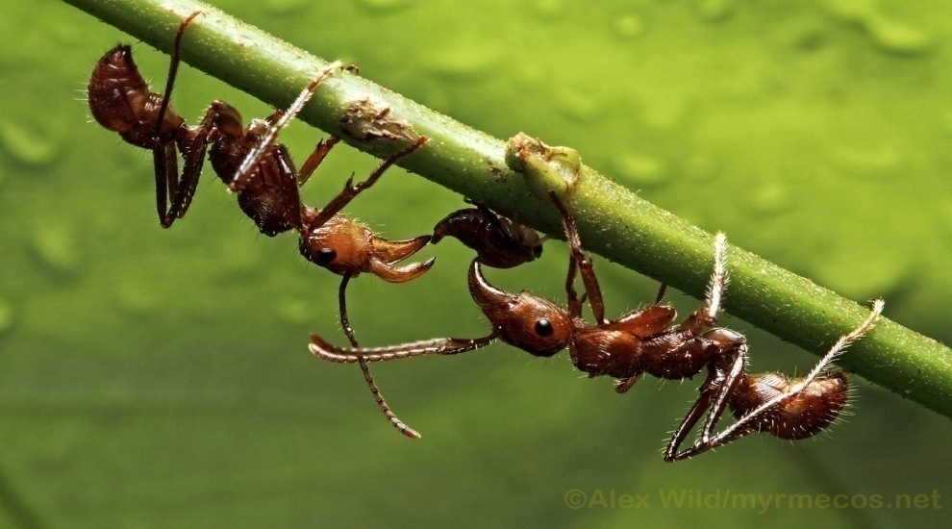
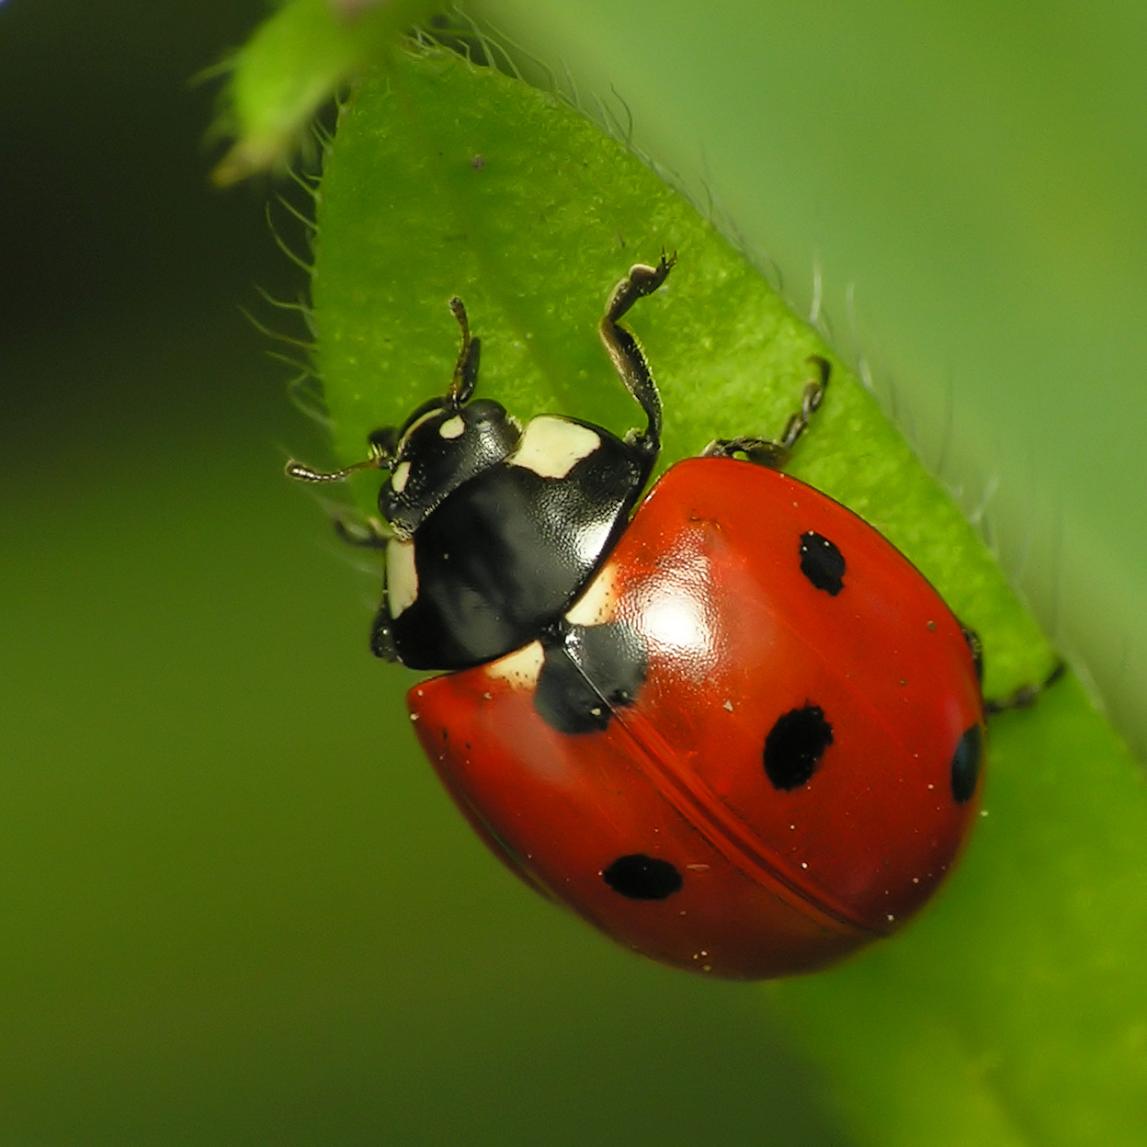
Words meaning
worm
insect

Slide 11
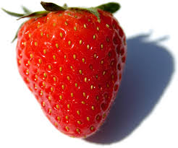

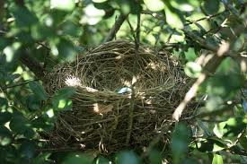
Fruit
flower
nest

Slide 12
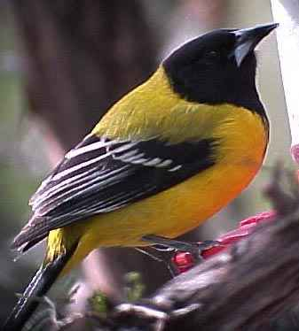
Read the passage
Bangladesh is a country full of natural resources. We are proud of flowers ,fruits and bird.
Today we will read about a bird known as ‘’ Benebau ‘’ in Bangla and Blackheaded Oriole
In English .
beak
wing
throat
tail
Yellow colour

Slide 13
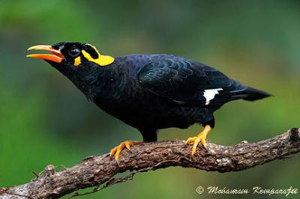
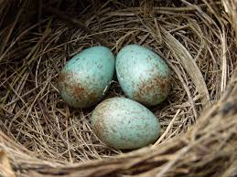
PAIR WORK
Ans .
Questions
1. How does it look like ?
2 .How many eggs does it lay ?

Slide 14
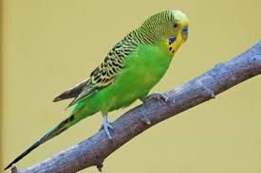
GROUP WORK
Write a paragraph about Tia using the following clues: found, clour,food,nest.

Slide 15
Evaluation
True or False .If false ,give the correct answer.
a)Bangladesh is a full of natural assets .
b) It has only flower .
c)Benebau looks like Mayna .
d)It lays 3eggs at a time .

Slide 16


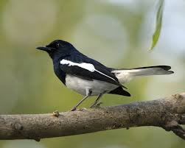
HOME WORK
Write some dissimilarity between DOEL and TIA .

Slide 17
END OF THE CLASS

