Slide 1
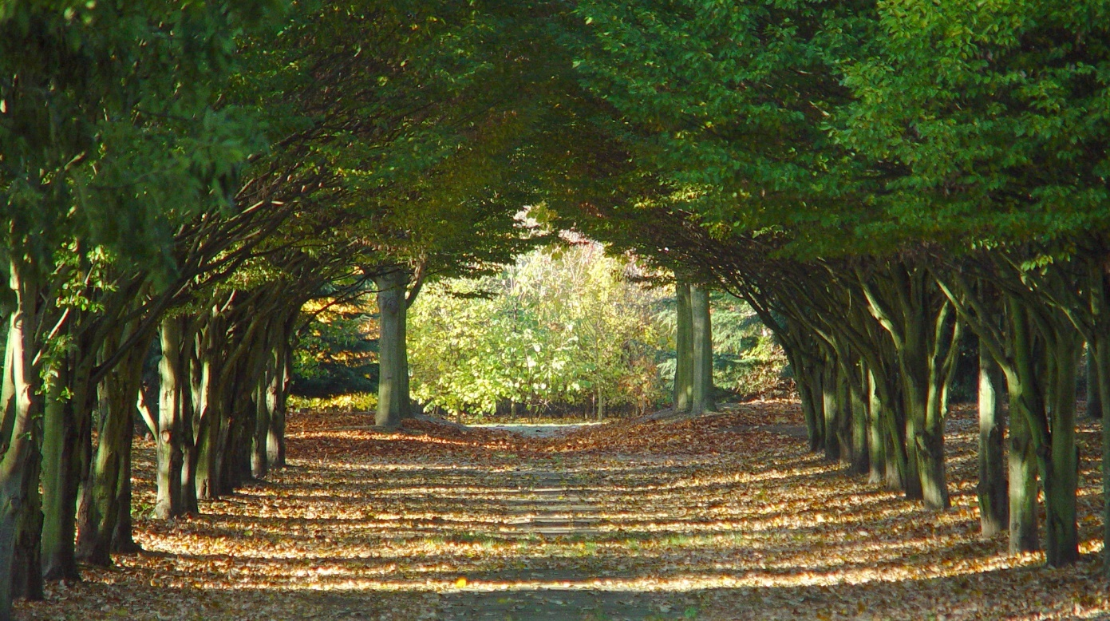
Dear Students, welcome to my class

Slide 2
Teachers’ identity
Md. Imran Kabir
Assistant teacher
Pabna Collectorate Public School And College, Pabna
Email-i.kabir01111@gmail.com
Mobile- 01756005577
Class-10
Unit-8
Lesson-1
Time-45 minutes

Slide 3
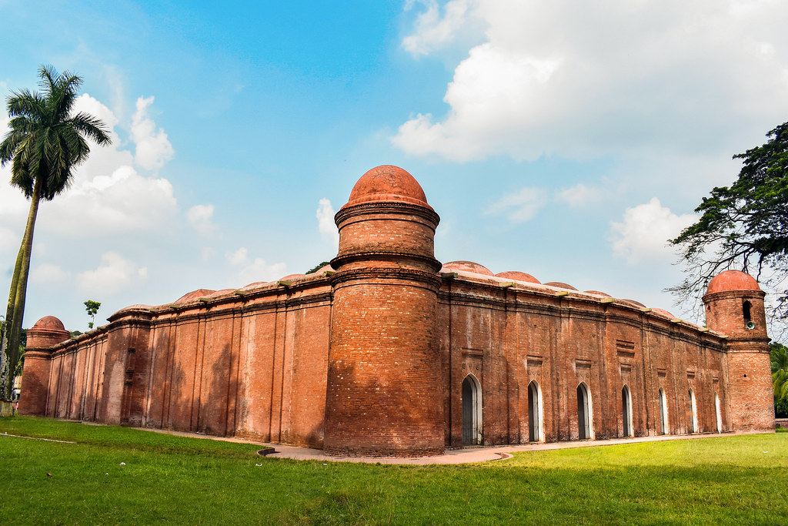
What do you see in the picture?
Shatgombuj Mosque

Slide 4
Our today’s lesson is-
Shat Gombuj Mosjid

Slide 5
Learning outcomes
After we have studied this lesson, we will be able to-
Listen for specific information
Read and understand text
Ask and answer questions
Describe a place.

Slide 6
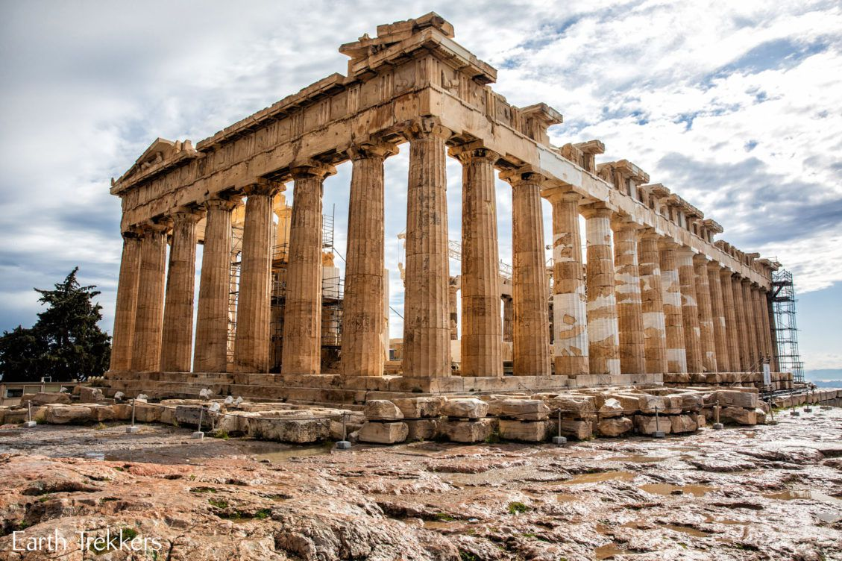
Inheritance, patrimony, legacy
Heritage
Thick, heavy, condensed
Dense

Slide 7
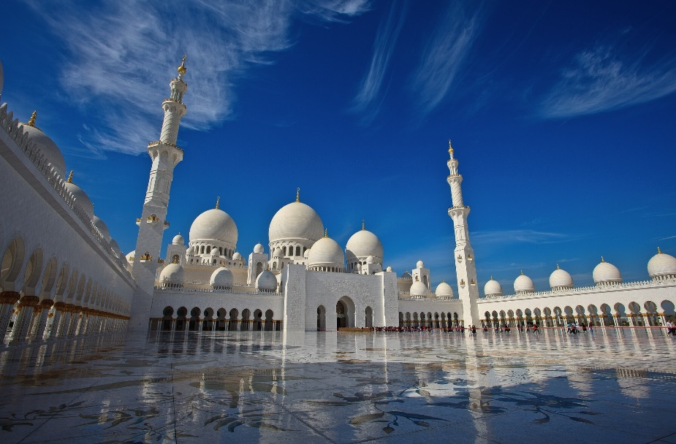
Mangrove
A tree found in tropical or sub-tropical tidal area
Islamic architecture
A piece of work done by Muslim architect.

Slide 8
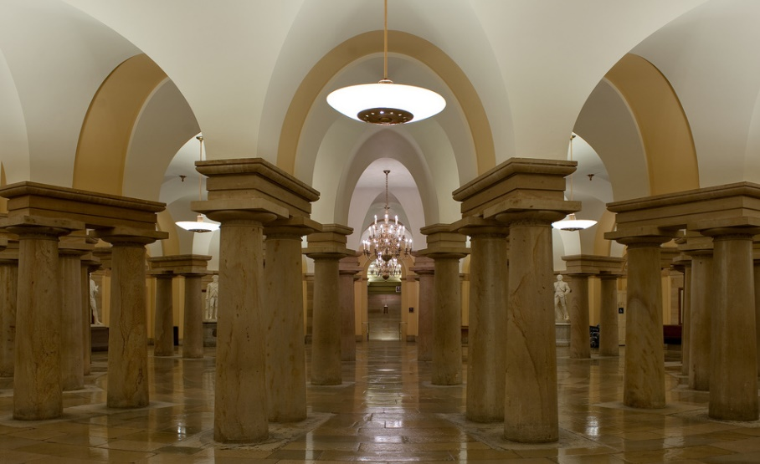
Reservoir
Pool, lake , pond
Columns
Pillar, post, poll

Slide 9
Read the following text and answer the following questions-
Shat Gambuj Mosque is the largest of the Sultanate mosques in Bangladesh and one of the most impressive Muslim monuments in the whole of the Indian subcontinent. It is ascribed to one Khan Al-Azam Ulugh Khan Jahan, who conquered the greater part of southern Bengal and named the area khalifatabad in honour of the reigning Sultan Nasiruddin Mahmud shah (1435-59). The mosque is unique in the sense that it has 60 pillars that support the roof, with 77 low height domes. The 4 towers at 4 corners have smaller domes on the roof as well. The vast prayer hall has 11 arched doorways on the east and 7 each on the north and south for light and ventilation. It has 7 aisles running along the length of the mosque and 11 deep curves between the slender stone columns. These columns support the curving arches created by the domes. The thickness of the arches is 6 feet and have slightly narrowing hollow and round wall. The west wall in the interior has 11 ‘mihrabs’ The interior and the exterior of the mosque give a view of rather plain architecture but the interior western wall of the mosque is’ beautifully decorated with terracotta flowers and foliage. Besides being used as a prayer hall the mosque was also used as the court of Khan Jahan Ali. Now it is one of the greatest tourist attractions and best architectural beauties of Bangladesh.

Slide 10
Individual work
Shat Gombuj Masque a)_ a world heritage site in 1985 b)_ UNESCO. The historic Mosque city c)_ as Kholifatabad. It was d)_ by the Turkish, Ulugh Khan Jahan in the 15th century. Backed bricks e)_used for the construction.
Answer- a) Has been declared b) by c) is known d) founded e) are

Slide 11
Pair work
Shat Gombuj Mosque | Information
Founded by
Situated
Number of domes
Number of pillars
Used for
Ulugh Khan Jahan Ali
Bagerhat, not very far from Mangrove forest.
77 low heights domes
60 pillars
Prayer hall as well as court

Slide 12
Group work
What do you mean by heritage?
When did Shat Gombuj Mosque become a world heritage site?
Where is it situated?
What did Khan Jahan Ali build in the city?
What is the most remarkable work of Khan Jahan Ali?
a) Heritage means what we inherit from the past, live with in the present and then pass on to our children or future generation.
Answer-
b) Shat Gombuj Mosque became a world heritage site in 1985.
c) It is situated at the outskirts of Bagerhat town.
d) Khan Jahan Ali Built a network of roads, bridges, public buildings and reservoirs to make the city habitable.
e) The most remarkable work of Khan Jahan Ali is Shat Gombuj Mosque?

Slide 13
Homework
Look at the picture of the Star Mosque in Dhaka. Read the information and write a description of the mosque with the help of the given clue.
Location: Dhaka, Abul Khairat Road
Style: Mughul
Number of domes: 5
Decoration: Different sizes of stars on dome and outside wall
Materials used for decoration: chinaware and white cement
Interior of the mosque: mosaic floor, floral tiles on the wall
Built by: Mirza Ghulam pir, a respected Zamindar of Dhaka
Time: early 18th century

Slide 14
Thank you everyone

