Slide 1
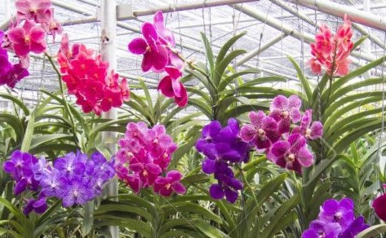
Dear students, welcome to my class

Slide 2
Teachers’ identity
Md. Imran Kabir
Assistant teacher
Pabna Collectorate Public School And College, Pabna
Email-i.kabir01111@gmail.com
Mobile- 01756005577
Class- Nine
Subject- English 1st paper
Unit- Eight
Lesson- Three

Slide 3
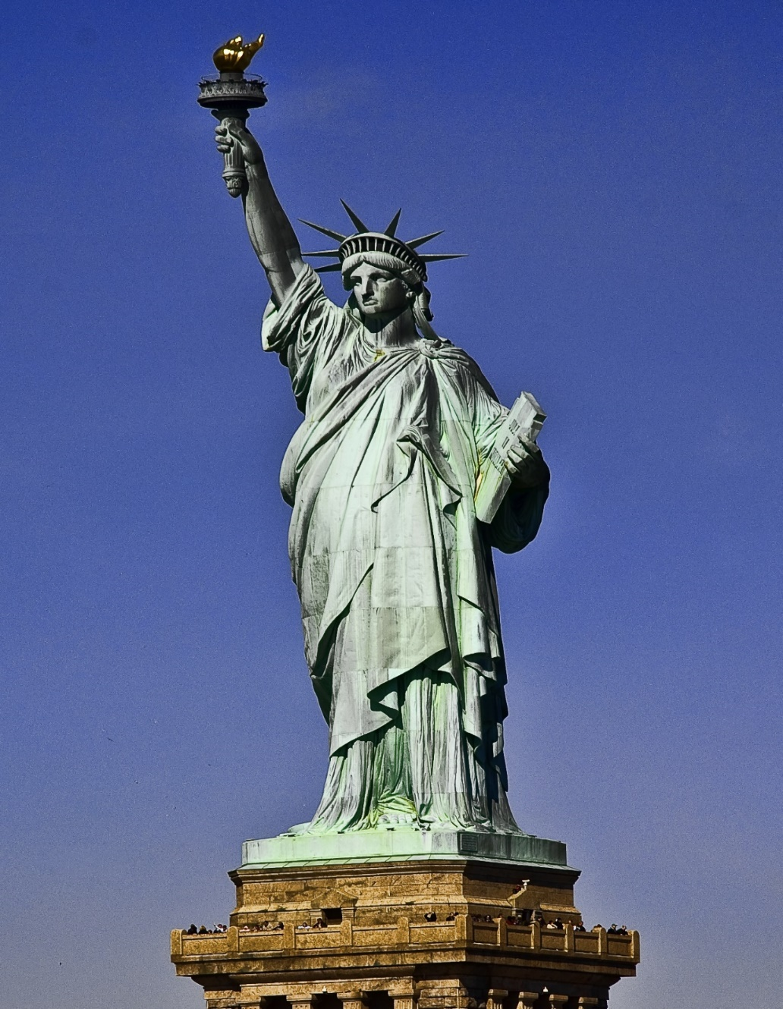
What do you see in the picture?

Slide 4
So our today’s lesson is-“The statue of liberty”

Slide 5
Learning Outcomes-
By the end of the lesson Students will be able to-
Ask and answer questions
Read and understand the text materials
Learn new words and pronunciation
Write to the answer of the questions

Slide 6
Key words

Slide 7
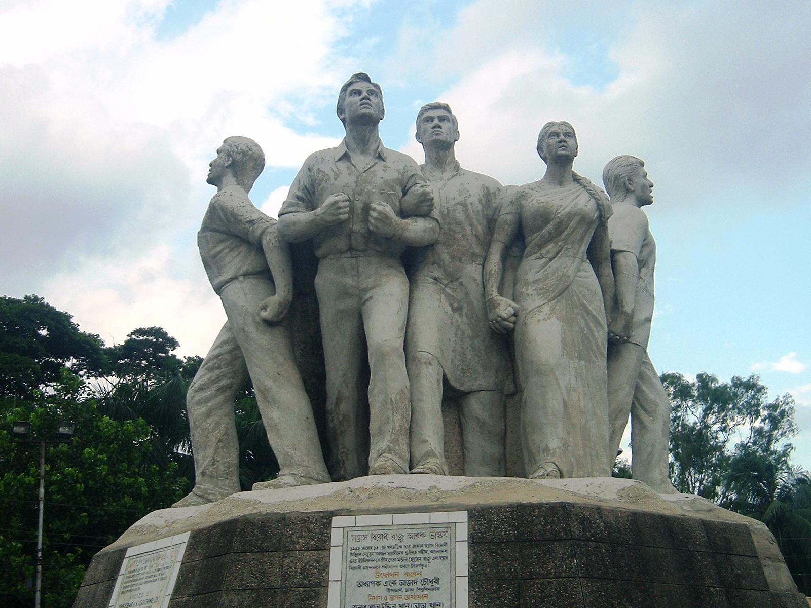
Sculpture
Word meaning- carve, chisel form, shape.
He teaches sculpture at a local school.

Slide 8
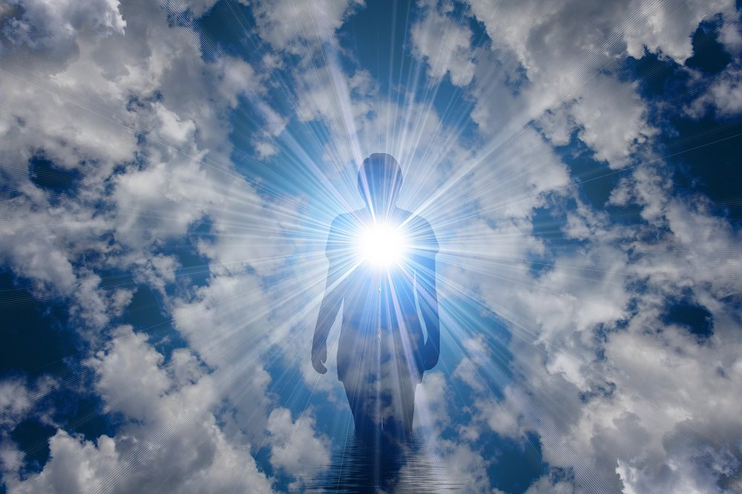
Enlighten
Word meaning- Uplift, apprise, highlight, illuminate
His speech enlightens us.

Slide 9
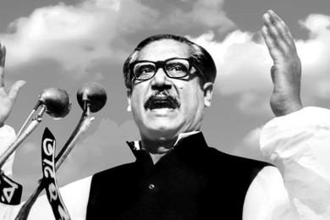
Declaration
Word meaning- Announcement, statement, proclamation pronouncement.
Bangabondhu declared the independence of Bangladesh.

Slide 10
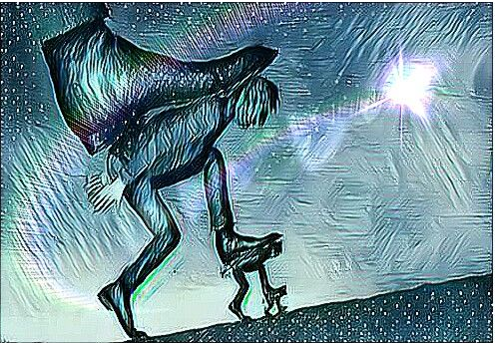
Slavery
Word meaning- persecution, abuse, maltreatment, tyranny.
Everyone wants freedom from slavery.

Slide 11
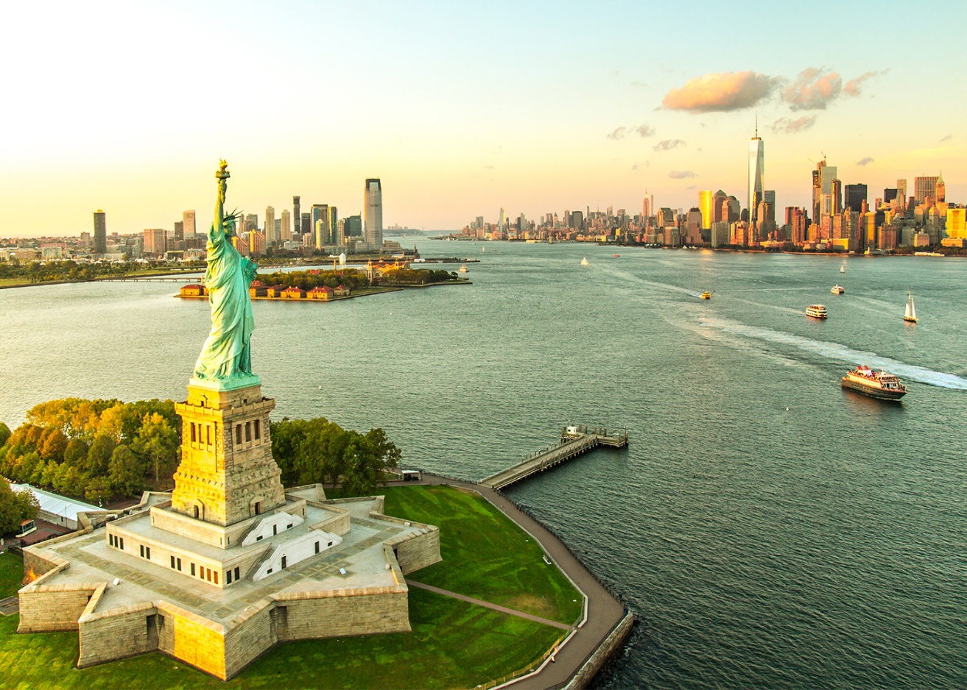
Dear students, now read the text A below-
The statue of liberty, originally called liberty Enlightening the world, is a statue on liberty Island, formerly Bedloe’s Island in the harbor of New York.

Slide 12
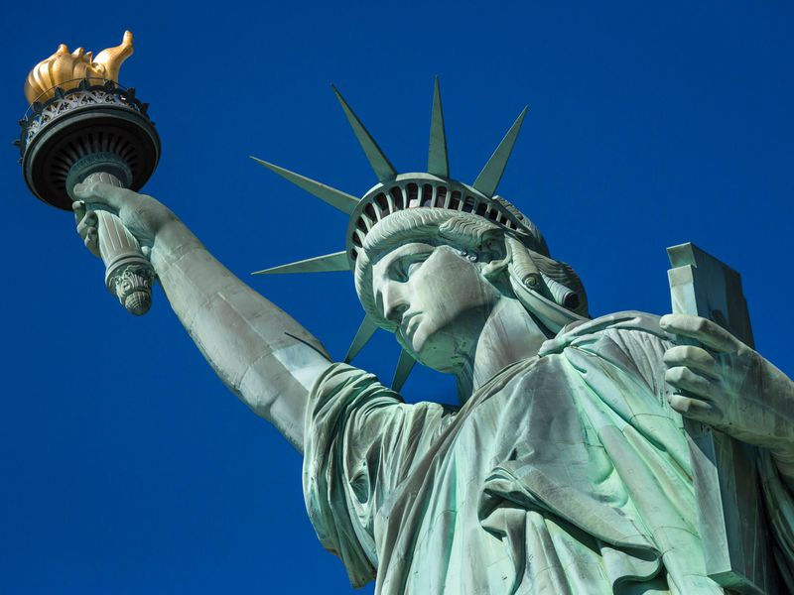
The statue symbolizes liberty in the form of a woman wearing flowing robes and a spiked crown. She holds a torch aloft in her right hand and carries in her left hand a book inscribed “July 4, 1776”. Broken chains symbolizing the overthrow of tyranny lie at her feet.

Slide 13
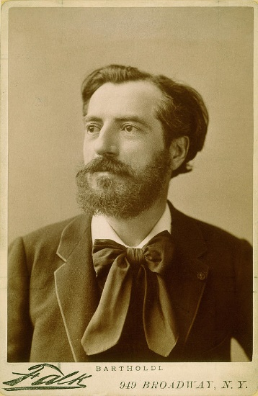
The statue was designed by the French sculptor Frederic Bartholdi and was given by France to the United states of commemorate the centennial of U.S Independence in 1876. France raised funds by popular subscription to pay for the statue.

Slide 14
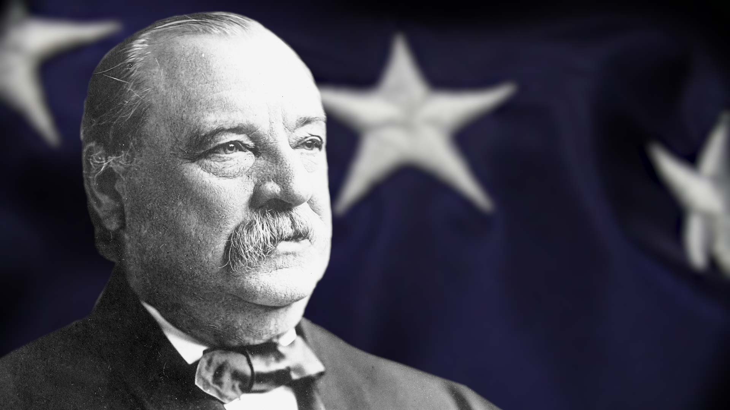
President Grover Cleveland dedicated the work on October 28, 1886. The statue, the Island, and nearby Ellis Island were declared a national Monument in 1924. The statue, formed of copper sheets riveted to an iron framework, is one of the largest statues of the world.

Slide 15
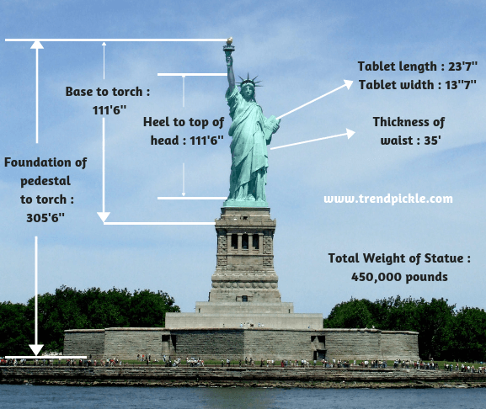
The statue, formed of copper sheets riveted to an iron framework, is one of the largest statues in the world. It measures 93.5m (306 ft 8 m) from the bottom of the pedestal to the tip of the torch. The figure itself is 46.4m (152ft 2 in) high; the right arm is 12.8m (42ft) long; the hand is 5.03m (16ft 5 in) long; and the head, which is reachable by staircase or emergency lift, measures 8.5m (28ft) from neck to diadem and 3.05m (10ft) from ear to ear. The statue weights 254 tons.

Slide 16
Individual work
Fill in the blanks-
The statue of liberty, originally a)_ liberty Enlightening the world, is a statue on liberty Island, formerly Bedloe’s Island in the harbor of New York. The statue b)_ liberty in the form of a woman wearing flowing robes and a spiked crown. She c)_ a torch aloft in her right hand and carries in her left hand a book inscribed “July 4, 1776”. Broken chains d)_ the overthrow of tyranny lie at her feet. The statue e)_ by the French sculptor Frederic Bartholdi.
Answer-
a) called
b) symbolizes
c) holds
d) symbolizing
e) was designed

Slide 17
Group work
Answer the following question-
a) Where is the statue of liberty situated?
Ans- It is situated in the harbor of New York city.
b) What does the statue symbolize?
Ans- The statue symbolizes liberty in the form of a woman wearing flowing robes and spiked crown.
c) What does she hold in her right hand?
Ans- She holds a torch aloft in her right hand.
d) Who designed the statue?
Ans- The statue was designed by France sculpture Fredaric Bartholdi.
e) Who financed for the pedestal?
Ans- US donors financed for the pedestal.

Slide 18
Home work
Write a dialogue between two friends about world heritage sights.

Slide 19
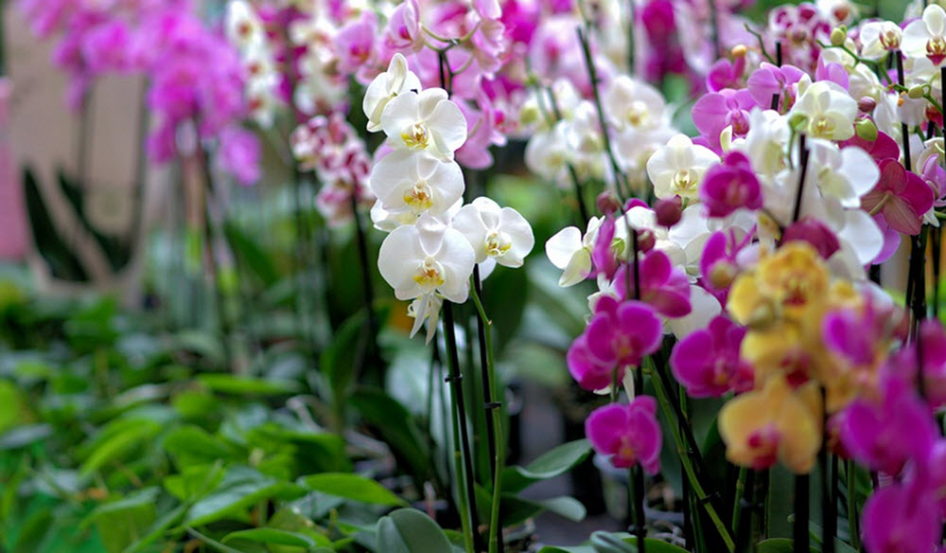
Thank you

