Slide 1
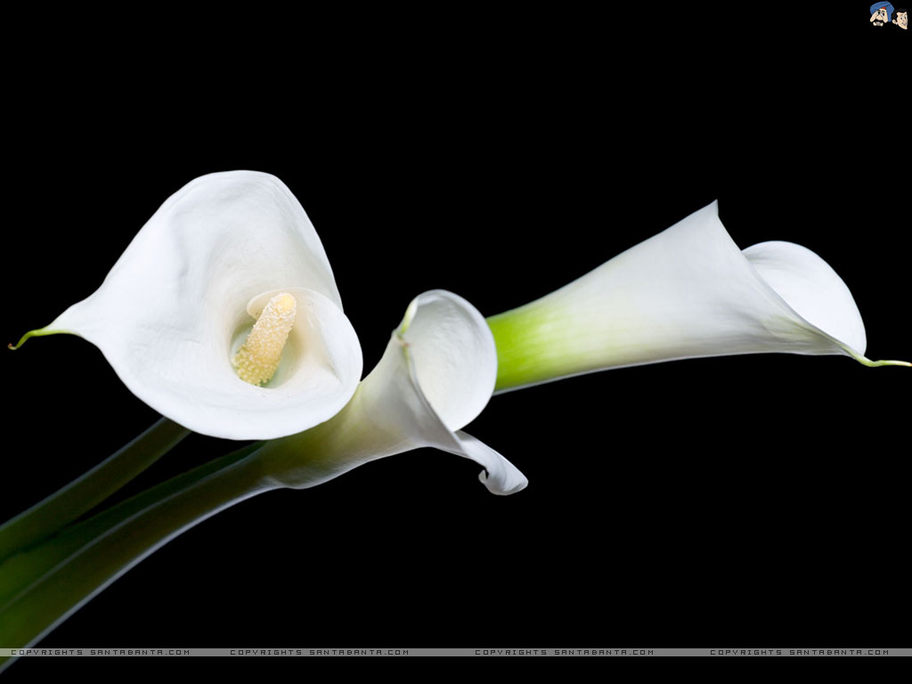
Welcome dear students.

Slide 2
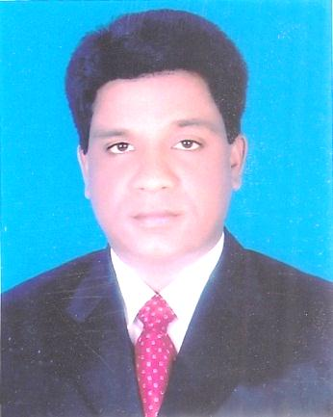
Class –viii
UNIT-6,LESSON-1
MOHAMMAD AZHARUL ISLAM
Assistant Teacher (English)
Hugra Habib Kader High School
Tangail Sadar Tangail

Slide 3
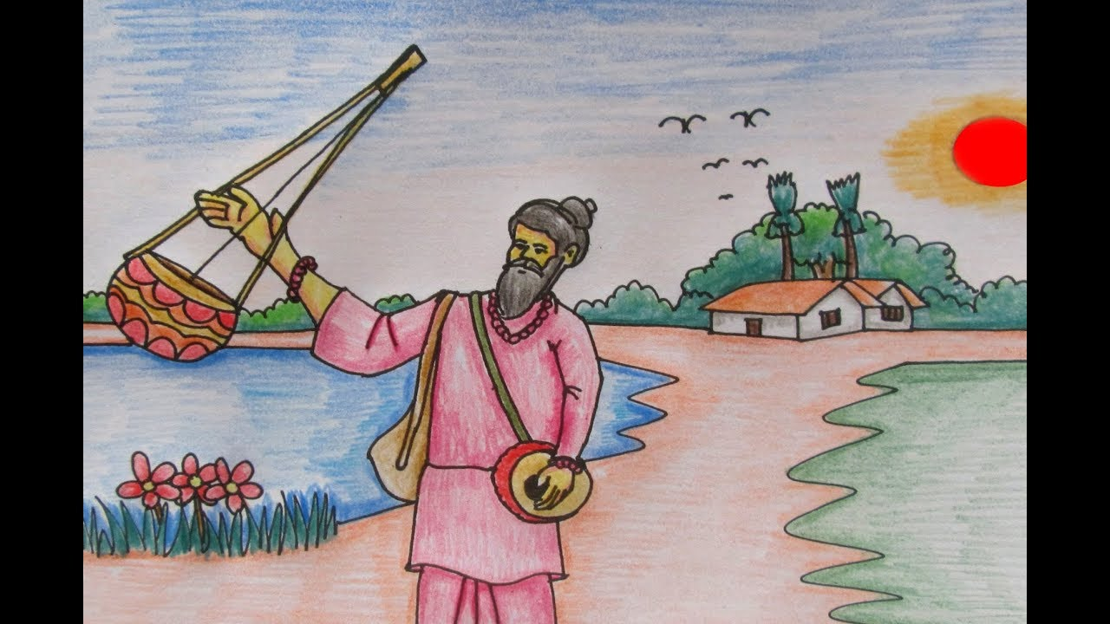
See the picture

Slide 4
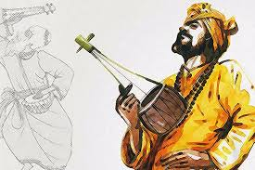
See the picture

Slide 5
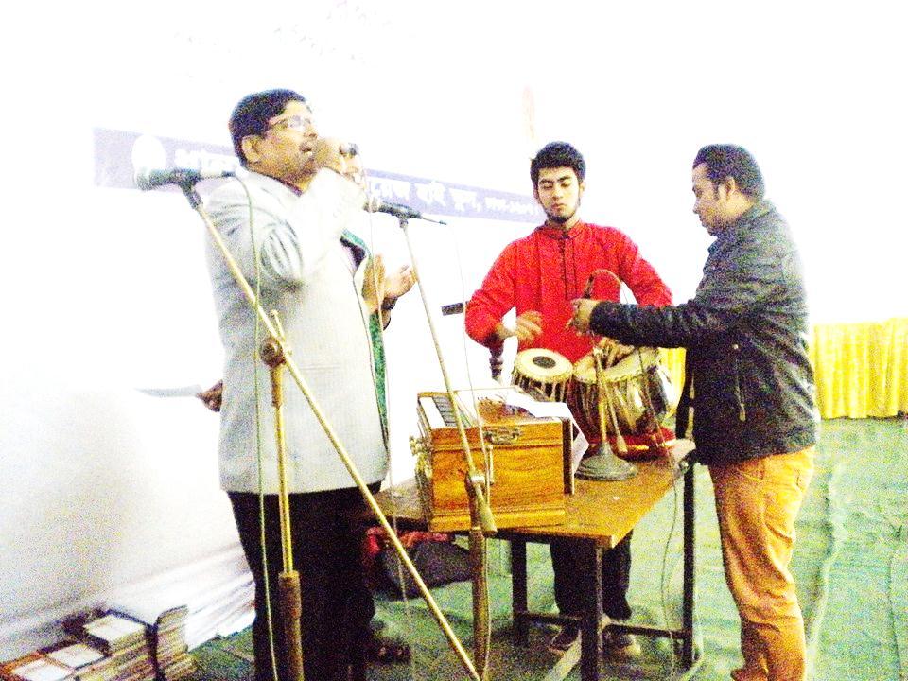
The head teacher is performing a renowned folk song.

Slide 6
She is well known

Slide 7
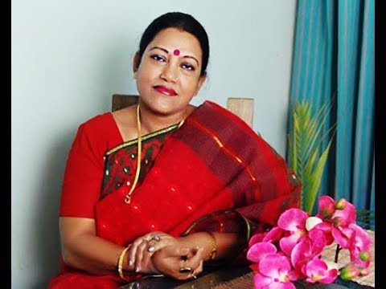
TODAY’S TOPIC
OUR FOLK SONGS
class viii
UNIT-6,LESSON-1

Slide 8
LEARNING OUTCOMES
By the end of the lesson, the learners will be able to…
ask and answer questions.
introducing with folk songs, musical instruments, lyricists and singers
explain the words and phrases
write a paragraph

Slide 9
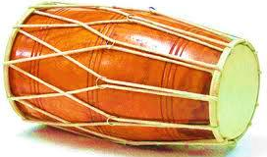
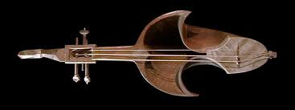
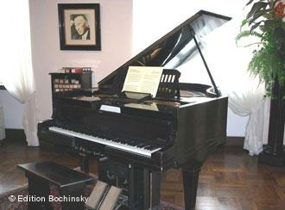
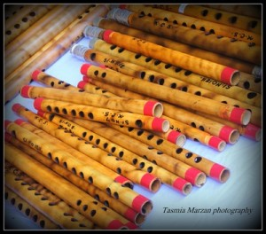
1.Can you sing a song?
2.Can you play any of these musical instruments?

Slide 10
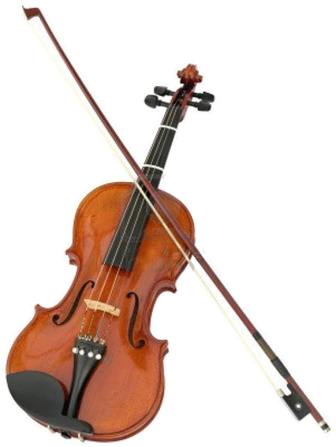
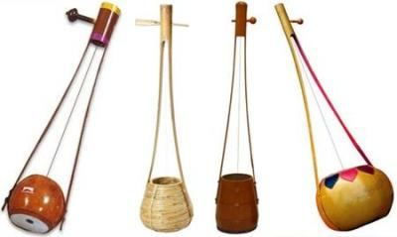
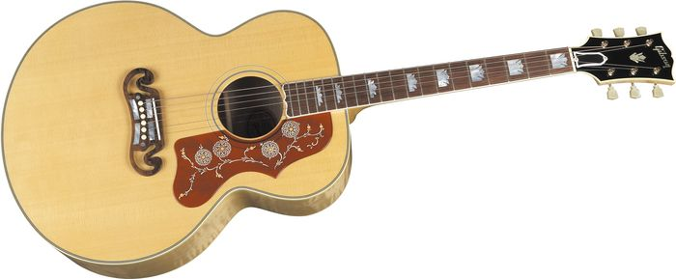
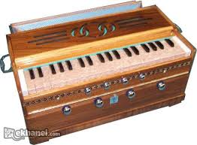
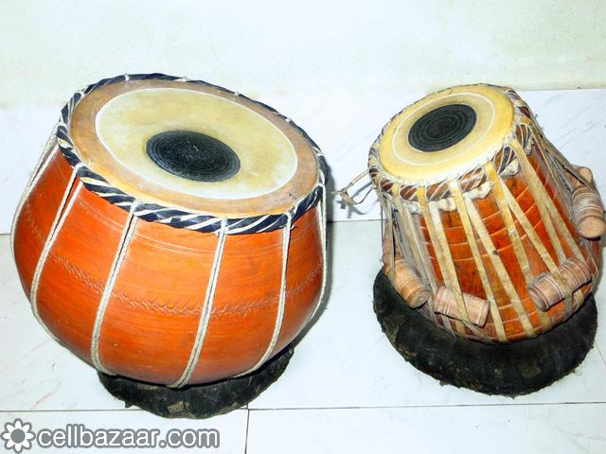
Can you play any of these instruments?
Who can ?

Slide 11
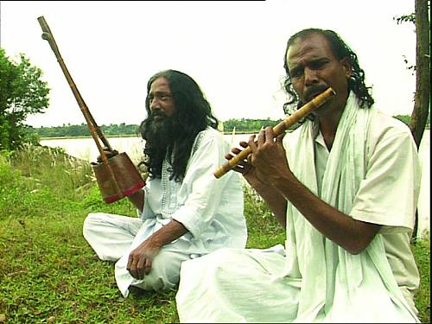
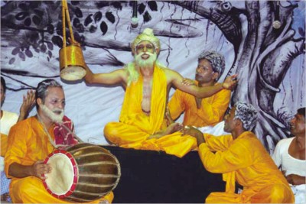
Can you name some well known folk singers?

Slide 12
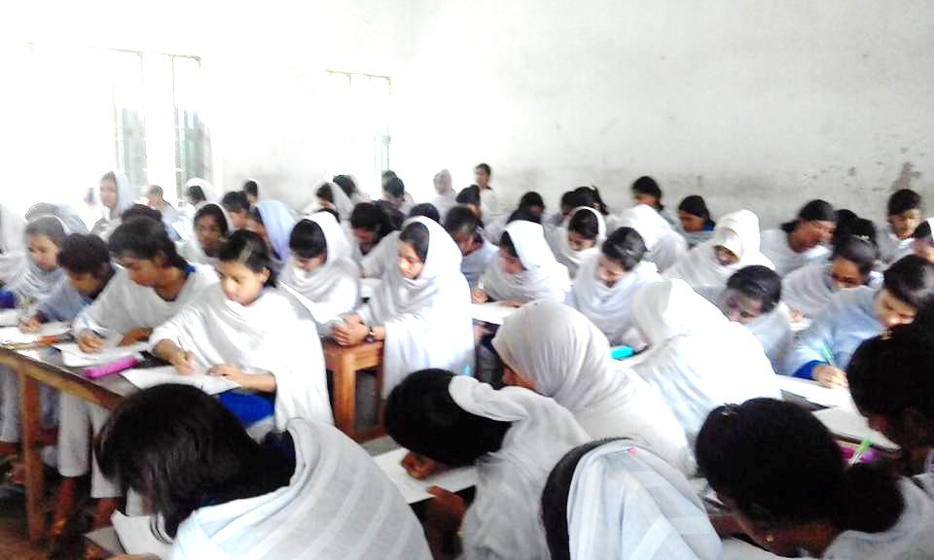
Group WORK
Make a chart some of well known folk singers.

Slide 13
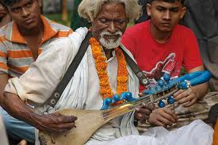
PAIR WORK
Write any two of well known folk singers

Slide 14
Hason Raja
Shah Abdul Karim
Lalon
Pollikobi Jasim Uddin

Slide 15
Common people
People in general from different classes and occupations ,specially the country people, according to the text

Slide 16
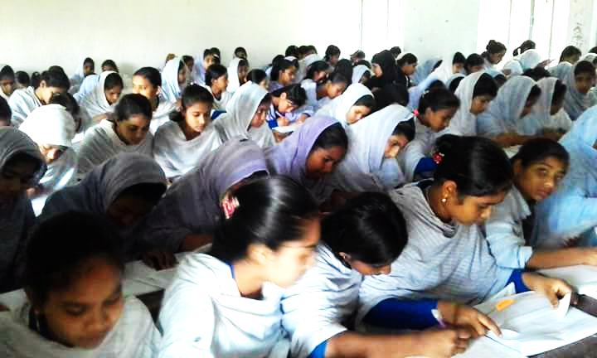
Pair Work
Read the text and write the famous Folk Singers

Slide 17
Let’s know the name of renowned Folk Singers
Hachon
Raja
Abbas
Uddin
Mustafa
Zaman
Abbasi
Ferdousi
Rahman

Slide 18
Let’s know the name of renowned Folk Singers
Shah
Abdul
Karim
Abdul
Alim
Shofiul
Alom
Raja
Farida
parvin

Slide 19
Group Work
Answer the following questions
1. Who usually likes our folk songs?
2. Can you name some well known folk singers?
3. Do you like folk songs?
4. Who is your favourite singers?

Slide 20
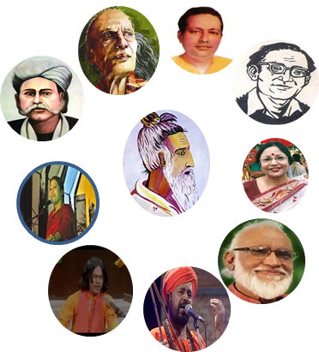
Let’s discuss in groups
“Do you want more or less programs on folk songs on our TV channels ? Why ?

Slide 21
Thank you

